Slide 1
The World and U.S. Cotton
Outlook for 2020/21
Interagency Commodity Estimates Committee
Presented by
Graham Soley graham.soley@usda.gov
Agricultural Outlook Forum
February 21, 2020

Slide 2
USDA Global Cotton Outlook Highlights
2019/20 Review:
  World consumption slows (again)
  Production higher, largest area harvested in 8 years
  Trade expands aided by domestic shortfalls, Brazil, and China
  China’s reserve stocks remain at government’s preferred level
  A-Index dips to the mid-70-cent range.

Slide 3
USDA Global Cotton Outlook Highlights
2020/21 Outlook:
  Global consumption rebounds (1.7%), led by China
  World production falls, lower relative prices
  China expected to increase imports (10 Mill)
  Global Stocks fall to 4-Year low
  World prices up slightly

Slide 4

2019/20 World Cotton Situation

Slide 5
World Cotton Prices Fall for 2nd Consecutive Year
Million bales
Cents/lb.
…with global consumption also declining
Sources: USDA, Interagency Commodity Estimates Committee and Cotlook.

Slide 6
Global Cotton Production Changes in 2019/20:
Highest area harvested in 8 years!
Million bale change
U.S.’s largest area harvested in 13 YEARS
Australia’s lowest area harvested
since 1978
Source: USDA, Interagency Commodity Estimates Committee.
Notes:
Lowest Australia production in 12 years

Slide 7
Cotton Consumption
Declines for 2nd Consecutive Year
Cotton consumption estimated at 119.0 million bales.
Marginal (1%) drop
  3-year low
  Led by reductions in China, Vietnam, and Indonesia
  Prior trade dispute and U.S. tariffs on Chinese apparel
  COVID-19

Slide 8
Cotton Consumption
Declines for 2nd Consecutive Year
Cotton consumption estimated at 119.0 million bales.
Lower Global GDP Growth Forecasts
  (IMF) Weakest growth since financial crisis
  Despite this, half of top 10 consuming countries projected up

Slide 9
Cotton/Polyester Price Ratio
Source: USDA calculations based on data from Cotlook Ltd., Cncotton, National Cotton Council, and International Cotton Advisory Committee.

Slide 10
China Consumption At 4-Year Low
Source: USDA
Notes:
Cotton Yarn imports down close to 10 percent from last year (5 months of data)

Slide 11
Global Cotton Stocks Up Y-O-Y
RECORD stocks (outside of China)
Exceeds previous record by 4 million
Source: USDA, Interagency Commodity Estimates Committee.

Slide 12
China Ending Stocks At 8-Year Low
Mil. Bales
%
Sources: USDA
Notes:
Cotton Yarn imports down close to 10 percent from last year (5 months of data)

Slide 13
2019/20 U.S. Cotton Situation
Notes:
Let’s begin with the latest estimates for the current marketing year.

Slide 14
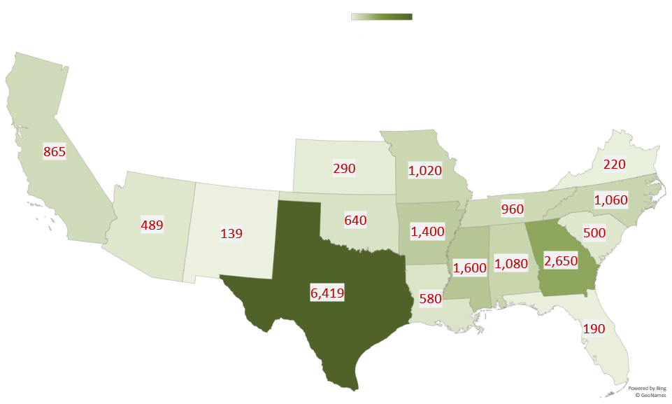

Slide 15
U.S. Cotton Supply & Demand Estimates:
Production, Exports, and Stocks Trend Higher
 | Unit | 2018/19 | 2019/20 | Change (%)
Beg. stocks | Mil. bales | 4.2 | 4.9 | 15.5
Production | " | 18.4 | 20.1 | 9.4
Imports | " | 0.0 | 0.0 | 0.0
Total supply | " | 22.6 | 25.0 | 10.6
Mill use | " | 3.0 | 3.0 | 0.7
Exports | " | 14.8 | 16.5 | 11.8
Total demand | " | 17.7 | 19.5 | 9.9
Ending stocks | " | 4.9 | 5.4 | 11.3
Stocks-to-use | % | 27.3 | 27.7 | 1.5
Upland farm price | Cents/lb. | 70.3 | 62.0 | -11.8
Source: USDA, Interagency Commodity Estimates Committee.

Slide 16
Top U.S. Cotton Export Shares
Source: U.S. Export Sales

Slide 17
2020/21 World Cotton Outlook
Notes:
Let’s begin with the latest estimates for the current marketing year.

Slide 18
USDA’s 2020/21 Outlook
Continuation of current policy
Signing of Phase One Agreement
World economic growth more favorable (3.3% vs 2.9%)
Caveat of Jan. IMF Forecast
Global consumption rebounds, led by China
Higher China imports (State Reserve’s role)
Relatively lower cotton prices lowers production
World and U.S. cotton prices up slightly

Slide 19
Higher World Cotton Consumption
Forecast for 2020/21
Global consumption projected at 121.0 M bales
  4th highest on record with modest growth (1.7%)
  Global GDP growth
China’s consumption growth at nearly 3%
  Recovery from trade dispute and coronavirus
  First y-o-y growth in 3 years

Slide 20
Higher World Cotton Consumption
Forecast for 2020/21
Consumption outside China:
  India, Turkey, and Pakistan expand use (once again)
  Growth in Vietnam and Bangladesh
Cotton’s projected share of world fiber market slightly lower

Slide 21
Global Production Projected Lower in 2020/21:
Area declines in major producing countries
Million bale change
Brazil, India, and U.S. decrease plantings
Australia and Pakistan recover from abnormal production levels
Source: USDA, Interagency Commodity Estimates Committee.

Slide 22
World Cotton Supply & Demand Projections:
Consumption Exceeds Production, Stocks Fall
 | Unit | 2019/20 | 2020/21 | Change (%)
Beg. stocks | Mil. bales | 80.0 | 82.1 | 2.7
Area Harvested | Mil. HA | 34.5 | 33.1 | -4.0
Production | Mil. bales | 121.3 | 118.5 | -2.3
Imports | " | 43.5 | 44.5 | 2.2
Total supply | " | 201.3 | 200.6 | -0.3
Exports | " | 43.5 | 44.5 | 2.2
Use | " | 119.0 | 121.0 | 1.7
Total Use | " | 119.2 | 121.2 | 1.7
Ending stocks | " | 82.1 | 79.4 | -3.3
Outside of China |  | 48.6 | 47.5 | -2.2
Stocks-to-use | % | 69.0 | 65.6 | -4.9
Source: USDA, Interagency Commodity Estimates Committee.

Slide 23
Global Cotton Stocks Projected Slightly Lower…
…and world prices edge up
Million bales
Source: USDA, Interagency Commodity Estimates Committee.

Slide 24
China’s State Cotton Reserves:
SR stocks continue at government’s preferred level
Million bales
Source: USDA, Interagency Commodity Estimates Committee.

Slide 25
2020/21 U.S. Cotton Outlook
Notes:
Let’s begin with the latest estimates for the current marketing year.

Slide 26
Outlook for 2020/21 U.S. Cotton Area
Planted acreage expected slightly lower.
  Total plantings at 12.5 M acres—9% decrease.
  NCC survey indicated 13.0 M acres.
Relative prices are somewhat unfavorable as of early February.
  Soybeans marginally higher Y-O-Y
  Corn marginally higher Y-O-Y

Slide 27
U.S. Cotton Planted Area:
A Historical Perspective
Million acres
Area in 2020 equal to the average!
Source: USDA, National Agricultural Statistics Service.

Slide 28
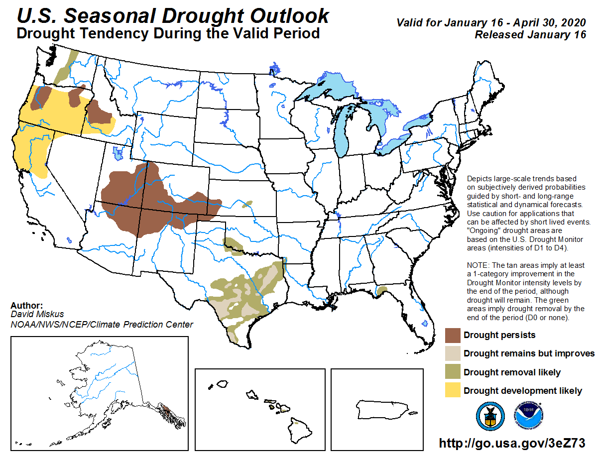

Slide 29
U.S. Cotton Area, Yield, and Production
Southwest expected to account for 60% of planted area
 | Unit | 2019/20 | 2020/21 | Change(%)
Planted area | Mil. acres | 13.74 | 12.50 | -9.0
Harvested area | " | 11.80 | 10.95 | -7.2
Abandonment rate | % | 14.1 | 12.4 | -12.1
Yield/harvested acre | Lbs. | 817 | 855 | 4.7
Production | Mil. bales | 20.10 | 19.50 | -3.0
Key Factor Includes Adequate Soil Moisture
Source: USDA, Interagency Commodity Estimates Committee.

Slide 30
Steady U.S. Export Forecast:
Contingent Upon…
Global Economic Growth
China
Brazil
Vietnam

Slide 31
U.S. Cotton Supply & Demand Projections:
Production and Stocks Fall; Exports Unchanged
 | Unit | 2019/20 | 2020/21 | Change (%)
Beg. stocks | Mil. bales | 4.9 | 5.4 | 11.3
Production | " | 20.1 | 19.5 | -3.0
Imports | " | 0.0 | 0.0 | 0.0
Total supply | " | 25.0 | 24.9 | -0.2
Mill use | " | 3.0 | 3.0 | 0.0
Exports | " | 16.5 | 16.5 | 0.0
Total demand | " | 19.5 | 19.5 | 0.0
Ending stocks | " | 5.4 | 5.3 | -1.9
Stocks-to-use | % | 27.7 | 27.2 | -1.8
Upland Farm price | Cents/lb. | 62.0 | 64.0 | 3.2
Source: USDA, Interagency Commodity Estimates Committee.

Slide 32
Global WILDCARDS
Production Shocks
China and COVID-19
India MSP Program
Vietnam and Bangladesh
Polyester, Viscose, and other MMFs
Notes:
Indeed, the stage is set for another interesting season in the world of cotton. Stay tuned!

Slide 33
Presented by
Graham Soley
USDA/FAS
graham.soley@usda.gov
202-772-4235

