Slide 1
Drought Risk: Adaptation,
Planning, and Response
Session: Building Resilience Through
Extreme Event Preparedness
USDA Agricultural Outlook Forum
February 24th, 2022
Steven Wallander, PhD
USDA Economic Research Service
The findings and conclusions in this presentation are those of the authors and should not be construed to represent any official USDA or U.S. Government determination or policy.

Slide 2
ERS Research on Key Aspects of Drought Risk and Adaptation

Slide 3
Drought data and metrics form a foundation for drought resilience and adaptation.
Measuring Drought

Slide 4
SIO DP EB Fig 9
Short-run management by irrigation organizations depends on federal data
Sources: USDA, Economic Research Service, EB-33, January 6, 2022.

Slide 5
At the farm level, drought is the largest cause of loss.
Climate change is likely to increase the impacts on farms and risk management programs.
Economic Impacts

Slide 6
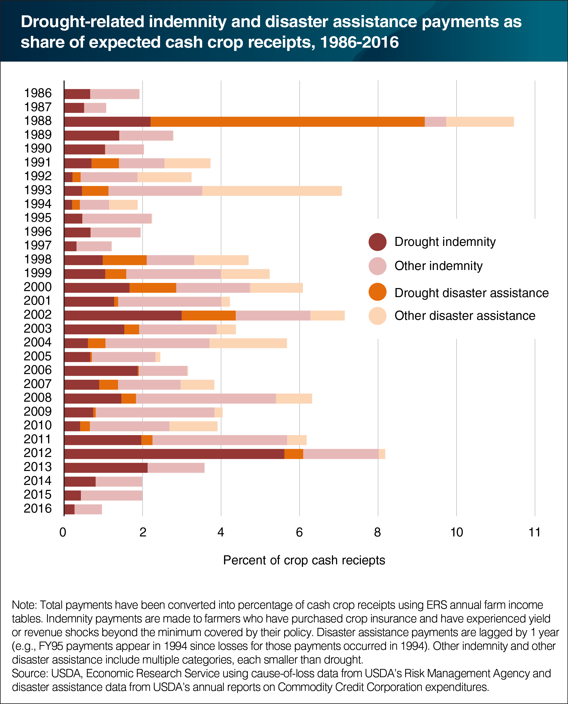
SIO Inf EB Fig 3
TBD
Sources: USDA, Chart of Note, “Drought is typically the largest single driver of crop disaster assistance and indemnity payments,” October 17, 2017 https://www.ers.usda.gov/data-products/chart-gallery/gallery/chart-detail/?chartId=85383

Slide 7
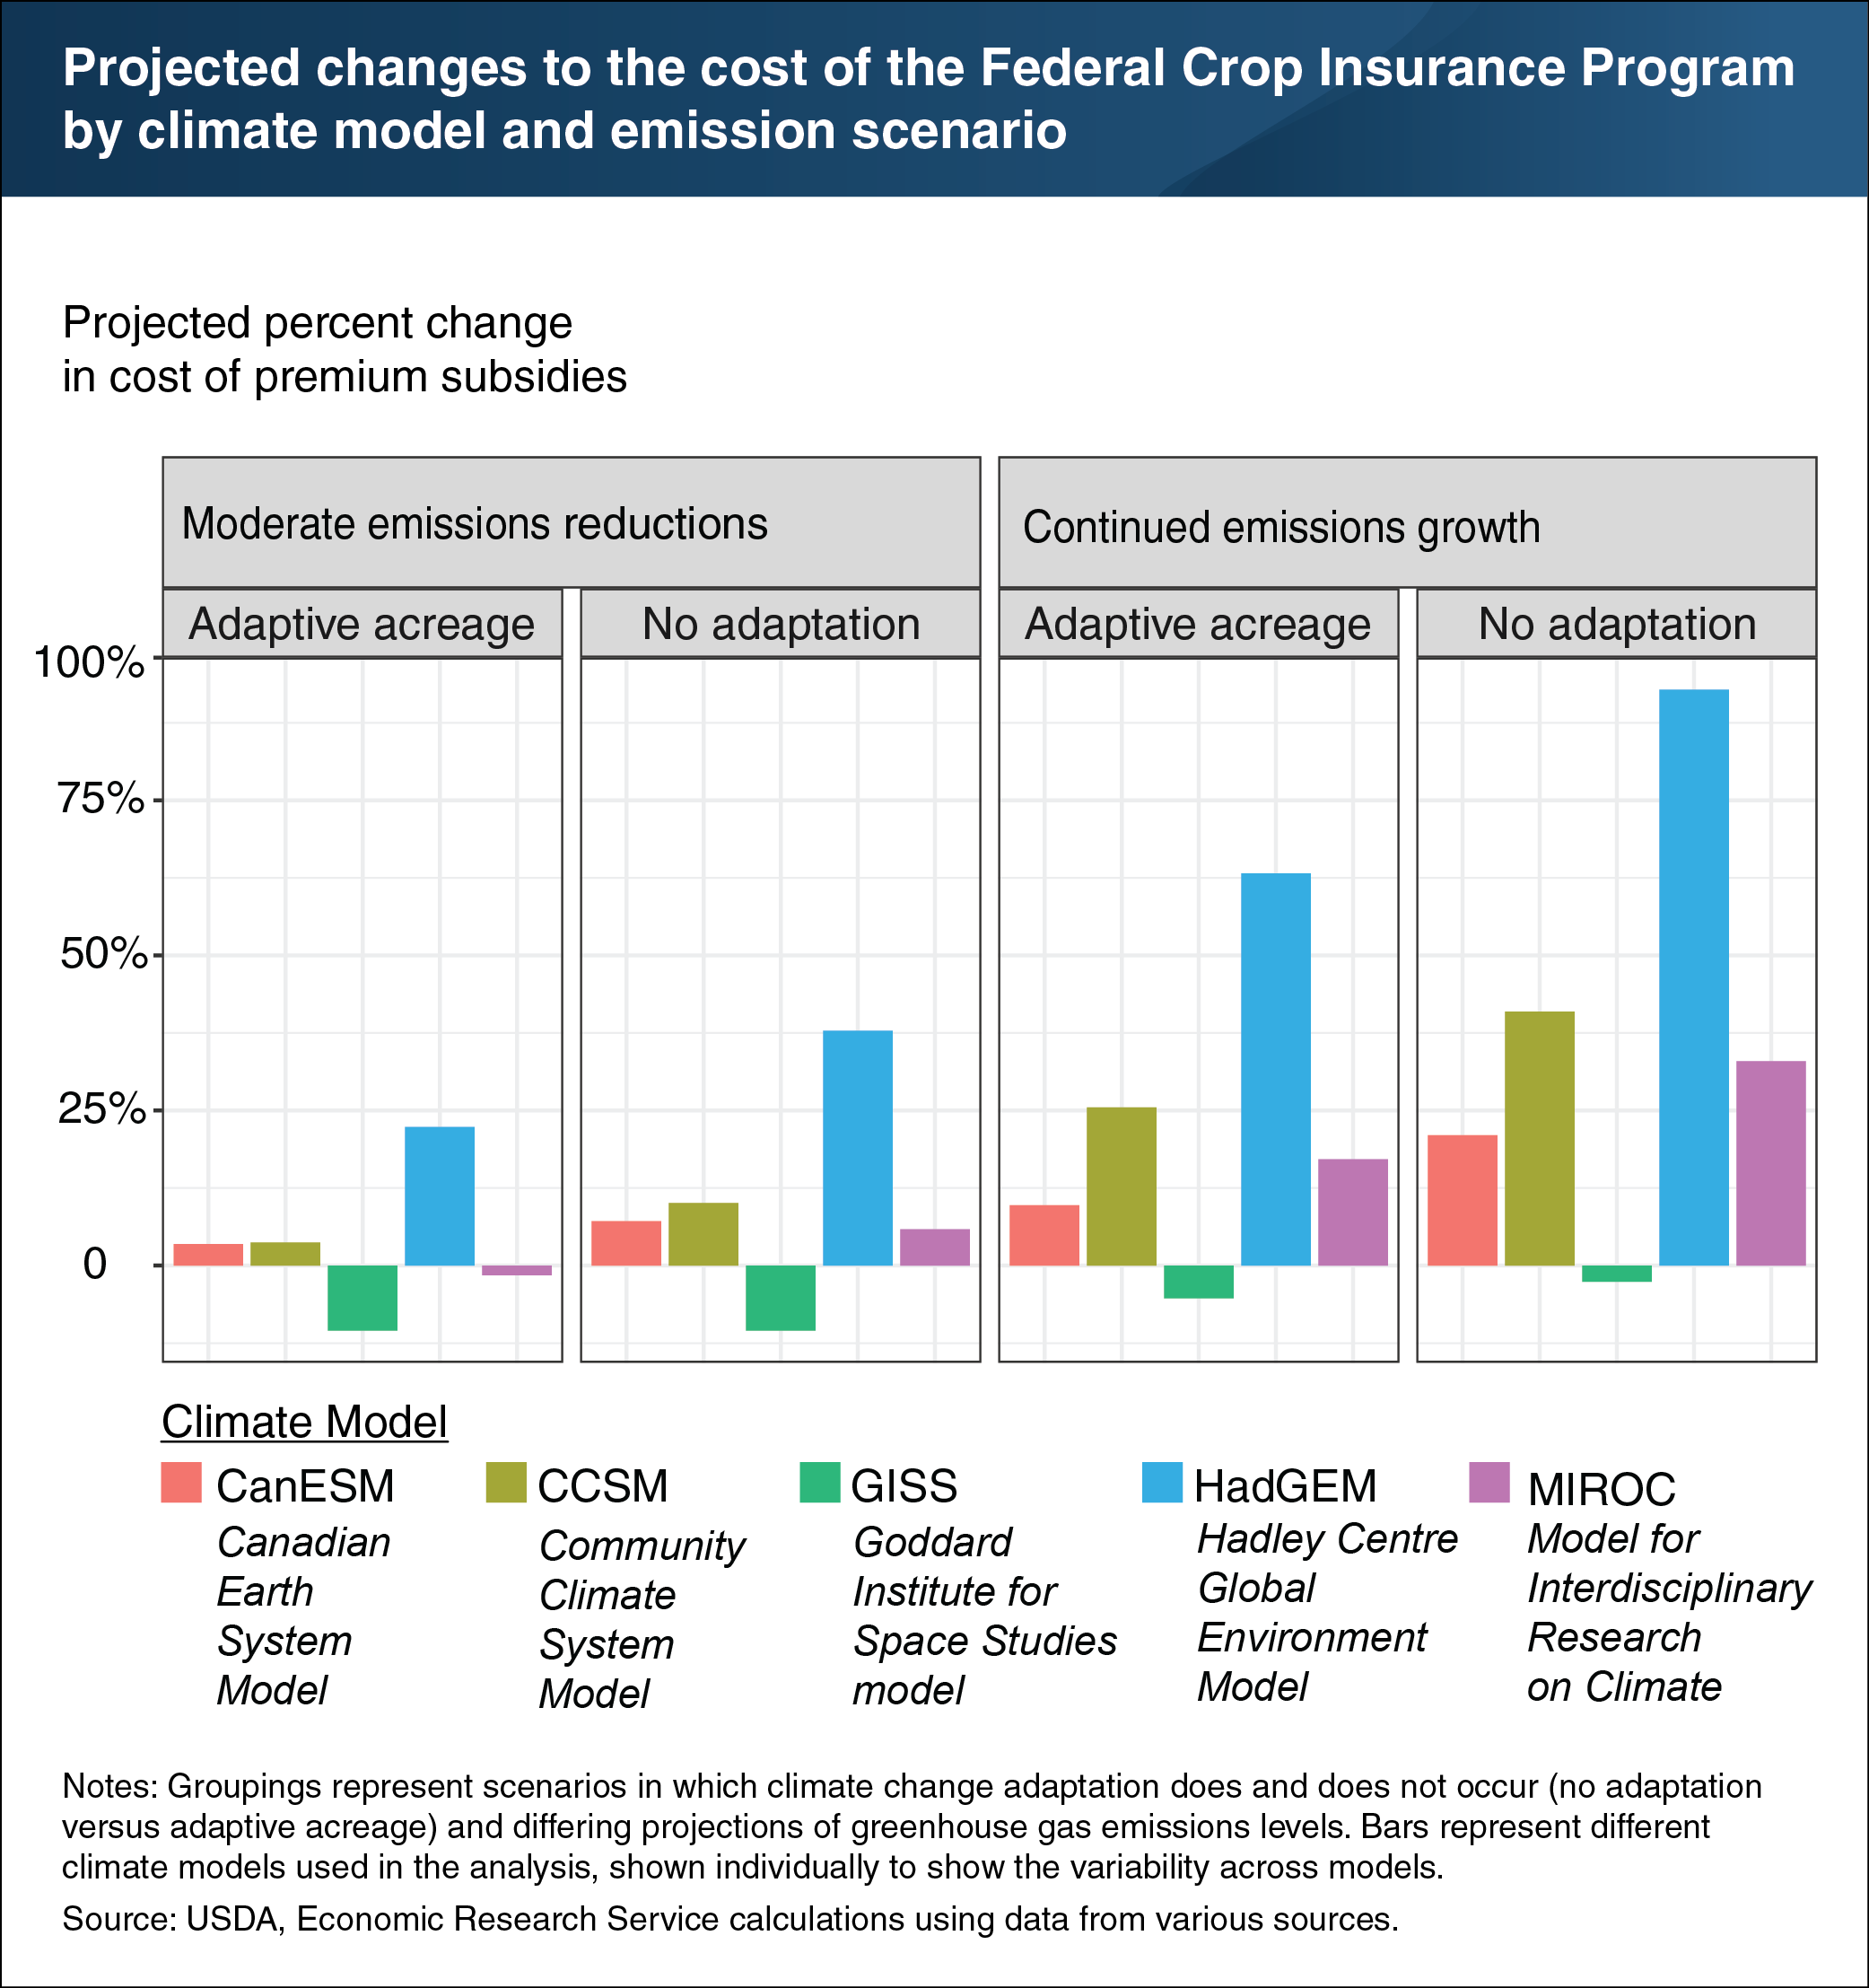
SIO Inf EB Fig 3
TBD
Source: USDA, Economic Research Service, ERR-266

Slide 8
Exposure to weather-related drought risk varies.
Irrigated farms face risk of water curtailments.
Drought Risk

Slide 9
SIO Inf EB Fig 3
Drought Risk Varies, but All Regions Face Some Risk
Sources: USDA, Economic Research Service, EB-33, January 6, 2022.

Slide 10
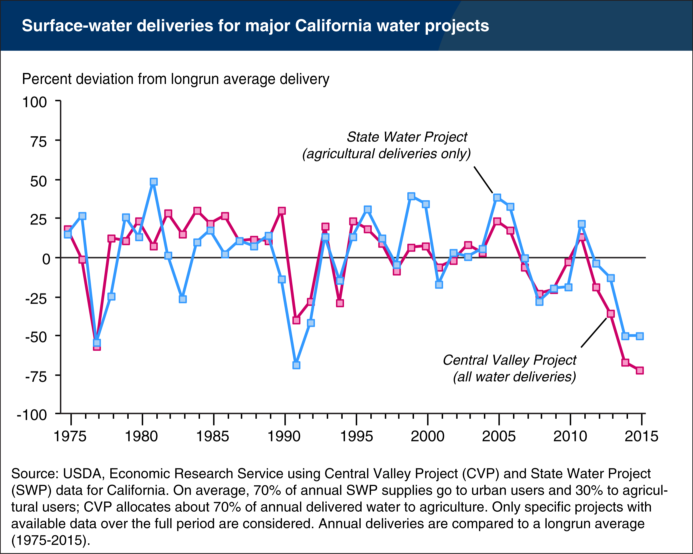
SIO Inf EB Fig 3
TBD
Sources: USDA, Chart of Note, “California’s surface water deliveries dip well below long-run averages,” March 22, 2016
https://www.ers.usda.gov/data-products/chart-gallery/gallery/chart-detail/?chartId=78835

Slide 11
Drought-tolerant seed adoption varies based on drought exposure.
Conservation program participation varies based on drought exposure.
Drought Adaptation

Slide 12
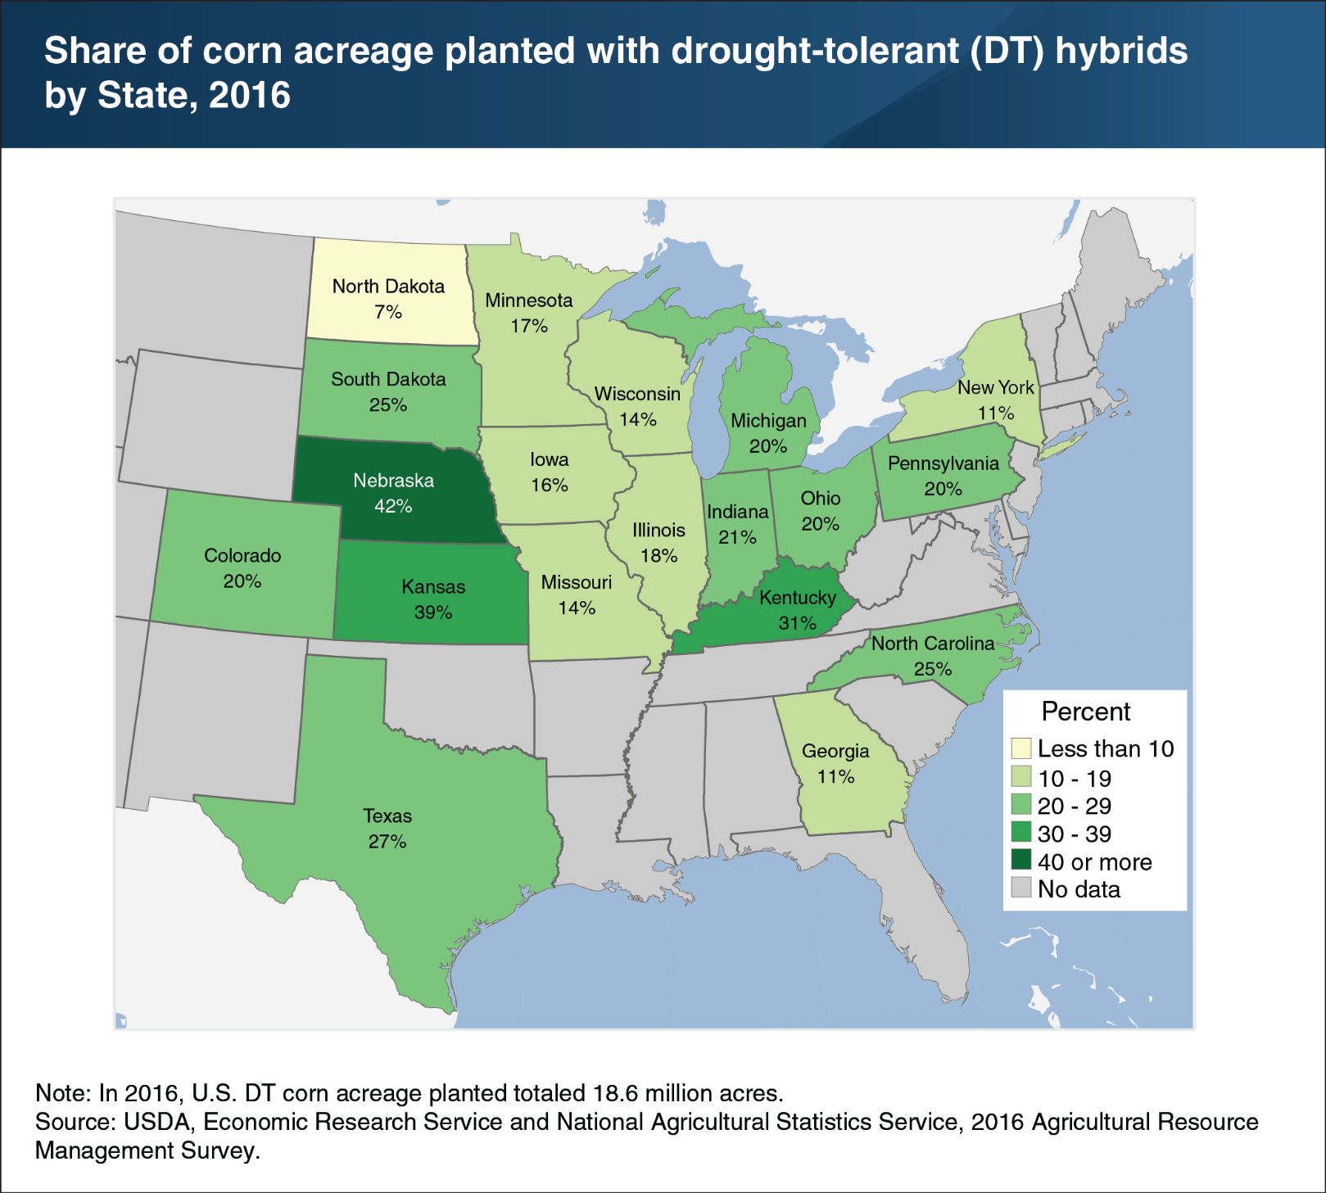
SIO Inf EB Fig 3
TBD

Slide 13
SIO Inf EB Fig 3
Participation in the Conservation Reserve Program is Related to Drought Risk
Sources: USDA, Economic Research Service, ERR-148

Slide 14
One-fifth of irrigation organizations have a formal drought plan.
Drought plans often include provisions for handling water curtailments.
Managing risk is the biggest reason organizations cite for water conservation investment.
Planning and Response

Slide 15
SIO DP EB Fig 5
One-fifth of irrigation organizations have a formal drought plan
Sources: USDA, Economic Research Service, EB-33, January 6, 2022.

Slide 16
SIO DP EB Fig 6
Drought plan components vary by organizations size
Sources: USDA, Economic Research Service, EB-33, January 6, 2022.

Slide 17
SIO DP EB Fig 11
Risk management is the primary reason for conservation investments
Sources: USDA, Economic Research Service, EB-33, January 6, 2022..

Slide 18
ERS Reports Cited
Survey of Irrigation Organizations: Drought Planning and Response (January 2022) (EB-33, pubid 102949)
Climate Change and Agricultural Risk Management into the 21st Century (July 2019) (ERR-266, pubid 93546)
Development, Adoption, and Management of Drought Tolerant Corn in the United States (January 2019) (EIB-204, pubid 91102)
The Role of Conservation Programs in Drought Risk Adaptation (April 2013) (ERR-148, pubid 45067)
Contact: steve.wallander@usda.gov

