Slide 1



Global Impacts of Agricultural Productivity Growth
Thomas W. Hertel
Distinguished Professor of Agricultural Economics
Purdue University
Presentation to USDA Outlook
February 2022

Slide 2
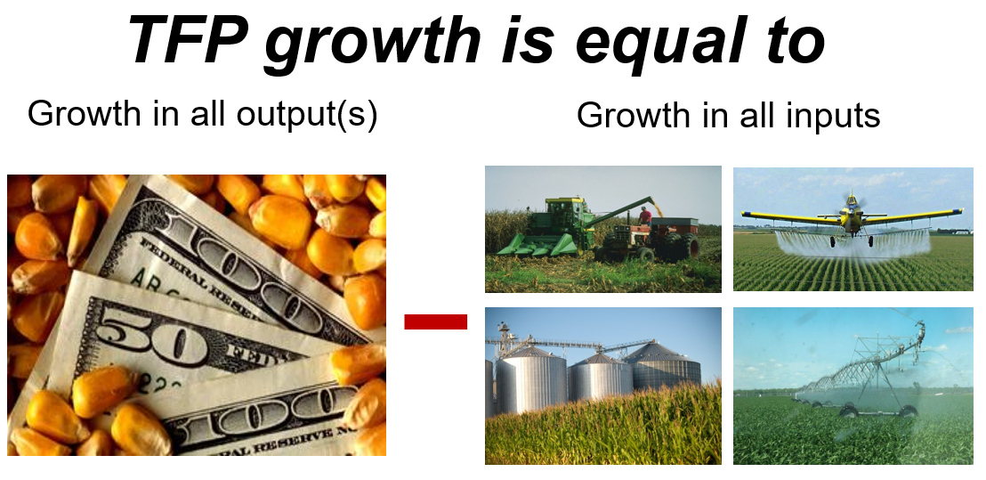
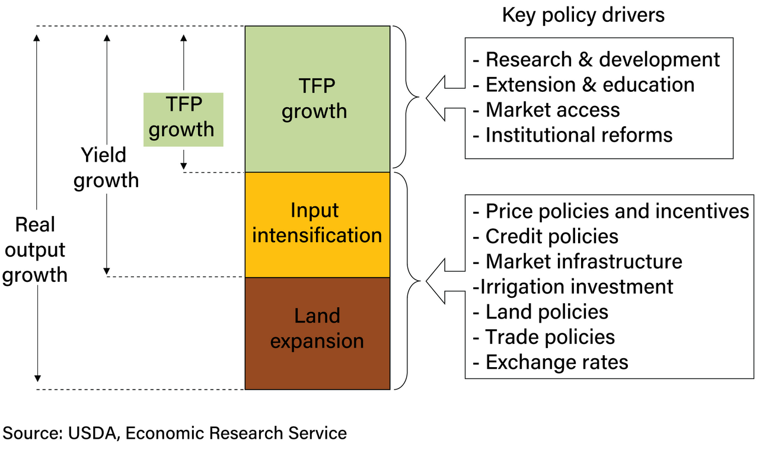

Key Concept: Total Factor Productivity (TFP)

Slide 3
TFP growth rates shape the global agricultural economy
TFP growth drives competitiveness in world markets
TFP growth drives land use change
TFP growth can reduce overall input usage
TFP growth can reduce greenhouse gas emissions
TFP growth can improve nutrition outcomes

Slide 4
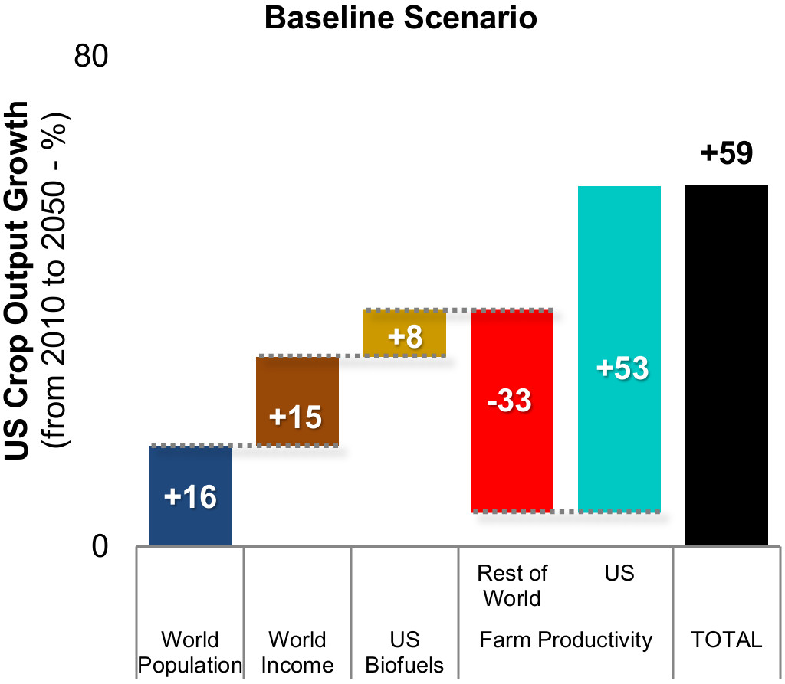
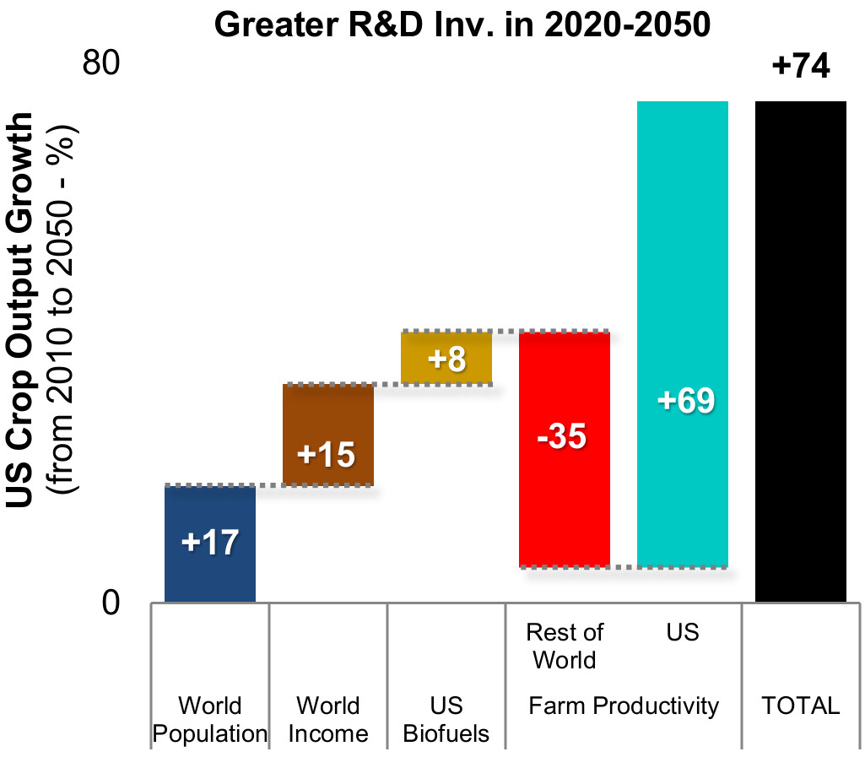

TFP growth drives competitiveness
Baseline
Productivity Growth
(+1.2 p.a. | 1981-10)
Projections from SIMPLE-G using Global Population, Income, US Biofuels as other drivers

Slide 5
TFP growth drives competitiveness
Baseline
Productivity Growth
(+1.2 p.a. | 1981-10)
Projections from SIMPLE-G using Global Population, Income, US Biofuels as other drivers

Slide 6
TFP growth drives competitiveness
Baseline
Productivity Growth
(+1.2 p.a. | 1981-10)
Projections from SIMPLE-G using Global Population, Income, US Biofuels as other drivers

Slide 7
TFP growth drives competitiveness
Baseline
Productivity Growth
(+1.2 p.a. | 1981-10)
Baldos, Uris, and Thomas Hertel. 2018. “Productivity Growth Is Key to Achieving Long Run Agricultural Sustainability.” Purdue Policy Research Institute, Policy Brief 4 (1).

Slide 8
Gains from R&D Spending:
Future Projections
Baseline
Productivity Growth
(+1.2 p.a. | 1981-10)
Greater R&D Inv.
Productivity Growth
(+1.5 p.a. | +1.1 B USD / yr 2020-50)
Baldos, Uris, and Thomas Hertel. 2018. “Productivity Growth Is Key to Achieving Long Run Agricultural Sustainability.” Purdue Policy Research Institute, Policy Brief 4 (1).

Slide 9
Regional patterns of TFP growth shape the global agricultural economy
TFP growth drives competitiveness in world markets
TFP growth drives land use change
Farmland use in the innovating region can contract (more efficient use of resources) or expand (owing to competitiveness effect). The outcome depends critically on openness to trade and whether the innovation is local or global in scope.

Slide 10
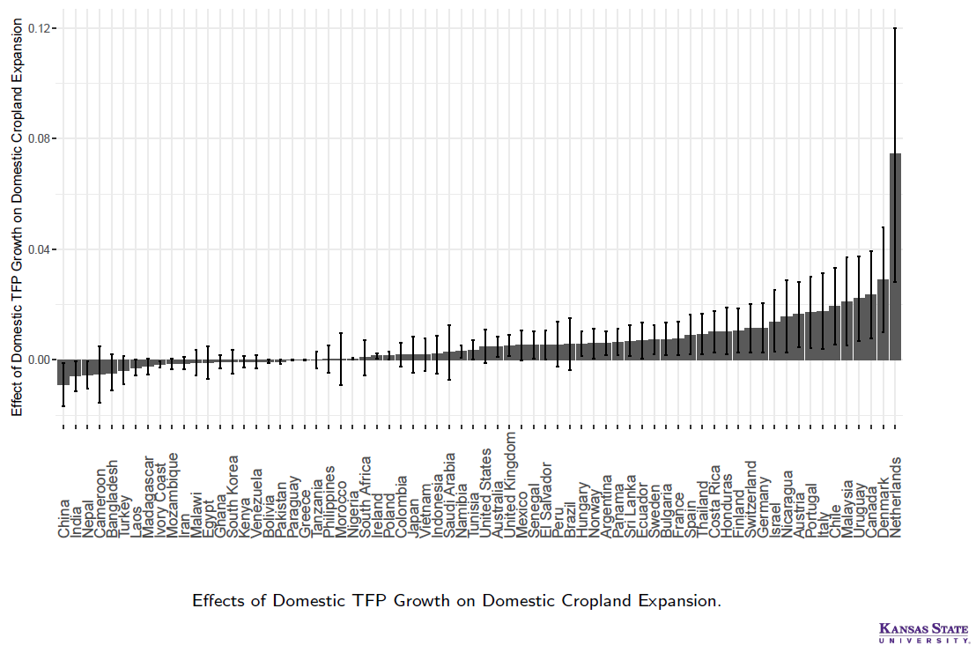

Effects of domestic TFP growth on domestic cropland expansion
Local TFP growth can lead to cropland expansion….

Slide 11
Effects of domestic TFP growth on domestic cropland expansion
Local TFP growth can lead to cropland expansion….
or contraction
Villoria, Nelson B. 2019. “Technology Spillovers and Land Use Change: Empirical Evidence from Global Agriculture.” American Journal of Agricultural Economics 101 (3): 870–93.

Slide 12
Effects of domestic TFP growth on domestic cropland expansion
The Netherlands is small open economy; local innovations will induce cropland expansion
Villoria, Nelson B. 2019. “Technology Spillovers and Land Use Change: Empirical Evidence from Global Agriculture.” American Journal of Agricultural Economics 101 (3): 870–93.

Slide 13
Effects of domestic TFP growth on domestic cropland expansion
China is a large, relatively closed agricultural economy; local innovations will induce cropland contraction
Villoria, Nelson B. 2019. “Technology Spillovers and Land Use Change: Empirical Evidence from Global Agriculture.” American Journal of Agricultural Economics 101 (3): 870–93.

Slide 14
Regional patterns of TFP growth shape the global agricultural economy
TFP growth drives competitiveness in world markets
TFP growth drives land use change
Let us move beyond the hypothetical and examine history. The challenge here is that we cannot rewrite history with a different rate of TFP growth – so we will need to use an economic model as our ‘laboratory’.

Slide 15
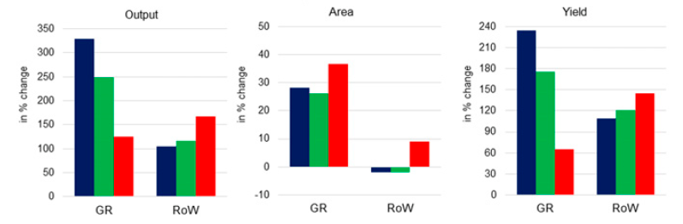

What if there had been no Green Revolution?
Blue = Baseline: what actually happened: 1961-2006: GR = Green Revolution regions; RoW = Rest of World

Slide 16
What if there had been no Green Revolution?
SIMPLE model used to simulate historical evolution of global agriculture
Blue = Baseline: what actually happened: 1961-2006
Green = Historical simulation using SIMPLE model: Provides a ‘lab’ to study alternative histories: What if?.....

Slide 17
What if there had been no Green Revolution? Rewriting history
The Green Revolution spared land for nature
Green = Historical simulation using SIMPLE model: 1961-2006
Red = Counterfactual simulation: Rewrite history using the model what would have happened if No Green Revolution
The Green Revolution spared land for nature
Hertel, T., W., N. Ramankutty and U.L.C. Baldos, (2014) “Global market integration increases likelihood that a future African Green Revolution could increase crop land use and CO2 emissions”, Proceedings of the National Academy of Sciences 111(38):13799–13804

Slide 18
TFP growth rates shape the global agricultural economy
TFP growth drives competitiveness in world markets
TFP growth drives land use change
TFP growth can reduce overall input usage
TFP growth can reduce greenhouse gas emissions
TFP growth can improve nutrition outcomes

Slide 19
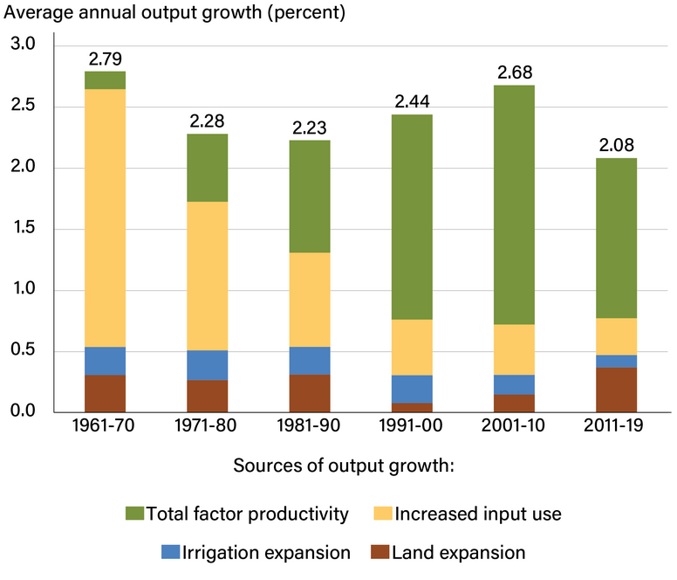
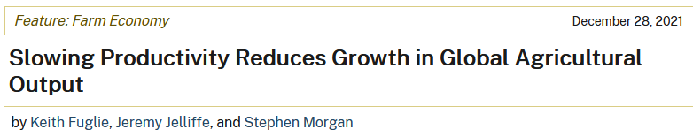
In the 60’s and 70’s global agricultural growth
relied on increases in inputs

Slide 20
Since 1990, world agriculture has been knowledge driven: TFP is the key driver of growth

Slide 21
TFP growth rates shape the global agricultural economy
TFP growth drives competitiveness in world markets
TFP growth drives land use change
TFP growth can reduce overall input usage
TFP growth can reduce greenhouse gas emissions
TFP growth can improve nutrition outcomes

Slide 22
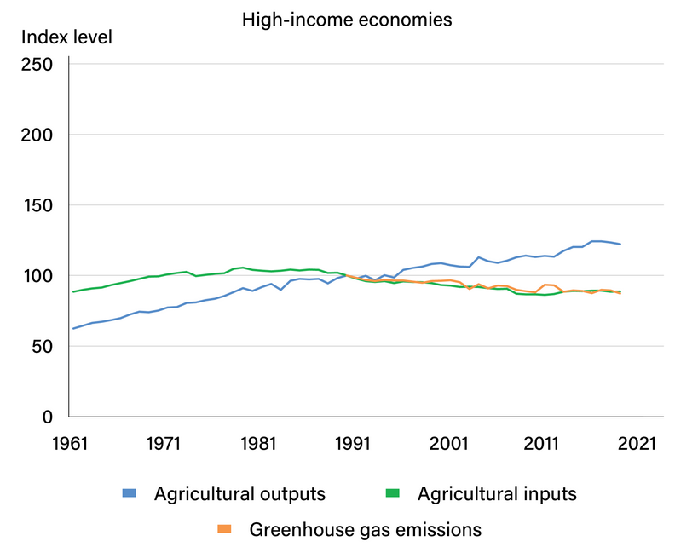
By permitting output to grow faster than input usage, TFP growth has dampened GHG emissions from agriculture in high income economies

Slide 23
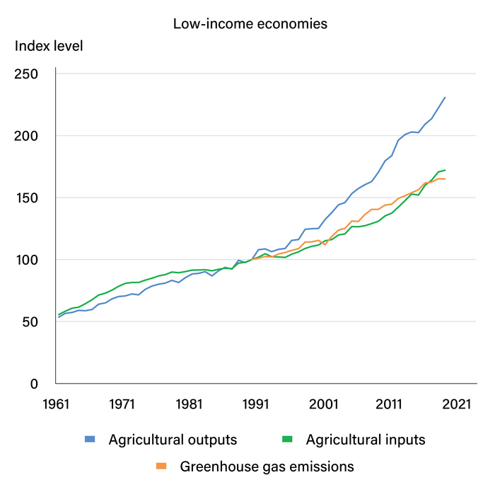
By permitting output to grow faster than input usage, TFP growth has slowed growth in GHG emissions from agriculture in low income economies

Slide 24

Accelerating public R&D spending would reduce GHG emissions intensity in 2050
Accelerated R&D spending in LDCs
Accelerated R&D spending globally
Fuglie, K.O., U.L.C. Baldos, S. Ray and T.W. Hertel. (Forthcoming) “The R&D Cost of Climate Mitigation in Agriculture”, Applied Economic Perspectives and Policy.

Slide 25
TFP growth rates shape the global agricultural economy
TFP growth drives competitiveness in world markets
TFP growth drives land use change
TFP growth can reduce overall input usage
TFP growth can reduce greenhouse gas emissions
TFP growth can improve nutrition outcomes

Slide 26
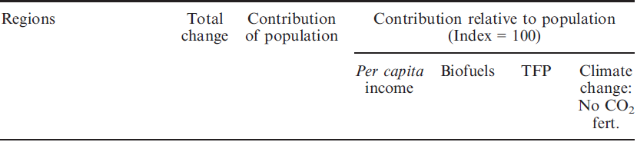

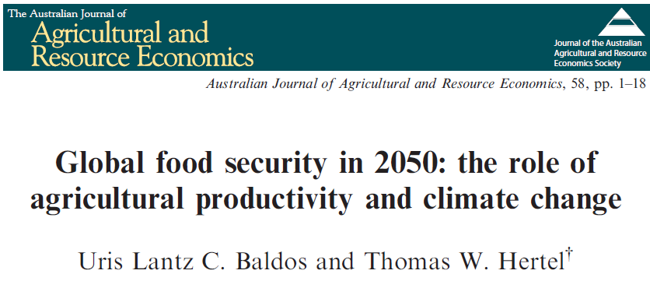
Over the decade 1991-2001, the malnutrition head count worldwide fell by 150M, while rising in SSA by 44.6M. Population growth alone would have increase malnutrition globally by 266.5M.

Slide 27

Globally, income growth and TFP growth allowed for the reduction in malnutrition
In SSA, per capita income declined, but global TFP growth mitigated the rise in undernourishment

Slide 28
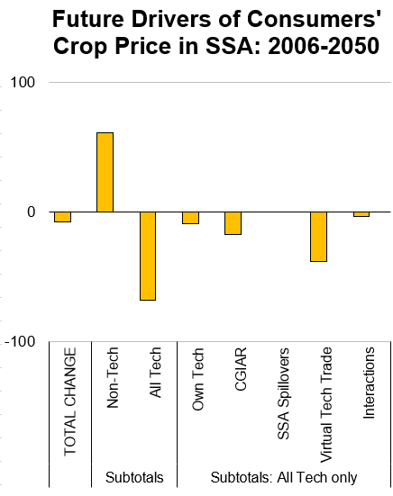
Domestic pop and income growth will drive up food prices in SSA
Domestic R&D has limited impact; projected SSA R&D investments are very modest to 2050
CGIAR investments to mid-century are important
However, virtual technology trade is the dominant driver of price reductions; SSA will depend on R&D investments in other regions to maintain stable food prices
Hertel, T.W. and U.L.C. Baldos and K.O. Fuglie. (2020) “Trade in Technology: A Potential Solution to the Food Security Challenges of the 21st Century”, European Economic Review 127(August):1-20.

Slide 29
Summary: TFP growth rates shape the global agricultural economy
Competitiveness of the US in world markets hinges on domestic TFP growth – driven by public & private R&D
Global TFP growth is critical to dampening farmland expansion – the primary source of biodiversity losses
Mitigating greenhouse gas emissions from agriculture also hinges on increasing TFP growth rates
TFP growth lowers food prices and improves overall nutrition outcomes in developing countries

