Slide 1
Trends in Farmland Values
Todd H. Kuethe
Associate Professor, Schrader Chair in Farmland Economics
Department of Agricultural Economics, Purdue University
2022 USDA Outlook Forum

Slide 2
Farm Sector Balance Sheet
Billions of dollars
 | 2000 | 2005 | 2010 | 2015 | 2020 | 2021F | 2022F
Farm Assets | 1,203 | 1,709 | 2,171 | 2,880 | 3,175 | 3,270 | 3,313
Real Estate | 946 | 1,373 | 1,660 | 2,366 | 2,641 | 2,693 | 2,720
Farm Debt | 164 | 209 | 279 | 357 | 441 | 454 | 467
Real Estate | 85 | 114 | 154 | 209 | 289 | 302 | 312
Equity | 1,039 | 1,500 | 1,892 | 2,523 | 2,733 | 2,816 | 2,845
Debt/Asset Ratio | 13.6 | 12.2 | 12.8 | 12.4 | 13.9 | 13.9 | 14.1
Real Estate/Assets | 78.7 | 80.3 | 76.5 | 82.1 | 83.2 | 82.4 | 82.1
Real Estate/Debt | 51.7 | 54.5 | 55.2 | 58.5 | 65.4 | 66.4 | 66.7
Source: USDA-ERS

Slide 3
Farm Sector Balance Sheet
Billions of dollars
 | 2000 | 2005 | 2010 | 2015 | 2020 | 2021F | 2022F
Farm Assets | 1,203 | 1,709 | 2,171 | 2,880 | 3,175 | 3,270 | 3,313
Real Estate | 946 | 1,373 | 1,660 | 2,366 | 2,641 | 2,693 | 2,720
Farm Debt | 164 | 209 | 279 | 357 | 441 | 454 | 467
Real Estate | 85 | 114 | 154 | 209 | 289 | 302 | 312
Equity | 1,039 | 1,500 | 1,892 | 2,523 | 2,733 | 2,816 | 2,845
Debt/Asset Ratio | 13.6 | 12.2 | 12.8 | 12.4 | 13.9 | 13.9 | 14.1
Real Estate/Assets | 78.7 | 80.3 | 76.5 | 82.1 | 83.2 | 82.4 | 82.1
Real Estate/Debt | 51.7 | 54.5 | 55.2 | 58.5 | 65.4 | 66.4 | 66.7
Source: USDA-ERS

Slide 4
Farm Sector Balance Sheet
Billions of dollars
 | 2000 | 2005 | 2010 | 2015 | 2020 | 2021F | 2022F
Farm Assets | 1,203 | 1,709 | 2,171 | 2,880 | 3,175 | 3,270 | 3,313
Real Estate | 946 | 1,373 | 1,660 | 2,366 | 2,641 | 2,693 | 2,720
Farm Debt | 164 | 209 | 279 | 357 | 441 | 454 | 467
Real Estate | 85 | 114 | 154 | 209 | 289 | 302 | 312
Equity | 1,039 | 1,500 | 1,892 | 2,523 | 2,733 | 2,816 | 2,845
Debt/Asset Ratio | 13.6 | 12.2 | 12.8 | 12.4 | 13.9 | 13.9 | 14.1
Real Estate/Assets | 78.7 | 80.3 | 76.5 | 82.1 | 83.2 | 82.4 | 82.1
Real Estate/Debt | 51.7 | 54.5 | 55.2 | 58.5 | 65.4 | 66.4 | 66.7
Source: USDA-ERS

Slide 5
Farm Sector Balance Sheet
Billions of dollars
 | 2000 | 2005 | 2010 | 2015 | 2020 | 2021F | 2022F
Farm Assets | 1,203 | 1,709 | 2,171 | 2,880 | 3,175 | 3,270 | 3,313
Real Estate | 946 | 1,373 | 1,660 | 2,366 | 2,641 | 2,693 | 2,720
Farm Debt | 164 | 209 | 279 | 357 | 441 | 454 | 467
Real Estate | 85 | 114 | 154 | 209 | 289 | 302 | 312
Equity | 1,039 | 1,500 | 1,892 | 2,523 | 2,733 | 2,816 | 2,845
Debt/Asset Ratio | 13.6 | 12.2 | 12.8 | 12.4 | 13.9 | 13.9 | 14.1
Real Estate/Assets | 78.7 | 80.3 | 76.5 | 82.1 | 83.2 | 82.4 | 82.1
Real Estate/Debt | 51.7 | 54.5 | 55.2 | 58.5 | 65.4 | 66.4 | 66.7
Source: USDA-ERS

Slide 6
Farm Sector Balance Sheet
Billions of dollars
 | 2000 | 2005 | 2010 | 2015 | 2020 | 2021F | 2022F
Farm Assets | 1,203 | 1,709 | 2,171 | 2,880 | 3,175 | 3,270 | 3,313
Real Estate | 946 | 1,373 | 1,660 | 2,366 | 2,641 | 2,693 | 2,720
Farm Debt | 164 | 209 | 279 | 357 | 441 | 454 | 467
Real Estate | 85 | 114 | 154 | 209 | 289 | 302 | 312
Equity | 1,039 | 1,500 | 1,892 | 2,523 | 2,733 | 2,816 | 2,845
Debt/Asset Ratio | 13.6 | 12.2 | 12.8 | 12.4 | 13.9 | 13.9 | 14.1
Real Estate/Assets | 78.7 | 80.3 | 76.5 | 82.1 | 83.2 | 82.4 | 82.1
Real Estate/Debt | 51.7 | 54.5 | 55.2 | 58.5 | 65.4 | 66.4 | 66.7
Source: USDA-ERS

Slide 7
Long-run US farm real estate values ($/acre)
Source: USDA-NASS

Slide 8
Corn Belt farm real estate prices ($/acre)
Source: USDA-NASS

Slide 9
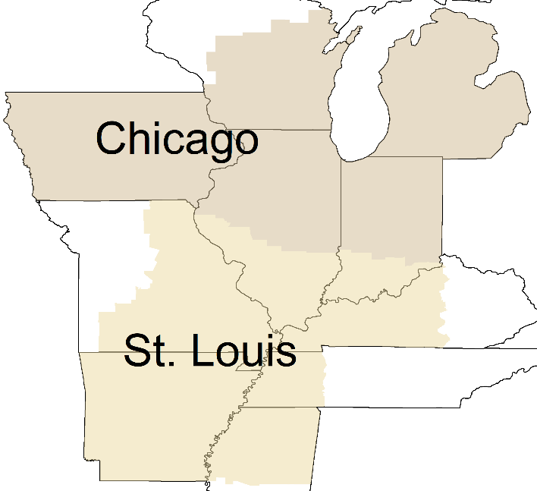
Federal Reserve Bank Surveys
Source: Federal Reserve Banks of Chicago and St. Louis

Slide 10
Iowa State University Land Value Survey
Source: Iowa State University

Slide 11
Indiana Farmland Values
Top, Average, and Poor Quality Land, 2000 − 2021
Source: Purdue Land Value and Cash Rent Survey

Slide 12
Indiana Farmland Values
Average Quality Land, 1980 − 2021

Slide 13
Land Value Drivers
Source: Purdue Land Value and Cash Rent Survey

Slide 14
A simple model of farmland prices

Slide 15

A simple model of farmland prices
$$Price= \frac{Expected returns}{(Discount rate −growth rate)}$$

Slide 16
A simple model of farmland prices
$$Price= \frac{Expected returns}{(Discount rate −growth rate)}$$
Assuming a growth rate of 1%:
 |  | Discount rate
 |  | 3% | 4.5% | 6.0%
Expected returns | 200 | 10,000 | 5,714 | 4,000
 | 300 | 15,000 | 8,571 | 6,000
 | 400 | 20,000 | 11,429 | 8,000

Slide 17
Farm Incomes Forecast to Decrease in 2022, But Potential to Improve
Source: USDA-ERS

Slide 18
Discount rates
Source: FRED and Federal Reserve Bank of Chicago

Slide 19

Thank You
Todd H. Kuethe
Purdue University
@ToddKuethe

