Slide 1
USDA
PRODUCTION ESTIMATES
Lance Honig, Chief
Crops Branch
USDA-NASS
February 20, 2020

Slide 2


WHY USDA ESTIMATES PRODUCTION
Used by…
Used for…
Farmers
Policymakers
Agribusinesses
State & Local Government
Researchers
USDA
Etc.
Marketing Decisions
Designing Programs
Product Distribution
Local Programs
Varietal Improvements
Designing & Administering Farm Bill Programs
Etc.
Levels the Playing Field
USDA
Equal Access
Unbiased

Slide 3
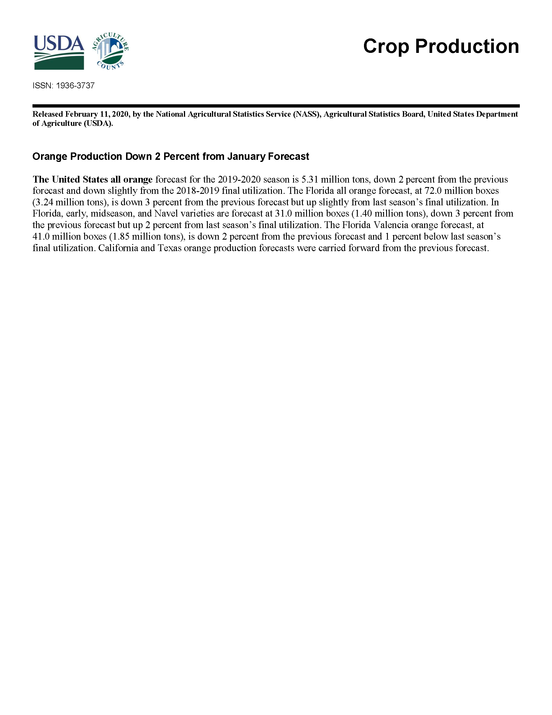
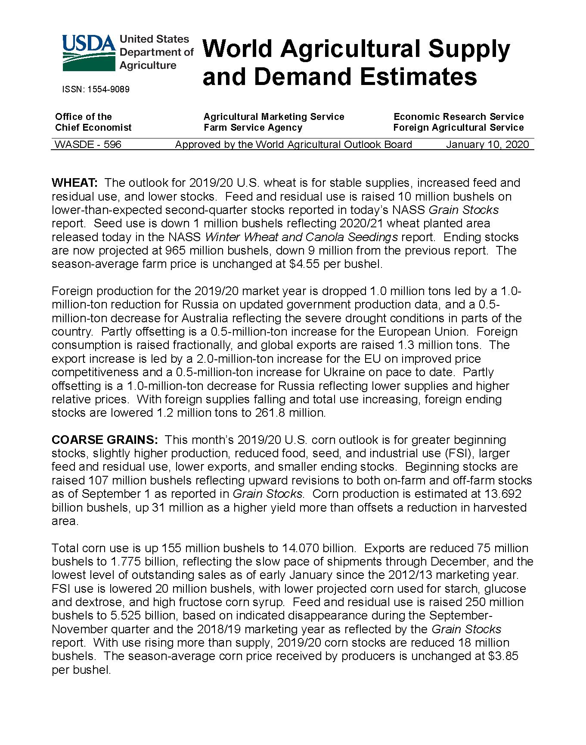
Who’s Responsible for USDA Estimates
National Agricultural Statistics Service (NASS)
USDA’s Statistical Arm
Measure all aspects of agriculture in U.S.
Monthly Crop Production Reports
World Agricultural Outlook Board (WAOB)
Office of the Chief Economist
Projections for the World
Monthly WASDE Reports

Slide 4
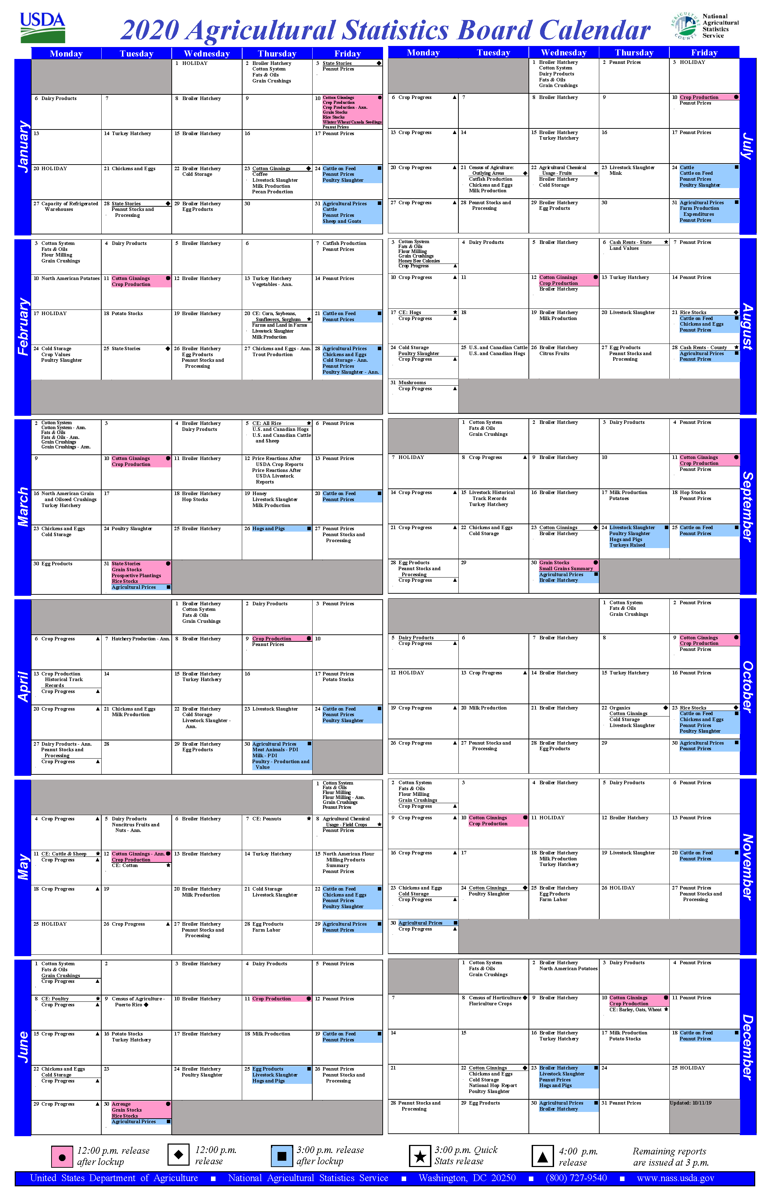
NASS MISSION
To provide timely, accurate, and useful statistics in service to U.S. agriculture.
~120 Crop Commodities
~40 Livestock Commodities
~500 National Reports Annually
> 9,000 State-Level Reports
Census of Agriculture
All
Scheduled in
Advance

Slide 5
WAOB FUNCTION
Provide economic information & coordinate USDA’s World Agricultural Supply and Demand Estimates (WASDE)
Coordinate Analysis Across Agencies
Nine Interagency Commodity Estimates Committees (ICEC)
World Agricultural Outlook Board (WAOB)
Agricultural Marketing Service (AMS)
Economic Research Service (ERS)
Farm Service Agency (FSA)
Foreign Ag Service (FAS)
Grain Inspection, Packers, and Stockyards Administration (GIPSA)
Wheat
Rice
Feed Grains
Oilseeds
Cotton
Sugar
Meat Animals
Poultry
Dairy

Slide 6
Other USDA Data
Farm Service Agency (FSA)
Most Useful for Planted Acreage
Summer Reporting Deadlines
Administers Numerous USDA Farm Programs
  Certified Acreage
  Limited Acreage Failed Data
  Prevent Plant Acreage
Risk Management Agency (RMA)
Both Planted Acreage and Yield
Yields Reported After Harvest
Administers Crop Insurance Program
  Acreage and Yield Data for Insured Crops

Slide 7
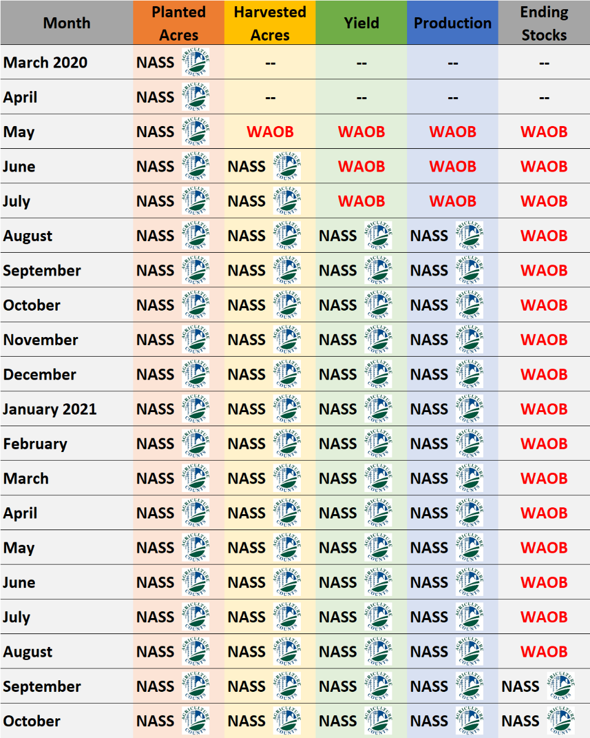
Who’s Responsible for USDA Estimates
2020-2021
Corn/Soybeans
WAOB
NASS
Harvested Acres: End of June
Yield/Production: August

Slide 8
Where WAOB Estimates Come From
Weather
Economics
Trend
WAOB Estimate

Slide 9
Where NASS Estimates Come From
Farmer Surveys
FSA & RMA
Satellite
NASS Acreage Estimate
Certified Acres
Failed Acres
Weather
Economics

Slide 10
Where NASS Estimates Come From
Farmer Surveys
Objective Yield
Satellite
NASS Yield Estimate
Weather
Crop Progress

Slide 11
Where NASS Estimates Come From
Farmer Surveys
Primary Acreage Surveys
March
Agricultural Survey
82,352 Farmers
~First 2 Weeks of March
June
Agricultural Survey
Area Survey
~100,000 Farmers
~First 2 Weeks of June
December
Agricultural Survey
78,637 Farmers
~First 2 Weeks of December
Prospective Plantings
Acreage
Annual Crop
Production

Slide 12
Where NASS Estimates Come From
Farmer Surveys
Primary Yield Surveys
Ag Yield
August - November
8,000 – 21,000 Farmers
Objective Yield
September - November
>1,000 Sample Fields
December
Agricultural Survey
78,637 Farmers
~First 2 Weeks of December
Objective Yield
Crop Production
Annual Crop
Production

Slide 13
Where NASS Estimates Come From
FSA & RMA
  Certified Acres
  Failed Acres
Acreage Data from FSA & RMA
FSA
Certified Acres
August
FSA & RMA Failed Acres
Annual
October
Annual
Crop Production
Annual Crop
Production

Slide 14
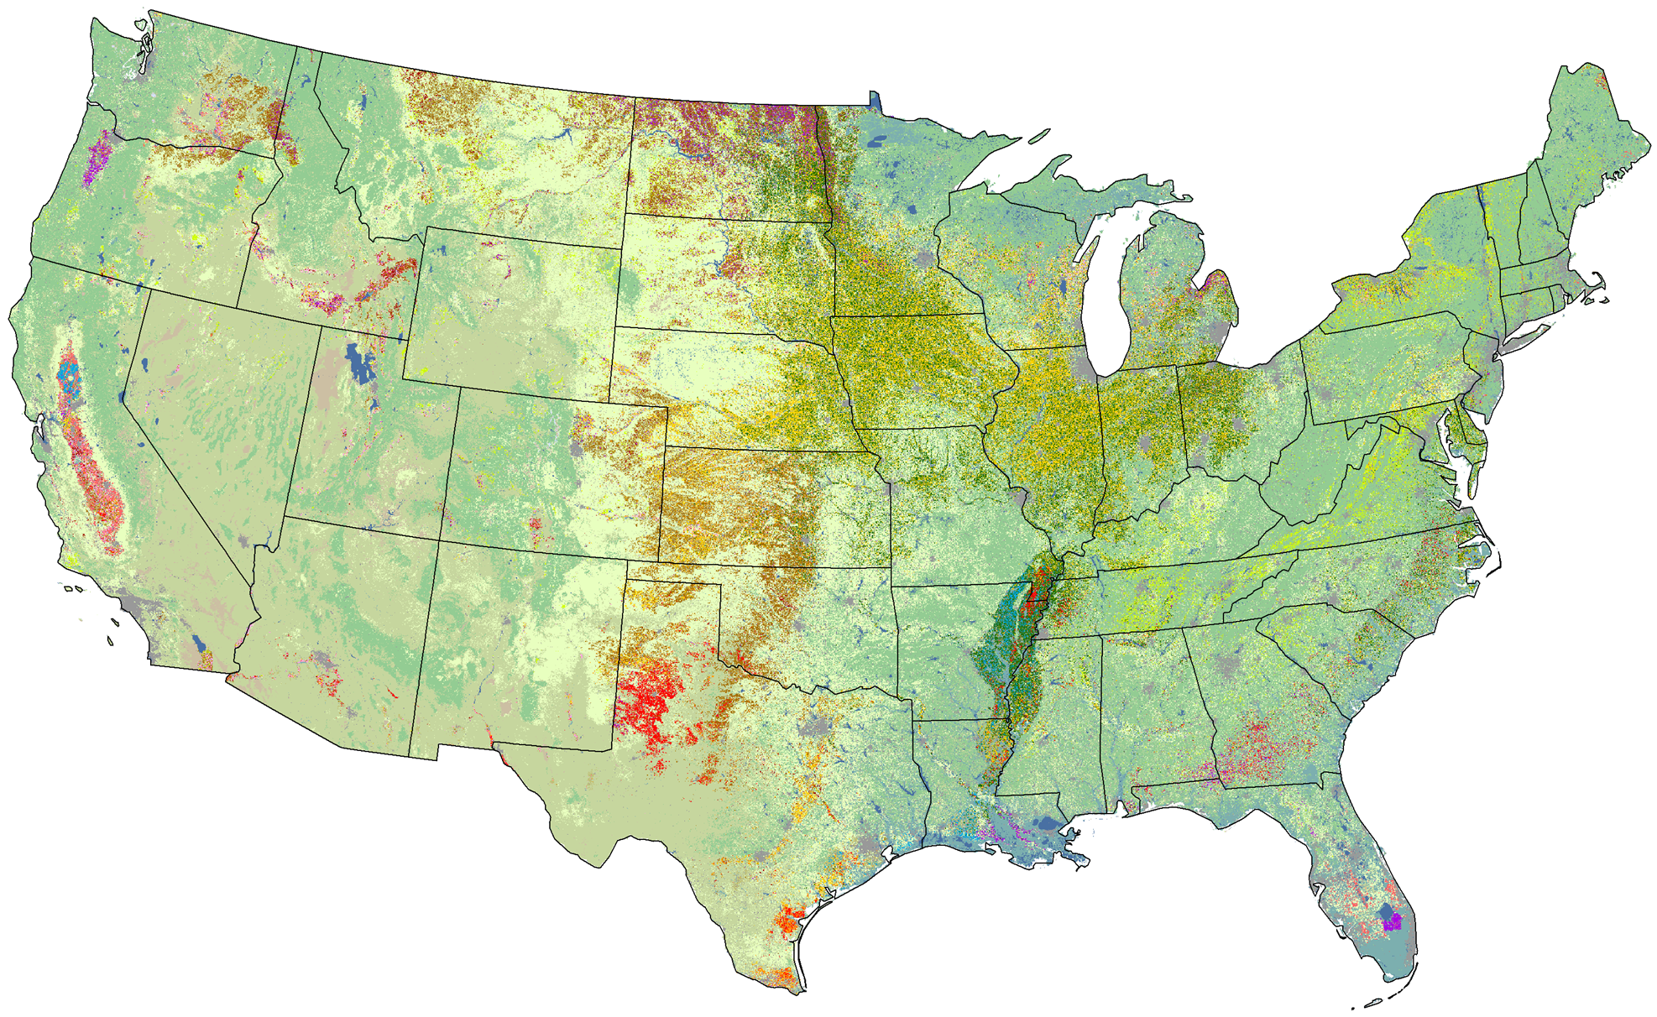
Where NASS Estimates Come From
Satellite
Acreage Data from Satellites
Cropland Data Layer
Geo-referenced, 30m, crop-specific land cover dataset.
Produced with optical satellite imagery spanning the growing season.
Leverage FSA Common Land Unit for ground reference data.

Slide 15
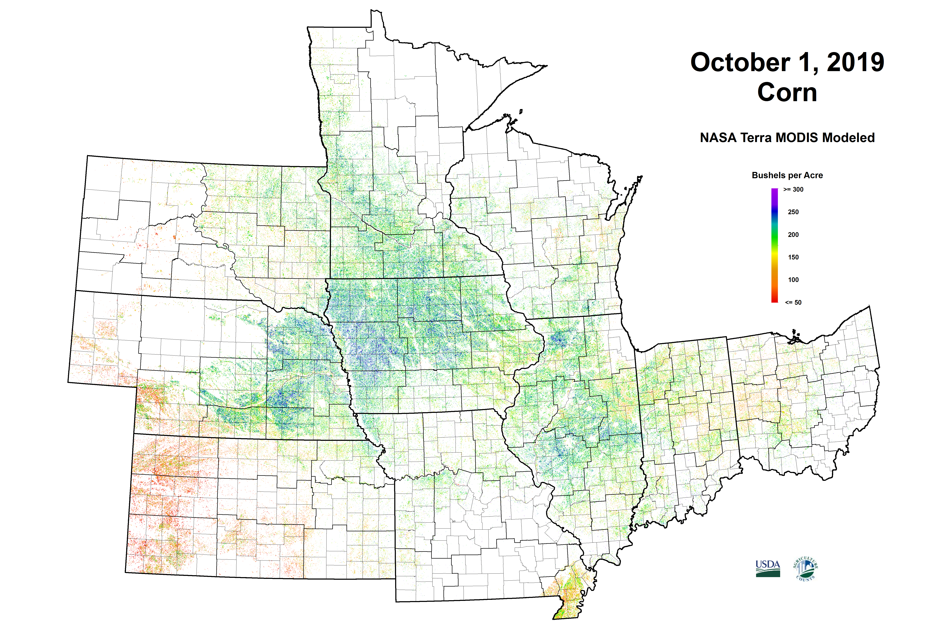
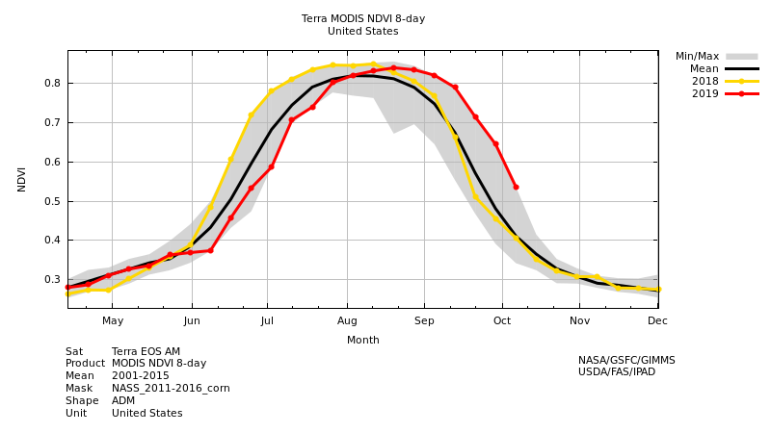
Where NASS Estimates Come From
Satellite
Yield Data from Satellites
Time-series 250m MODIS satellite data
Empirically-based prediction model
Integrate crop phenology over growing season
Use Cropland Data Layer (CDL) to isolate known crop areas
Positive relationship between crop yield and biomass – plant vigor “greenness” – NDVI
Negative relationship between crop yield and land surface temperature

Slide 16
Where NASS Estimates Come From
Farmer Surveys
FSA & RMA
Satellite
NASS Acreage Estimate
Certified Acres
Failed Acres
Weather
Economics

Slide 17
Where NASS Estimates Come From
NASS Acreage Estimate
Weather
Economics

Slide 18
Where NASS Estimates Come From
Multiple Indications For Given Estimate
Item of Interest
60
50
40
30
20
10
0

Slide 19
Where NASS Estimates Come From
Multiple Indications For Given Estimate
Item of Interest
60
50
40
30
20
10
0
Precision/Accuracy
Coefficient of Variation (CV)
Range Around Indication

Slide 20
Where NASS Estimates Come From
Multiple Indications For Given Estimate
Item of Interest
60
50
40
30
20
10
0
Bias
Historical Performance
Amount Above or Below

Slide 21
Where NASS Estimates Come From
Multiple Indications For Given Estimate
Item of Interest
60
50
40
30
20
10
0
Precision/Accuracy
Coefficient of Variation (CV)
Bias
Historical Performance
Range Around Indication
Amount Above or Below

Slide 22
Where NASS Estimates Come From
Multiple Indications For Given Estimate
Item of Interest
60
50
40
30
20
Estimate
10
0
Precision/Accuracy
Coefficient of Variation (CV)
Bias
Historical Performance
Range Around Indication
Amount Above or Below

Slide 23
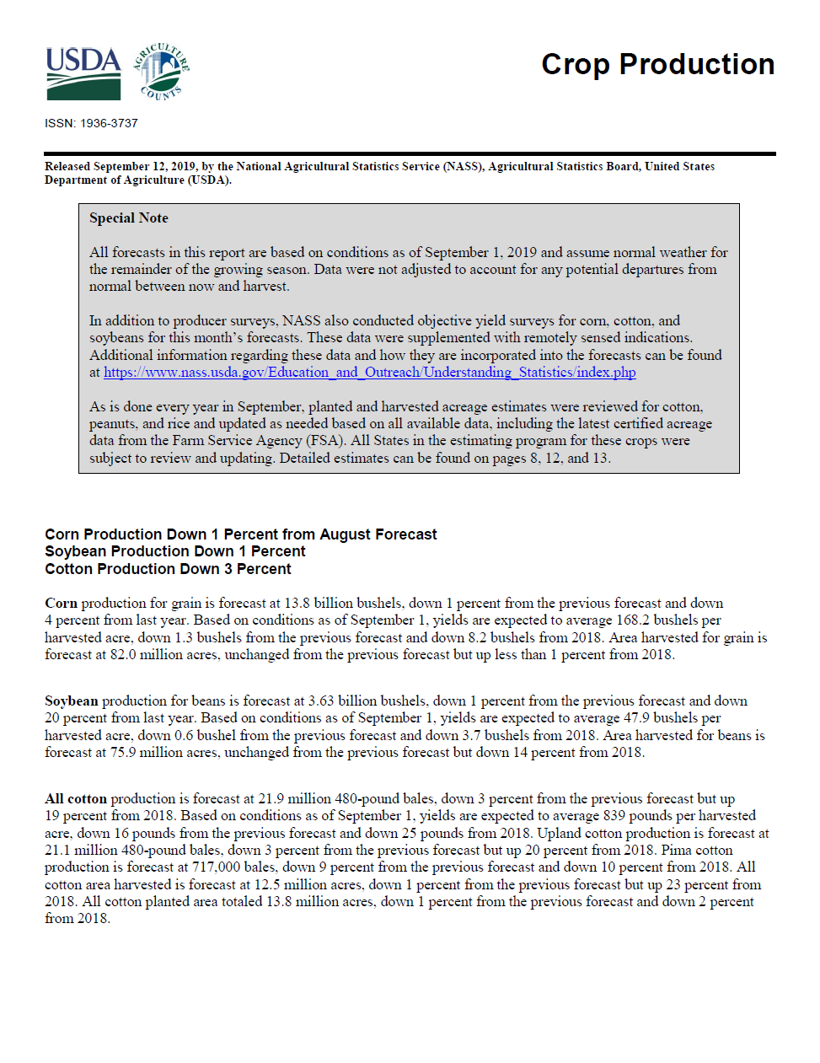
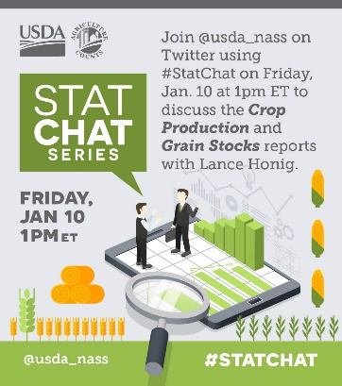
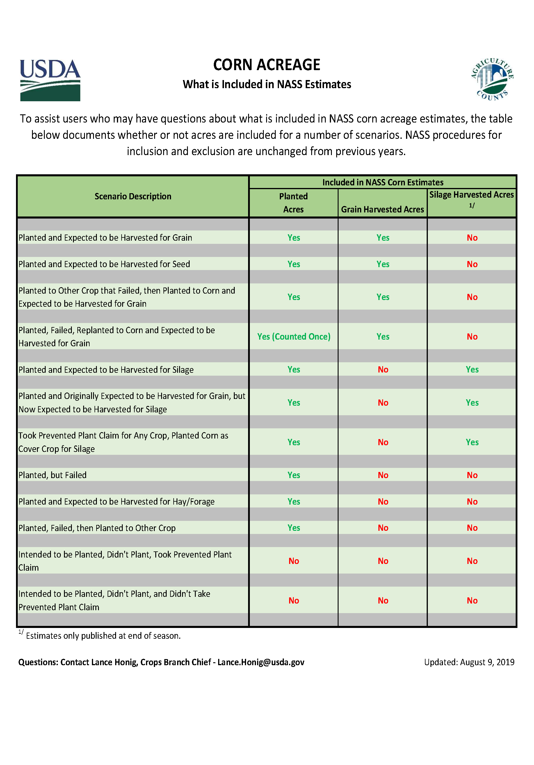
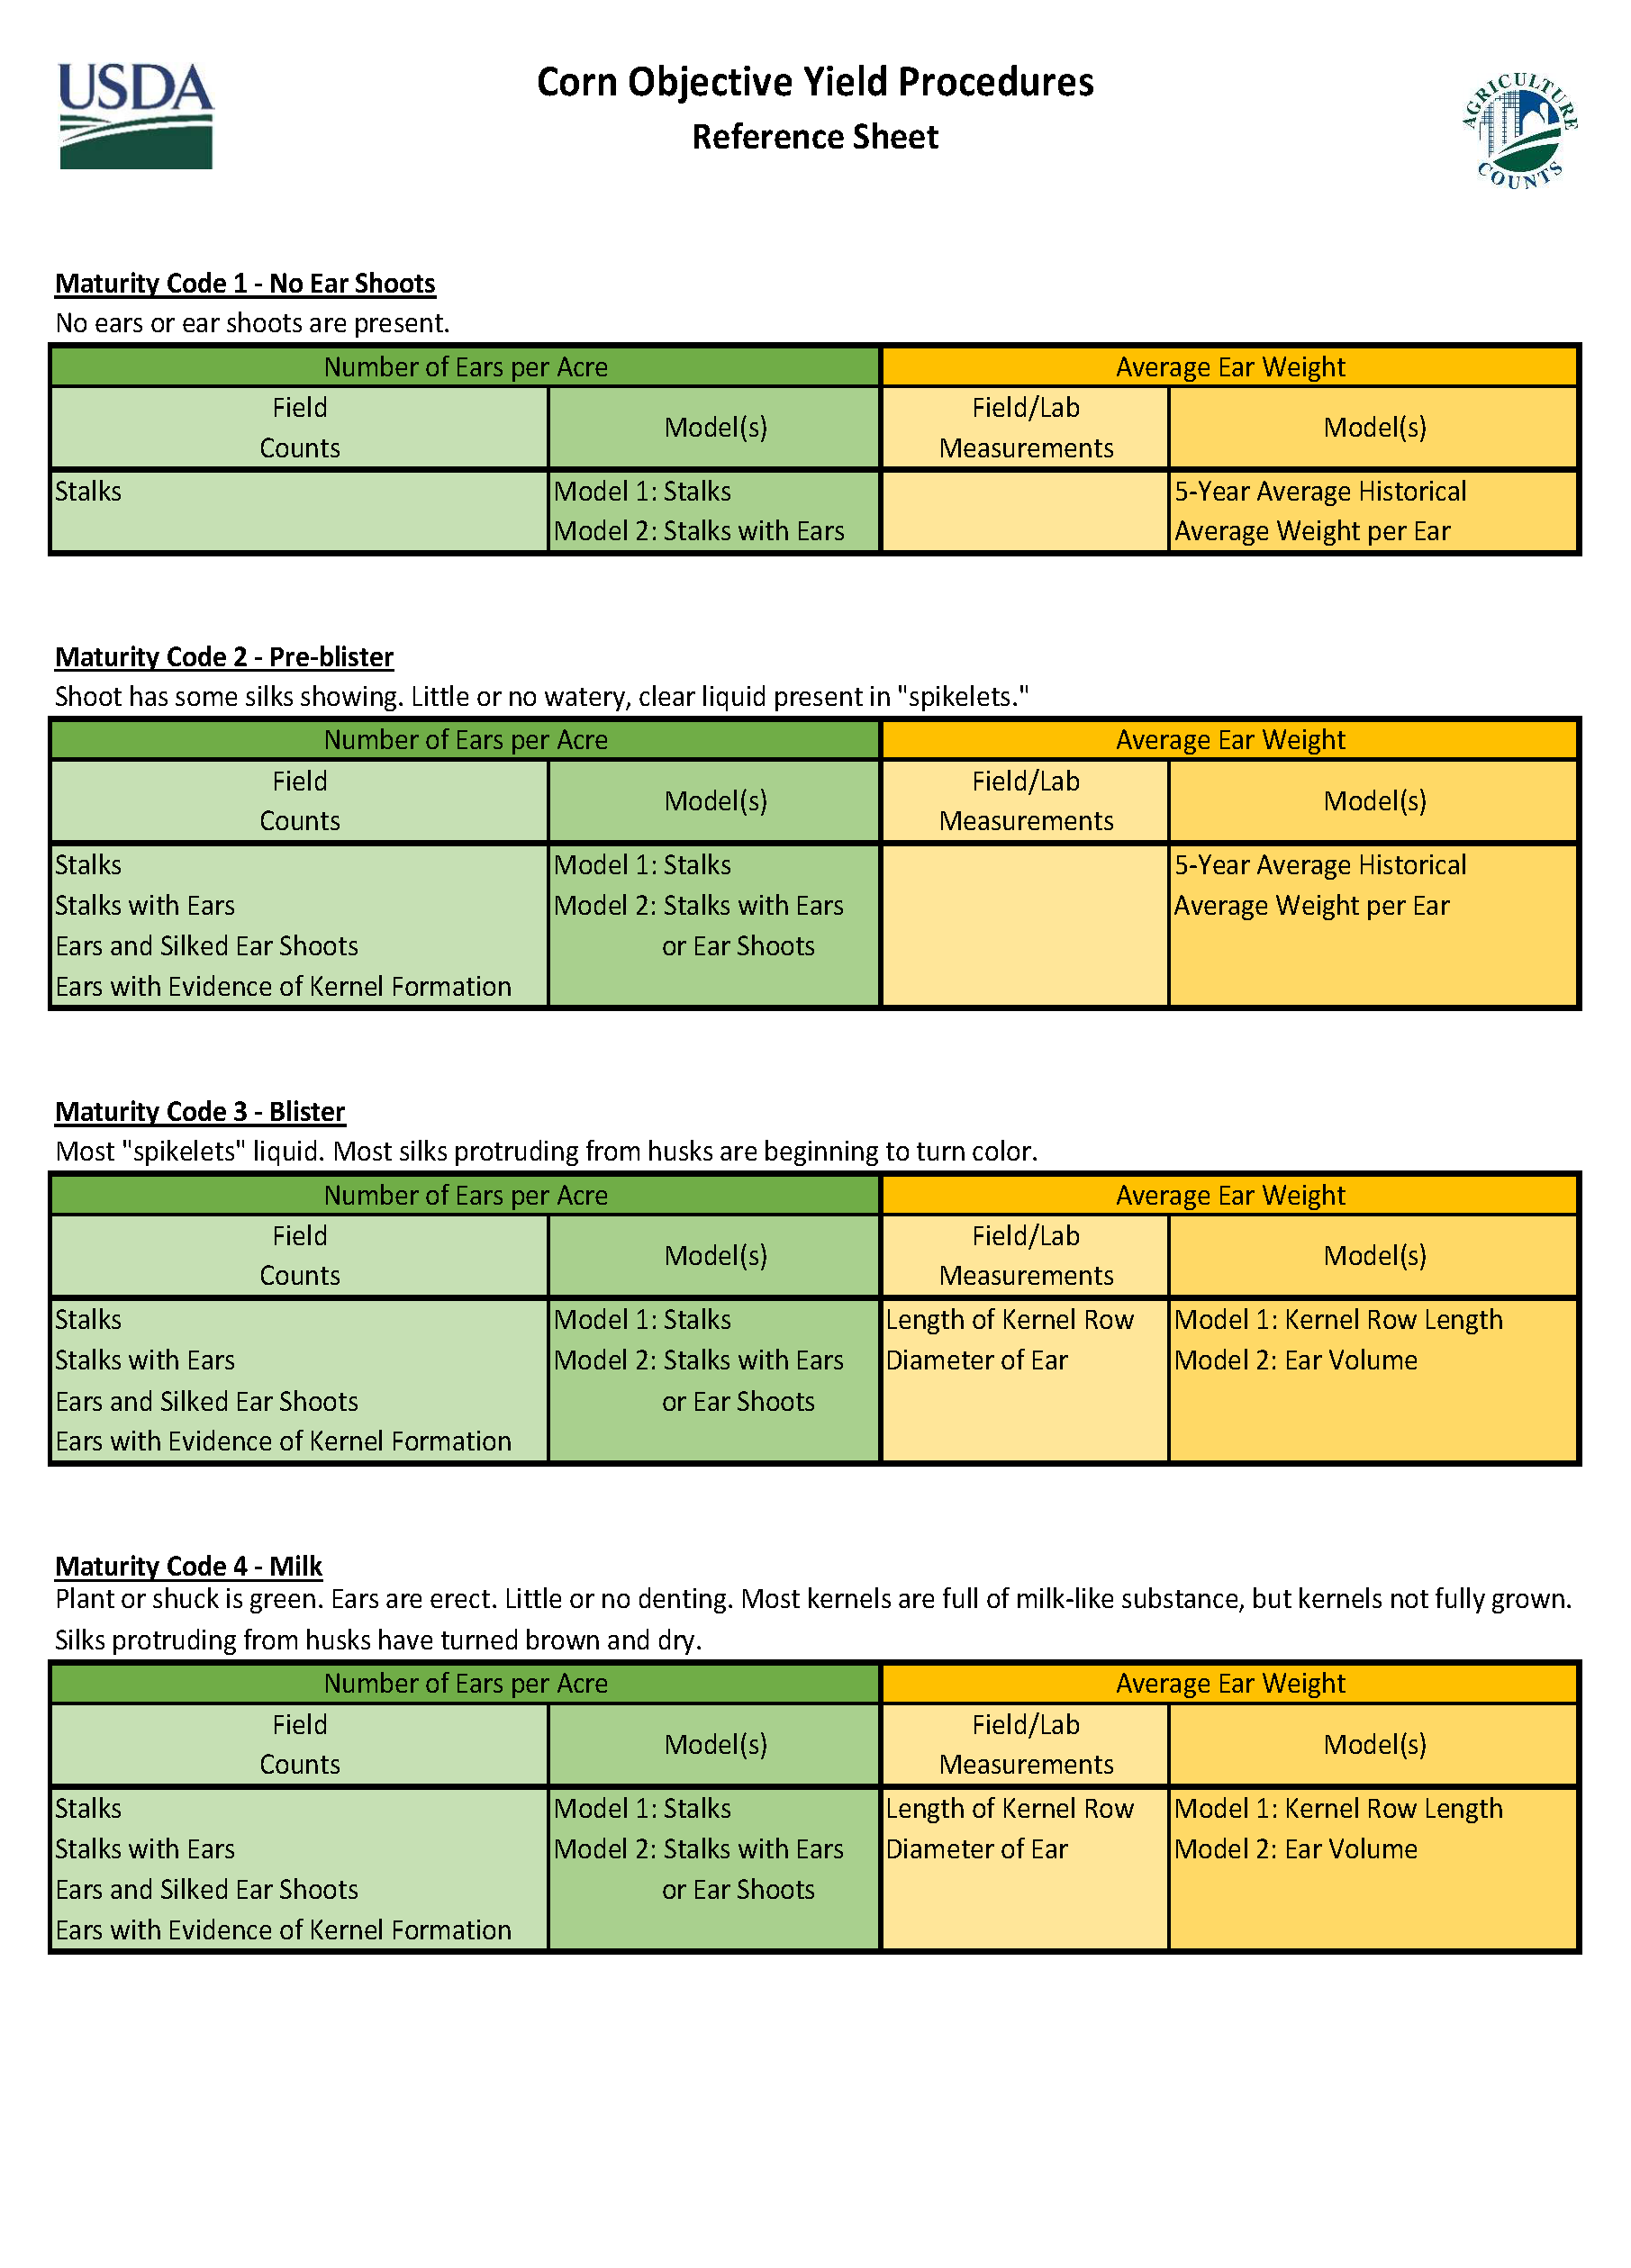
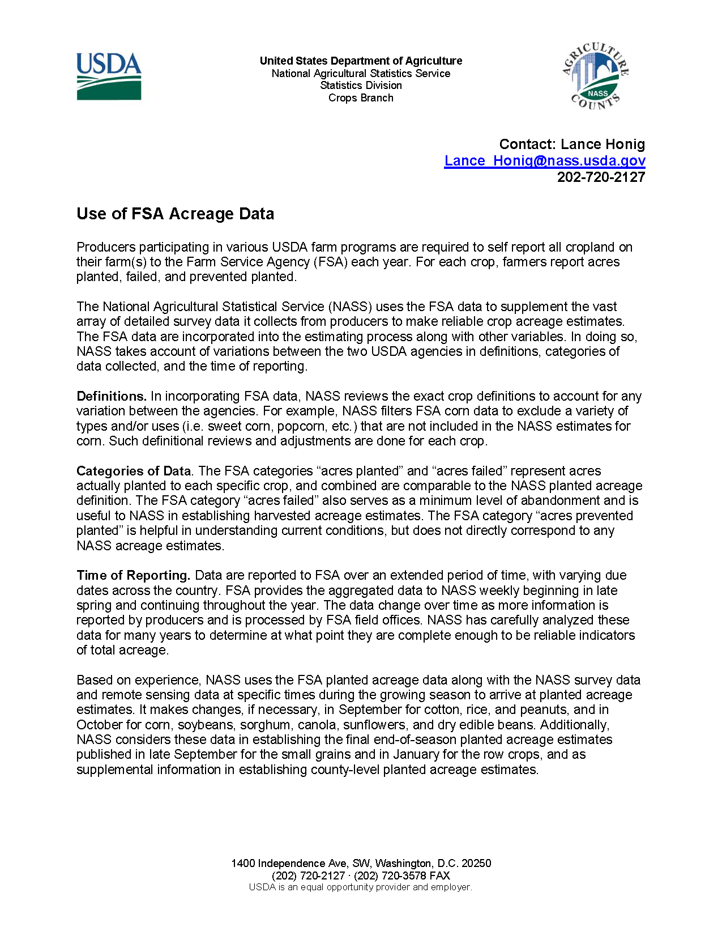
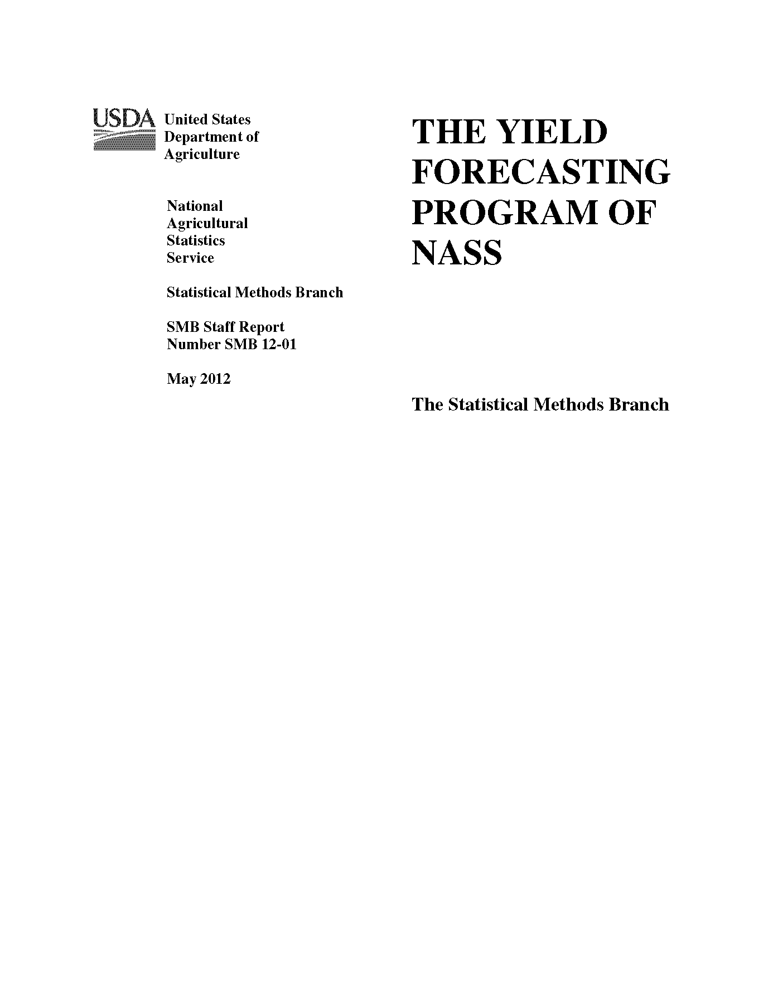
Communication and Documentation
Enhanced release time information and communication.
Both quick reference and in-depth documentation of procedures.
https://www.nass.usda.gov/Education_and_Outreach/Understanding_Statistics/index.php

Slide 24
Adjustments for Extreme Conditions
Excessive Rainfall
Delayed Plantings
Delayed Harvest
Drought
Rapid Development
Yield Reduction
Temperature Extremes
Rapid Development
Yield Implications
Delayed Development
Situations That Occur Somewhere Every Year
Procedures Already Account for Unusual Situations
Re-Surveys
(Recontact Producers)

Slide 25

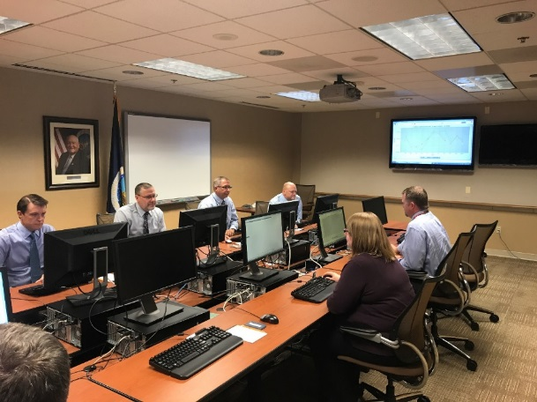
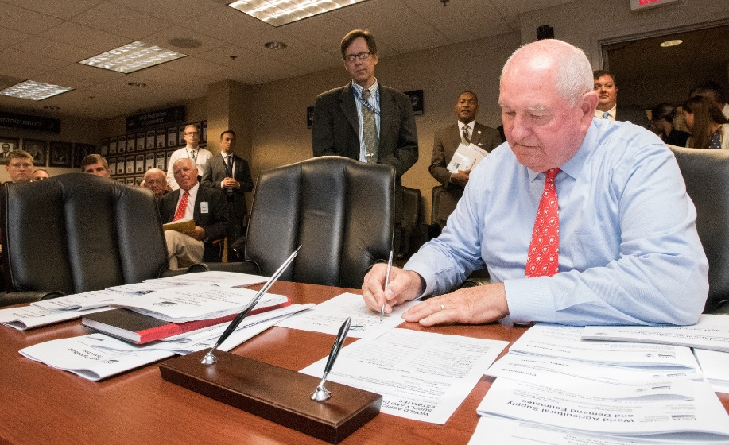
Opportunity To See The Process
Join Us for Lockup
Contact
nass@usda.gov
202.690.8141

Slide 26
All Reports Available At
www.nass.usda.gov
Executive Summaries Available At
www.nass.usda.gov/Newsroom/Executive_Briefings
Lance Honig
Crops Branch Chief
Lance.Honig@usda.gov

