Slide 1

The Changing Landscape of World Textile Trade
Julia K. Hughes, President
United States Fashion Industry Association (USFIA)
USDA Agricultural Outlook Forum
February 21, 2020

Slide 2

FASHION
MADE POSSIBLE BY
GLOBAL
TRADE

Slide 3
Our Work for the Industry
Communication
Education
Advocacy

Slide 4
USFIA Members & Affiliates include…
Brands, retailers, importers, and wholesalers of apparel, textiles, footwear, accessories, travel goods, home products, and other fashion products
Service providers, including customs brokers, freight forwarders, law firms, logistics providers, steamship lines, and testing and certification companies
Manufacturers and suppliers of finished products and inputs
Supplier associations, business councils, and promotional groups and agencies
Academic institutions

Slide 5
What does USFIA do?
Provides advocacy leadership and access to policymakers around the world whose decisions impact fashion businesses
Seminars, conferences, and training sessions to help companies and employees do business more efficiently
Exclusive, members-only publications on the latest trade and customs news
Opportunities to meet industry leaders, peers, and potential business leads
Strong network of industry experts across the supply chain to provide guidance on every aspect of fashion companies’ work
Certified Importer Organization to the Cotton Board

Slide 6
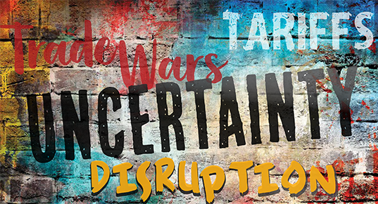
Today’s Trade Outlook

Slide 7

Planning for Disruption and Uncertainty

Slide 8
Sourcing Landscape
WHERE ARE WE TODAY?
CHINA
TARIFFS
USMCA
MORE ENFORCEMENT
NEW TRADE TALKS

Slide 9
Trump Administration Trade Agenda
2019 Trade Policy Agenda
Inheriting a deeply flawed global trading system
Making U.S. trade policy work better for American workers
Pursuing new trade deals and stronger enforcement to continue rebalancing America’s trade relationships

Slide 10
In three years, President Trump has…
Withdrawn from the Trans-Pacific Partnership (TPP)
Renegotiated U.S.-Korea Free Trade Agreement and signed trade deal with Japan
Renegotiated NAFTA (now called USMCA)
Imposed new 232 penalty tariffs on imports of steel and aluminum
Imposed new 301 penalty tariffs on imports from China
  Targets forced technology transfers & IPR violations
Imposed new 301 penalty tariffs on imports from the EU

Slide 11
U.S. Section 301 tariff measures on Chinese products
 | Affected Products | Effective Date | Tariff Rate | Process
List 1 | Products that generally fall into the technology sector and cut across the aerospace, information and communications technology, robotics, industrial machinery, and automotive industries (818 Tariff lines) | July 6, 2018 | 25% on $34 billion annual trade value | Some exclusions approved.
List 2 | Products principally identified under China’s “Made in China 2025” policy (279 tariff lines) | August 23, 2018 | 25% on $16 billion annual trade value | Some exclusions approved.
List 3 | Many products including consumer items such as headwear, leather, apparel, handbags, luggage, gloves, and furniture. (6031 Tariff lines) | September 24, 2018 | 10% immediately on $200 billion annual trade value. Increased to 25% on May 10, 2019. | Some exclusions approved.
List 4 | Essentially all products not already subject to Section 301 additional tariffs. Products include all apparel, footwear, and manufactured textile products. (3805 Tariff lines) | List 4A September 1, 2019 List 4B December 15, 2019 | Original 15% on List 4A was reduced to 7.5% on February 14, 2020. List 4B tariffs did not go into effect. | Exclusion process ended January 31, 2020.

Slide 12
Higher Tariffs
As of February 19th, the U.S. collected more than $56.6 billion in additional tariffs
$1.4 billion in Section 201 tariffs.
$1.9 billion in Section 232 aluminum tariffs.
$6.7 billion in Section 232 steel tariffs.
$46.4 billion in Section 301 tariffs on goods from China.
$284 million in Section 301 tariffs on goods from the EU.

Slide 13
Trade Policy Uncertainty
Acting chairman of the White House Council of Economic Advisers says
“Uncertainty about trade policy is one often-cited culprit in the manufacturing slowdown, particularly uncertainty surrounding the Administration’s negotiations toward a bilateral trade agreement with the People’s Republic of China on enforceable commitments to remove or lower structural barriers in China”

Slide 14
Trade Policy Uncertainty
From The Economic Report of the President
“Negotiations over a new agreement necessitate a degree of uncertainty over how that agreement will be shaped, exacerbating near-term costs. However, achieving a new trade relationship with China that is balanced and reciprocal will deliver long-term economic benefits for the United States, including a reduction in near-term costs”

Slide 15
Trade Policy Uncertainty
TRADE ACTIONS MOVE QUICKLY
Federal Register notices and hearings remain important
But … major trade decisions are announced on Twitter

Slide 16
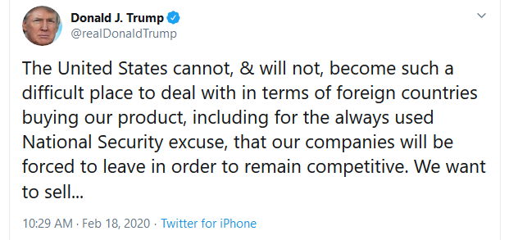
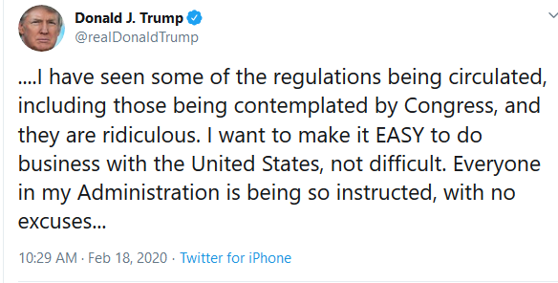
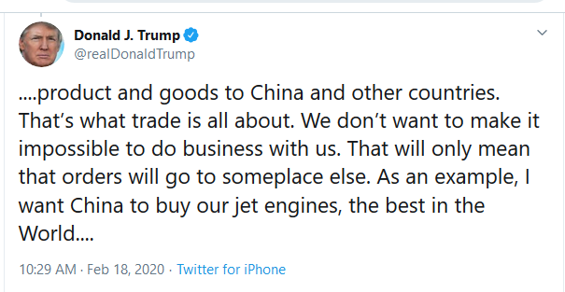
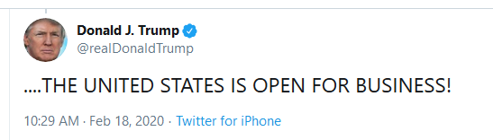

Slide 17
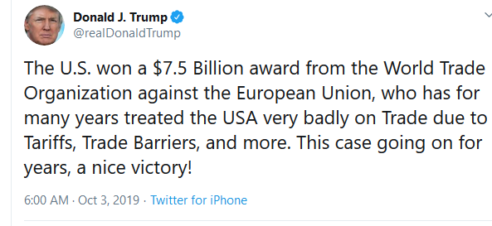
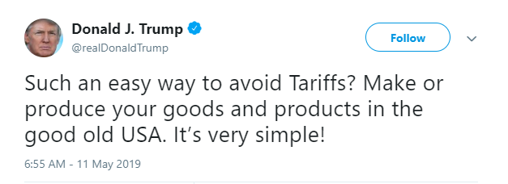

Slide 18
U.S-Mexico-Canada Agreement
NAFTA 2.0
Top trade priority for Trump Administration passed Congress with bipartisan support
Waiting for Canada to approve the deal and expect implementation no later than January 1, 2021

Slide 19
Tariff Threats
Biggest shock to apparel brands was the use of emergency powers to threaten new tariffs on imports from Mexico -- a Free Trade Agreement partner
June 10 – 5%
July 1 – 10%
August 1 – 15%
September 1 – 20%
October 1 – 25%

Slide 20
Tariff Threats Today
USTR is using GSP – program in place since 1974 giving duty-free access to some products made in developing countries – to take action against countries that are “unfair”
Turkey lost GSP on May 16
India lost GSP on June 5

Slide 21
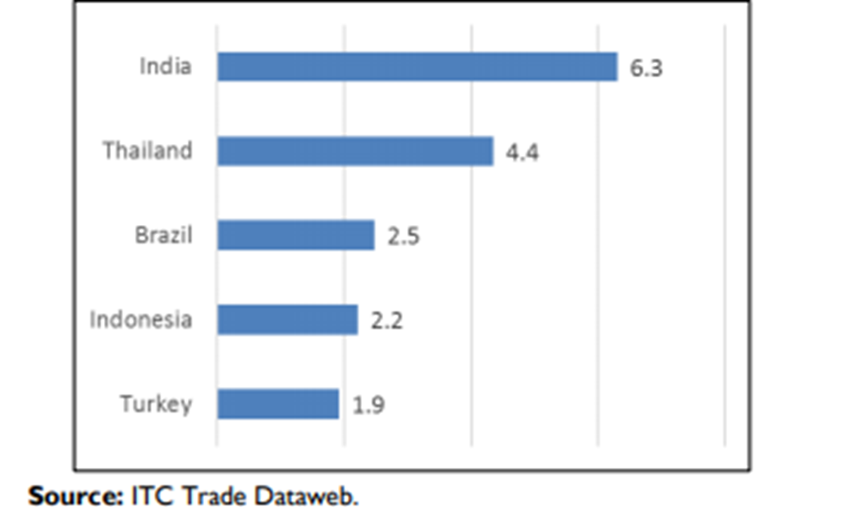
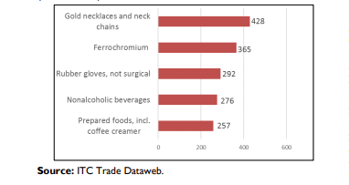
Top 5 GSP Imports, 2018
($ in millions)
Generalized System of Preferences (GSP)
Top 5 GSP Beneficiaries, 2018
($ in billions)

Slide 22
Strategies for Fashion Brands and Retailers to Minimize the Impact of Trade Uncertainty

Slide 23
Strategies for Brands and Retailers
Sourcing Diversification
Product Exclusions
Technical Options
  Classification
  Valuation
  Low-Value Shipments (E-Commerce Direct to Consumer)

Slide 24
What Fashion Products Are Affected?
25% tariffs on List 3
Boxes, for packing of goods, of plastic (3923.10.90)
Bags, for packing of goods, of plastic (3923.29.00)
Plastic rainwear valued under $10 (3926.20.60)
Patent leather (4114.20.30)
Leather Handbags (4202.21.90)
Leather Apparel (4203.10.40)
Leather Gloves (4203.29)
Wool Yarn (5106.10.00)
Cotton (5201)
Hats and headgear (6504)

Slide 25
What Fashion Products Are Affected?
7.5% Tariffs on List 4A
Chapter 61 – Knit Apparel
Chapter 62 – Woven Apparel
Chapter 63 – Home Textiles
Chapter 64 – Footwear
Plus wood, plastic, electronics

Slide 26
Sourcing Trends

Slide 27
Trend #1:
China remains the top supplier… but imports are falling
-2% decrease in 2019
China is the dominant supplier to the United States in most categories:
  39% of apparel
  29% of fabrics
  67% of made-ups
  16% of yarns (ranks 2nd to Korea)

Slide 29
Trend #2:
Top Asian apparel suppliers continue to profit from the pressure on China
Vietnam – ranks 2nd with 14% market share
Bangladesh – ranks 3rd with 7% market share
Indonesia – ranks 4th with 4% market share
India – ranks 5th with 4% market share
Cambodia -- ranks 6th with 3.7% market share

Slide 30
Trend #3:
Costs are rising from Asian suppliers
Unit value of apparel imports from key Asian suppliers
China – fell from $2.35 in 2018 to $2.25
Vietnam – rose from $3.28 to $3.43
Bangladesh – rose from $2.79 to $4.03
Cambodia – rose from $2.39 to $2.57

Slide 31
Trend #4:
Duty-free options dominate the hot new apparel suppliers
The fastest growing suppliers in 2019:
  #12 Haiti – up 13%
  #15 Jordan – up 29%
  #17 Egypt – up 11%
  #21 Turkey – up 17%
  #22 Ethiopia – up 79%
  #23 Myanmar – up 36%

Slide 32
What do fashion brands and retailers think?
Perspectives from USFIA’s 2019 Fashion Industry Benchmarking Study

Slide 33
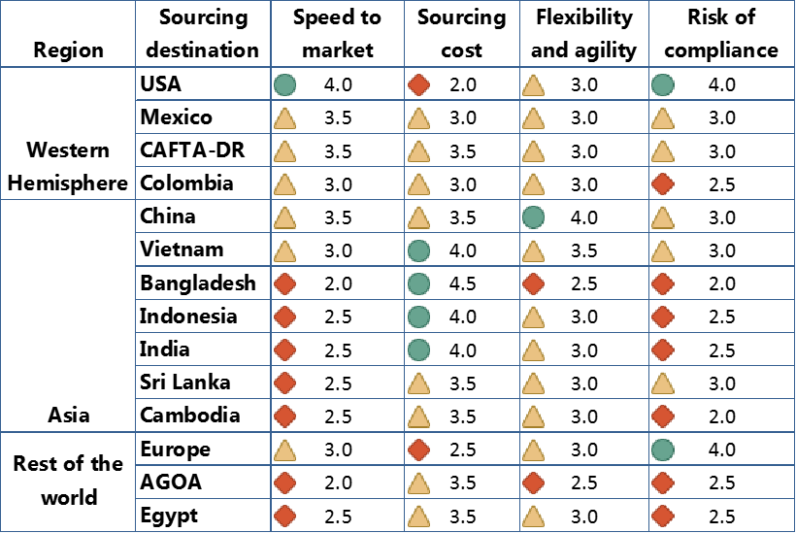
How Execs Rank Sourcing
Strength
Average
Weakness
Most balanced:
China
Vietnam
Mexico
CAFTA-DR

Slide 34



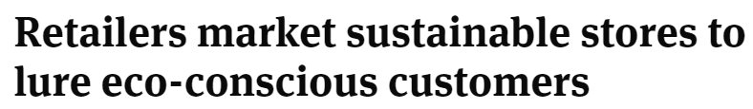




Sustainability in the Retail Industry
More Consumers Want Sustainable Fashion, But Are Brands Delivering It?
From the Rooftops, Big Box Stores Are Embracing Solar
Holiday 2019 Expected to Usher in the Era of ‘Responsible Retail’
Why Sustainability Should Be Top of Mind for Retailers This Holiday Season

Slide 35
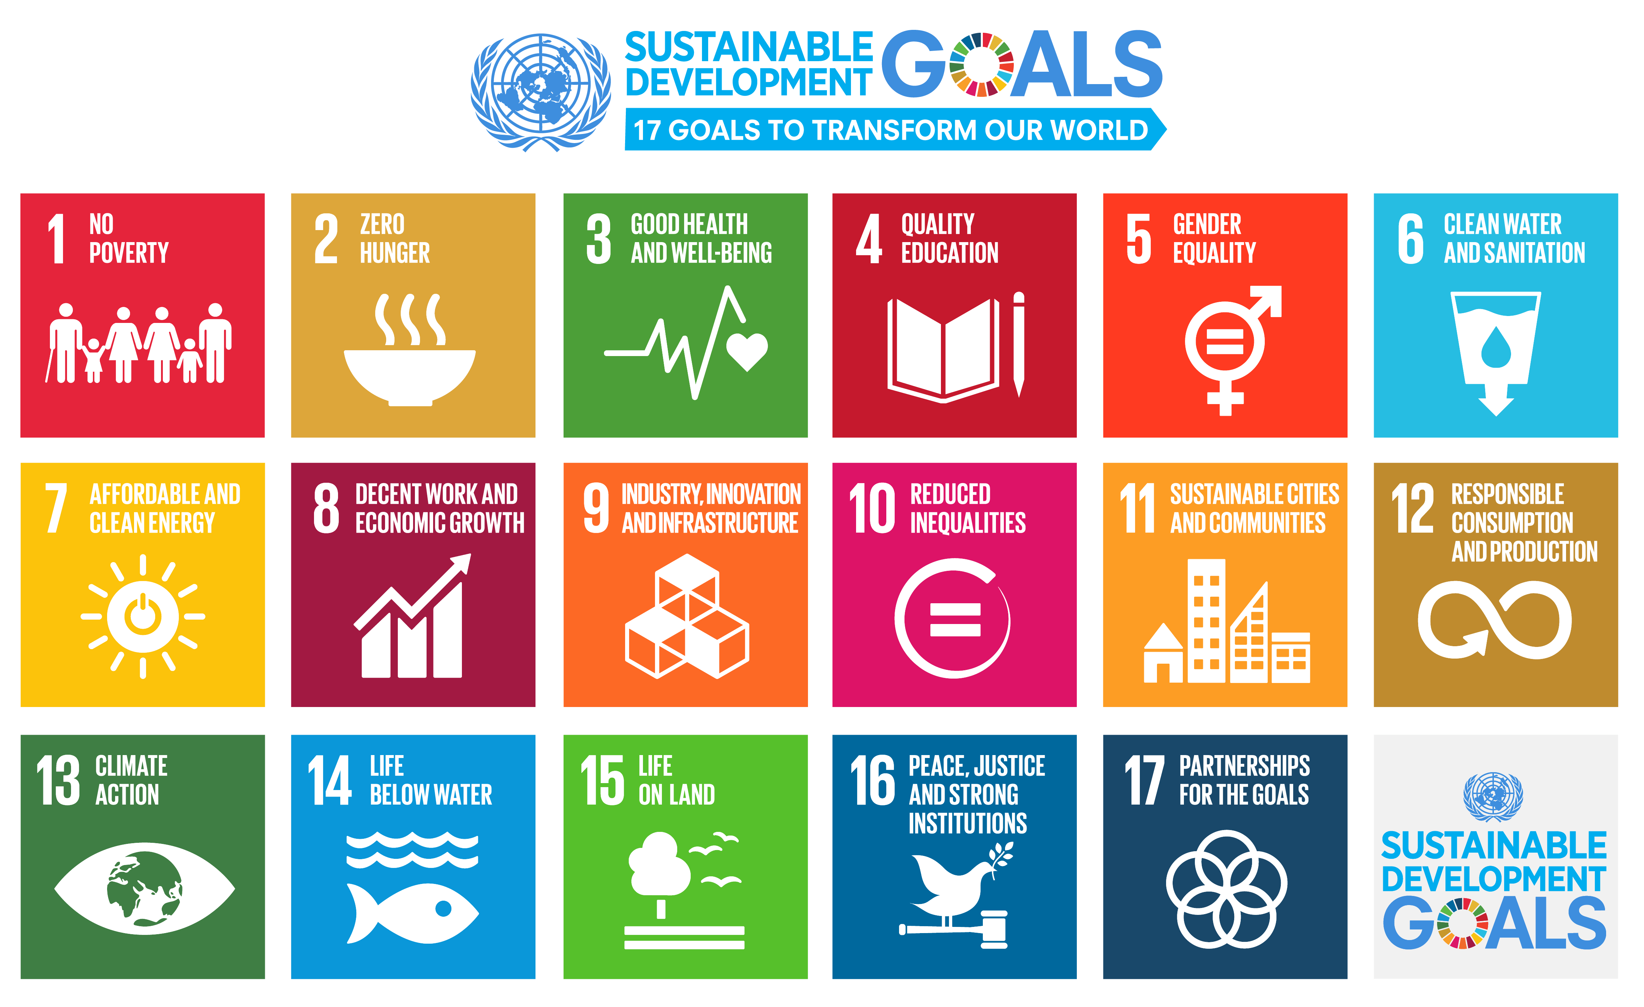

Slide 36
Relevant SDGs for Apparel, Footwear & Retail
SDG 3: Health exposure risks in production environments
SDG 5: Predominantly female workforces throughout much of the supply chain
SDG 6: Water intensive processes in washing, dying; Consumer use
SDG 8: Complex, global supply chains with vulnerable workers exposed to exploitation
SDGs 7 & 13: GHG emissions of data centers, transport, production & use
SDG 12: Raw material extraction and end of life

Slide 37

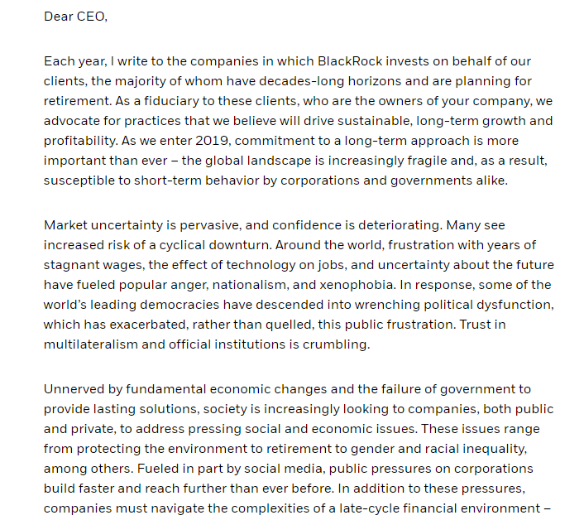
ESG Reporting
LARRY FINK’S 2019 LETTER TO CEOS
PURPOSE & PROFIT
Environmental, social and governance (ESG) reporting is now considered a mainstream priority as investors and regulators are seeking more and better disclosure from companies.
Measures how companies:
  Manage their supply chain
  Respond to climate change
  Contribute to charitable organizations
  Treat their workers
  Manage the composition and processes of their Boards
The following large investors have issued guidance or inquired about ESG matters:
  Blackrock
  Vanguard
  Fidelity
  State Street

Slide 38
Top Sourcing Concerns in 2019 vs Today
In 2019:
Increasing production or sourcing cost
Managing supply chain risks
Protectionist trade policy agenda in the U.S.
Today:
Trade restrictions and disruption to business operations – 100%
Tied for #2 with 75%
Managing supply chain risks
Impact of the Coronavirus

Slide 39
What’s on the horizon?
Key issues for textile and apparel companies
  Global uncertainty from tariffs to BREXIT to Covid-19
  Industry upheaval from corporate bankruptcies and restructuring and store closures
  Shifts in consumer demand affecting apparel and footwear
  Sustainability initiatives and more c-suite engagement

Slide 40
Thank you!
For additional information:
Email: info@usfashionindustry.com
Twitter: @usfashion
Phone: +1-202-419-0444

