Slide 1


2022 USDA Ag Outlook Forum
Sugar Outlook
Moderated by: Vidalina Abadam
USDA, Economic Research Service
February 25, 2022
Notes:
Good morning, everyone. Welcome to the sugar outlook session. It is so nice to see new and familiar faces alike.
My name is Vidalina Abadam. I’m the sugar and sweeteners senior analyst at ERS and a member of the sugar interagency committee. I’ve been at this position since October 2021 and before that, I’ve met many of you when I was working with Barb and Kent on the sugar program management side of things.

Slide 2

2022/23 Sugar outlook available at: https://www.usda.gov/sites/default/files/documents/2022AOF-sugar-outlook.pdf
Sugar ICEC:
  WAOB and Chair: Steve Haley
  FPAC: Barb Fecso, Kent Lanclos, Fran Hentz
  FAS: Joe Wereszynski, Souleymane Diaby, Bill Janis
  ERS: Vidalina Abadam
Sugar Luncheon Session will follow immediately at 11 am.

Slide 3
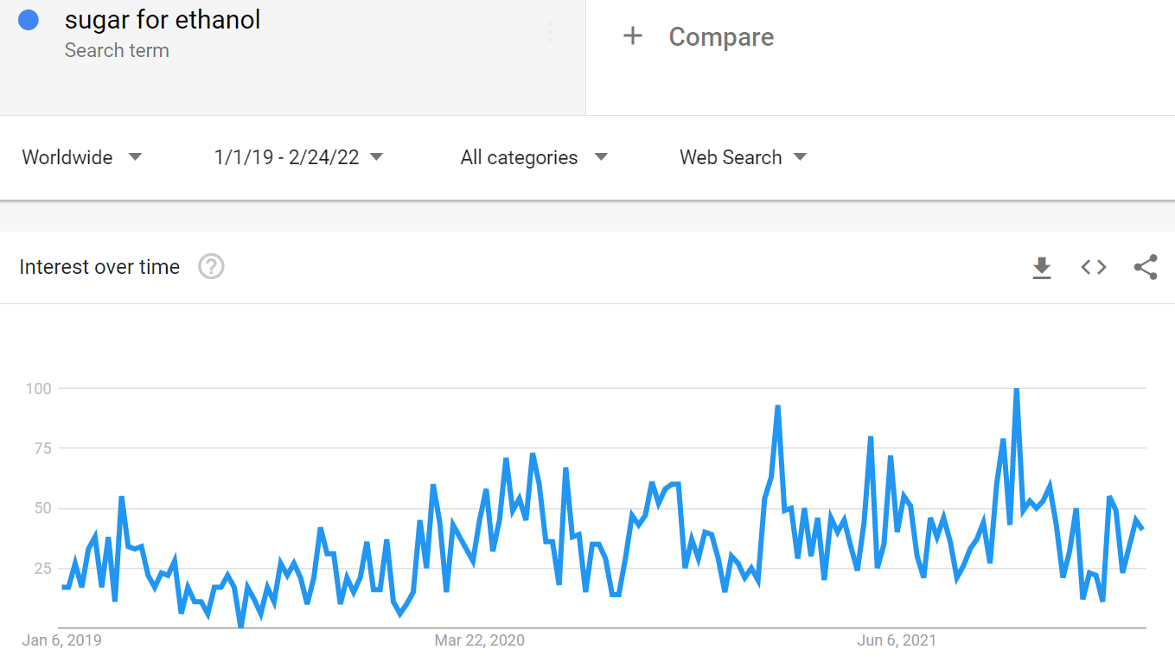
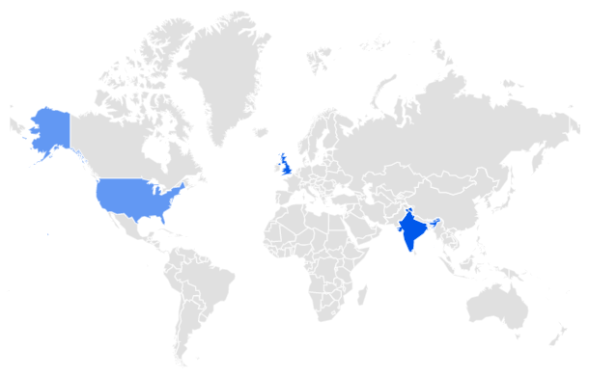
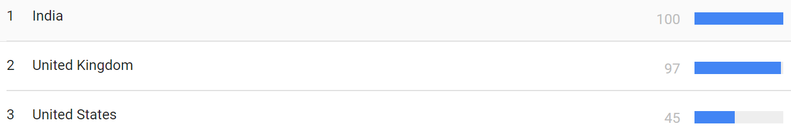
Source: Google Trends

Slide 4
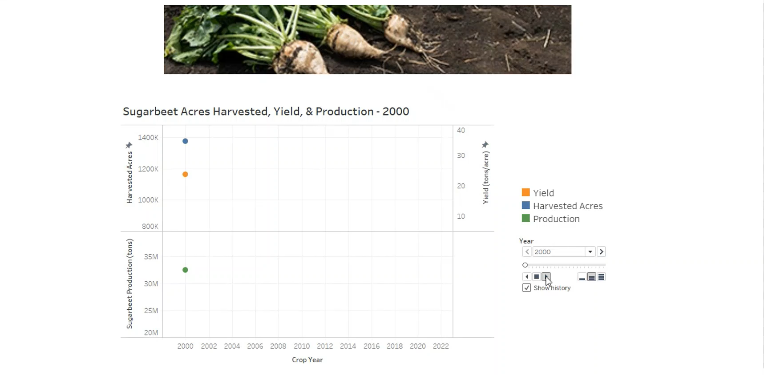

Slide 5




Like, Share, & Follow ERS
Thank you!
Vidalina Abadam
vidalina.abadam@usda.gov
www.ers.usda.gov
www.ers.usda.gov/data-products/charts-of-note
@USDA_ERS
linkedin.com/company/usda-economic-research-service
Subscribe For Weekly E-mail Notifications: www.ers.usda.gov/subscribe
Job Info: http://ers.usda.gov/about-ers/careers-at-ers
Notes:
Before I close, I’d like to note a few ways you can stay up-to-date with ERS research.
On social media, you can find us on Twitter (@USDA_ERS) and LinkedIn (USDA Economic Research Service).
You can also visit our website – www.ERS.USDA.gov – to find full copies of our reports or subscribe to specific products of interest.
Our multimedia page includes a variety of webinars, podcasts and videos as well.
Here in the next few months, be on the lookout for a new Webinar Data Series, which will highlight the ins and outs of our most popular data products.
I’d also like to give a shoutout to our new Charts of Note Mobile App – coming soon to Google Android & Apple app stores in the next few months.
Once available, this app – free of cost -- will deliver the latest ERS research straight to your mobile device. With this app, you can easily search ERS’s full library of charts, mark your favorites and share them on social media.
Remember to keep ERS in mind in your future pursuits – whether as a helpful resource or potential career path. We’re always seeking the best and the brightest minds to advance our research.
For a list of current ERS openings, visit our career webpage listed at the bottom of this slide.

