Slide 1
Global Freight Market &
Supply Chain Challenges
Walter Lanza
Notes:
Two people in this room: ones that are having supply chain issues and ones that are lying

Slide 2
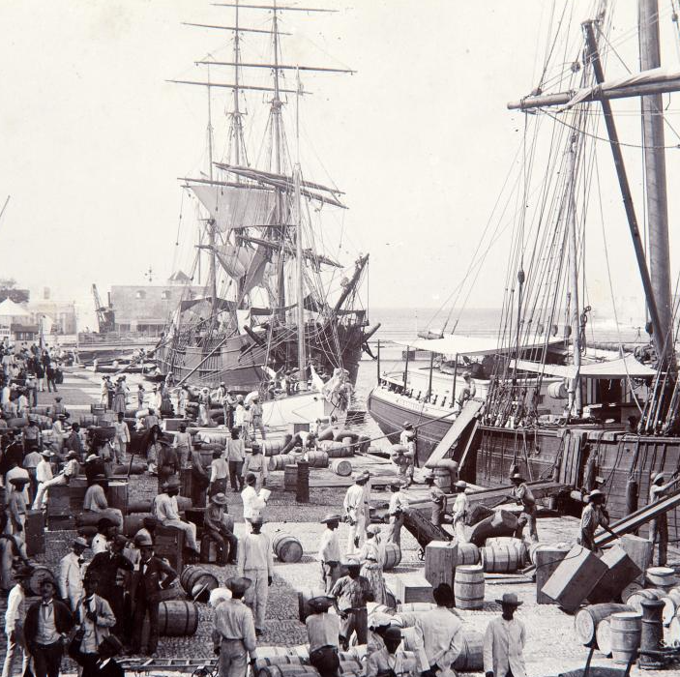

Shipping Before Containers
Using ships to move good was hugely complicated before 1950s
Loaded piece-by-piece
1956
Malcom McLean designed the first model of today’s containers
58 metal boxes on a ship going from New Jersey to Houston
Revolutionize the industry

Slide 3
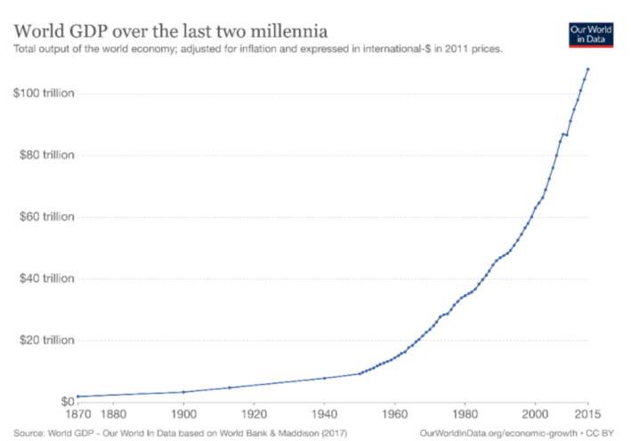
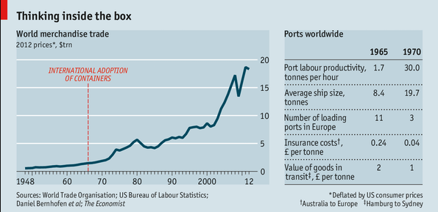
The Container Revolution
Notes:
The integration of national economies into a global economic system has been one of the most important developments of the last century. This process of integration, often called Globalization, has materialized in a remarkable growth in trade between countries.
The chart here shows the value of world exports over the period 1800-2014. These estimates are in constant prices (i.e. have been adjusted to account for inflation) and are indexed at 1913 values.
This chart shows an extraordinary growth in international trade over the last couple of centuries: Exports today are more than 40 times larger than in 1913.

Slide 4
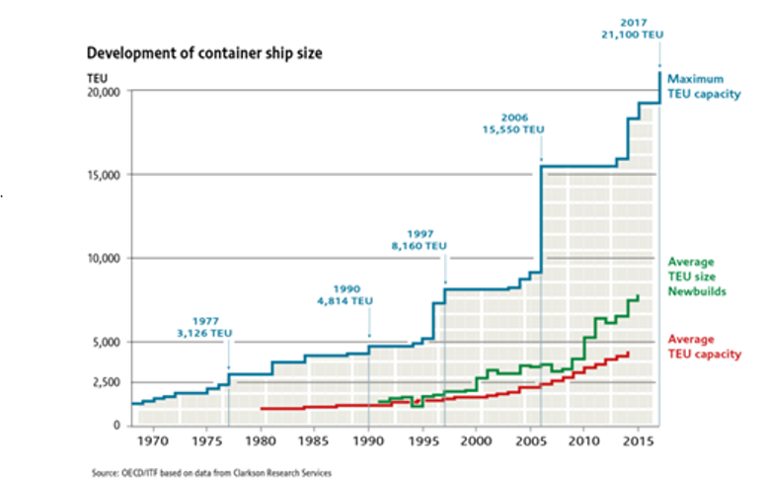

Big Ships Getting Bigger
Notes:
This new economic geography allowed firms whose ambitions had been purely domestic to become international companies. Those who had no wish to go international, who sought only to serve thri local clientele, learned that they had no choice: they were competing globally. In 1956, the world was full of small manufacturers selling locally. By the end of the century,

Slide 5
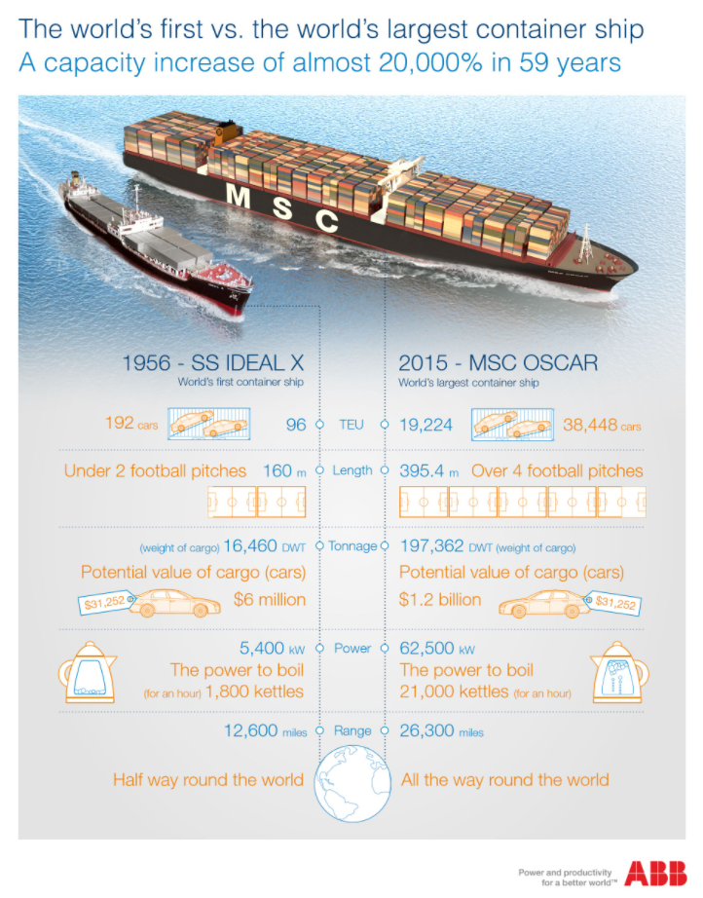
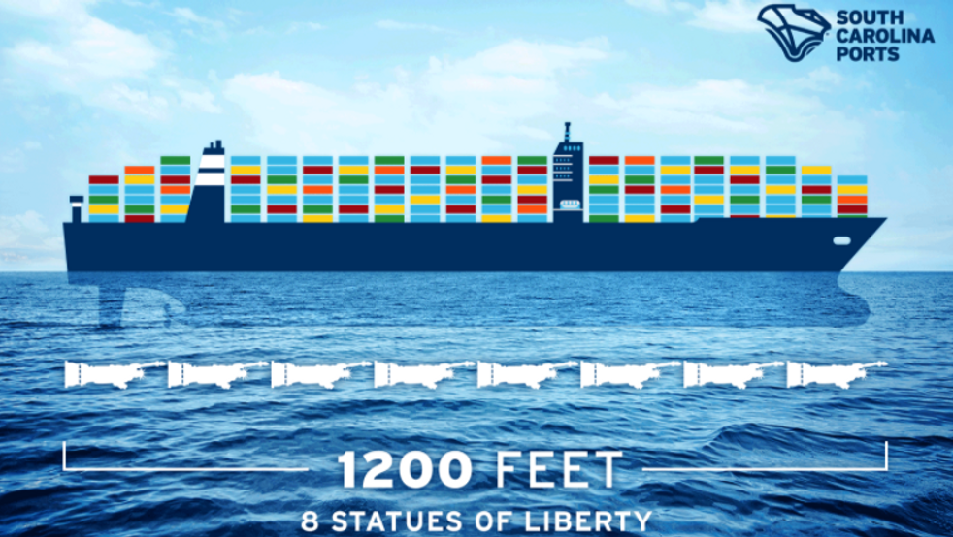
Notes:
Containers brough sweeping reduction on costs. Containers matured into a highly automate, highly standardized industry on a global scale.

Slide 6
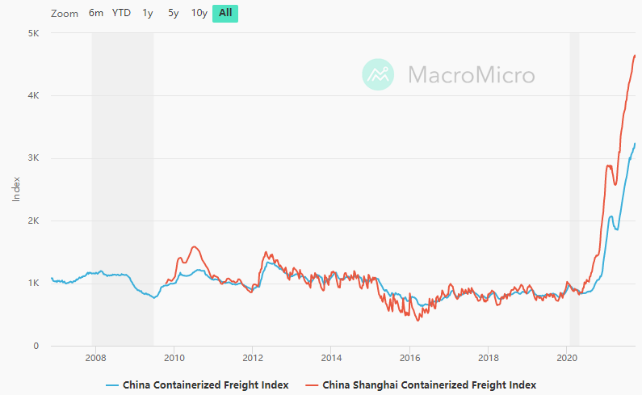
Freight Rates unchanged in the last 10+ years
Notes:
With freight being more efficient, and ships bigger, we’ve seen rates relatively steady, to slightly weaker, in the past 15 years

Slide 7
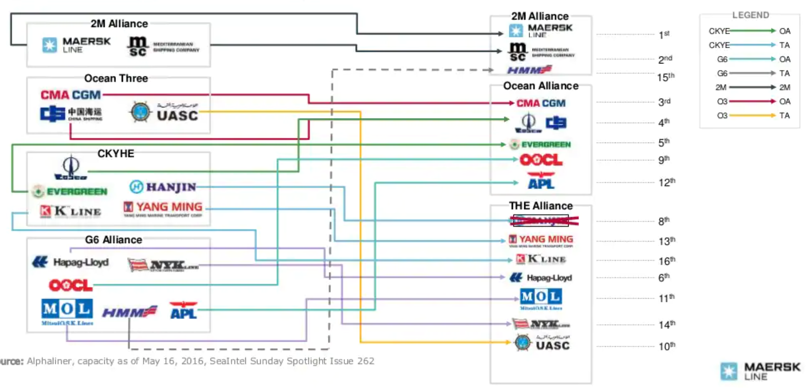
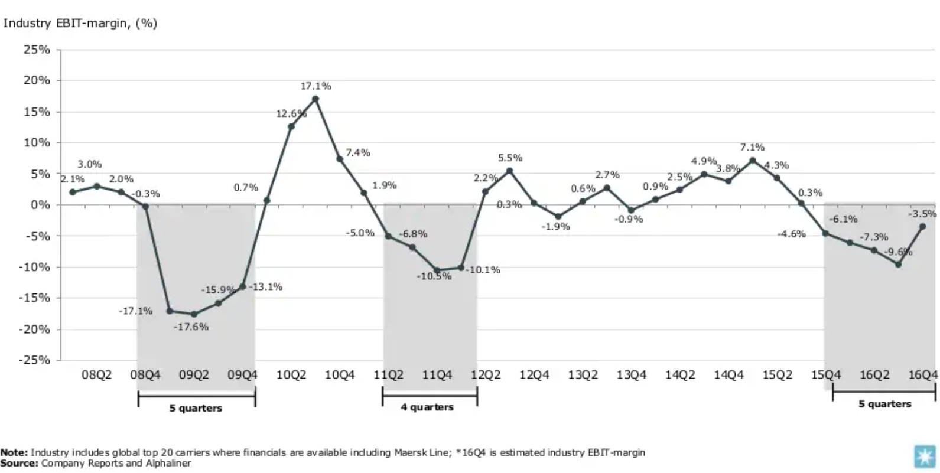
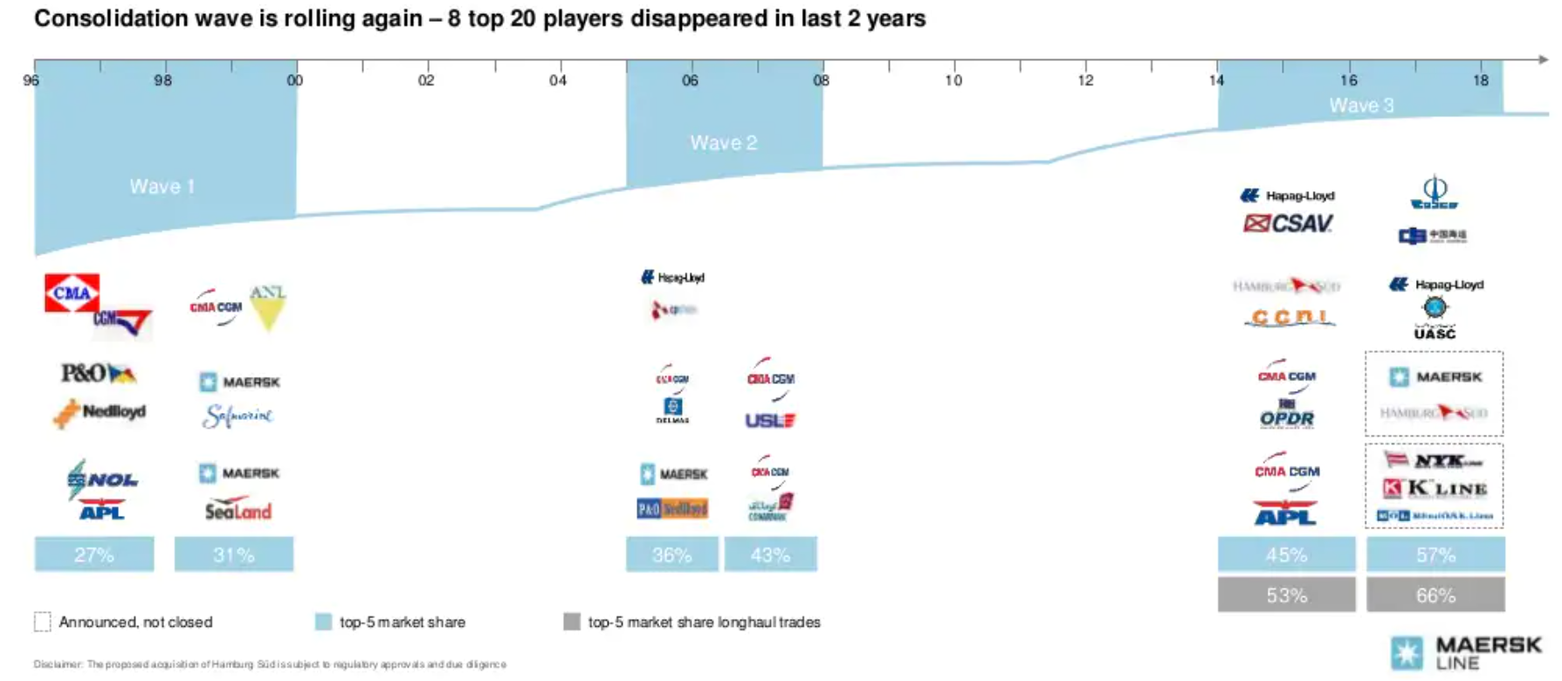
Lack of sustainable profit level has triggered acceleration in industry consolidation
Notes:
Due t

Slide 8
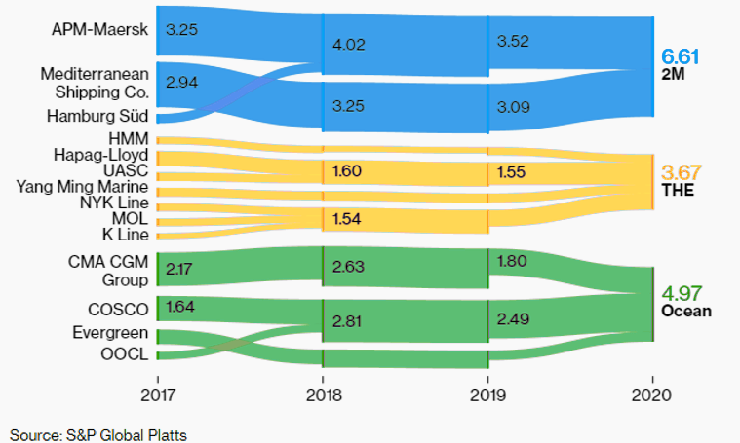
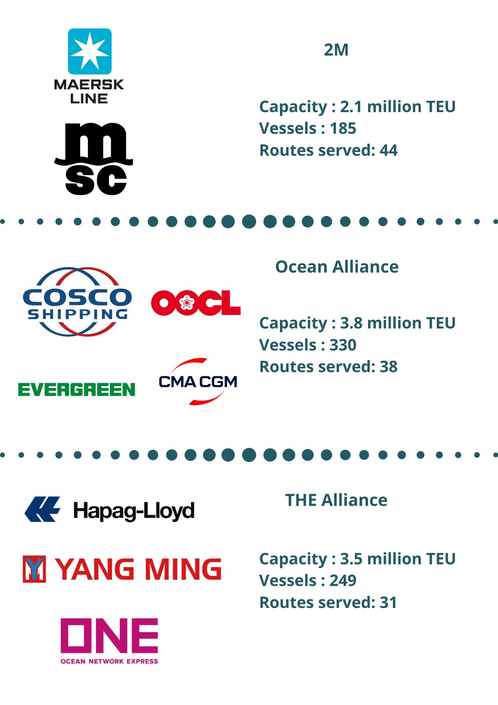

Big Three of the Seas

Slide 9
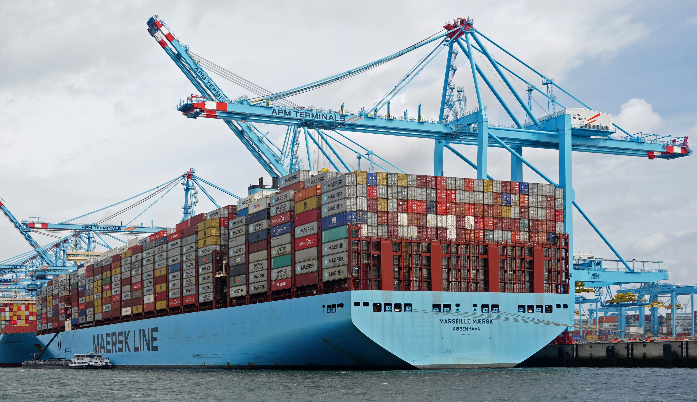

Pre-covid container situation
January 2020
Container ships idled 13% of their capacity
Approximately 3 million container
250 schedule sailing cancelled Q2
Vessels less than “half full”

Slide 10
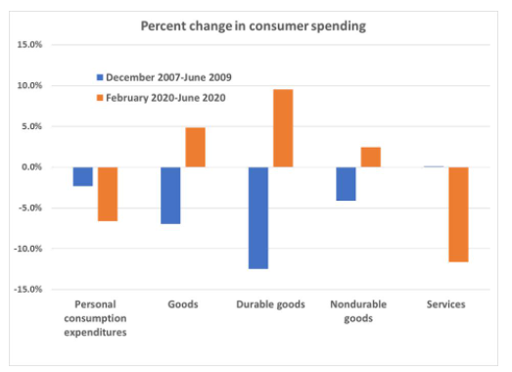
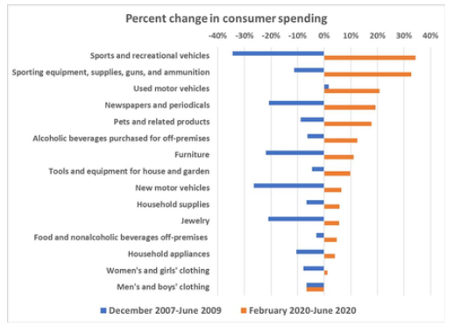
Consumer Spending – Before & After Covid
Notes:
However, something interesting happened in 2020 vs in 2008 with the 2008 great recession. In 2008, as you can see the comparison of consumer spending change, before and after the recession, in blue, everything dropped after, as expected. However, last year was very different. The service industry had a big drop, since restaurants, and hotels were closed (although there was a jump in food delivery). But what is remarkable is how the spending on durable goods. This one was unique, because although the unemployment numbers went up very fast, the government stimulus check kept the spending. But now, instead of spending on restarants or travel, they were spending on new TVs, refrigerators, getting a pet for company or buying a car.

Slide 11
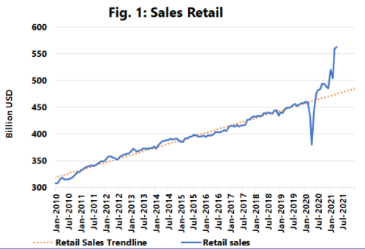
Strong Sales and
No Inventory
Notes:
We can see a drop around March for sales retails, except toilet papers, but it was fast recovered in July already and continue to be strong. It was so strong, that the inventories to sales ratio is at its lowest for the last 25 years. Rebuilding inventories to pre-pandemic levels would mean an increase of import volume. Target chartered its own container ship to sidestep the global shipping crisis ahead of holiday season, Costco, Home Depot is renting 3 container ships

Slide 12
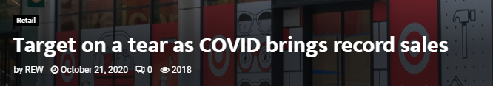
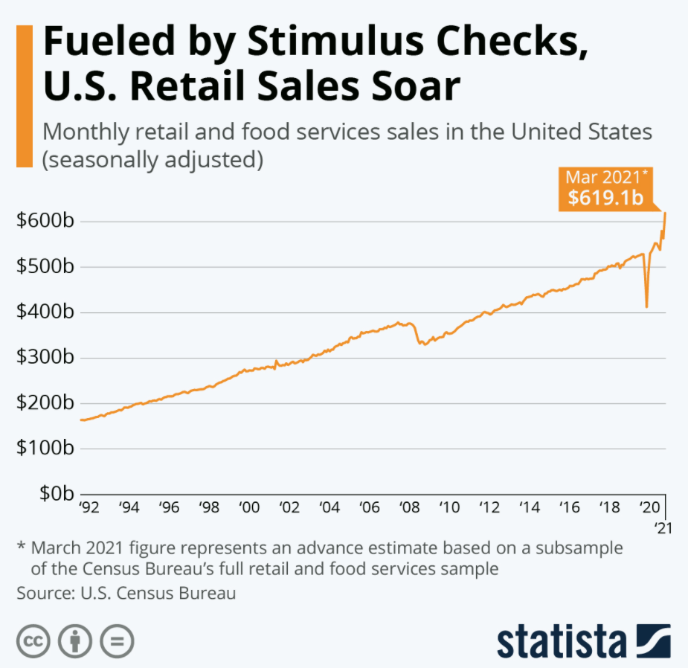
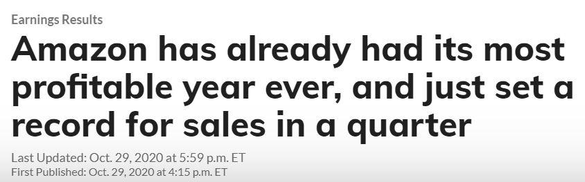
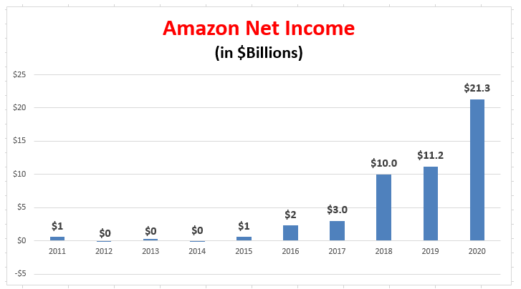
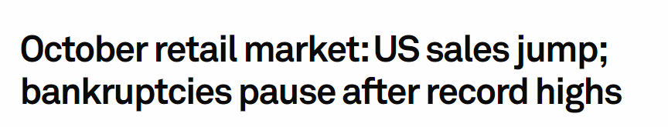
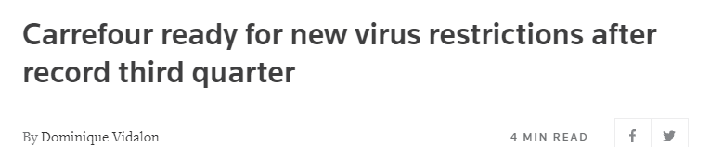

Slide 13
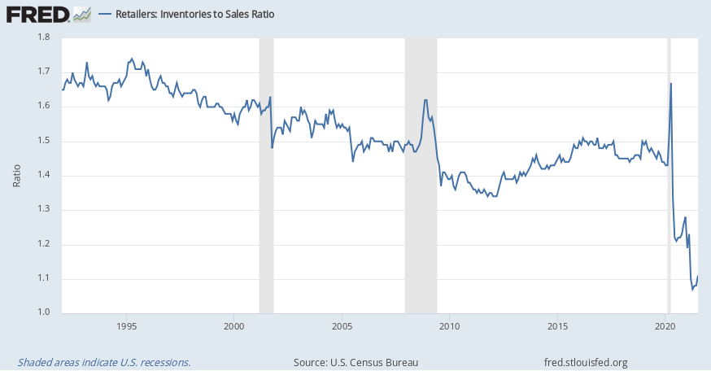
Lowest Inventories to Sales Ratio in 25+ Years
Target chartered its own container ship to sidestep the global shipping crisis ahead of holiday season
Costco is renting 3 container ships and 'several thousand containers' to shield itself from supply-chain delays and rising costs
Coca-Cola turns to bulk vessels normally used for grain and coal to transport manufacturing materials amid shipping crisis (October 2021)
Home Depot contracted its own container ship as a safeguard (June 2021)

Slide 14
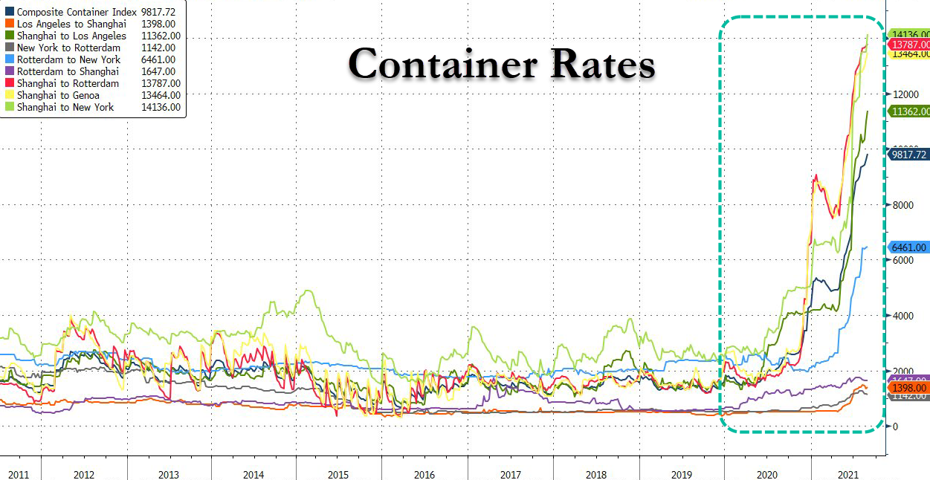
Notes:
Mention what happened to US exports

Slide 15
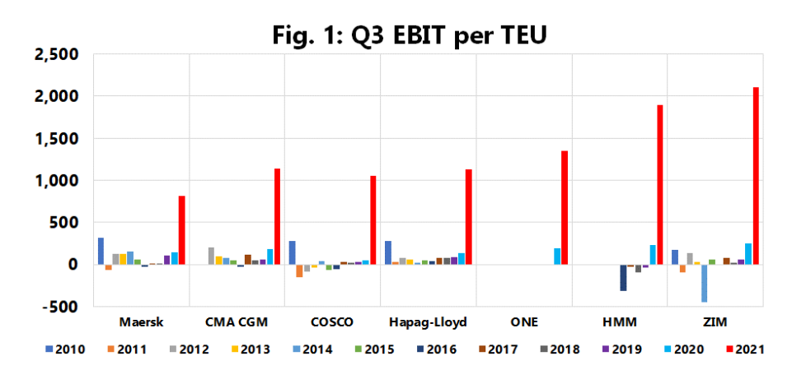
Record Profits
First time in 10 years: All major carriers recorded positive EBIT of more than $1 billion
From 2010-2020, only a positive earnings of more than $500 million
Combine 2021-1H EBIT: $42 bi
Combined EBIT Q3: $37 bi
Font: Sea-Intelligence
Notes:
For the first time, all carriers had $13.3 billion in operating profit in second half of 2020

Slide 16
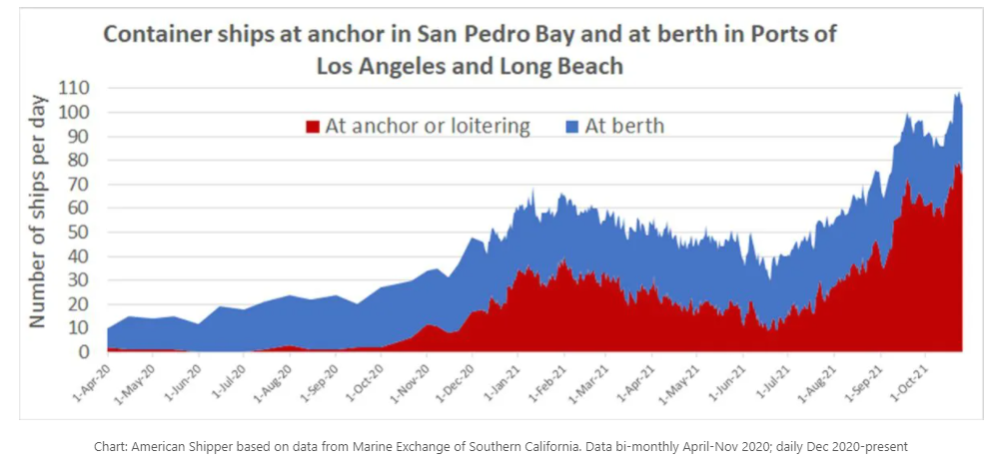
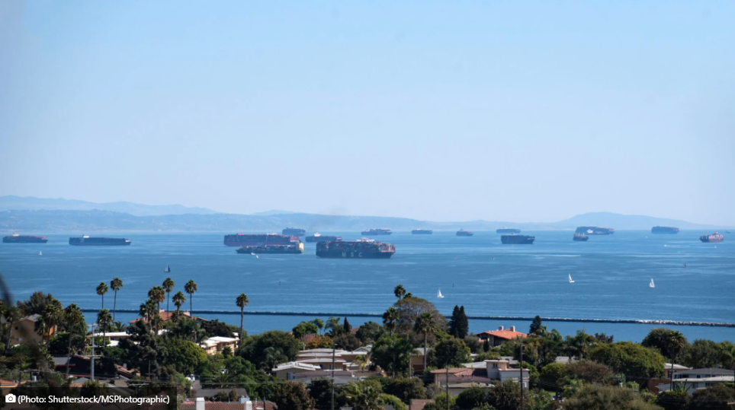
What’s the bottleneck problem?
Record 80+ container vessels were at anchor or adrift in the San Pedro Bay (half a million shipping containers) in October
Container on chassis are waiting 8.5 days “on the street” for warehouse space
8,000 containers ready to be taken away by train, with wait at 11.7 days
Port operating at 60%-70% of capacity (busiest U.S port complex shuts its gates for hours on most days and closes Sunday)
Notes:
Ports in Los Angeles and Long Beach broke multiple records for the number of ships in the locations, as well as the number of cargo ships waiting to dock. Since then, the number of vessels has trended slightly downward, but the ports maintain unprecedented levels of congestion. On Tuesday, the ports housed 144 ships — including 66 container ships waiting off the shore at anchor or in drift areas. Long Beach plans to use its extended hours as a pilot program toward 24/7 operations — like many ports in Asia and Europe — but has been unable to do so thus far due to a shortage of workers across the industry, including dock workers, truckers, and warehouse workers.

Slide 17
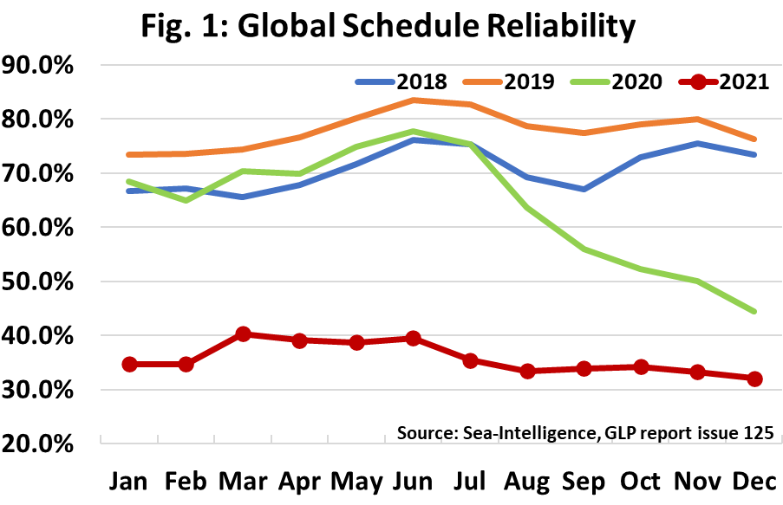
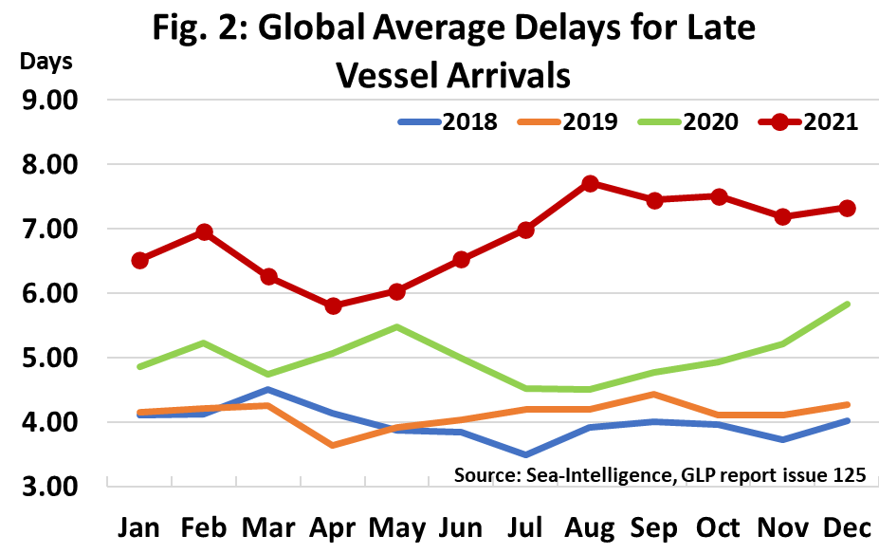
Reliability All Time low
Notes:
This is a index created by Sea-Intelligence and it measures schedule reliability across 34 different trades lanes. 35%-40% for most of the year, in August 2021 it dropped to 33.6%, a new all-time low during the 10 years

Slide 18
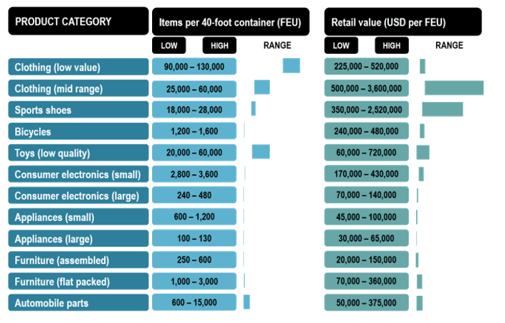
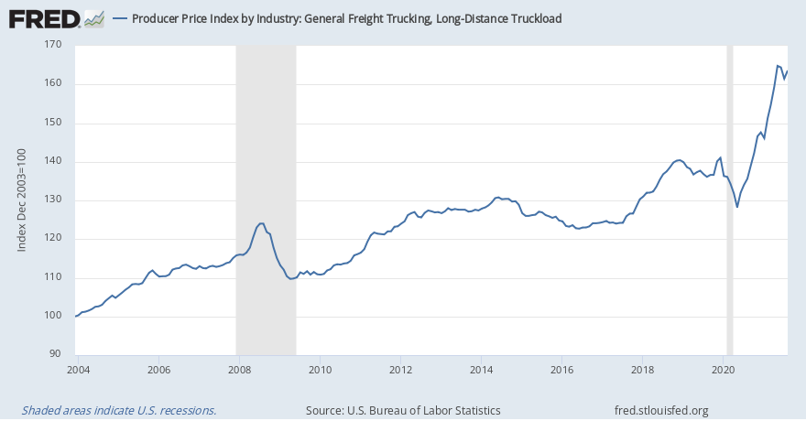
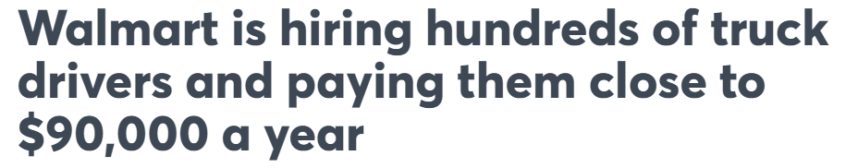
Competition for resources

Slide 19
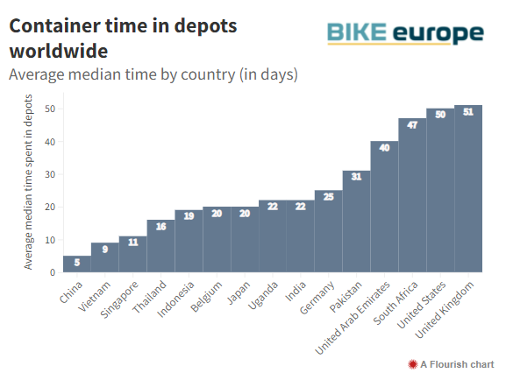
What can we expect in 2022?
“Normal” supply chain is still unlikely
The chaos at ports, warehouses and retailers will probably continue to persist
Shortage of labour
Severe congestion in many destination ports saw container dwell times at depots reach near-record levels in 2021.
Demand for goods is still strong

Slide 20
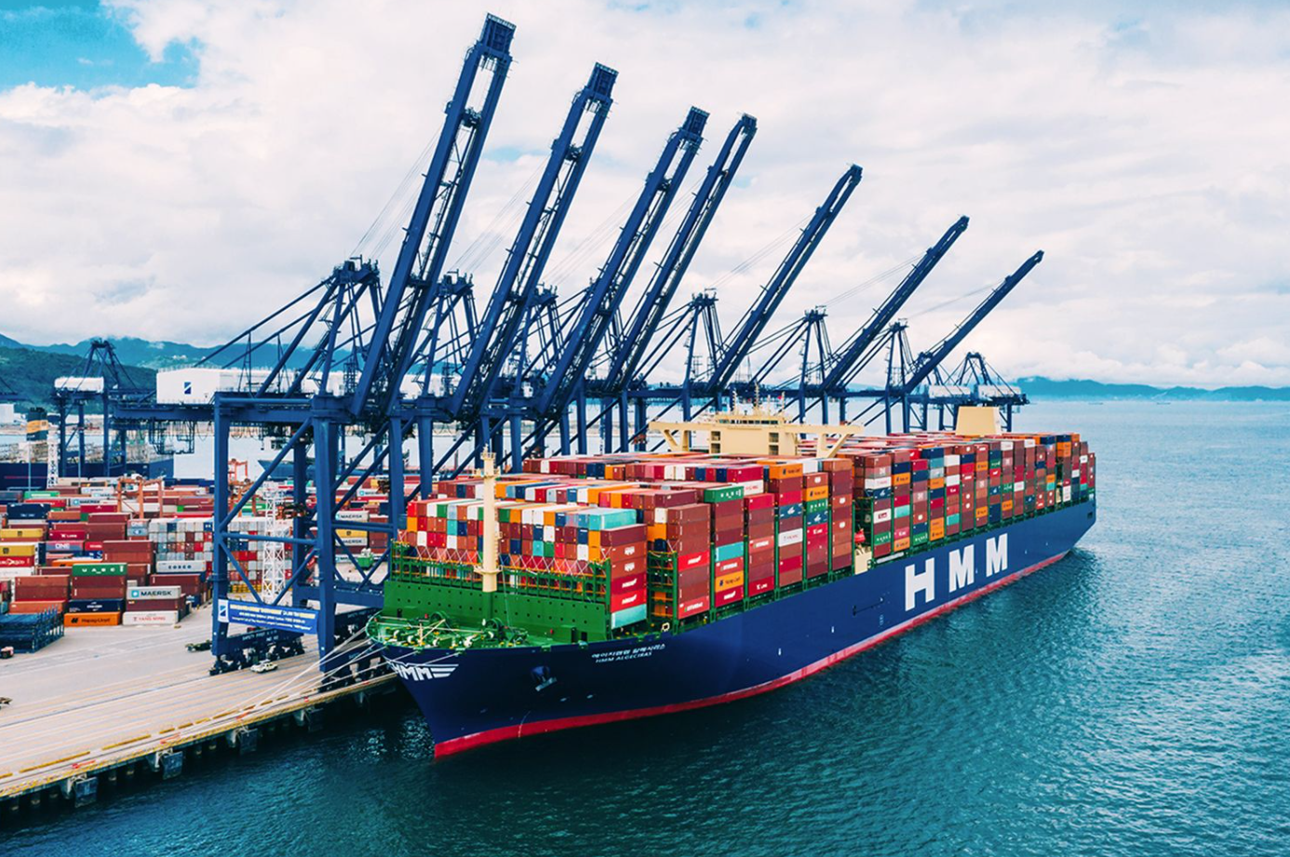
Challenges
Unclog ports
  Incentivize moving containers
  More efficient/automation
Chassis shortage
  Reduce import cost
Warehouse
  Industrial vacancies 3.2%
  Expand footprint
Labor problem
Notes:
Due t

Slide 21
Thank You
Thank you

