Slide 1

The Dawning of a New National Crop
Where do we go from here?

Slide 2
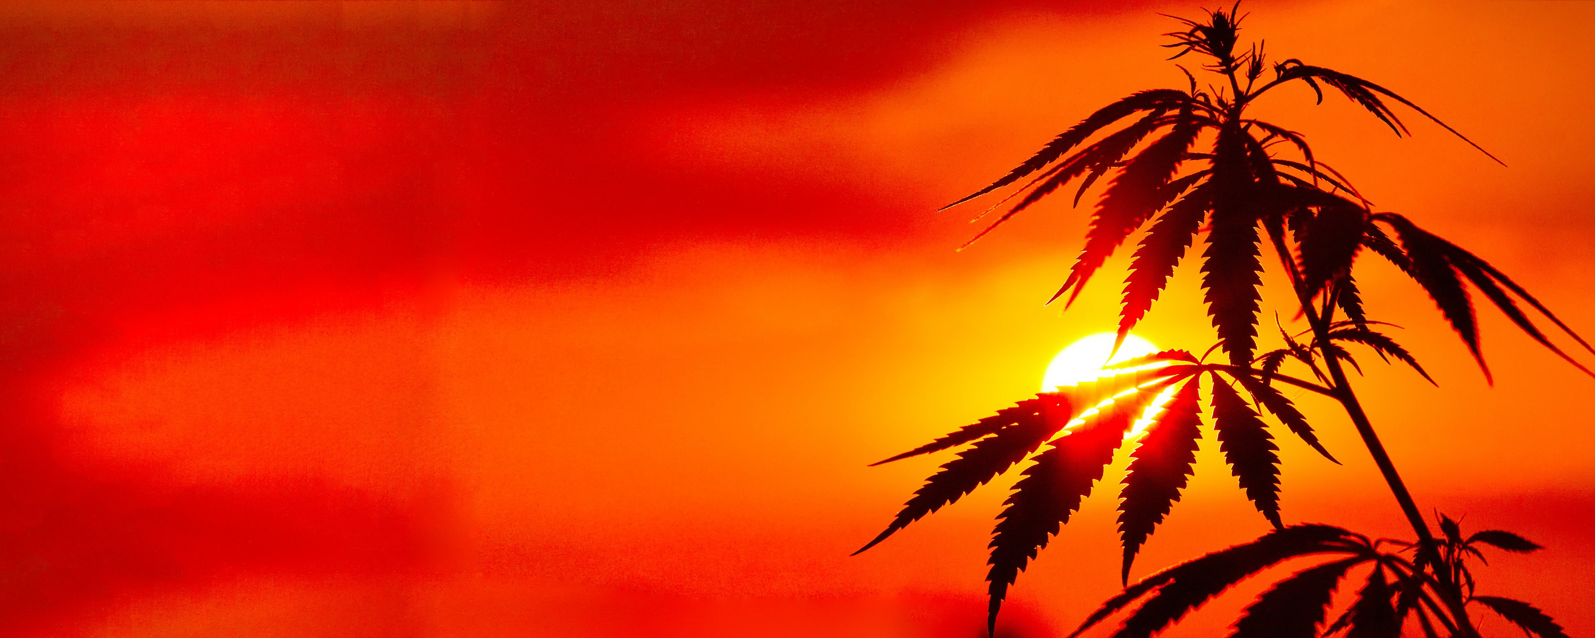

ABOUT NHA
Our Mission: To support the growth and development of all aspects of the industrial hemp industry.
We firmly believe that American industry is trending towards bio-sustainability and hemp plays a critical role in the establishment of a new economic paradigm. The National Hemp Association is dedicated to shifting the perception of hemp as being an alternative crop to a mainstream commodity.
With more than 50K Members, Supporters and Followers we represent:
farmers, processors, manufacturers, start-up businesses, entrepreneurs and, retailers
www.nationalhempassociation.org

Slide 3
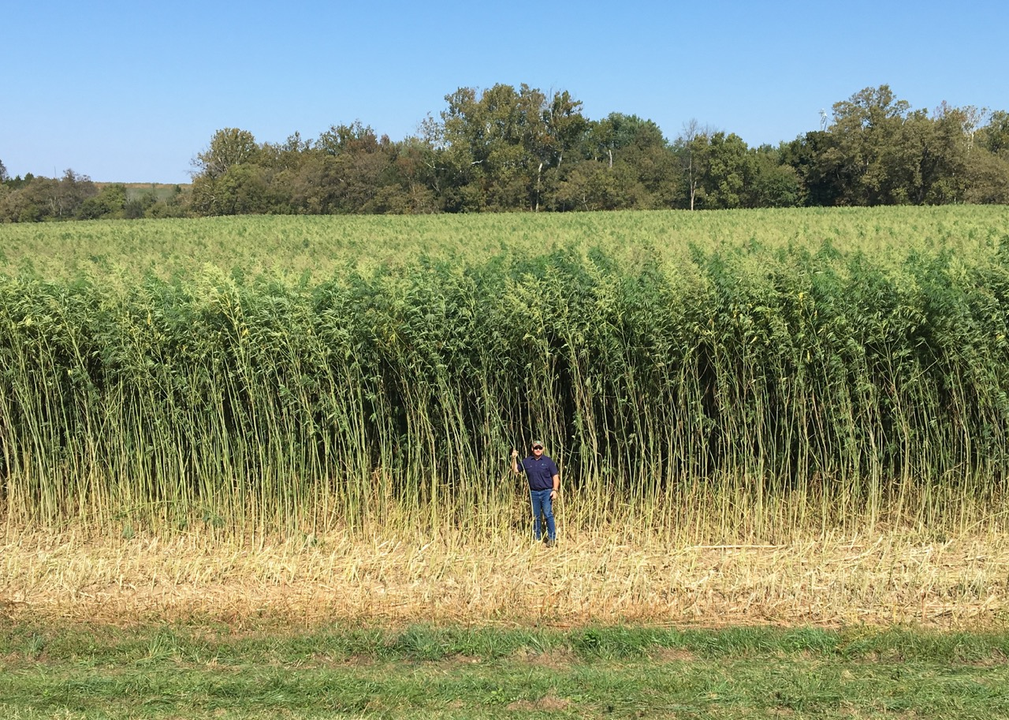
THIS IS HEMP!

Slide 4
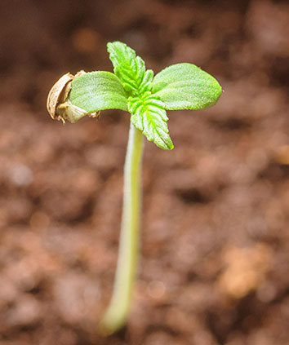
CULTIVATION OF THE HEMP PLANT
Compared to other crops, the advantages of hemp cultivation are limitless. Fiber hemp grows incredibly fast – it can grow to 21 feet - and will therefore be available in ample quantities. This miracle plant enriches the soil, can be used entirely and, perfectly represents the circular economy concept.
BENEFITS OF INDUSTRIAL HEMP CULTIVATION
Thrives in virtually any climate, grows quickly and
requires little maintenance
Uses very little water per pound of fiber
(multitudes less than cotton!)
Stores CO₂ during growth, positive for the CO₂-balance
Enriches the soil, ideal for crop rotation
Thrives in neutral PH

Slide 5
SEED AND FIBER
FEATURES
Hemp seeds are among the most nutritious foods. They contain all the essential fatty acids (Omega 3, 6 and 9), essential amino acids and dietary fibers necessary for good health. Hempseed oil pressed from seeds has a diverse range of applications.
APPLICATIONS
The oil and seeds are used for human consumption in nutrition and nutritional supplements (nutraceuticals) but are also processed in bird seed and other animal feed. Hempseed oil is also very suitable for cosmetic and health-promoting products as well as maintenance of leather. The seed is of course used in cultivation, and for propagating and breeding.

Slide 6
WOOD CORE
FEATURES
Hurd or Shives, the woody inside of the hemp stem, has an enormous absorption capacity and therefore binds well to materials such as lime and water.
It’s also good in absorbing odors.
APPLICATIONS
The woody inside of the hemp stem (hurd or shives) is extremely versatile. Highly suited as stable bedding (straw) for horses and smaller animal enclosures, horticulture mulch, but also for insulating panel material and hemp concrete.

Slide 7
OUTER FIBER
FEATURES
The fibers are removed through a process called decortication. Hemp fibers have great moisture and temperature regulating properties. They’re also extremely strong, highly flexible and very light, which is an enormous advantage in the automotive and construction sectors. Plus, it has the same properties as copper – it can bhold an electrical charge and its strong antibacterial properties make it, for example, ideal for hospital clothing!
APPLICATIONS
Hemp fibers can be turned into nearly anything. They’re used in construction and insulation materials, in felt, in growing mediums and tree disks, and in many industrial applications such as the furniture, paper and textile industry.

Slide 8
ROOT
FEATURES
The hemp root’s deep and wide with an extensive root hair structure. This improves the soil structure and returns a higher soil yield.
APPLICATIONS
The root primarily plays a role in soil improvement, allowing more of this super plant to be cultivated. In addition, there are strong indications that the roots can be used in pharmaceutical products. Extensive research needs to be conducted.

Slide 9









applications of hemp
Food
Construction
Body Care
Supplements
Essential Oils
Textiles
Paper Products
Livestock feed and bedding
BioPlastics

Slide 10
Where we are today
USDA Interim Final Rule
FDA Regulations
Crop Insurance

Slide 11
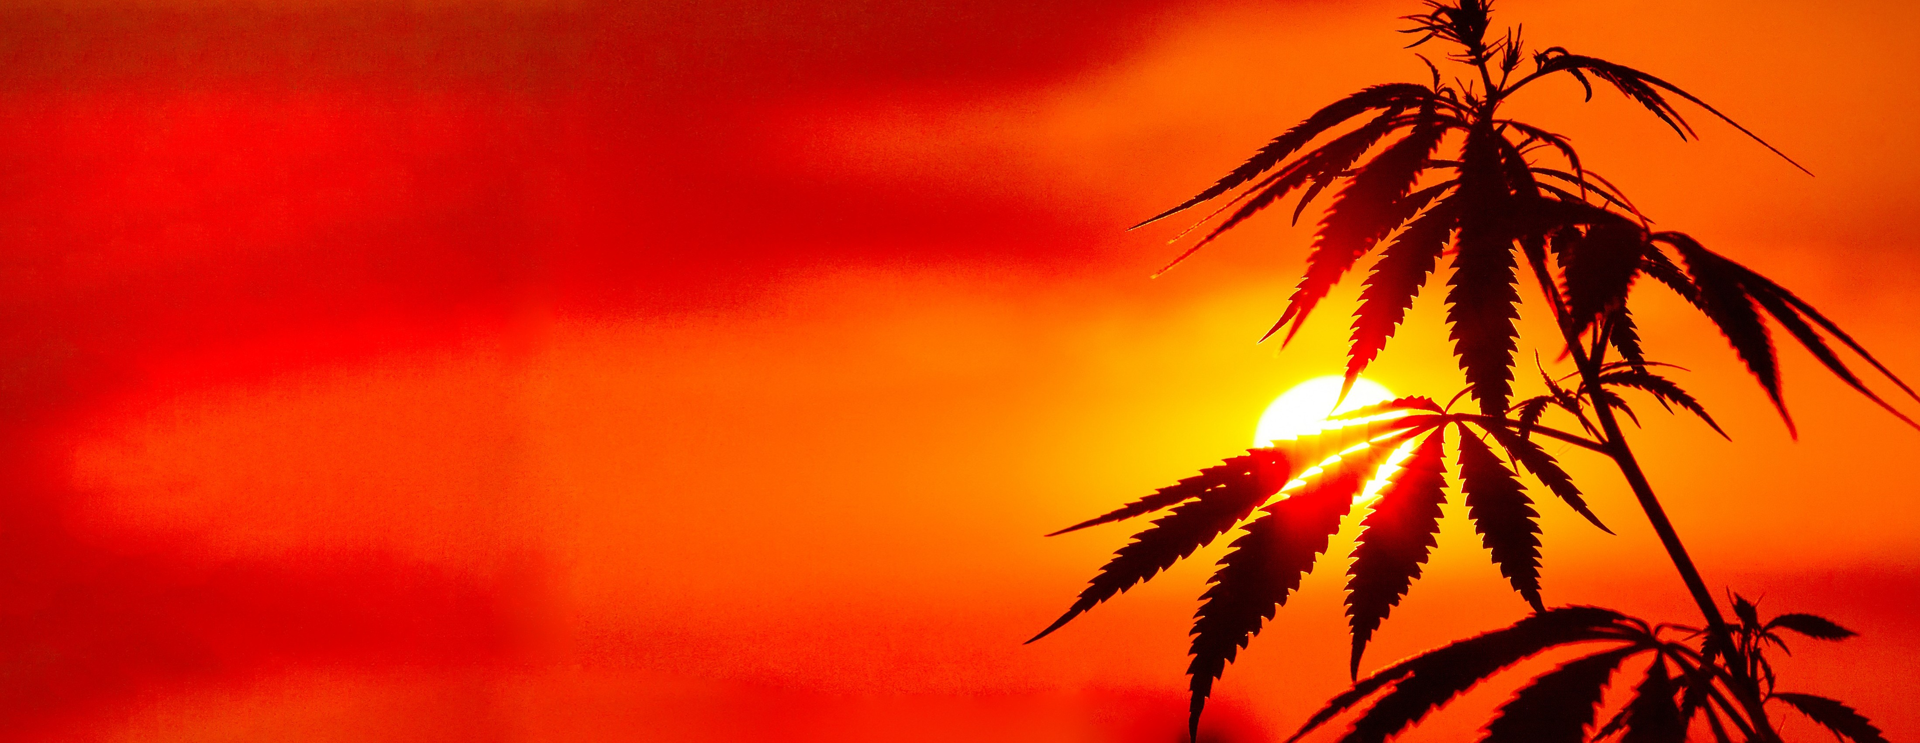
Federal Banking Regulatory Guidance
On December 2, the Board of Governors of the Federal Reserve, offered guidance stating “that hemp was no longer a controlled substance” opening the door for all legally permitted hemp growers and business access to the US Banking system.

Slide 12
Challenges On the Horizon
Fixes to USDA Interim Final Rules
  Those that USDA have no authority
  Those that fall under other Federal Agencies
  Those that are not permitted under the Farm Bill – requiring Congressional fixes
Bringing together a global solution to harvesting and decortication of Fiber crop on a commercial scale
Farmer outreach and education
Consumer Awareness

Slide 13
National Collaboration
NHA has embarked upon driving solutions to build a national industry
Working simultaneously with governments, agricultural sector, equipment manufacturers, seed suppliers, researchers, manufacturers and consumers
Goal is to have infrastructure and sustainable supply chain in place and operational within 2 years

Slide 14

Partnership with
EXCLUSIVE ALLIANCE: “PUSHING PROGRESS TOGETHER”
Partnership Will Develop Educational Outreach for Farmers to Build America’s Newest Sustainable and Versatile Commodity Crop
Alliance to Lay the Foundation of an Integrated North American Hemp Supply Chain, develop harvesting and decortication equipment and Calls on Partners to Join “Hemp Pledge”
NHA Commits to Creating and Funding New “Hemp Farmer Educational Fund” to Assist Farmers in Converting to Hemp Production

Slide 15
HEMP PLEDGE
BUILD A COLLECTIVE OF LIKE MINDED ENTITIES THAT WILL PLEDGE:
We recognize the responsibility to shift global manufacturing priorities away from nonrenewable materials and practices, acknowledging that hemp represents one of our best opportunities to achieve green agricultural and manufacturing solutions without sacrificing cost or quality.
We pledge to support the American farmer, to research the applications of American-grown hemp and begin to introduce it into our supply chains by 2022, whether for the production of food and supplements, fiber for textiles, biocomposite, green building materials, livestock bedding, animal feed, bioplastics, biofuels, or any of the thousands of its practical industrial applications thqt can be derived from American-grown hemp

Slide 16
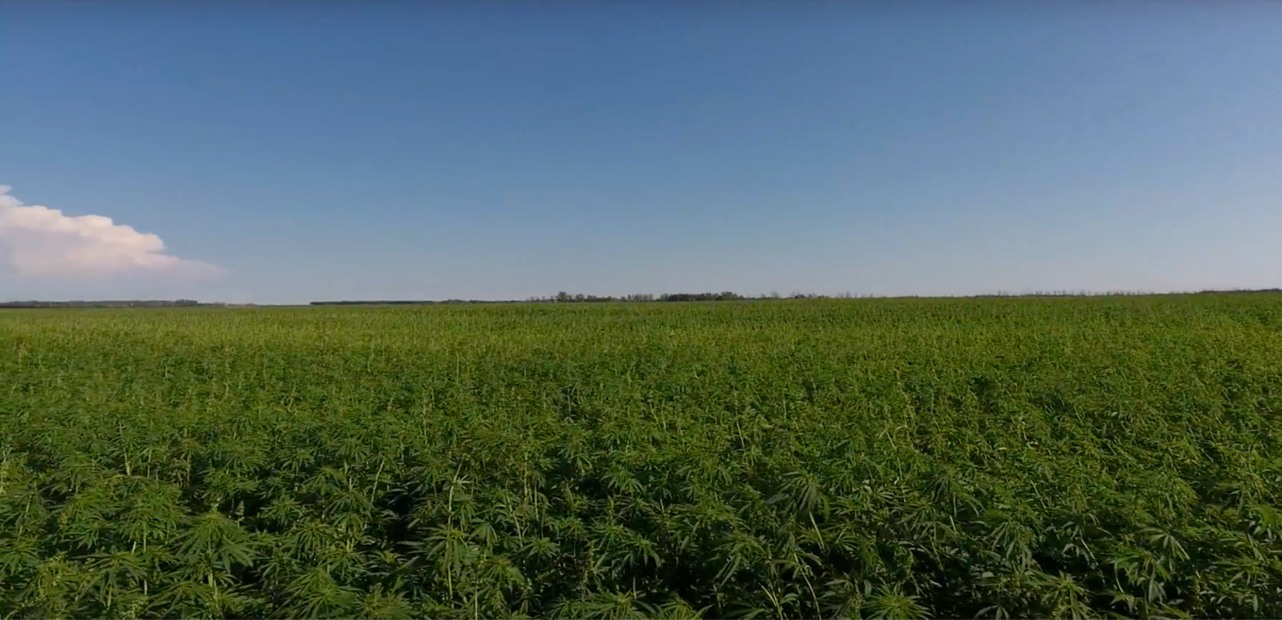

“This is a once in a lifetime opportunity. We will only grasp the staggering potential of hemp if we empower ALL people to participate, regardless of background.”
Geoff Whaling, Chair, National Hemp Association
Thank You!
Let’s GROW!
25

