Slide 1

What Does it Take to Farm in Russia and Ukraine?
Feb 20, 2020 To the USDA 2020 Outlook Conf U.S. Trade and the Global Market Place Black Sea Grain Export Market Washington DC
To the:
Moscow
By Dr. William W. Wilson
CHS Chair in Risk Management and Trading
University Distinguished Professor
William.Wilson@ndsu.edu
701 231 7472
Dept of Agribusiness & Applied Economics
North Dakota State University
Fargo, USA

Slide 2
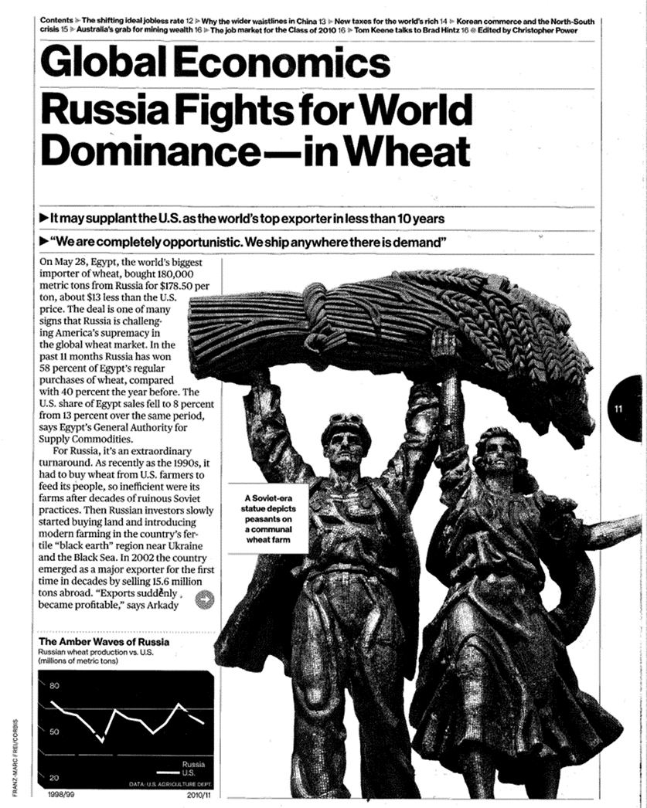
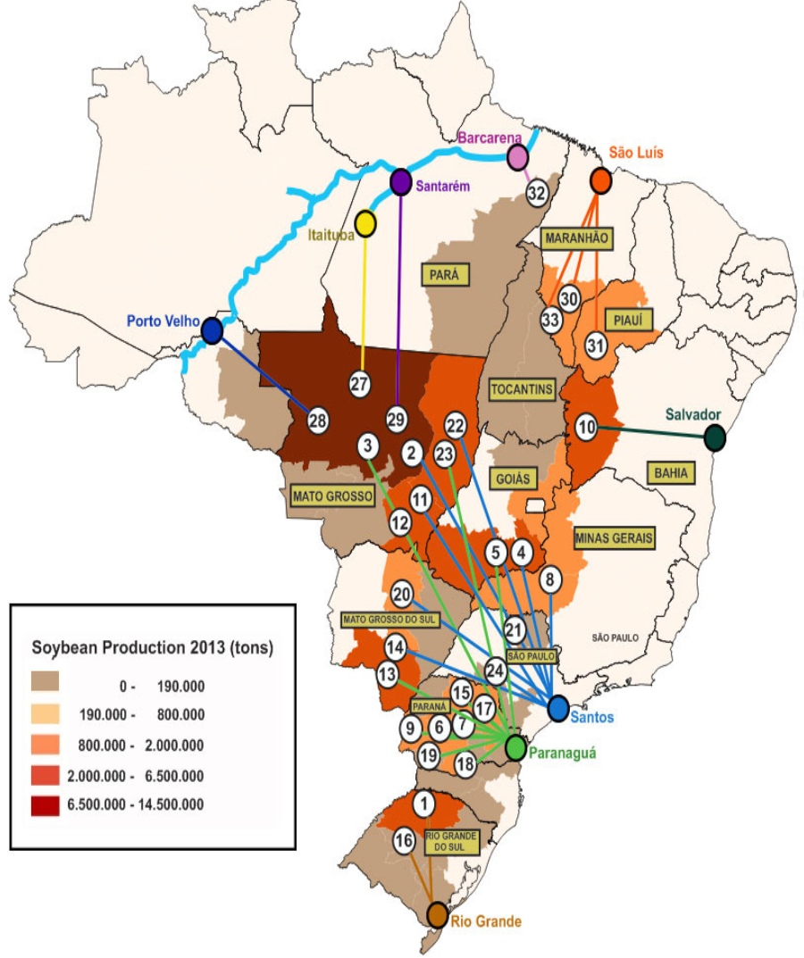

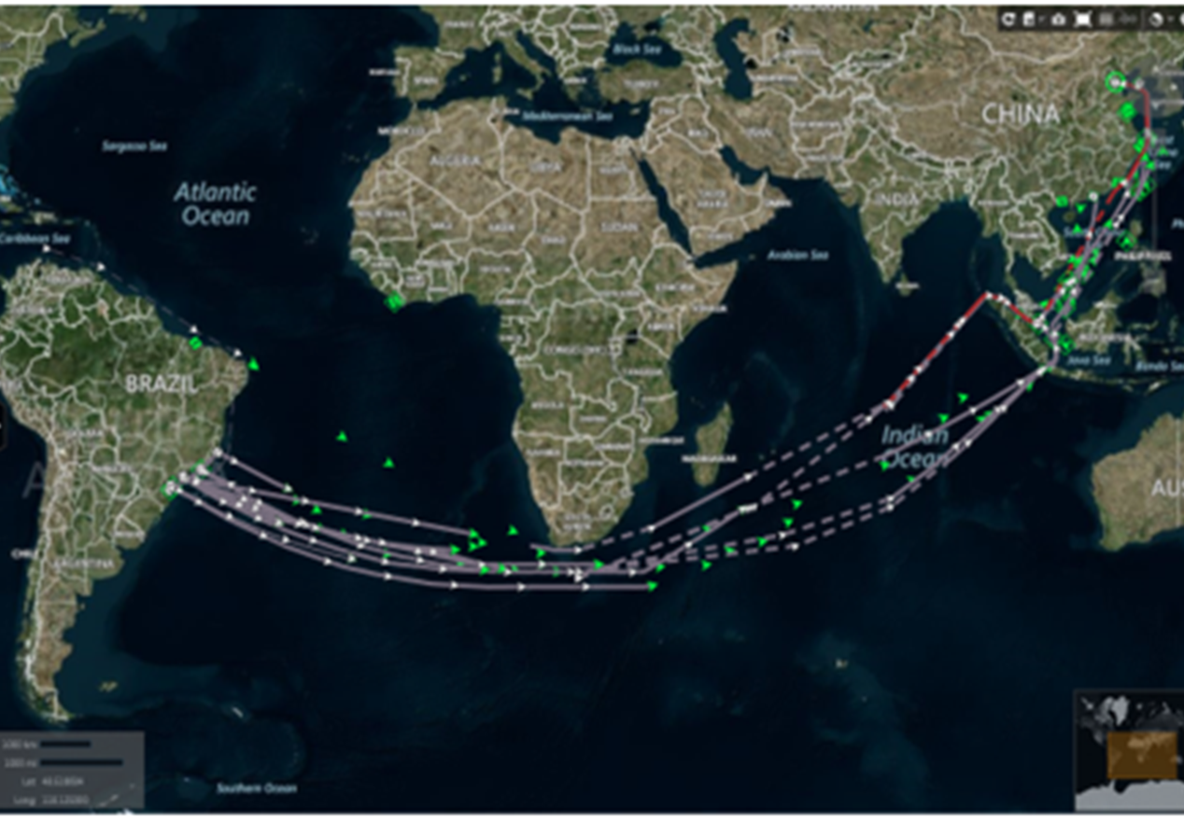
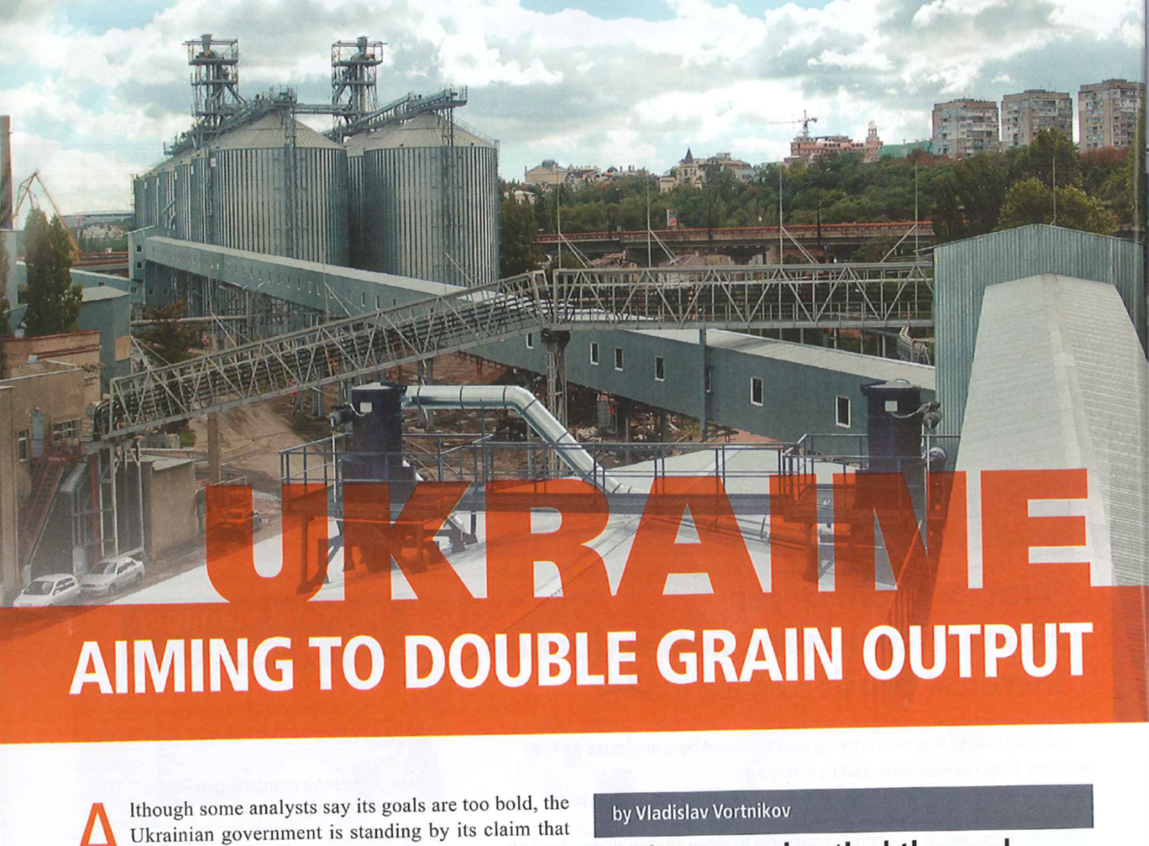
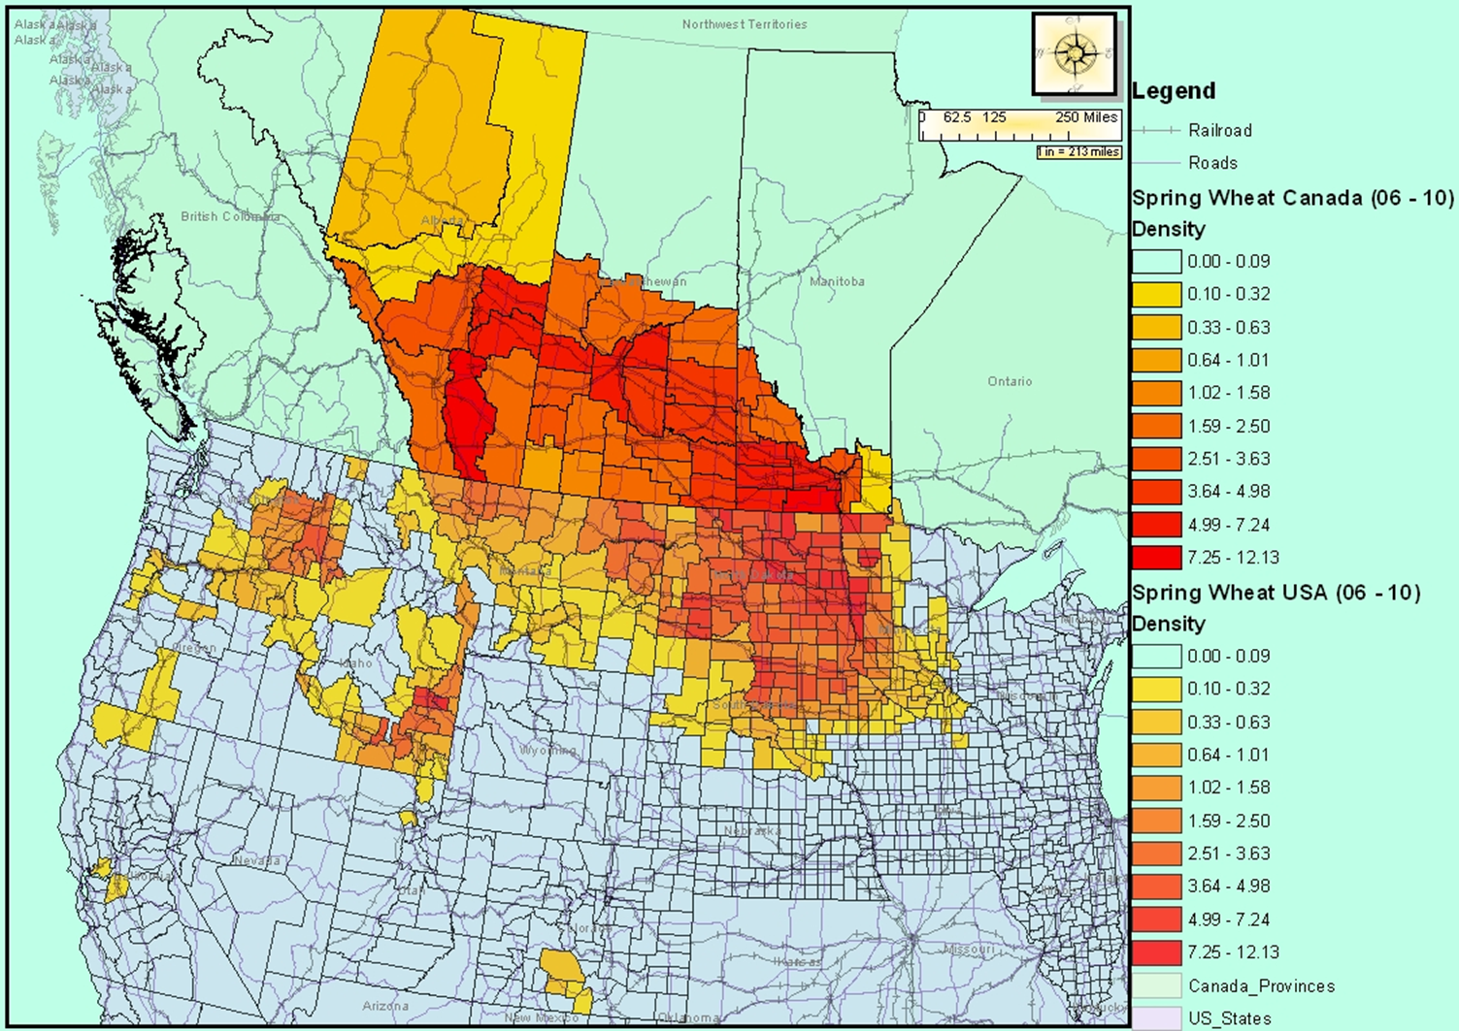
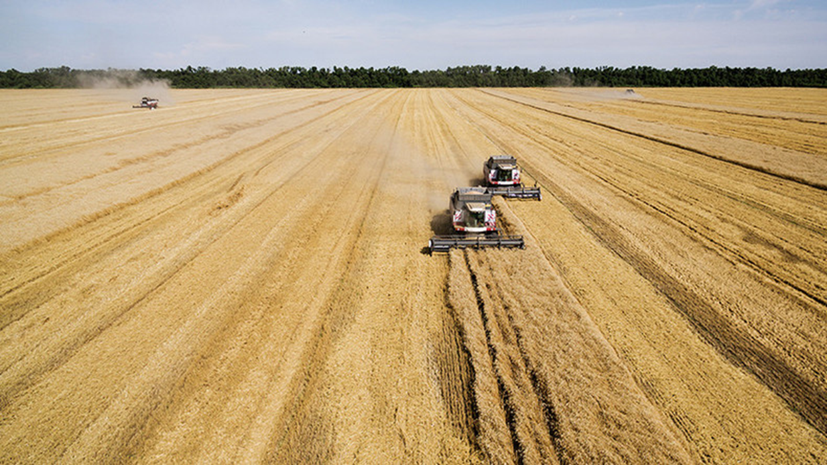
Increased Competition!
Technology is Key and Essential
Soybean to China April 2015
Notes:
Comptetion - Technology

Slide 3
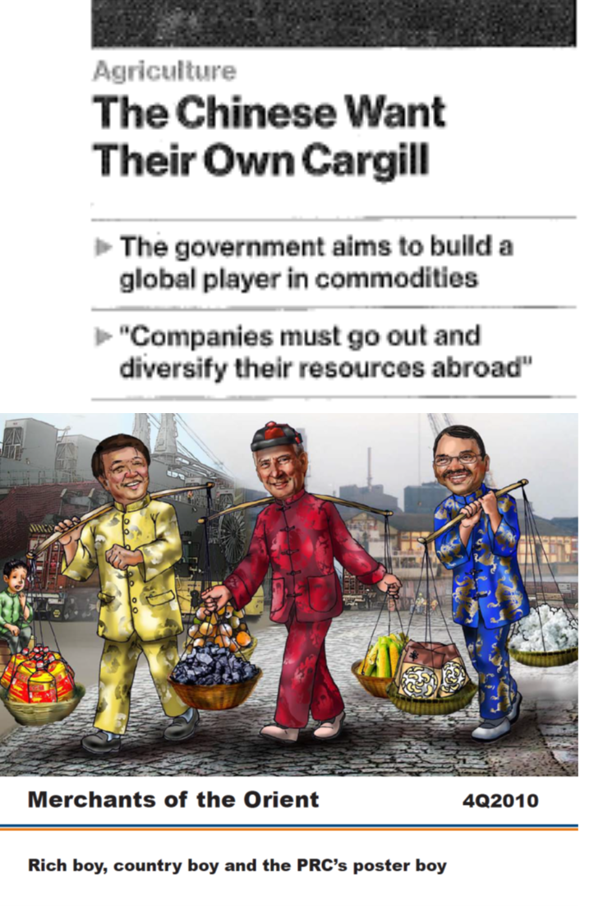
Extreme competition in exporting
Competition among international suppliers in grains and oilseeds is more intense now than ever before
  Growth in other origins: S. America, FSU
Increase in competition in ag trading
  Traditionally: Andre, Bunge, Cargill, Conti, Dreyfus
  Recently: ABCD
  Now: ABCD+C+C+G+G+15 Russian and Ukr trading
  firms
Escalation in Ag Commodity Interventions
  China
  COFCO
  Phase 1
  VTB
  etc.
Impact:
  Prices, are w/in pennies/bushel on a landed basis
  Periodic interventions exacerbating volatility in prices, and flows
  Flows: reflect in part geographic and seasonal supplies
Non-price factors have escalated in importance
  Quality:
  Logistics
  Seasonal supplies

Slide 4

Wilson in Russia and Ukraine
Russian Grain Trading (The USDA COMEX Project):
  Co-leader of a 4-year USDA/OICD/FAS project to assist in the development of the private grain marketing industry in Russia (1993-1997).
2000 to current: Numerous presentations to industry and academic groups.
Numerous journal articles
2012 Award: St Petersburg International Economic Forum from President Medvedev
NCH Capital (one of the largest private equity funds invested in Russia/Ukraine agriculture),
  Consultant on risk and strategy: 1995-current
  Board of Directors. Appointed 2015.

Slide 5
NCH Capital
Background
Headquarters: New York
1993 following collapse of FSU
$150 million, now valued at $3billion
Farms concentrated in Russia and Ukraine, in addition to other countries
25 Funds with 3+ focused on current operations in Ukraine and Russia
  First Western investor to raise, invest and successfully liquidate thirteen funds in Russia and Eastern Europe.
  NCH Agribusiness Partners and NCH Agribusiness Partners II, were launched in the autumn of 2007 and the fall of 2014, respectively.
  NCH Agribusiness platform invests in farmland and agribusiness-related activities.
Other (some) agroholdings are public held stock companies
$3 Bn Assets under management
11 Offices globally
130 Professionals
25 Investment funds since inception
700,000 Hectares of agricultural land under management

Slide 6


Slide 7
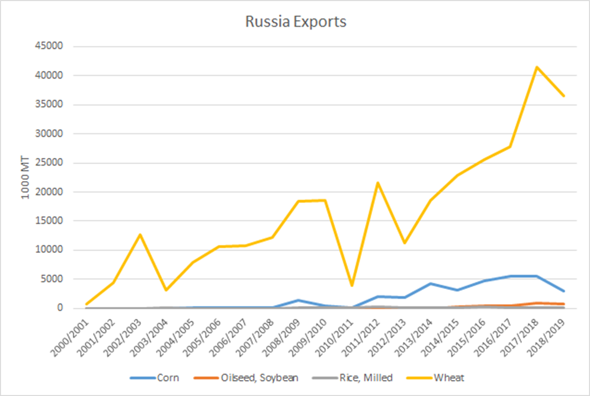
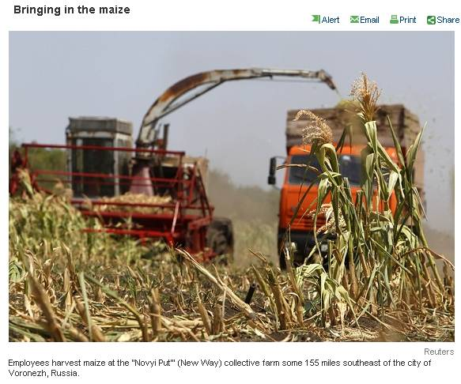
FSU Exports of Selected Commodities
Increased substantially from 2000
Comprise 24% of world trade; 2nd largest in corn
Markets (Dominant): N. Africa, Egypt, EU etc.
Expanded to Asia including Philippines, Indonesia, and into L. America, etc..; and now Mexico and now Brazil
No. 1 wheat exporting country
  2017/18 41 mmt
  2019/20 34 mmt
Prices: Typically a substantial discount to US (world) values

Slide 8
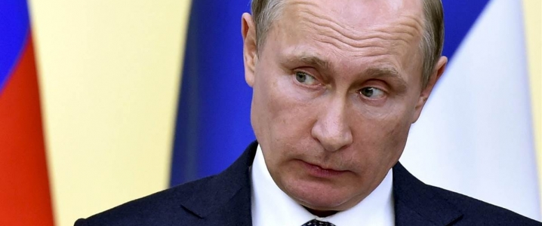
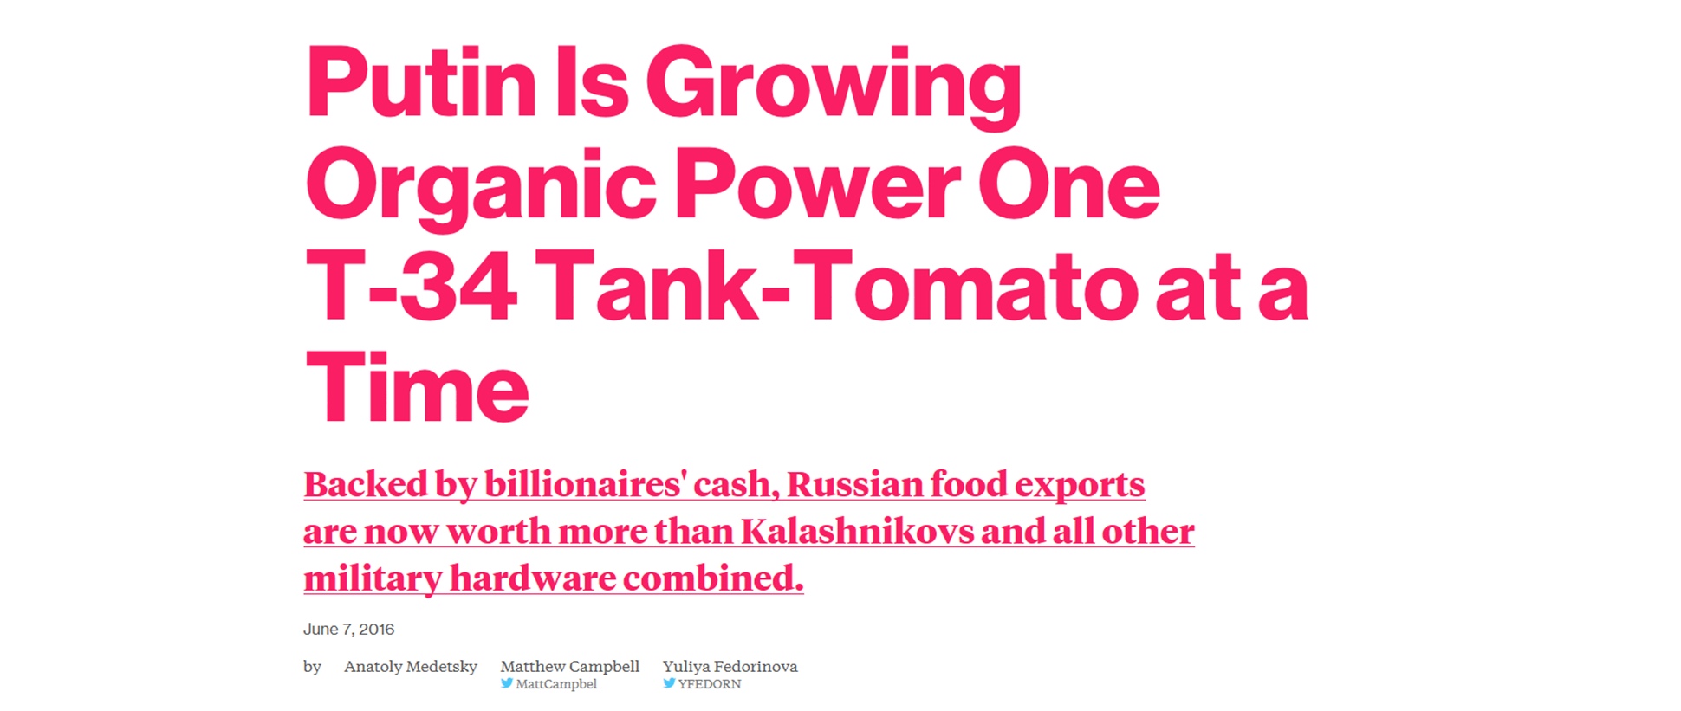
Russia Shifts Focus From Oil To Agriculture
By Michael McDonald - Oct 13, 2016, 2:43 PM CDT
Russia’s biggest industry has been oil production historically,
Diversify that by putting more emphasis on agriculture.
With Russia’s increased production of wheat, farmers need to find alternative means of storage.
Russia has officially surpassed the United States wheat exports.

Slide 9
Recent Interventions
VTB (state-controlled bank)
  Large bank
  Consolidated its role in the local grains market – expanding into trading, logistics, and port handling.
  Enter into ag export and logistics sector
    Seeking partnerships
    Increased control ref export logistics
    Acquires partial ownership of export ports, and several trading firms including 70% stake in grains trader Mirogroup
  VTB asks the Russian government to create a vertically integrated grain market champion that can curb the role of foreign companies in the Russian trade
  Russia too important to rely on ABCD
Export Quota
  Goal: Control (manage) internal prices
  Traditionally applied an export tax
  Proposed: export quota annually at 20 mmt for Jan-July commencing after this year
  Ministry of Agriculture confirmed the possibility of imposing of the non-tariff quotas for grain exports
  “In the first half of the season, the exports totaled nearly 25 mmt; in the second half of the agricultural year Russia can export 20 mmt without any threat for the domestic market, which should to be fixed in form of the non-tariff quotas,” [Advisor to the Minister]
Tightening regulation and taxation of offshore investment vehicles.
High probability of additional US sanctions in 1Q 2020. 2024 Russian presidential elections.
Export channels consolidated by a state-owned bank.
Escalating farm labor turnover and cost inflation due to negative demographics. Arms-race for qualified labor
Technology advance hampered by negative perceptions in IP protection and significant regulatory hurdles.
Domestic suppliers of competitive agri technology slowly emerging.
Climate volatility increasing.
Stricter regulation of insecticides in the EU shifting certain crops to RU and UA

Slide 10
Important Structural Characteristics:
Russia
Large domestic market
Exports are important, but, of lesser relative importance (vs Ukraine)
Food price inflation important
More interventions/regulations
Extreme seed/technology regulations
Inducing domestically produced seeds, traits and chemicals
Less corruption

Slide 11
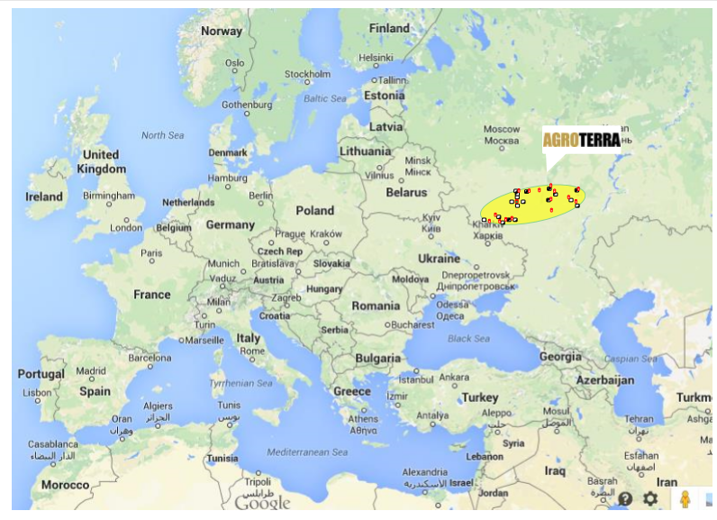
NCH Russian Farms

Slide 12
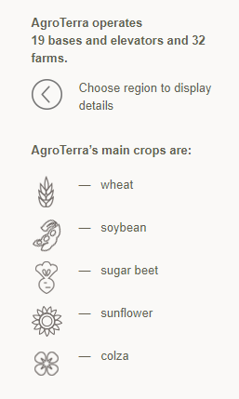
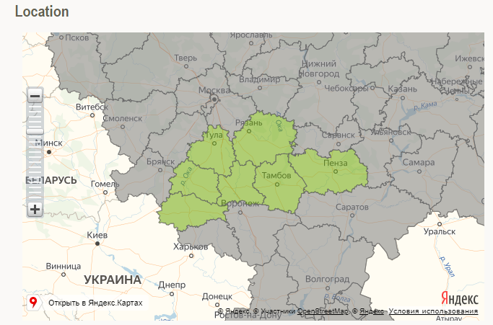
NCH Farms
Crops Produced
Over 200,000 hectares
Latest brand-name, high-performance equipment: John Deere, Claas, Amazone, New Holland, Case, Amity, and others.
Crops stored: 19 elevators with a total capacity of over 500,000 tons.

Slide 13
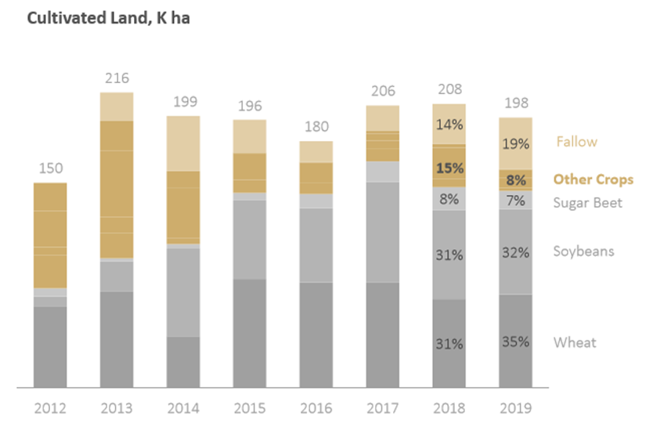
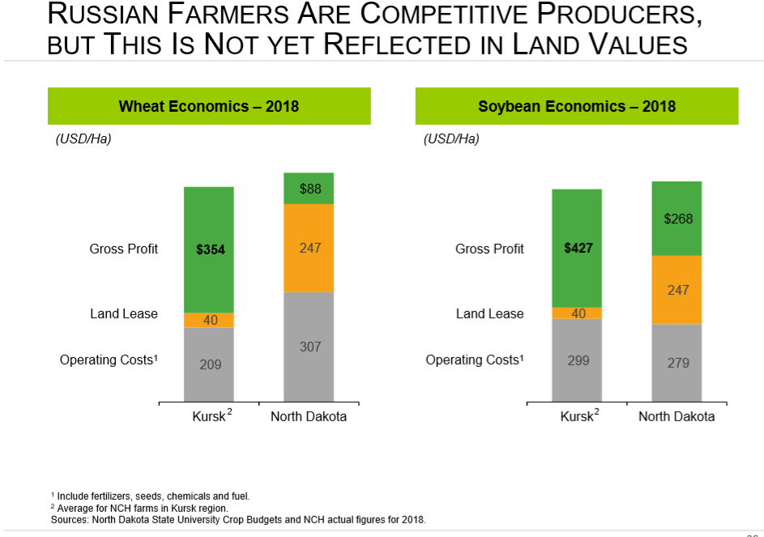
NCH Farms
Crops Produced (ranked by ebdita)
Cost Competition vs North Dakota
Dominance of wheat
Growth of soybean
Reduced Sugar

Slide 14
Strategic Initiatives: Russia
Land: Consolidating ownership
Risk
Big Data
Technology
SCM (supply chain mgmt.)
Expand soybean
  Seed plant
  Breeding partnerships

Slide 16
Approach to Risk
Elements of Risk in Russia/Ukr Ag
Approach
Price risk
  Futures and basis
Yield risk
Quality risk
Exchange rate risk
Counterparty risk—major
  Precludes active forward contracting
Markets are efficient:
  Futures!
  Basis may have bias.
Risk policy
  Long position: effective when begin acquiring inputs
  Models: Optimal hedging under yield uncertainty
  Risk limit and marketing vary by
    Time of year:
      40% prior to pre-planting
      60% (_20%)prior to end of harvest
    Reserve retained to meet cash requirements in t+1
    Limits on use of instruments
VaR models
  Elaborate
  Updated weekly
  VaR limits over time
  VaR used to evaluate all projects
Instruments: Priority
  Forward contracts
  Futures (Matif or CME)
  Options: Collars
Crop Insurance

Slide 17
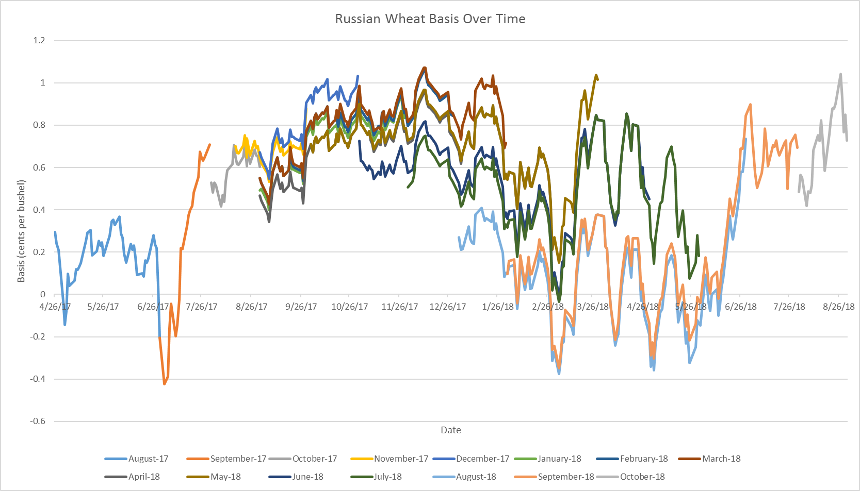
Russian wheat: Daily basis c/b, by trading month Feb 2017 to May 2019
Basis to CME:
  Escalation in post-harvest period
  Extreme volatility: much greater than in US and probably too great to justify hedging in futures

Slide 18
Basis values:
Large post-harvest increases

Slide 19
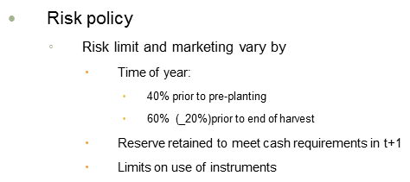
Risk Policy:
Why?: Investors want aggressive risk mgmt.
Essential for firm management of risk!
VaR is backbone
VaR derived
  By Farm
  By crop
  Including elements of farm budgets
  Aggregated to holdings, and Company
  Key risk variables
    Price (F and basis)
    Yields
    Counterparty
    Strategies
      Forward marketing
      Insurance
      etc.
  Updated weekly

Slide 20
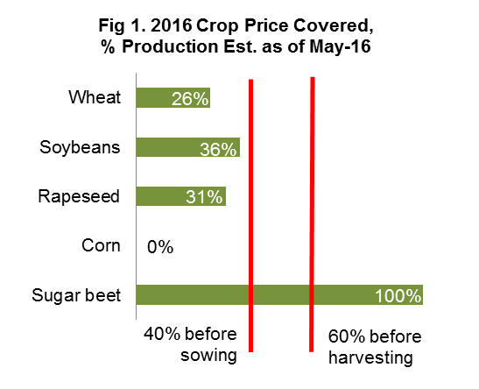
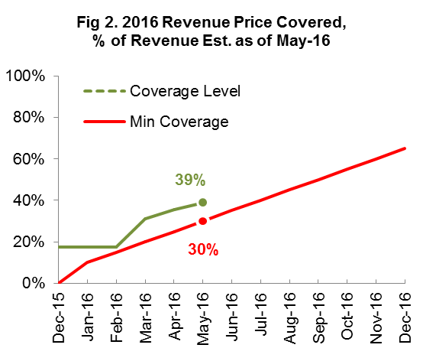
Current status of RMP in 2016/17 commercial season

Slide 21
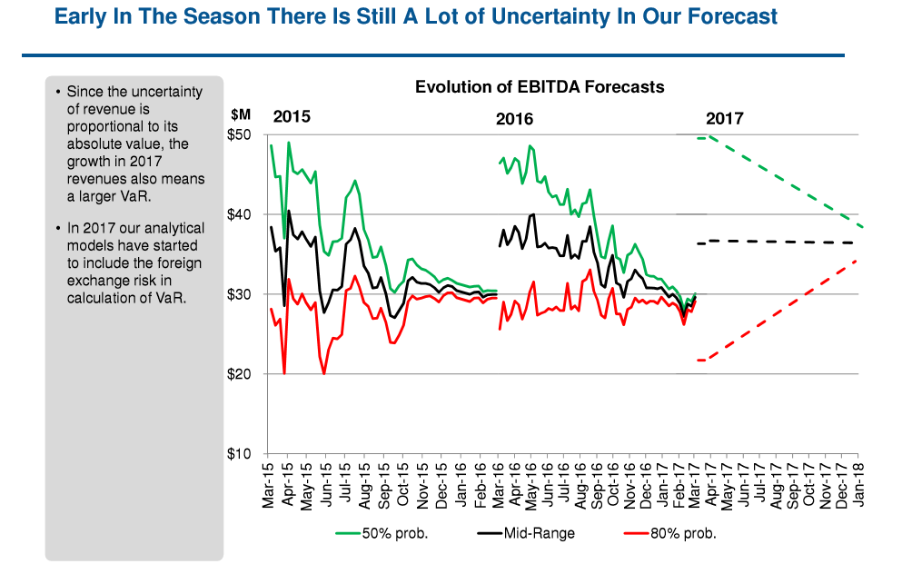
VaR:
Measured through time and allows assessment of risk exposure (potential for loss)

Slide 22
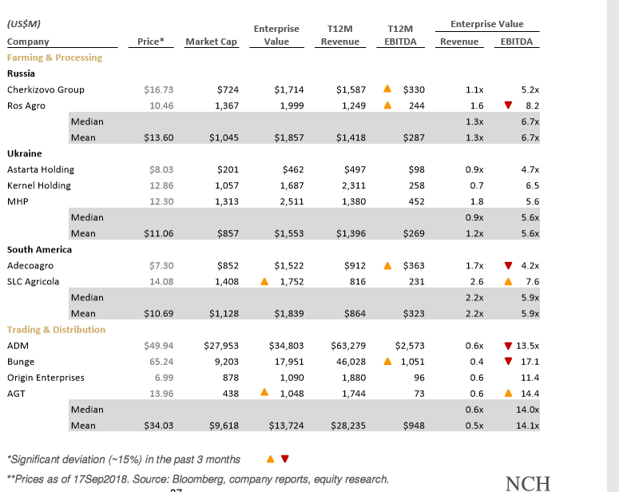
Emerging Markets Multiples of EBITDA: Comparables
NCH has to compete in capital markets
EBITDA is common measure
Historically
  Russian/Ukr farms at 3 to 4XEBITDA
  Other ag firms much greater
More recently: Russian/Ukr farms multiple has increased to 6-7

Slide 23
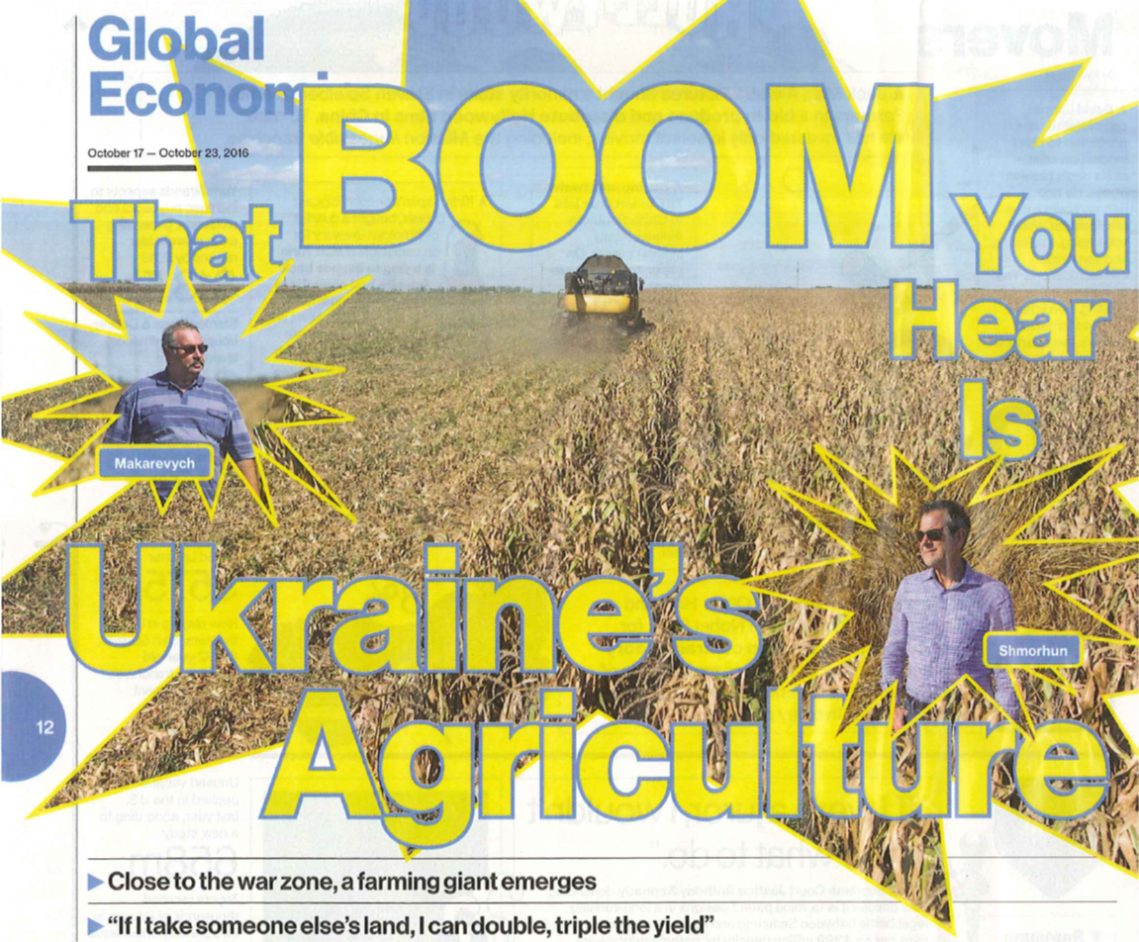
Recent Headlines!

Slide 24
Structural Differences:
Ukraine
Exports of great national importance
Major source of earnings; so, little interference
Land regulations: Lease Only
Less interventions/regulations
High degree of corruption

Slide 25
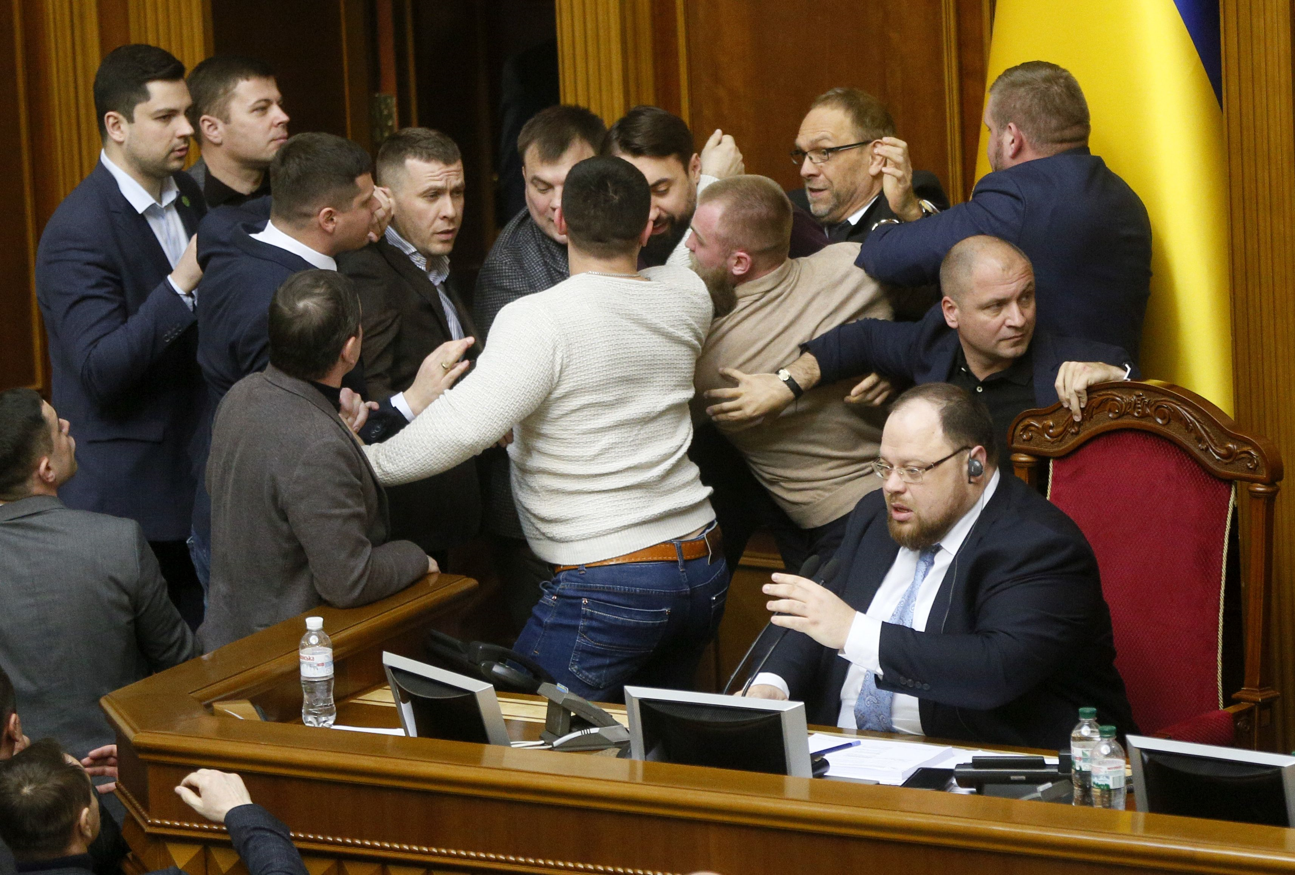
Current Mega-Issue: Land-Reform
Background
Current Proposal/Outlook?
Land privatized following break up of FSU
Legislation 2001 (Land Code) was a moratorium having effect of freezing land sales
Effect:
  Large agriholdings mostly lease land on varying forms of multi-year leases (NCH has 100,000 leases)
  Land values depressed
  Farmers unable to use land as collateral,
  Reduced productivity
International agencies want to encourage a liberal land market in Ukraine
Zelenskiy initial proposal (fall 2019)
  Sales to commence October 2020
  Limited to Ukrainians, and, foreign firms currently farming in Ukraine
  October 2024: Open land market
  Limit: 200,000 ha
Current proposal (supported by parliament):
  Sales to Ukrainians only
  Max: 10,000 Ha
  Referendum (proposed) ref foreign ownership
Brawl breaks out as Ukraine's lawmakers debate land reform

Slide 26
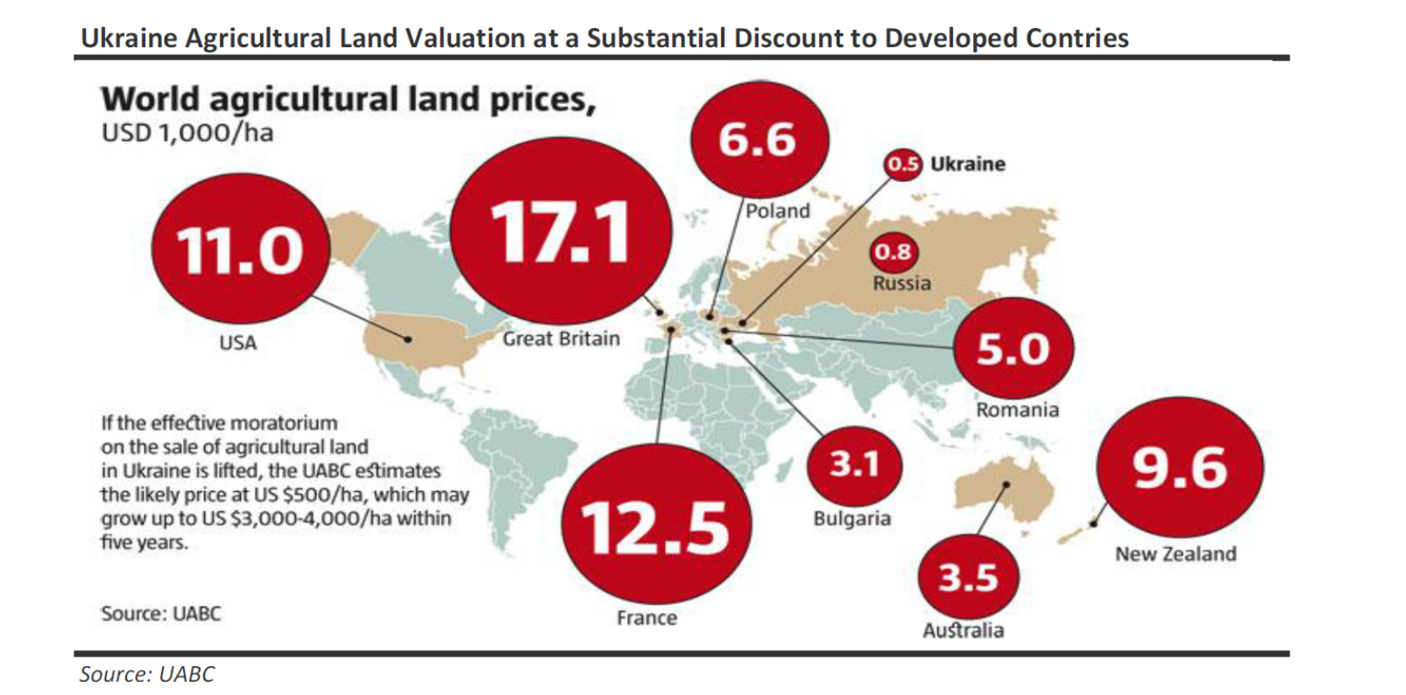
Land Markets: Underdeveloped
Russia
  Ownership and leasing
  Undervalued due to uncertainties in ownership
Ukraine
  Sales of land prohibited, allegedly to protect small holdings
  Precludes asset ownership
  Inhibits collateral for borrowings
  Land is short term leased
  Undervalued due to uncertainties

Slide 27
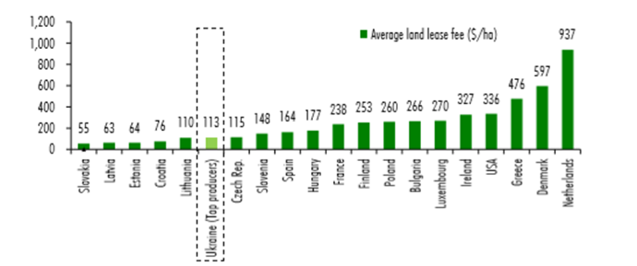
Background: land lease fees ($/ha)
Source: Dragon Capital, Land Reform: Solid Ground for Economic Growth, Jan 2020.

Slide 28
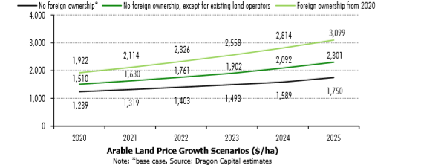
Projected land Prices:
No change: grow to $1750/ha
Foreign ownership allowed: grow to $3099/ha

Slide 29
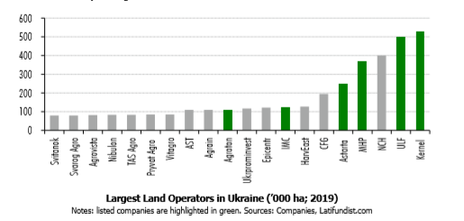
Agriholdings of Ukraine Farms
6 Agric holdings have > 200,000 ha
Prospective alternatives (to be explored)
  foster new modes of cooperation between large land operators and smaller farmers in order to secure sustainability of large-scale farming operations (e.g. long-term partnerships).

Slide 30
NCH Ag Holdings: Overview
Maps
Cost
Profits
Strategic Initiatives

Slide 31
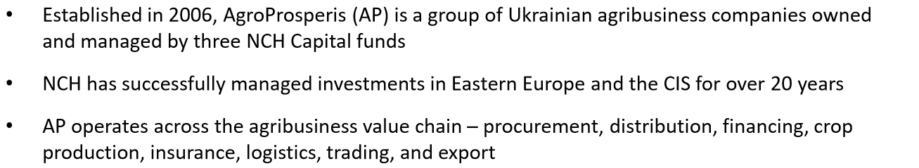
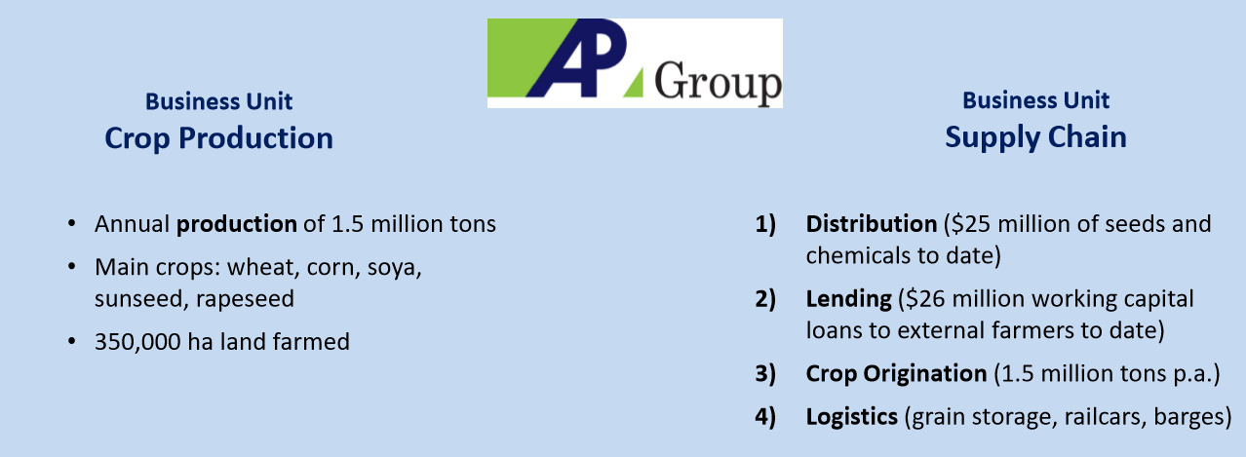
NCH Ukraine (AP Group)

Slide 32
Ukraine Holdings

Slide 33
Productivity and Costs:

Slide 34
Cost advantage Ukraine
  Land rent
  Input costs
  [capital]
Crop margins [rank]
  Rapeseed
  Sunflower
  Corn
  Wheat
  Soya

Slide 35
Mega-Farm Mgmt Strategy
Profit Sharing
Franchise Model (looking forward)
Incentives: alternative to corruptive practices
Experiment
Incentive Mechanism
  20% ROWC
  Profit sharing > 20%
  Pay 10% of the excess above a 20% Return on Working Capital
  Ownership option
Farming Games
Thesis: owner-operators make better decisions than centralized decisions
Experiment:
  Selected farms w/in NCH: 2019, 2020 and beyond
  Farm directors invest
  AP provides: inputs, technology, agronomic advice, banking, marketing
  Profit share
  Results: Favorable!

Slide 36
Supply Chain Strategy
  Missing intermediate functions or, insufficient competition in banking, inputs, distribution/handling
  Pricing
    Sharp discount to world (i.e. large margins for traders)
    Nearby (available);
    Deferred (i.e. w/in planning horizon) na or, persistently inverted
  Major strategy:
    Acquire ag bank
    Major long term contracts on inputs
    Elevators
    Rail cars
    Port throughput
    Add: 3rd party farmers

Slide 37

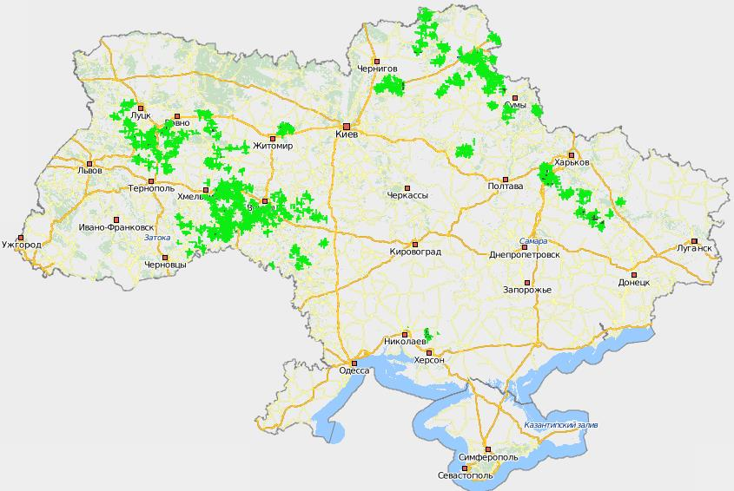
AP Group Elevators location
Rovno reg.
Sumy reg.
Khmelnitsky reg.
Vinnitsa reg.
Kharkov reg.
Nikolayev reg.
Main services:
Reception
Cleaning
Drying
Storage
Shipping

Slide 38
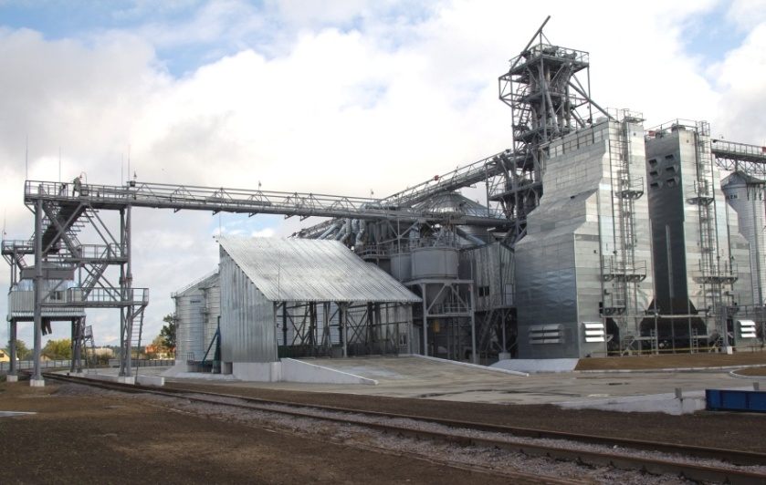
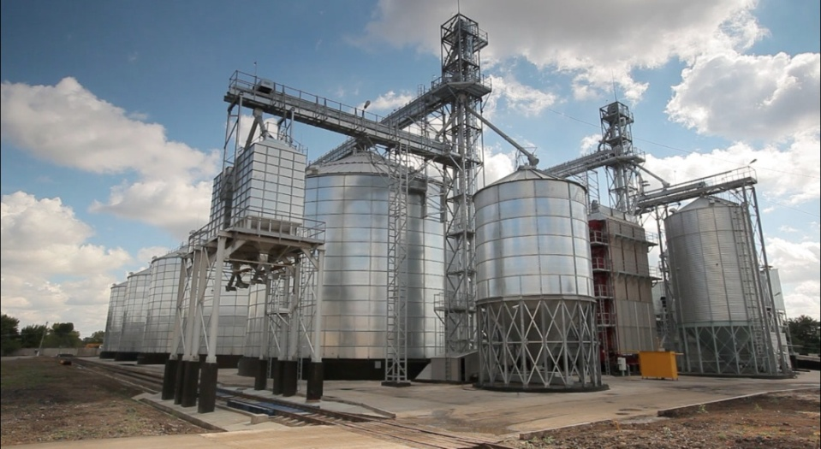
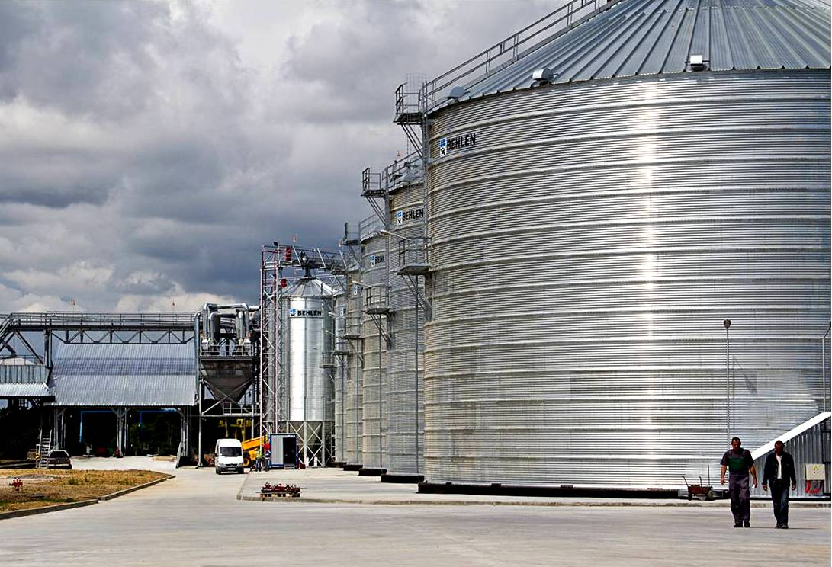

AP grain supply chain
  Owns 592,000 tons of grain elevator capacity; it is not reliant on 3rd-party storage facilities
  State-of-the-art grain storage minimizes costs and guarantees crop quality
  Equipment suppliers
      Behlen, USA– silos
      Tornum, Sweden – dryers
      InterSystems, USA – transporters
      FOSS, Denmark – laboratories

Slide 40
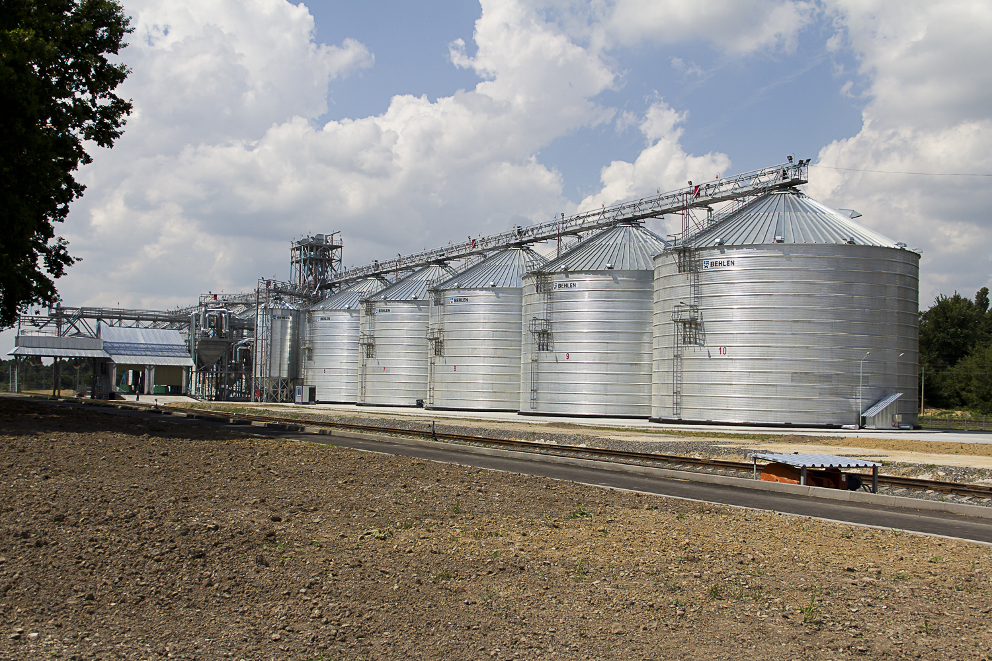
Agrodar Bar

Slide 41
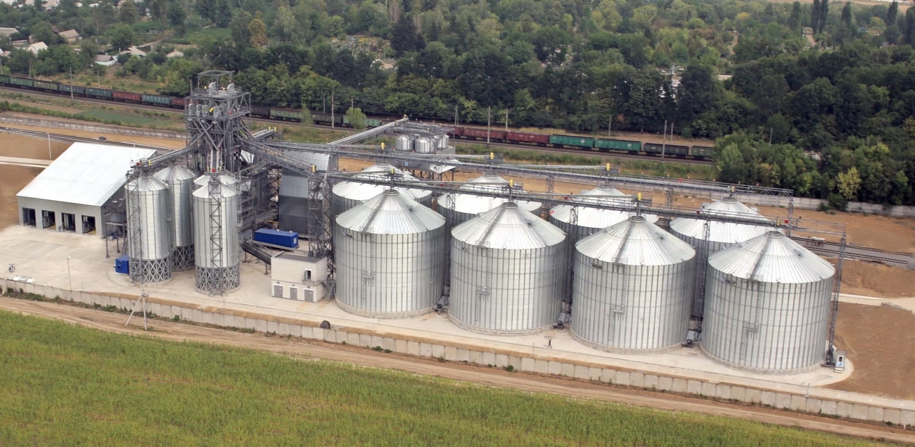
Zhmerinskiy Elevator
Zhmerinskiy elevator

Slide 42
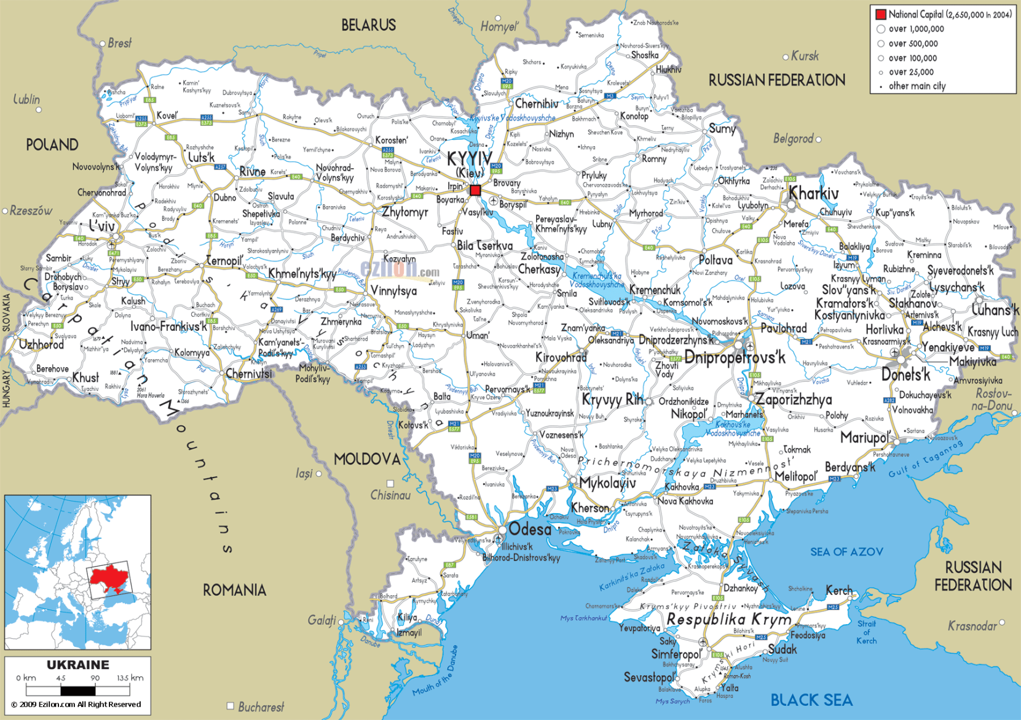
Access to Black Sea ports to export crops
Donetsk, Lugansk
Notes:
The green circles show the location of our farming clusters, and the green arrows the export routes through which we transport our crops to the Black Sea ports. The red area on the right is the territory which is controlled by separatists.
Our real estate fund NEPF used to lease farmland on Crimea. However, we discontinued these operations already in 2013 and transferred all movable assets to other farms in Ukraine. Our only remaining asset on Crimea is a grain elevator, which we purchased for $3 million, and which we are going to sell.
Except this grain elevator, neither our assets nor our operations have been affected by the military conflict ||||
What do we expect in the future?
During the last summer, the Kremlin floated the idea of turning Ukraine ‘s South East into NovoRussia. This would have cut us off from the export market and impacted our investment. The developments since last summer made the creation of NovoRussia unlikely ||||
We do not expect any impact on our assets or operations in the future ||||
Let’s now review how much capital we invested and what it is worth today, starting with our real estate fund:

Slide 43
Logistical strategies!
Control the supply chain
  More predictable port delivery 30 vs 4 days, $10/mt
Elevators: Shuttles
Rails
  Shuttle concessions
  Own Rail cars
Futures
  Own locomotives
  Expand river

Slide 44
Logistical Cost Comparisons for Grain:
Major Exporters $US/mt
Numerous elements of logistical costs vary across countries
Ukraine has substantial advantage mostly due to rail and country elevation
Adv: about $25 to $70/mt

Slide 45
Grain Exporters: Very competitive

Slide 46
Ukraine Grain Logistics: Challenges and Opportunities
Challenges
Opportunities
Rail Rate Regulation Stymie Innovation
Standard single car movements
Small cars (65 vs 110 cars)
Cost analysis for rates and rate differentials
Difficulty in developing incentives
Shipment size
Car Allocation
Rail rates are already quite low (by international standards)
Export handling costs are high
Increased size of shipments: 1 to 65-70 cars
Increased turn-around at origin and destination
Increased utilization of equipment
Cost savings for the overall movements
Share in cost savings among: Shipper, farmer and railway
Development of river as a waterway for grain shipping

Slide 47
Major Ag Implications:
Ukr and Russia
Fundamentals
Major implications
Largest countries fully within Europe
Soviet Legacy
  Large state-owned farms begin dismantled
Land markets
Corruption! Overwhelming
  Endemic
  High-level, and micro-level
  Efforts to change; but, monumental challenges
Springboard to Chinese Market (Russia; not Ukr)
Economy weakening
Sanctions
In need of IMF funding
Foreign Corrupt Practices Act of 1977
Land markets esp in Ukr need favorable developments

Slide 48
Important Differences to US
Lower cost
Non-stable currency, High inflation and interest cost
Owner operator in US vs, larger corp, or coop. farms in FSU
Lesser technology (notably, GM)
Lower productivity
  But improving on some farms
Land costs:
  Lower (by a lot)
No gov’t crop insurance: NCH has private self-funded crop insurance through re-insurance
Apparent vertical market failure inducing incentives for varying forms of integration
Counterparty risk!
Marketing
  Intense post-harvest selling pressure

Slide 49
Implications for
US Grain
Permanent shift in global agriculture
US Farming sector
Increased production of non-gmo crops in Ukr/Russia
Low logistics cost (esp Ukr)
Penetrate many parts of world market
Increased/periodic interventions causing volatility in prices and production
Chinese linkage may/will be developed (Putin centric!)
Challenges to growth
  Increasing costs
  Yield growth will be stalled w/o western technology
  Logistics: capacity and costs
Technologies
  US advantage: 3-5 years
  IP protection
  GM and others are essential
  Shifting to non-cereals, to the extent technically (rotations) feasible
Economies of farming
  Size
  Vertical coordination
Focus on quality:--to avoid discounts!
  Wheat; soybean, etc.
Lower production costs
  Direct/operating
  Land
Farm advise is critical regarding technology, risk, finance
  Extension, other
Risk mgmt.: More assertive
Financial mgmt.: More strategic

