Slide 1
Centralized excess property operation’s furniture catalog
Sample of Furniture stored at the warehouse
Address: USDA, CEPO
6351 Ammendale Road
Beltsville, MD 20705
Contact: Leslie Fisher on (301) 394-0441 for Appointment Screening

Slide 2
Table of Contents
Desk--------------------------------------------------------------------- Page 3
Credenzas & Hutch--------------------------------------------------- Page 4
Working Stations------------------------------------------------------ Page 5
End Tables & Coffee Tables------------------------------------------- Page 6
Conference Tables----------------------------------------------------- Page 7
Storage and File Cabinets-------------------------------------------- Page 8
Bookcases-------------------------------------------------------------- Page 9
Assorted Chairs------------------------------------------------------- Page 10
Wingback Chairs, Easy Chairs, Sofas & Loveseats--------------- Page 11
Metal File / Storage Cabinets--------------------------------------- Page 12
Wardrobes------------------------------------------------------------- Page 13
Lamps & Mirror-------------------------------------------------------- Page 14
Coat Trees & Bookstand--------------------------------------------- Page 15

Slide 3
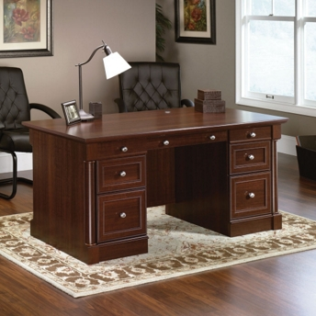
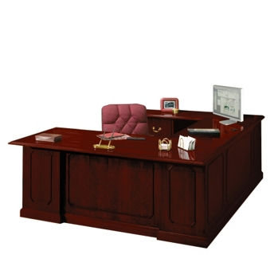
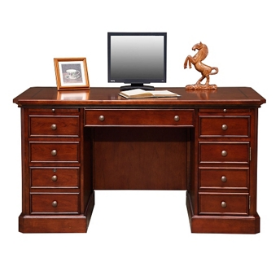
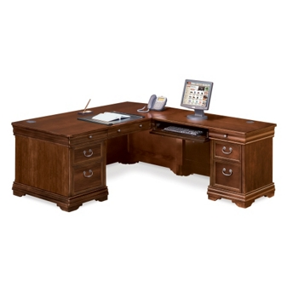
Desk, Executive, L-Unit, U-Shape , Secretary
Executive Desk Sizes:
72x36
68x36
60x30 - Secretary
U-Shape Desk
Secretary or Student Double Pedestal Desk
L-Unit Desk
Left or Right Returns

Slide 4
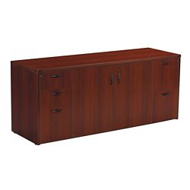
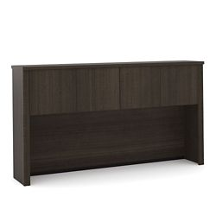
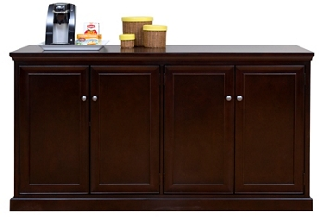
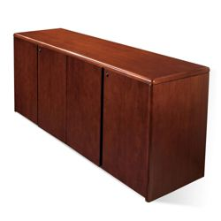

Credenzas and Hutch
Hutch
Credenzas

Slide 5
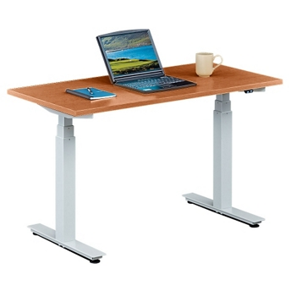
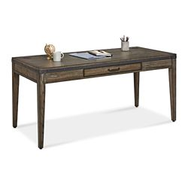
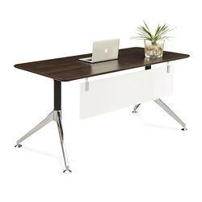
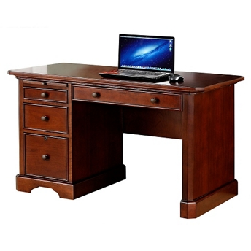
Work Stations
Adjustable Table
Writing Desk
Working Table
Student Desk

Slide 6
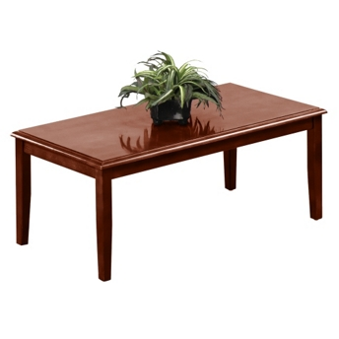
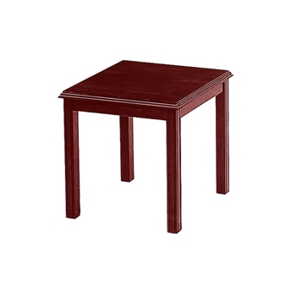
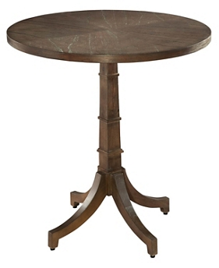
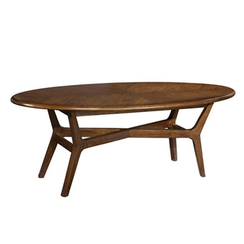
End Table and Coffee Tables
Rectangular Coffee Table
Square End Table
Round End Table
Oval Coffee Table

Slide 7
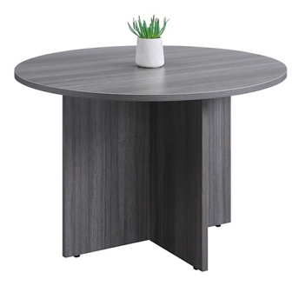
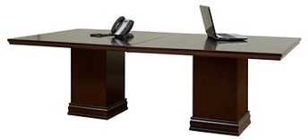
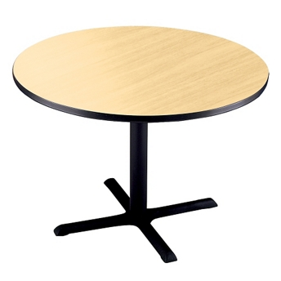
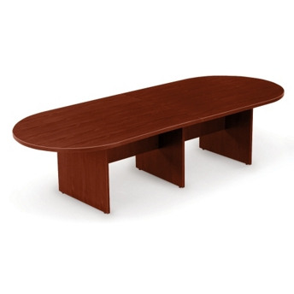
Conference Tables
Rectangular Conf. Table
6 Feet
8 Feet
10 Feet
12 Feet
Round Conf. Table
60 inch
66 inch
70 inch
Cafeteria Style Table
Racetrack Conf. Table
6 Feet
8 Feet
10 Feet
12 Feet

Slide 8
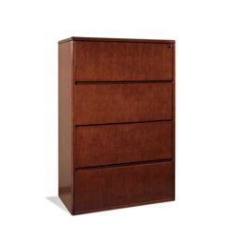
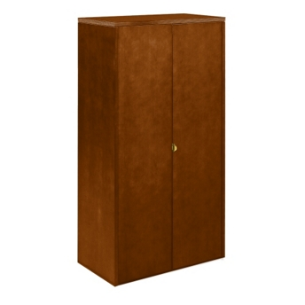
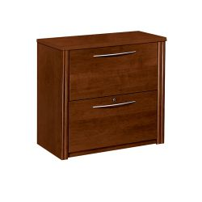
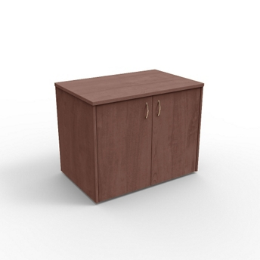
Storage and File Cabinets
4 Drawer Lateral File Cabinet
Tall 2 Door Storage Cabinet
2 Drawer Lateral File Cabinet
Small 2 Door Storage Cabinet

Slide 9
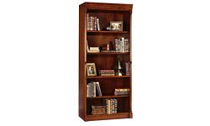
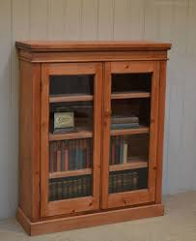
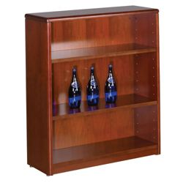
Bookcases Open Front and 2 Door w/Glass
Tall Open Face Bookcase
2 Door w/Glass Bookcase
Short Open Face Bookcase

Slide 10
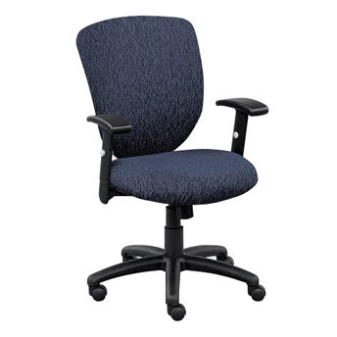
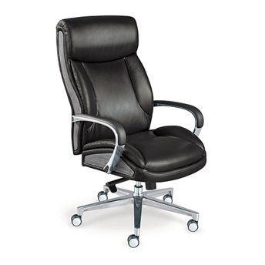
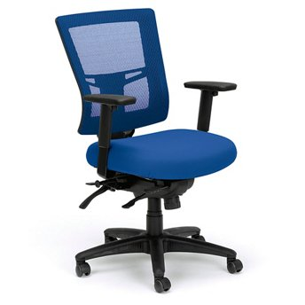
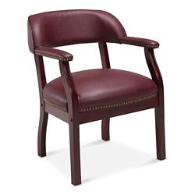
Assorted Chairs
Rotary Chair
Desk Chair
Straight Leg Chair w/Arms
Ergo Chair

Slide 11
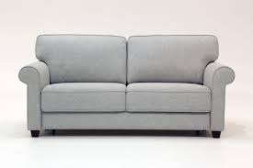
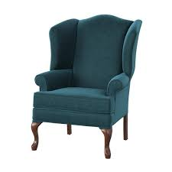
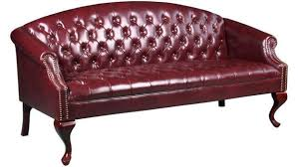
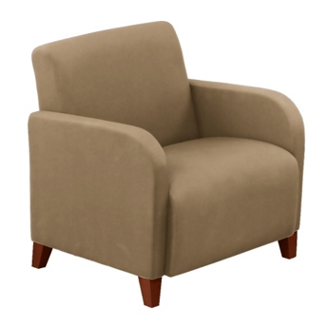
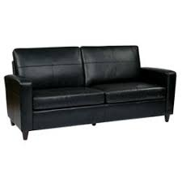
Wingback Chairs, Sofa and Loveseat
Standard Loveseat
Wingback
Executive Sofa
Standard Sofa
Easy Chair

Slide 12
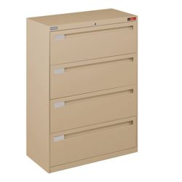
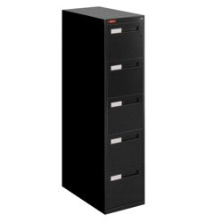
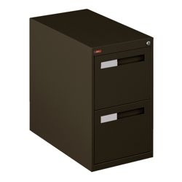
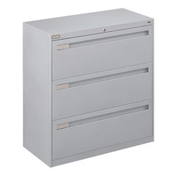
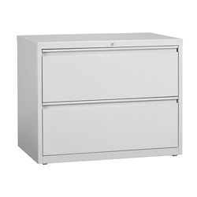
Metal File / Storage Cabinets
4 Drawer Lateral File Cabinet
5 Drawer Letter File Cabinet
4 Drawer
2 Drawer Letter File Cabinet
3 Drawer Lateral File Cabinet
2 Drawer Lateral File

Slide 13
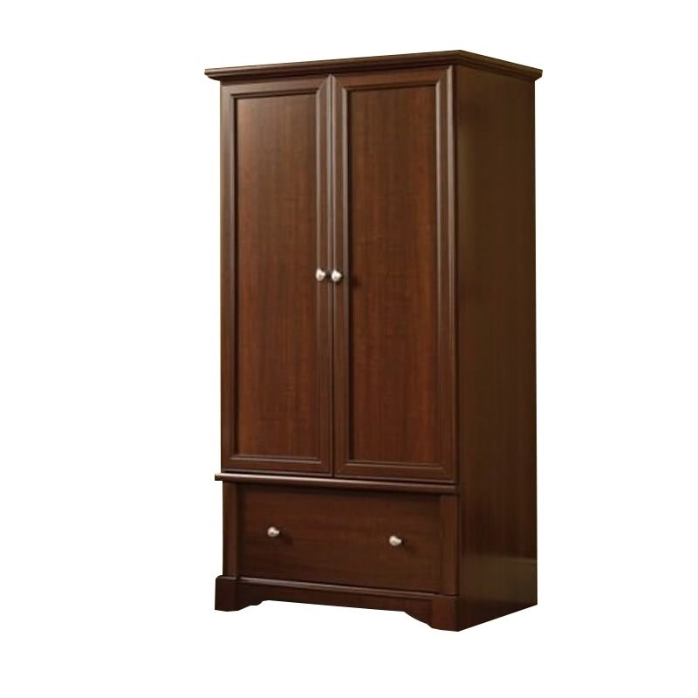
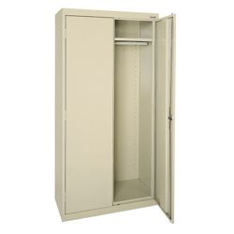
Wardrobes Wood or Metal
2 Door Wardrobe with storage drawer
2 Door Metal Wardrobe

Slide 14
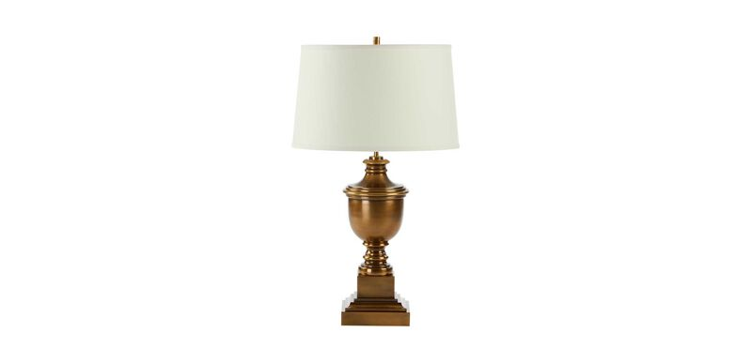
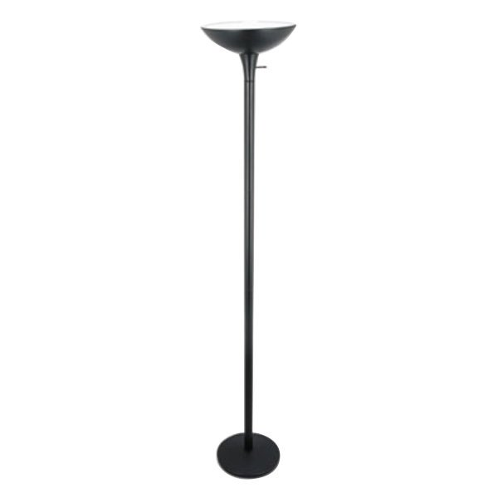
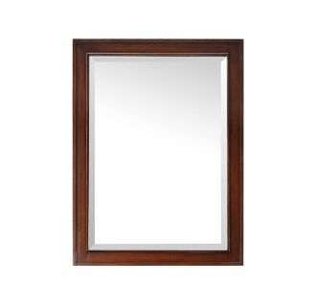
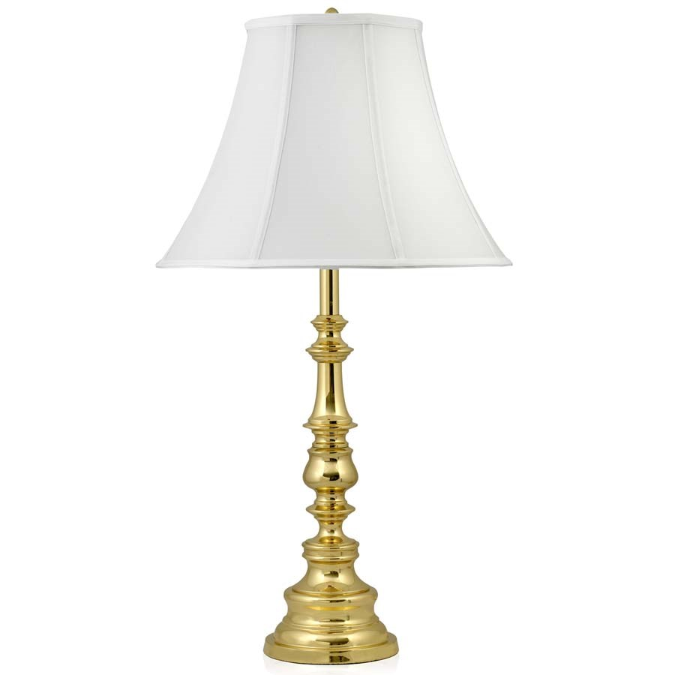
Lamps and Mirror
Brass Desk Lamps
Floor Lamp
Wood Framed Mirror

Slide 15
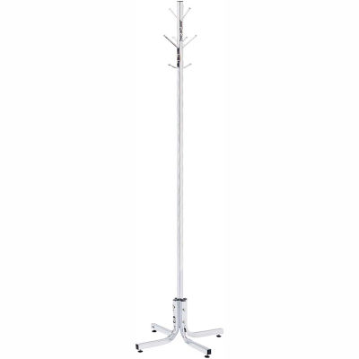
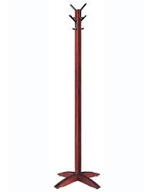

Coat Trees Metal/Wood & Bookstand
Metal Coat Tree Wood Standard Coat Tree Bookstand

