Slide 1



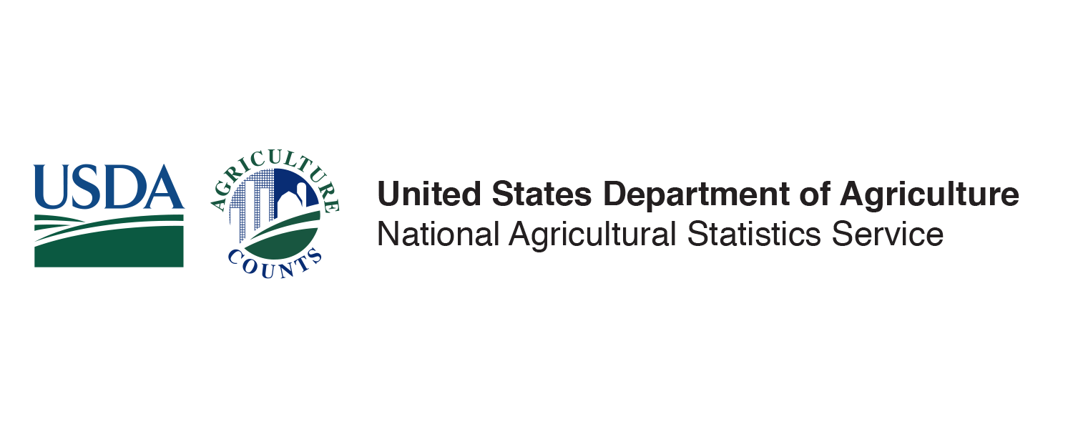
Hubert Hamer, Administrator
THE AG CENSUS COUNTS
March 30, 2023
nass.usda.gov/AgCensus

Slide 2



Our Mission
As the official statistical agency of the USDA, the National Agricultural Statistics Service provides timely, accurate, and useful statistics in service to U.S. agriculture.
Notes:
TALKING POINTS:
NASS Mission
Our goals today are to:
Provide a short introduction to NASS, starting with a little history.
Show you how we collect our data with the help of our in-house public affairs team and highlight some of our current and upcoming surveys and censuses
And share with you just how important the data we produce are/how they directly benefit our farmers, ranchers, local and national governments, trade associations, agribusinesses, universities, and many others.

Slide 3
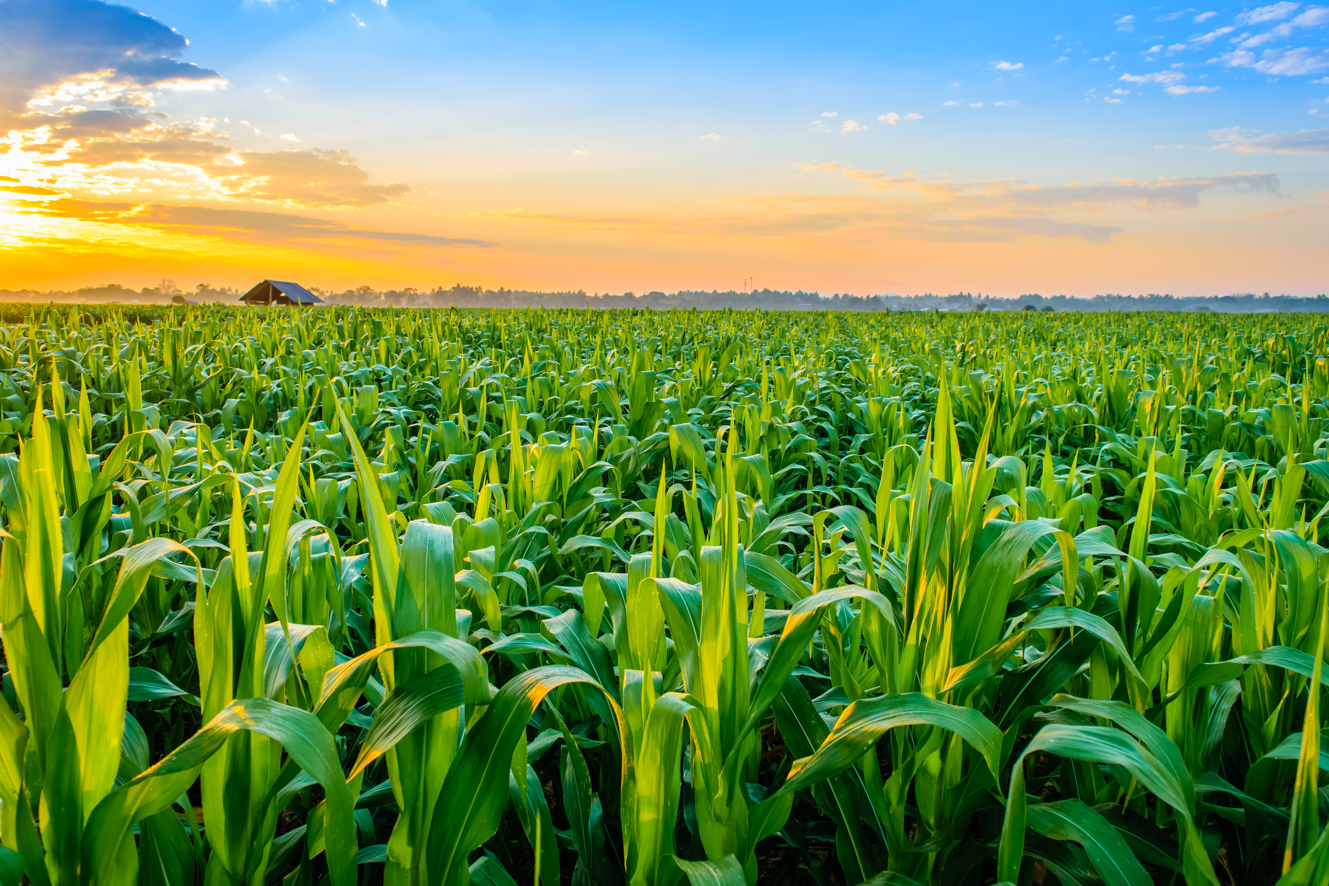




Our History
First Agricultural Statistician
The Birth of USDA
George Washington (August 1791)
8 survey questions to 5 states
Focused on land values, prices, yields
Established by Lincoln (1862)
Intended for information gathering
First crop report: July 1863

Slide 4
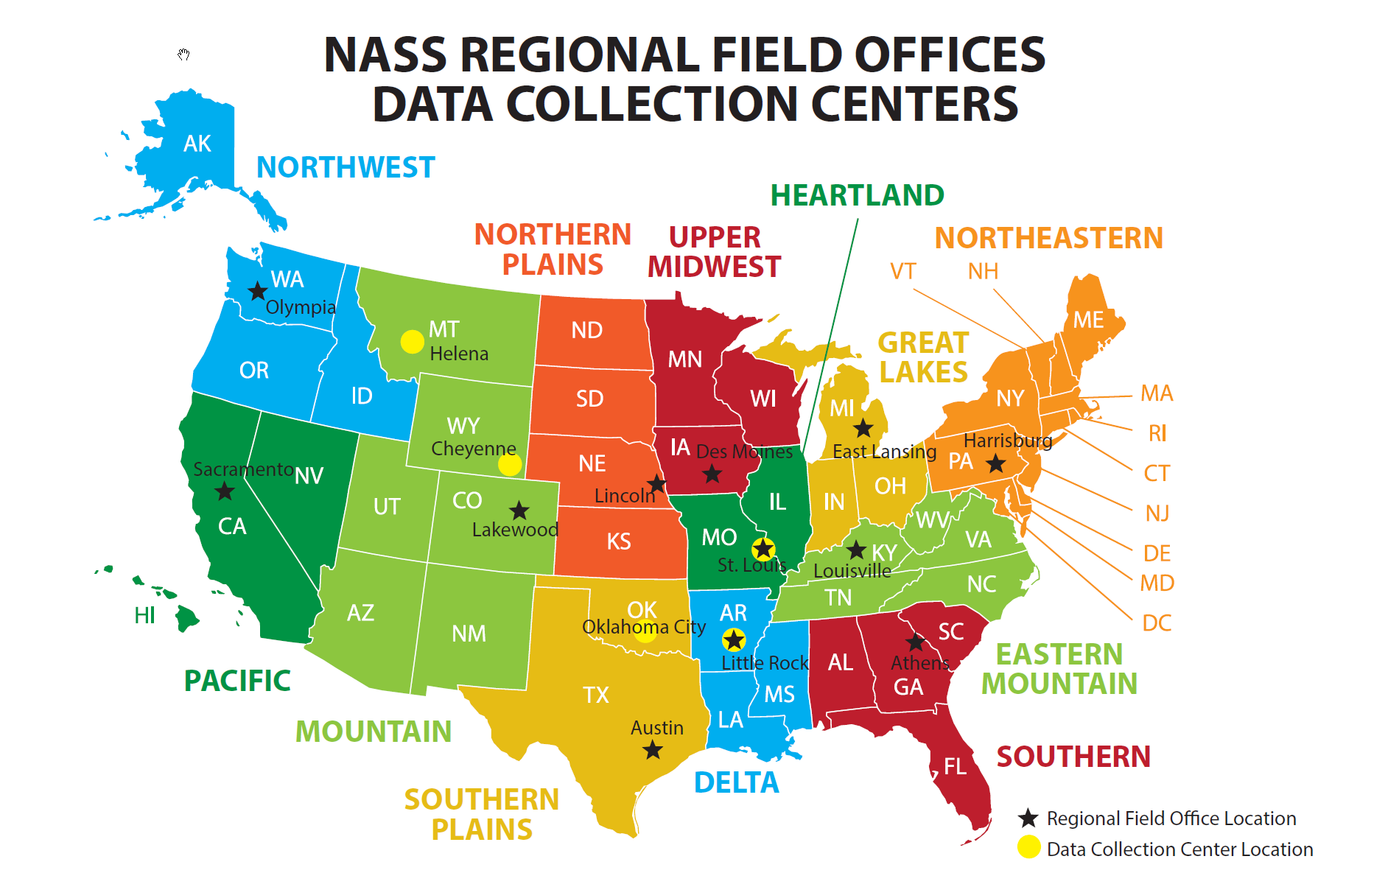
170 Years Later
More than 900 personnel
Serving all 50 states and Puerto Rico
Centralized data collection and processing
3,000 enumerators

Slide 5














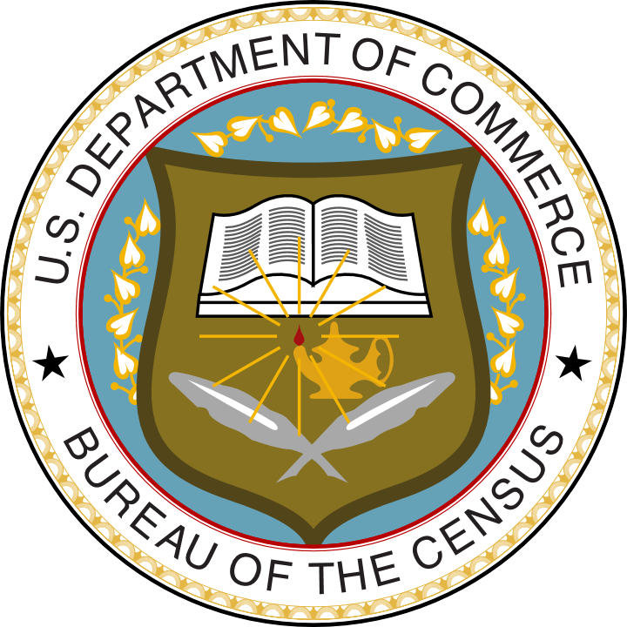



Our Core Values
^{Policy relevance}
^{Objectivity}
^{Credibility}
^{Trust}
^{Commitment}
Statistics with Integrity
Relevance
Credibility
Trust
Independence

Slide 6
What We Do…
Collect, assemble, process, and disseminate U.S. agricultural data
Conduct hundreds of annual surveys
Publish over 450 statistical reports annually
Conduct the detailed Census of Agriculture every 5 years
Partner with state ag departments, trade associations, universities, and others
Conduct research to advance statistical science

Slide 7
What We Do Not Do…
Set policy
Regulate activities
Permit influence
Disclose the identity of respondents
Favor any group above others
We do not….

Slide 8
Census of Agriculture History
The first Census of Agriculture was conducted in 1840 in 26 states and the District of Columbia.

Slide 9
170 Years Later
NASS conducts the Census of Agriculture in:
• all 50 states
• Puerto Rico
• Guam
• U.S. Virgin Islands
• Commonwealth of Northern Mariana Islands
• American Samoa
That’s data for more than 3,000 U.S. counties and 30,000 zip codes.

Slide 10



Census of Agriculture
A complete count, taken every five years, of America’s farms and ranches and the people who operate them.

Slide 11
Census of Agriculture
The most complete agricultural data available.
The only source of uniform, comprehensive and impartial agricultural data for every county in the nation.
Information on land use and ownership, producer characteristics and demographics, production practices, income and expenditures, and more.

Slide 12
Farm Defined
Any place from which at least $1,000 of agricultural products were produced and sold, or normally would have been sold, during the census year.

Slide 13

YOUR VOICE
nass.usda.gov/AgCensus | 13

Slide 14
Your Voice
By participating in the Census of Agriculture, you help show the nation the value and importance of U.S. agriculture.
This is your opportunity to tell how American agriculture provides food, fuel, and fiber to the world.
By responding to the census, you have the power to influence decisions that will shape American agriculture for years to come, including:
transportation and marketing locations
farm services, programs, and policies
production practices and new technologies

Slide 15
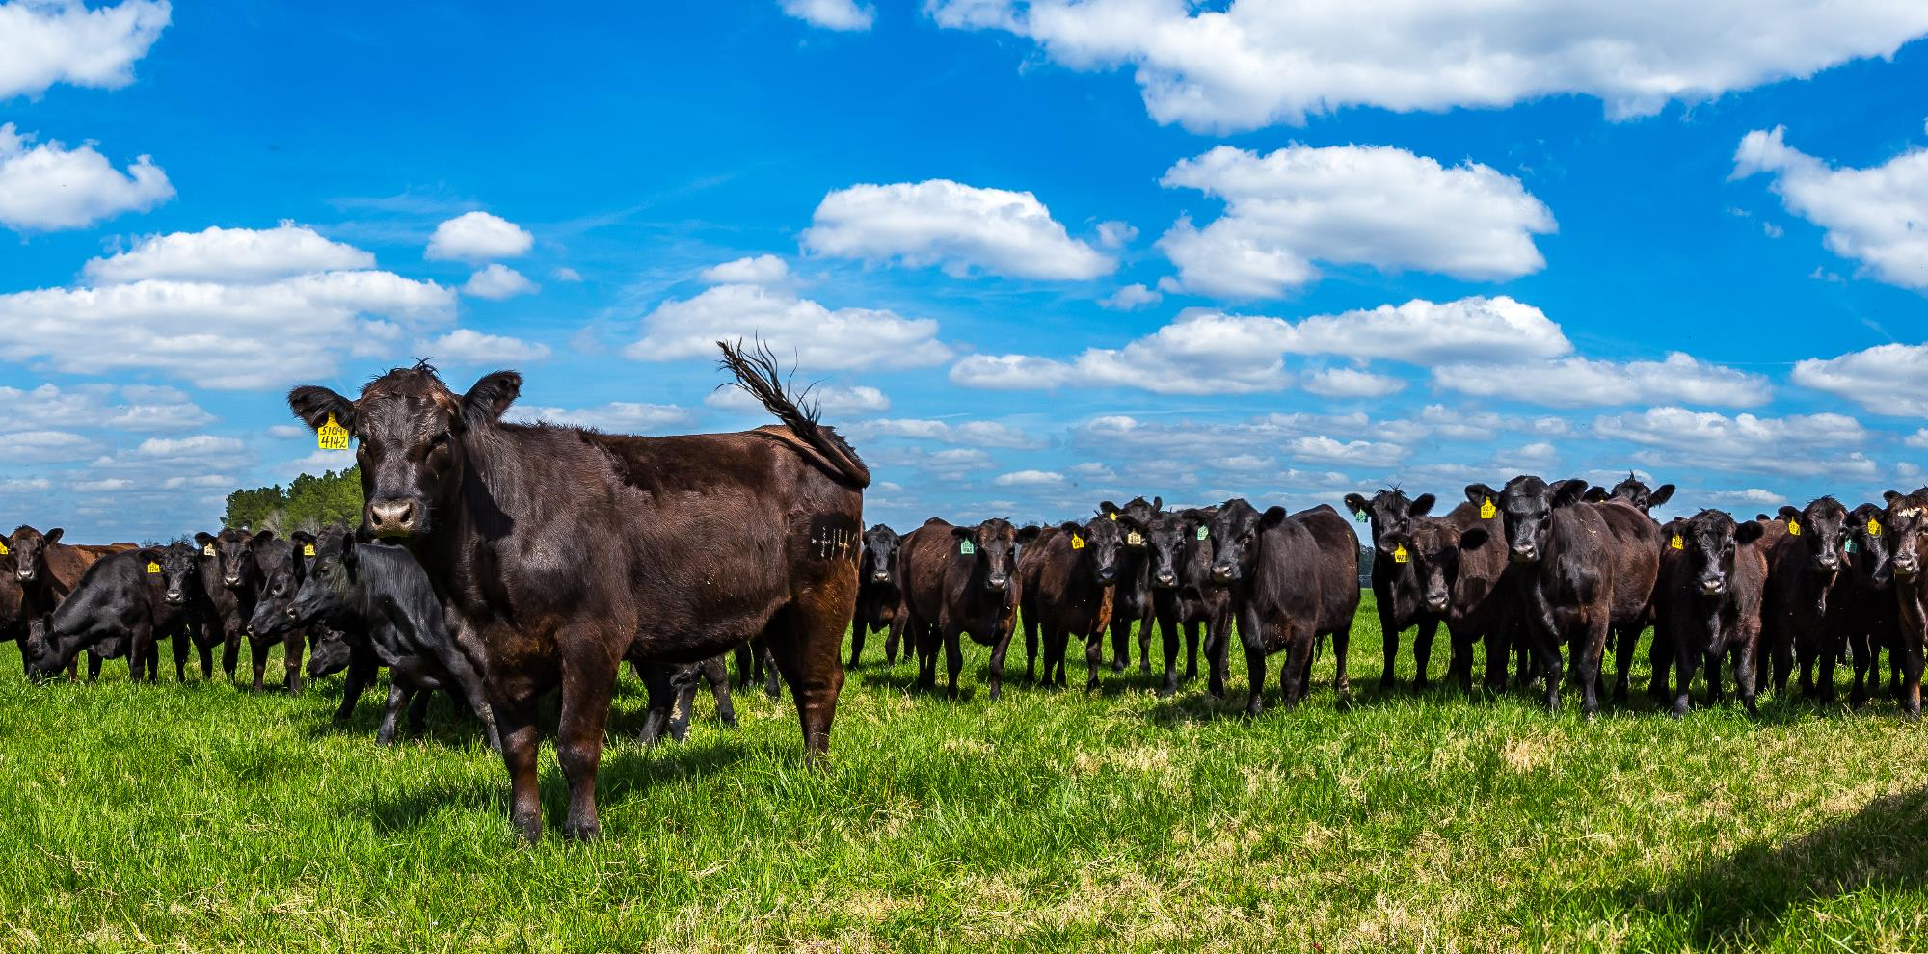

YOUR FUTURE
nass.usda.gov/AgCensus | 15

Slide 16
Your Future
By responding to the Census of Agriculture, you have a positive impact on the future of your operation and your community.
The Census of Agriculture provides valuable information that will be used to plan the future, including:
community planning
farm succession planning
store/company locations
availability of operational loans and other funding
federal budget support for agriculture

Slide 17
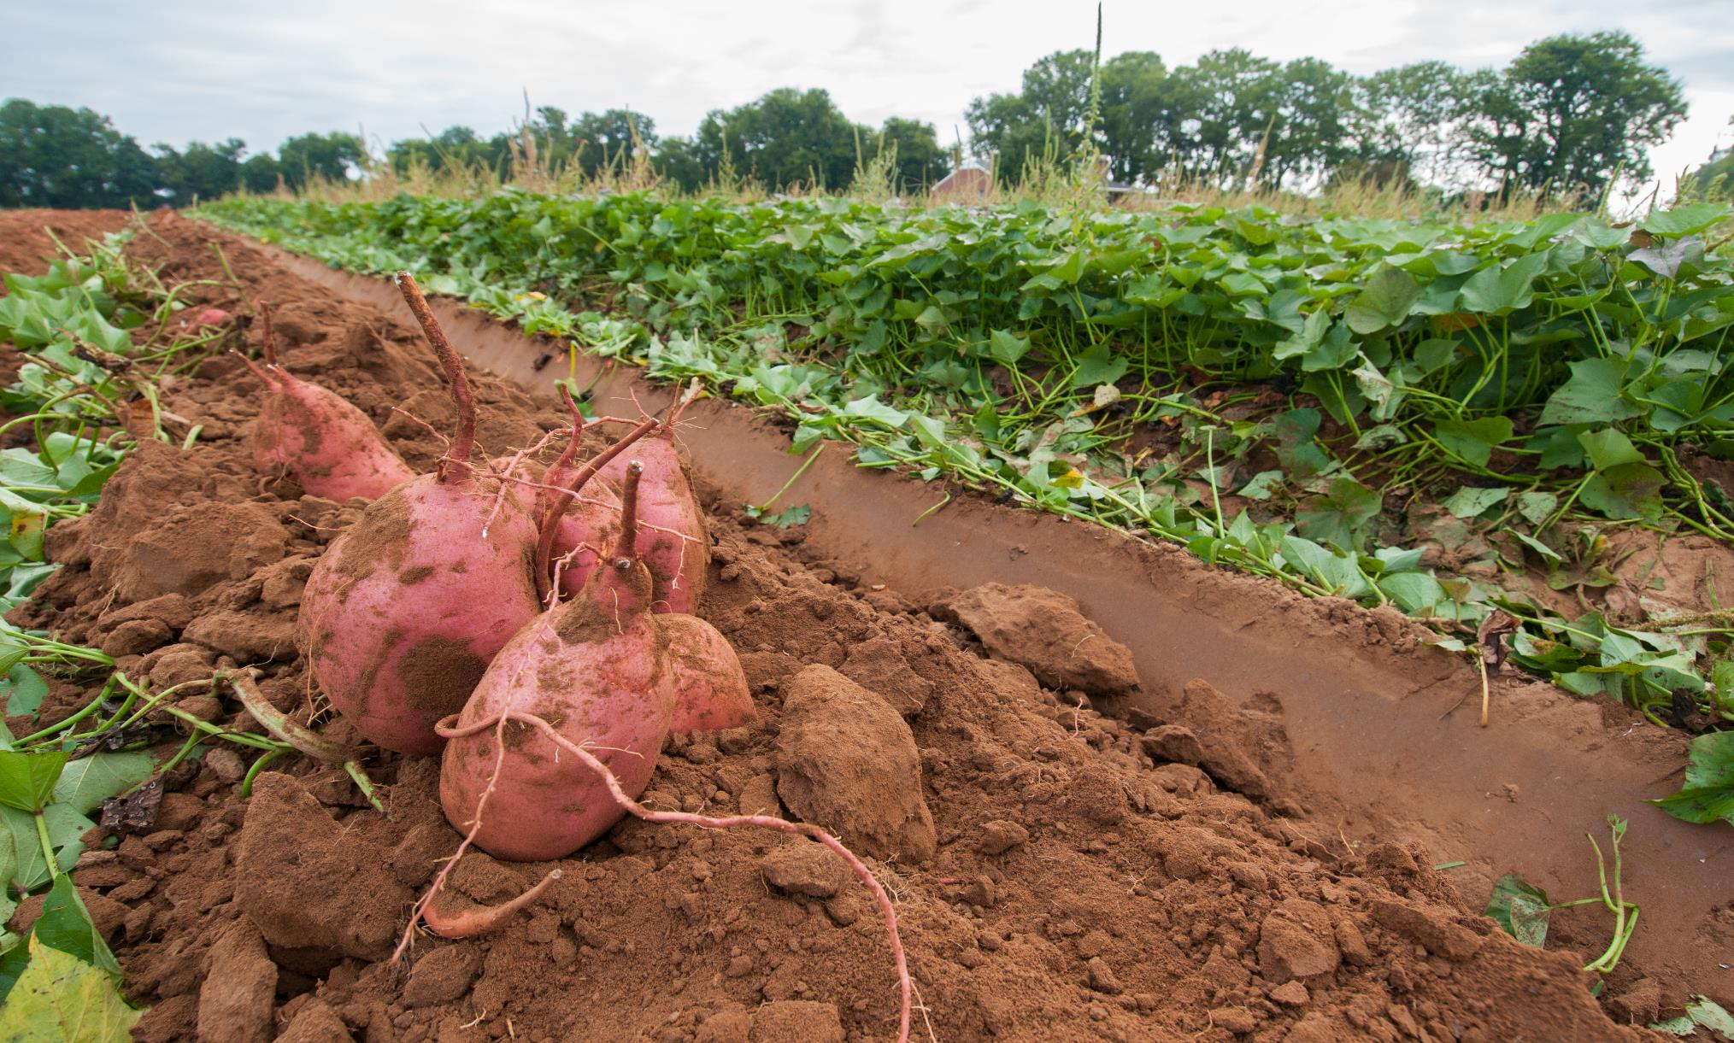

YOUR OPPORTUNITY
nass.usda.gov/AgCensus | 17
nass.usda.gov/AgCensus | 17

Slide 18
Your Opportunity
Your response to the Census of Agriculture makes a difference!
To ensure that the best tools and reports are available, we need accurate information from ALL farmers and ranchers no matter how large or small your operation.
Respond early and avoid follow-up contacts.
Your response is required and protected by federal law.

Slide 19
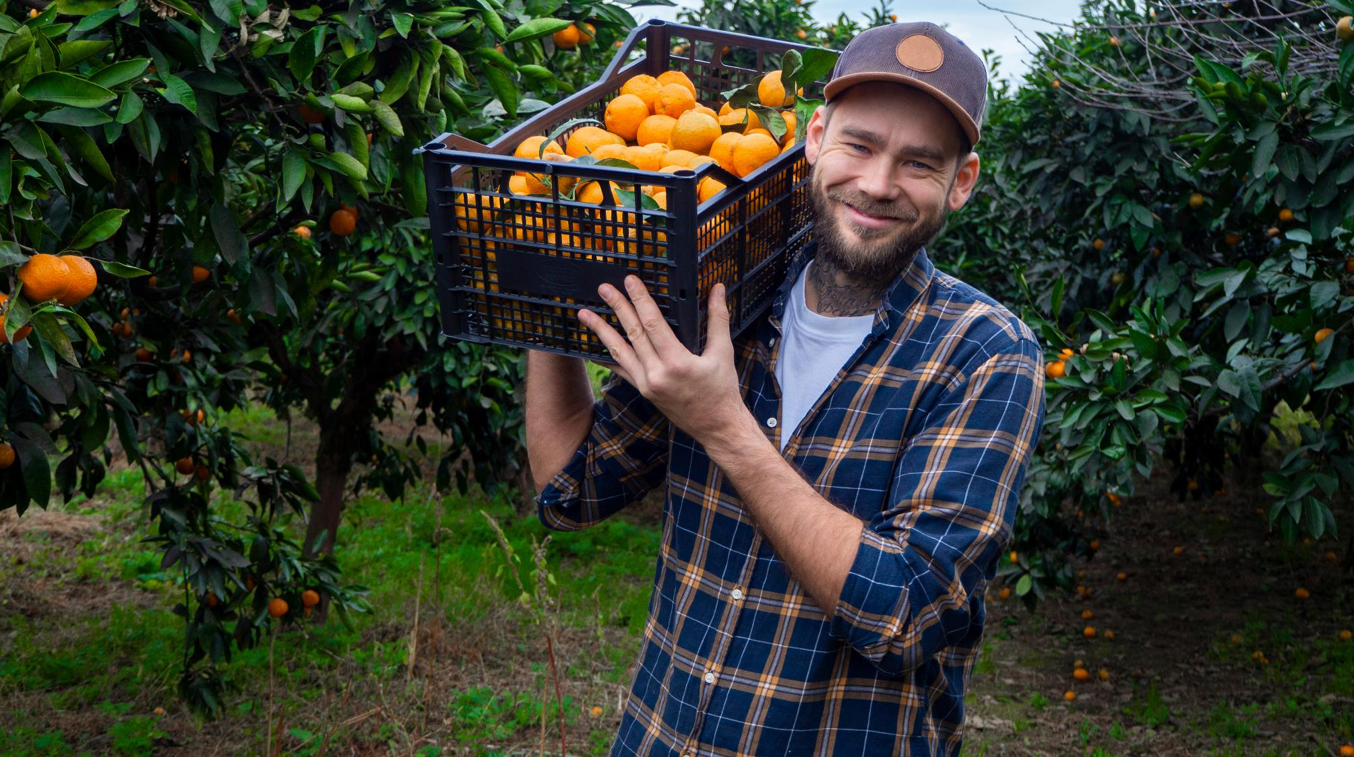

BE COUNTED
THERE’S STRENGTH IN NUMBERS
nass.usda.gov/AgCensus | 19
nass.usda.gov/AgCensus | 19
nass.usda.gov/AgCensus | 19

Slide 20
Census Products
Still time to respond!
Spring/Summer 2024: Census data release
Other Census Products in 2024:
Sate and County Profiles
Congressional District Profiles
REG Profiles

Slide 21
Responding to the Census
You are highly encouraged to complete the Census of Agriculture online at www.agcounts.usda.gov. The online questionnaire is secure, convenient and user-friendly. Save time by responding online as the form calculates totals automatically, offers quick drop-down menu options, and skips questions that do not pertain to you operation.
Alternatively, you may also respond by mail.

Slide 22
Partnership is Important
Help us spread the word to farmers and ranchers about the importance of responding to NASS surveys and censuses.
The resultant data can have a direct impact on their operations, industries, and communities.
Demand for Data is growing to support important decisions.

Slide 23
What’s been successful
Community Based Organizations (CBO) Partnerships
First CBO Workshop
Conducted in preparation for the 2007 Census of Agriculture
In 2007 we had just over 30 participants
In 2022, we had almost 100 participants!

Slide 24
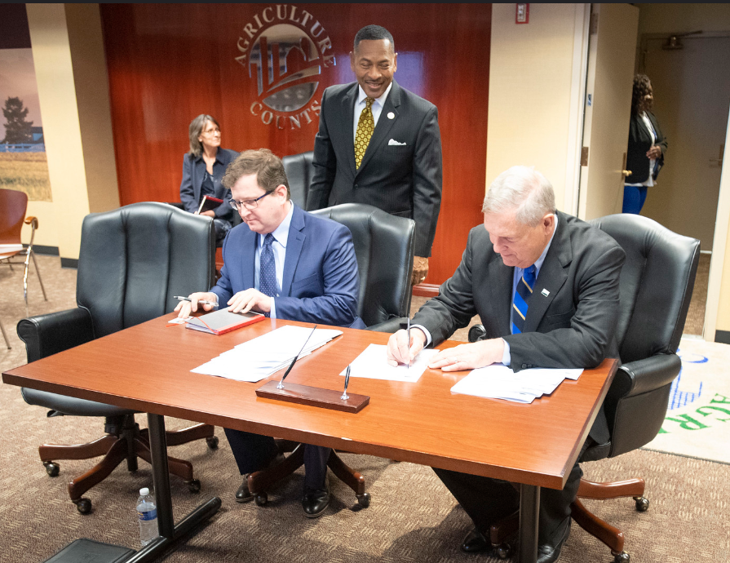
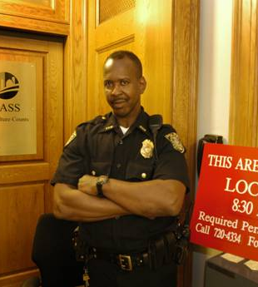
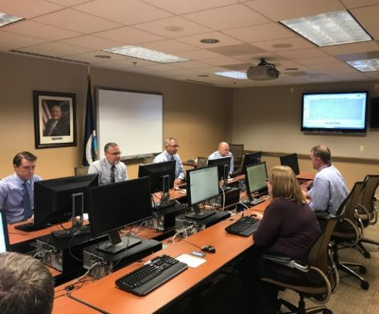
Join us for “Lockup”

Slide 25
For More Information
Visit www.nass.usda.gov/AgCensus
Find the latest promotional and outreach products under Partner Tools in the left column of the Ag Census web page.
Follow @USDA_NASS on Twitter
Call (800) 727-9540

