Slide 1
SARE Farmer/Rancher Grant Program
Vance N. Owens, National Program Leader
USDA NIFA

Slide 2
Non-Discrimination Statement
https://www.usda.gov/non-discrimination-statement
In accordance with federal civil rights law and U.S. Department of Agriculture (USDA) civil rights regulations and policies, the USDA, its Agencies, offices, and employees, and institutions participating in or administering USDA programs, are prohibited from discriminating based on race, color, national origin, religion, sex, gender identity (including gender expression), sexual orientation, disability, age, marital status, family/parental status, income derived from a public assistance program, political beliefs, or reprisal or retaliation for prior civil rights activity, in any program or activity conducted or funded by USDA (not all bases apply to all programs). Remedies and complaint filing deadlines vary by program or incident.
Persons with disabilities who require alternative means of communication for program information (e.g., Braille, large print, audiotape, American Sign Language, etc.) should contact the responsible agency or USDA’s TARGET Center at (202) 720-2600 (voice and TTY) or contact USDA through the Federal Relay Service at (800) 877-8339. Additionally, program information may be made available in languages other than English.
To file a program discrimination complaint, complete the USDA Program Discrimination Complaint Form, AD-3027, found online at How to File a Program Discrimination Complaint and at any USDA office or write a letter addressed to USDA and provide in the letter all of the information requested in the form. To request a copy of the complaint form, call (866) 632-9992. Submit your completed form or letter to USDA by: (1) mail: U.S. Department of Agriculture, Office of the Assistant Secretary for Civil Rights, 1400 Independence Avenue, SW, Washington, D.C. 20250-9410; (2) fax (202) 690-7442; or (3) email: program.intake@usda.gov.
USDA is an equal opportunity provider, employer and lender.
Notes:
REQUIRED SLIDE FOR ALL EXTERNAL PRESENTATIONS. DO NOT REMOVE FROM YOUR PRESENTATION.
It is acceptable to summarize this statement verbally while displaying it, by reading the first bullet point in its entirety, and stating that the slide contains contact information for individuals with disabilities to request reasonable accommodations, that language access services will be provided to limited English proficient individuals upon request, and that anyone wishing to file a complaint can utilize the phone number, fax number, or postal mailing address listed on the slide.

Slide 3
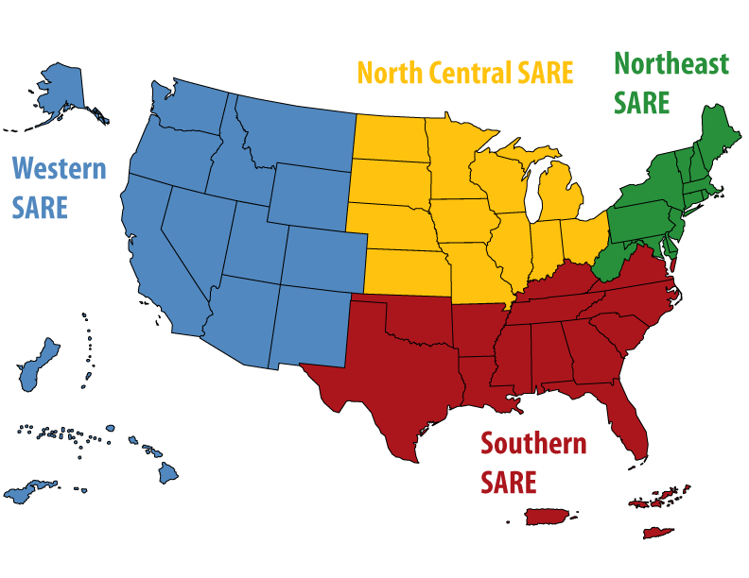
Sustainable Agriculture Research and Education (SARE): Four Regional Host Institutions plus a National Reporting, Coordination and Communications Office (NRCCO)
North Central: University of Minnesota
Northeast: University of Vermont
Southern: University of Georgia
Western: Montana State University
NRCCO: University of Maryland

Slide 4
The SARE Model
USDA NIFA provides funding to host institutions through annual, 5-year cooperative agreements
Each region has a legislatively mandated Administrative Council that sets priorities for several grant programs and selects, based on reviewer feedback, projects to fund
Host institutions administer the grant programs in their region
NRCCO runs the Grant Management System and produces practical informational materials

Slide 5


SARE Projects Address the Three Aspects of Sustainability
Environmental — Stewardship of Land and Water
Economic — Profitability over the Long Term
Social — Quality of Life for Producers and their Communities

Slide 6
SARE Funding 1988-2022

Slide 7
Regional SARE Grant Program Characteristics
Open to all types of farming: large or small; organic or conventional; urban or rural; row crop, livestock, small fruit and vegetable, agroforestry, and aquaculture
Open to different points on the value chain: production, processing or marketing
Not restricted to specific disciplines
Eligible applicants: varies by grant type but is generally broad and diverse

Slide 8
SARE Grant Types (Amount and Type Vary by Region)
Research Grants
  Larger Research and Extension (~$300k)
  Smaller grants ($5-50k)
    Farmer/Rancher
    Professional + Farmer (Partnership)
    Graduate Student
Professional Development and Training
  State Programs
  Professional Development Program: Train-the-Trainer ($50-100k)
Check regional websites for funding amount and deadlines

Slide 9
SARE Farmer/Rancher Grant Goals
Explore new concepts in sustainable agriculture conducted through experiments, surveys, prototypes, on-farm demonstrations or other research and education techniques ... addressing issues that affect farming with long-term sustainability in mind
Explore sustainable solutions to problems through on-farm research, demonstration and education projects
Enable farmers and ranchers to test a sustainable agriculture idea using a field trial, on-farm demonstration, marketing initiative or other technique
Advancing on-farm sustainability solutions by funding innovative producer-driven research and outreach

Slide 10
Farmer/Rancher Grant Information by SARE Region (1)
SARE Region | $/Project | Funding | Project Length | RFA release | Time to apply
Northeast | $5-30k | ~ $750k | 12 to 36 months | Summer/Fall | 2-3 months
North Central | $15k: Individuals $30k: two or more farmers | ~ $700k | Up to 23 months | Summer/Fall | 2-3 months
Southern | $15k: Individual $20k: Farmer organization | ~ $200k | 24 months | Summer/Fall | ~ 2 months
Western | $25k: 1-2 producers $29,900: 3 or more producers | ~ $550k | 12 to 36 months | Summer/Fall | 2-3 months

Slide 11
Helping reach underserved producers
Technical Assistance
  Pre-Award
  Post-Award
Focus areas in regional Calls for Proposals (CFPs)
Diverse farmer/rancher panels
Focused outreach by Host Institution staff and AC members

Slide 12
Key SARE Websites
The main SARE website is found at: www.sare.org
  Regional websites can be accessed from this main website
  Contact information for grant coordinators for each grant type in each region can be found at the regional website
For access to the SARE Grant Management System, and to search the SARE projects database, visit: projects.sare.org

Slide 13
Questions or Comments

