Slide 1
Food Safety & Inspection Service (FSIS) Overview
George D. Baptist III, Branch Chief, Procurement Branch

Slide 2
FSIS Mission
The Food Safety and Inspection Service (FSIS), is a food safety regulatory agency within the U.S. Department of Agriculture (USDA) responsible for ensuring that domestic and imported meat, poultry, and egg products are safe, wholesome, and accurately labeled.
  FSIS employs approximately 9,000 workers who collectively conduct a broad range of food safety activities to achieve FSIS’ overall vision—that everyone’s food is safe. The Agency’s employees comprise a frontline workforce assigned duties at federally regulated establishments, FSIS laboratories, and in-commerce facilities nationwide as well as technical, administrative, and support staff.
  FSIS is unique as we are our own mission area. Unlike some other USDA agencies that have multiple agencies within their mission. Within FSIS, we have 15 program offices that we procure goods and services .

Slide 3
What FSIS procures?
FSIS procures a wide variety of supplies, equipment, and services in the following areas:
  Laboratory/scientific equipment and supplies
  Maintenance agreements on laboratory equipment
  Equipment and Personal Protection equipment used by inspection staff
  Information technology equipment and services
  Office machines and supplies
  Management and professional services
  Training (commercial-off-the-shelf and customized)

Slide 4
Small Business Achievements
Actions to achieve small business goals:
  Procurement Branch and the program offices have partnered in Small Business outreach via updating the procurement forecast twice a year, bi-weekly contract reviews and aligning all known requirements with small business and 8a companies.
FY22 Small Business Achievements
 | FY22 Department-wide Goals (from SBA as of 2/11/2022) | FY22 Achievement as of 03/22/2022 | FY22 Achievement as of 03/29/2022
Small Business | 47% | 76.83% | 76.11%
Small Disadvantaged Business | 21.50% | 61.89% | 62.38%
Women-Owned Small Business | 5% | 29.12% | 28.16%
HUBZone Small Business | 3% | 28.38% | 27.67%
Service-Disabled Veteran-Owned Small Bus | 3% | 25.30% | 23.17%
8(a) Business (Tracking due to EO) | 5-15% by 2025/26 | 8.46% | 9.41%

Slide 5
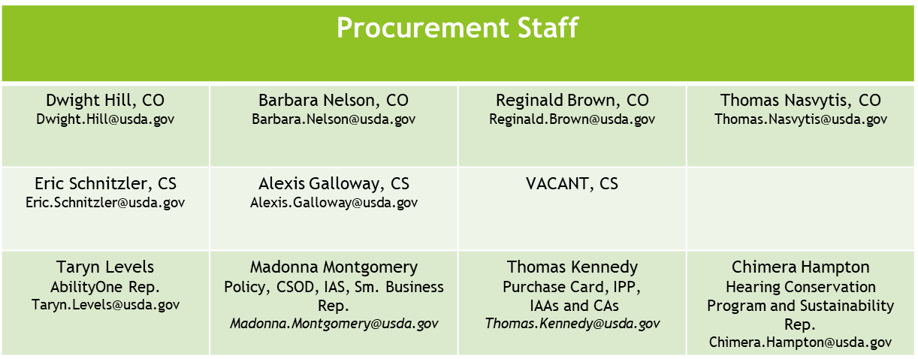
Agency Contracting Structure
Branch Chief of Procurement
George Baptist (202) 604-6767
Team Lead
Program Areas: OM(OAS, OHR, ESHWS); IA, OIEA, OPHS, OPACE, OPARM, OCFO
VACANT
Team Lead
Program Areas: OCIO, OFO, OPPD, OIC, OEED
Karen Petty Karen.Petty2@usda.gov

Slide 6
Small Business Contact Information
FSIS Small Business Representative
  Madonna Montgomery, Acquisition Analyst
  E-mail: Madonna.Montgomery@usda.gov
  Firms or individuals wishing to do business with FSIS, please provide company capability statement identifying your areas of expertise with your e-mail.
  We look forward to doing business with you in the future!

