Slide 1
Procurement – Small Business Activities
Forest Service Overview
Melissa Dyniec
Deputy Director
Procurement & Property Services

Slide 2
Natural Resources and Environment
The mission of Natural Resources and Environment is to sustain the health, diversity, and productivity of the Nation’s forests and grasslands to meet the needs of present and future generations.
We carry out our mission in partnership with States, Tribes, and communities across the country who steward our Nation’s forest and grasslands.
Notes:
The FS is the only agency that falls under NRE. As you can see, the NRE mission aligns with the work done by the FS.

Slide 3
About the Forest Service
“Caring for the Land and Serving People”
  The Forest Service mission is to sustain the health, diversity, and productivity of the nation’s forests and grasslands to meet the needs of present and future generations.
  The agency is responsible for
    Protection and management of natural resources on lands we manage
    Research on all aspects of forestry, rangeland management, and forest resource utilization
    Cooperation with State and local governments, forest industries, and private landowners to help protect and manage non-Federal forest, range, and watershed lands
    Support of an effective workforce reflecting the diversity of the American people
    Internal assistance for the protection and management of the world’s forest resources
Notes:
The FS helps people enjoy the forest while conserving the environment for generations to come.
We manage 193 million acres of land, roughly the size of Texas.
- We manage public lands such as national forests and grasslands, provide technical and financial assistance to S&PF agencies, and make up the largest forestry research organization in the world.

Slide 4
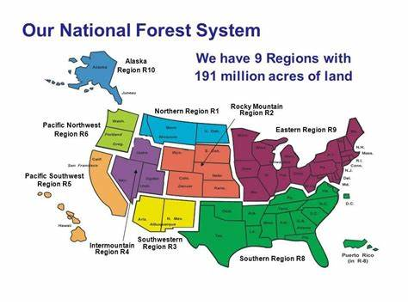
About the Forest Service (cont.)
191 million acres
9 regions
154 national forests
20 grasslands
600 ranger districts
30K employees
Notes:
- This is a map showing the Regions of our National Forest System, which is what most people think of when they think about working with the FS.
The natural resources of our forests and grasslands contribute a variety of essential elements to our well-being, including clean air, water and soil.
The impact of our National Forests] Annually,
outdoor recreation generates $887 billion in consumer spending,
7.6 million American jobs,
$65.3 billion in federal tax revenue, and
$59.2 billion in state and local tax revenue,
In addition to recreation, the FS has been managing wildland fire on National Forests and Grasslands for more than 100 years. We work closely with other federal, tribal, state, and small businesses to help our Incident Support efforts

Slide 5
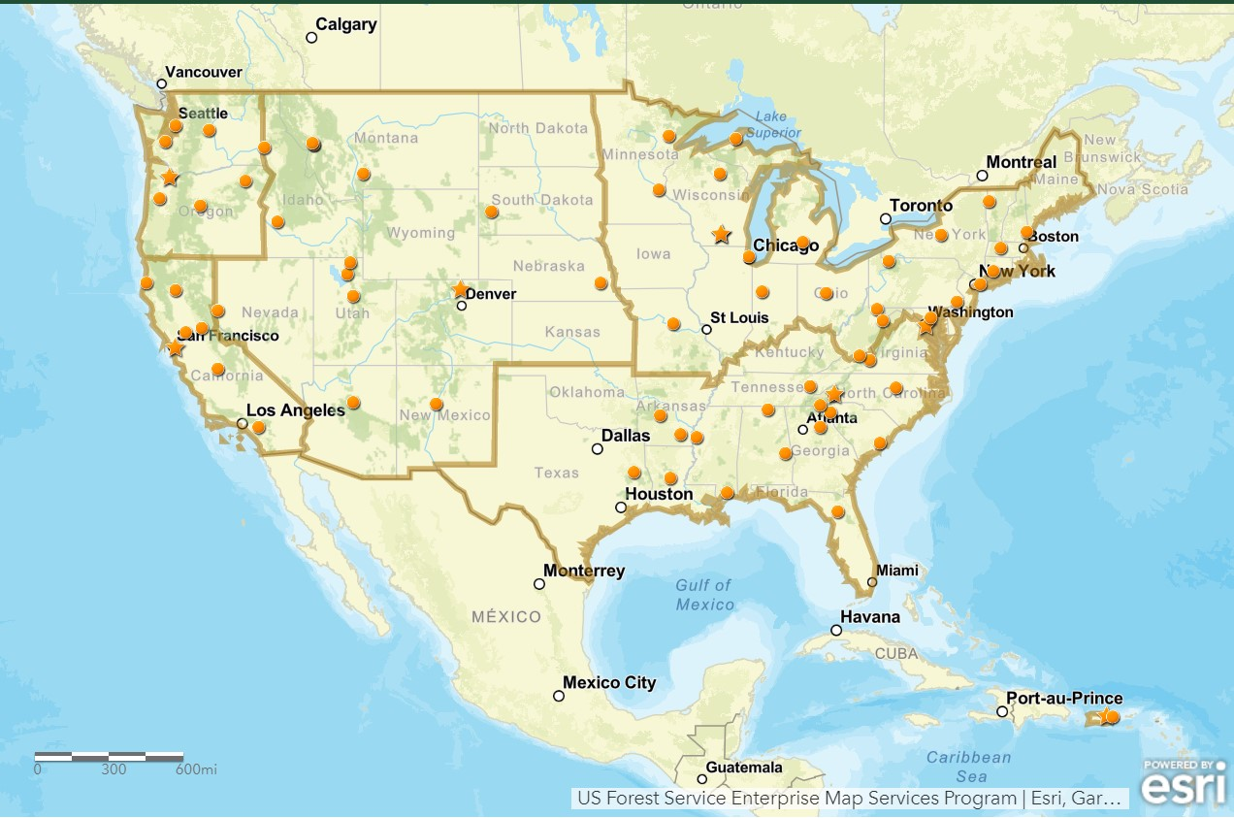
About the Research Stations
Our Research Stations
R&D science is conducted at roughly 80 locations across the U.S.
Five research stations and two research centers
80 experimental forests strategically located to reflect the diversity of natural resources
Notes:
-

Slide 6
National Programs and Offices
Office of the Chief
Business Operations
Chief Financial Office
National Forest System
Research & Development
State & Private Forestry

Slide 7
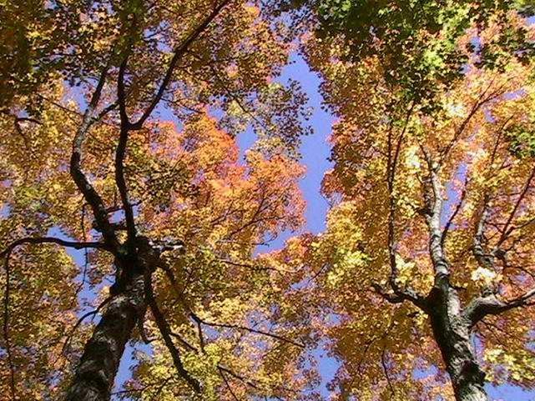
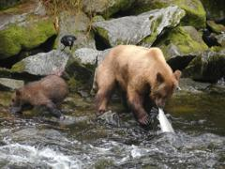
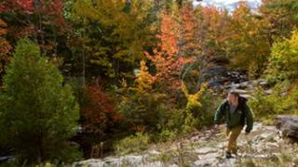
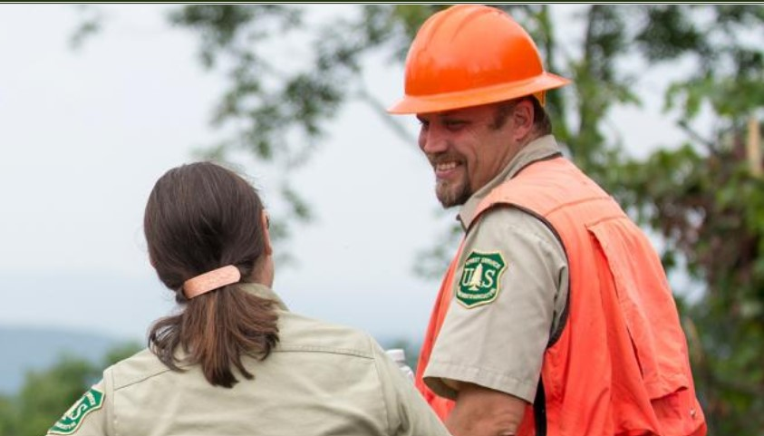
Small Business Program
The Forest Service is dedicated to maximizing small business participation organization-wide and has consistently done so for over a decade.
  Specialist/Coordinators track agency achievement weekly
  At the field level, Coordinators review each proposed acquisition expected to exceed SAT ($250k) prior to its solicitation.
  Specialist/Coordinators regularly participate in local/national vendor outreach events and match-making sessions.
Notes:
The FS is committed to maximizing small business participation. In fact, for at least the past 10 years, 80% of the awards made to small businesses by USDA came from the FS.
I understand you will hear more about what types of things we buy tomorrow.

Slide 8
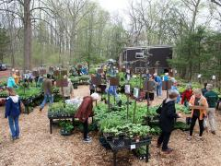
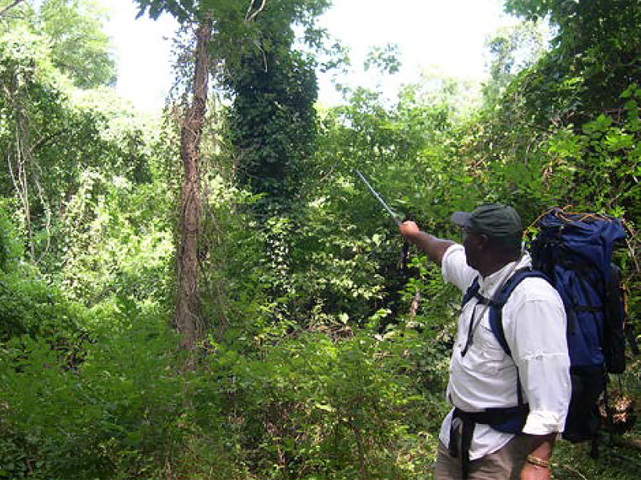
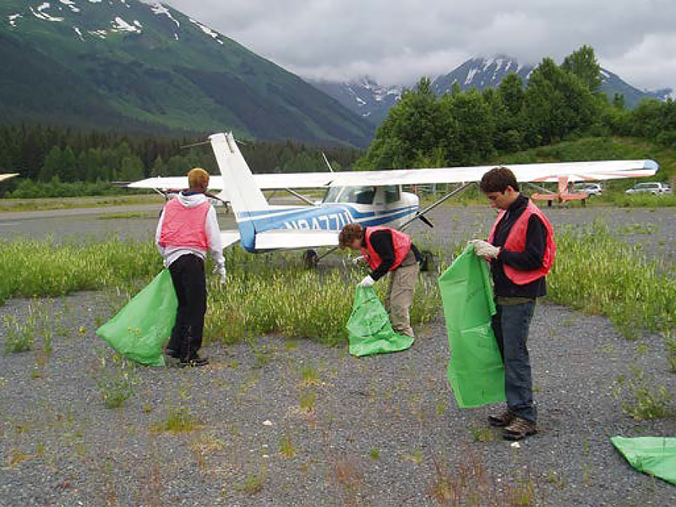
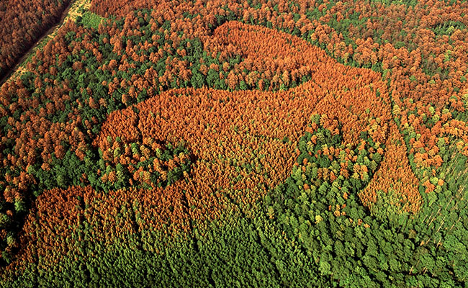
Historical Small Business Achievement
Fiscal Year | Total Dollars Spent | SB Dollars Spent | Agency SB Percent | USDA SB Goal
FY 2017 | $1,887,733,362 | $1,646,484,377 | 87% | 49%
FY 2018 | $2,023,144,674 | $1,758,755,275 | 86% | 53%
FY 2019 | $1,538,365,786 | $1,335,108,836 | 87% | 57%
FY 2020 | $1,986,707,165 | $1,596,932,405 | 80% | 58%
FY 2021 | $1,850,446,628 | $1,449,005,957 | 79% | 49.5%
Data source: Sam.gov – Small Business Goaling Report for 3.21.22
Notes:
The agency historical achievement [as captured in beta.sam] is as follows
FY10 – 80%
FY11 – 82%
FY12 – 83%
FY13 – 83%
FY14 – 84%
FY15 – 84%
FY16 – 84%
FY17 – 87%
FY18 – 86%
FY19 – 87%
FY20 – 80%

Slide 9
Additional Funding & Business Opportunities
Great American Outdoors Act (GAOA)
  Funding Land and Water Conservation Fund (LWCF) that will advance the Administration’s conservation goals and establishes a new National Parks and Public Land Legacy Restoration Fund (LRF) to address the deferred maintenance backlog for the USDA and DOI in FY21 – FY25.
Bipartisan Infrastructure Legislation (BIL)
  Provides funding for FY22 – FY26 for Ecosystem Restoration and other programs related to post-fire recovery, healthy watersheds, and mission critical programs that complement an even larger focus on wildland fire.
Grants & Agreements
  You can find financial help from the Forest Service through grants and cooperative agreements, primarily through Research and Development and State and Private Forestry Units. For more info email: accessga@usda.gov

