Slide 1


Mission Area Overview
Rural Development
Presented by Karla Peiffer, Management & Program Analyst

Slide 2
USDA Rural Development’s Mission
USDA Rural Development is committed to helping improve the economy and quality of life in rural America. Through our programs, we help rural Americans in many ways. Together, America Prospers.

Slide 3
Rural Development Offices
Rural Development
Rural Business-Cooperative Service
Rural Housing Service
Rural Utilities Service

Slide 4
Rural Development Business Offices
Business Center
Finance
Office
Enterprise Office
Servicing
Office
Procurement
Management
Office
Technology Office
Human Resources Office

Slide 5
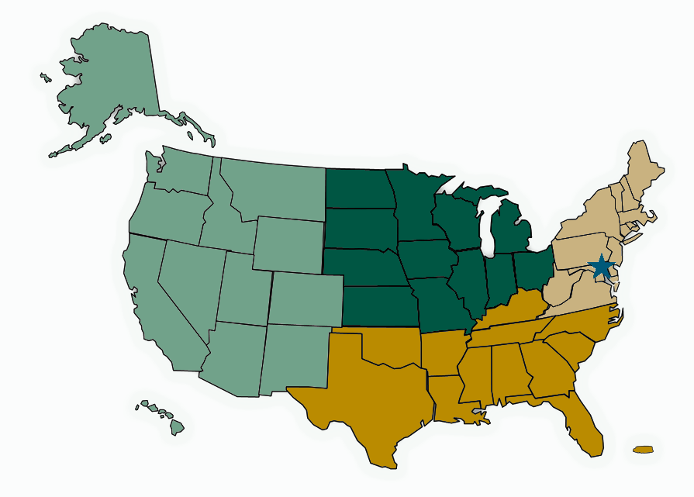
Rural Development Program Offices
4 Regions
47 State Offices
400 Area Offices
1 National Office in DC

Slide 6
Rural Development Programs

Slide 7
Rural Business-Cooperative Service (RBCS)

Slide 8

Business Programs

Slide 9
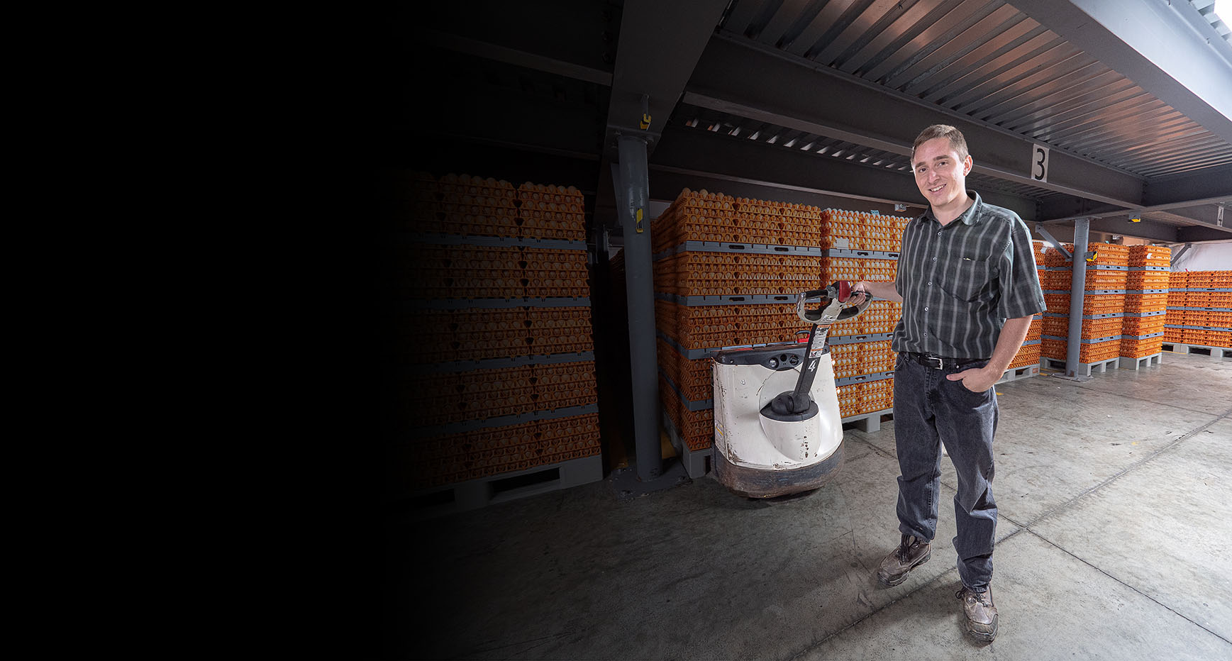
Business & Industry Loan Guarantees
Convert, enlarge, repair, modernize, or develop business
Purchase and develop land, easements, rights-of-way, buildings, or facilities
Purchase equipment, machinery, supplies, or inventory
Refinance when new jobs will be created and other conditions are met

Slide 10
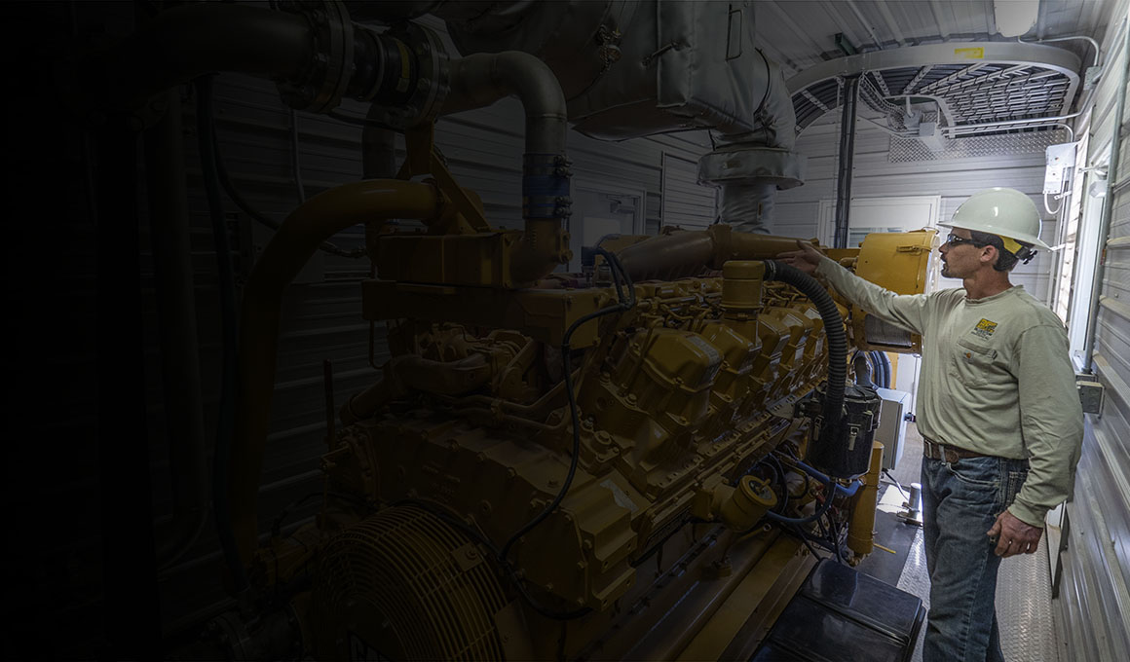
Energy Programs
Business & Industry Loan Guarantees
Advanced Biofuel Payment Program
Biorefinery, Renewable Chemical, and Biobased Product Manufacturing Assistance Program
Rural Energy for America Program (REAP)
  Energy Audits & Renewable Energy Development Grants
  Renewable Energy Systems & Energy Efficiency Improvement Loans & Grants
Convert, enlarge, repair, modernize, or develop business
Purchase and develop land, easements, rights-of-way, buildings, or facilities
Purchase equipment, machinery, supplies, or inventory
Refinance when new jobs will be created and other conditions are met

Slide 11

Cooperative Programs

Slide 12
Rural Housing Service (RHS)

Slide 13

Single-Family Housing
No Down Payment
100 Percent Affordable Fixed Rate Financing
Closing Costs and Repairs may be included
No Prepayment Penalties

Slide 14

Multi-Family Housing

Slide 15
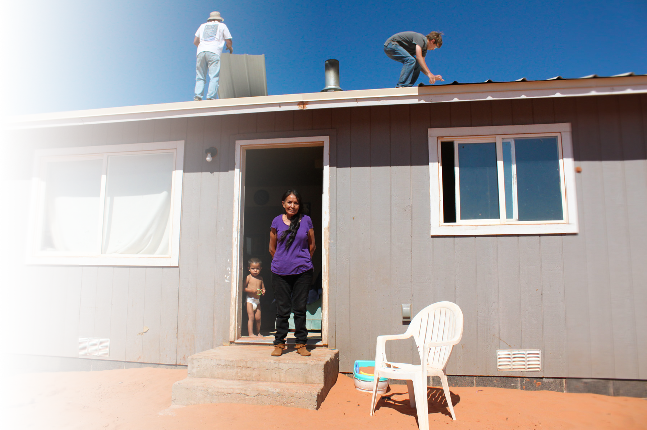
Single-Family Home Repair Loans and Grants
Access for persons with disabilities
Roofs and septic tanks
Energy-saving upgrades, and more.

Slide 16

Community Facilities
Hospitals, health clinics
Schools
Daycares
Fire houses, first responder vehicles and equipment
Community centers and more.

Slide 17
Rural Utilities Service (RUS)

Slide 18
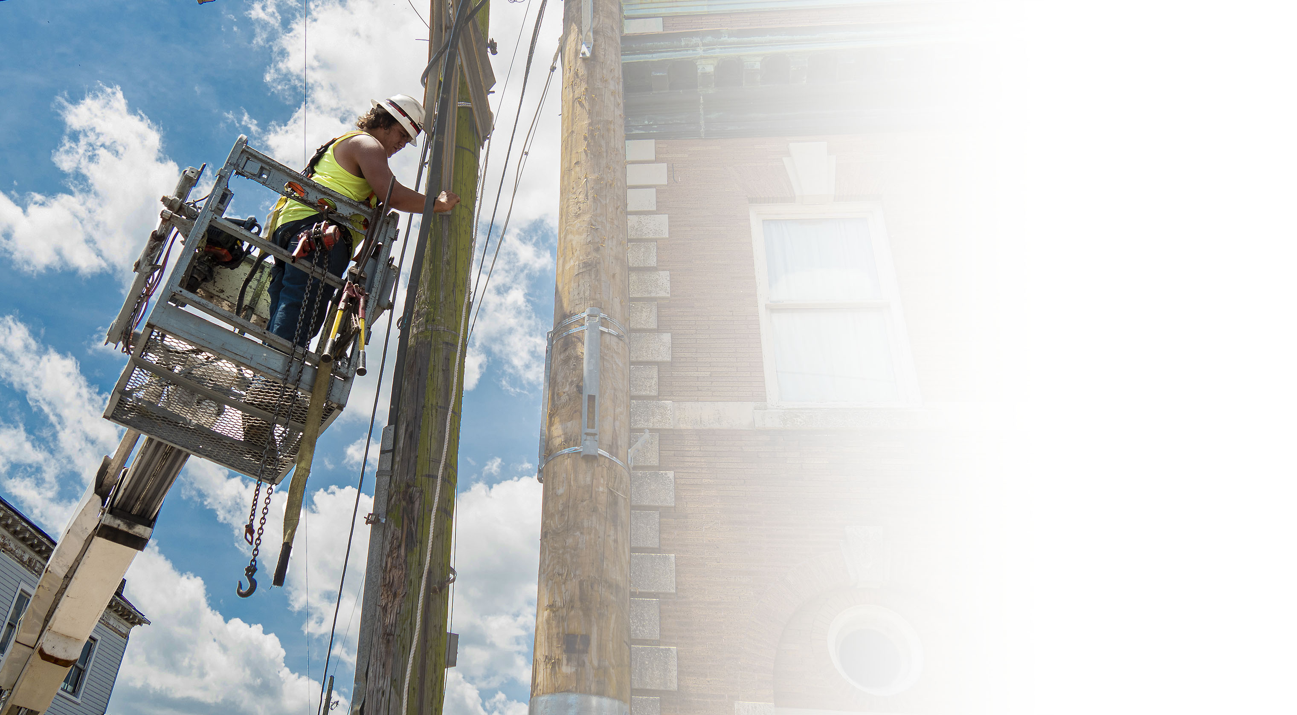
Electric Program

Slide 19

Telecommunications Program

Slide 20
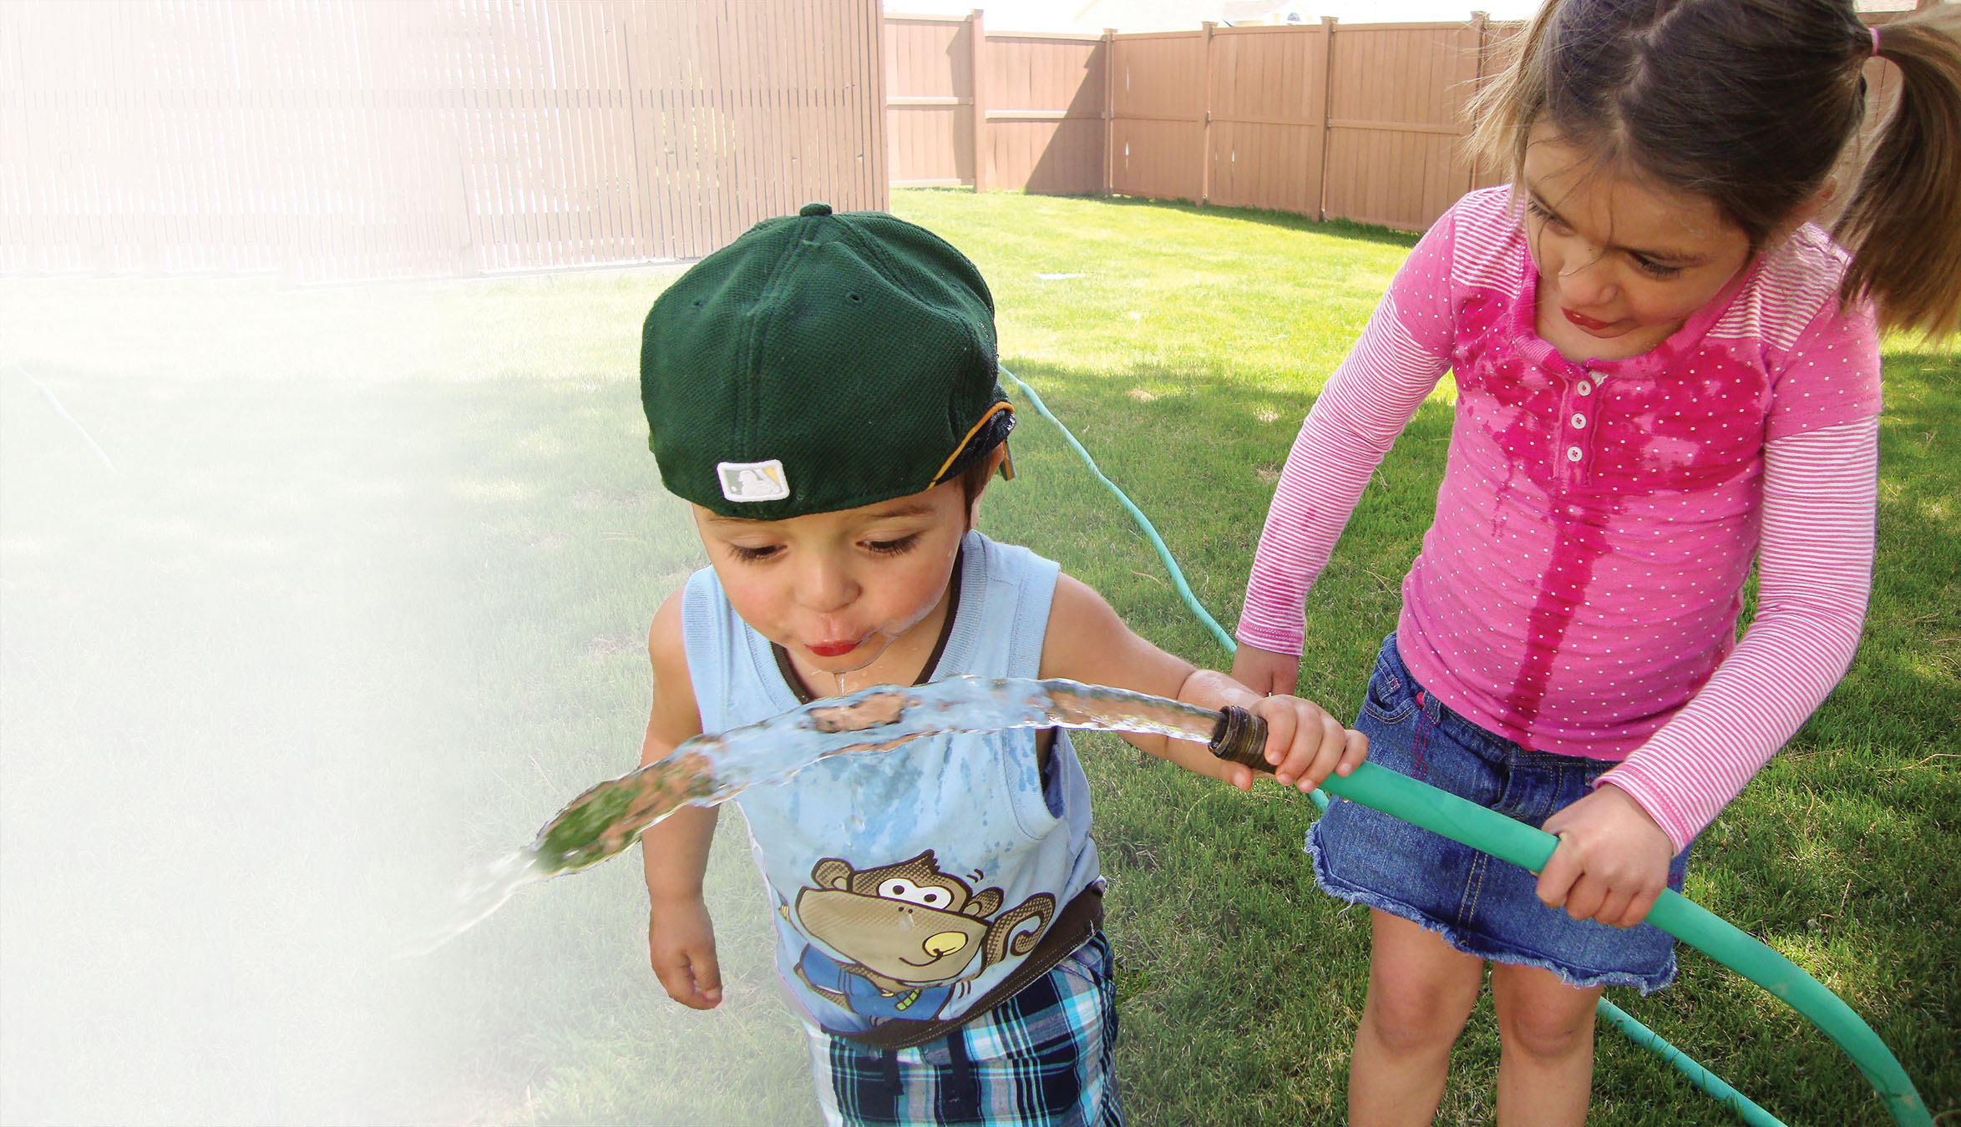
Water and Environmental Programs

Slide 21
Contact Information
Assistance under USDA Rural Development programs is available to applicants in areas designated as “rural.” Under law, the definition of “rural area” is different for each program.
For more information about these programs go to: www.rd.usda.gov
Or call 1 (800) 670-6553 (toll free)
USDA is an equal opportunity provider, employer, and lender.

Slide 22

Final slide – end of presentation
USDA is an equal opportunity provider, employer, and lender.

