Slide 1
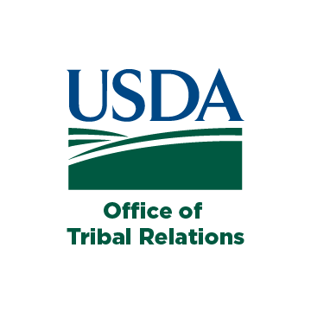
USDA Office of Tribal Relations
Heather Dawn Thompson
Director, Office of Tribal Relations
United States Department of Agriculture

Slide 2
I. USDA Tribal Advisory Committee (TAC)

Slide 3
Appointed By:
USDA (3)
Chair, Senate Indian Affairs (1)
Ranking Member, Senate Indian Affairs (1)
Chair, Senate Agriculture (1)
Ranking Member, Senate Agriculture (1)
Chair, House Agriculture (2)
Ranking Member, House Agriculture (2)

Slide 4
Nominators:
An Indian tribe
An Tribal organization
A national or regional organization with expertise tribal agriculture
Requirements:
diverse set of expertise on issues relating to geographic regions, Indian tribes, and the agricultural industry

Slide 5
II. USDA Tribal Barriers Annual Consultation

Slide 6
Tribal Barriers
Regulatory/Administrative
Tribal land definitions/eligibility
Tribal government and entity definitions/eligibility
Eligibility of indigenous plants and animals
Native language availability
Statutory
Matching requirements
Requiring tribes to work through states

Slide 7
III. Federal Policy
Impact on
Tribal Agriculture

Slide 8
Federal Policies of
Land Loss

Slide 9
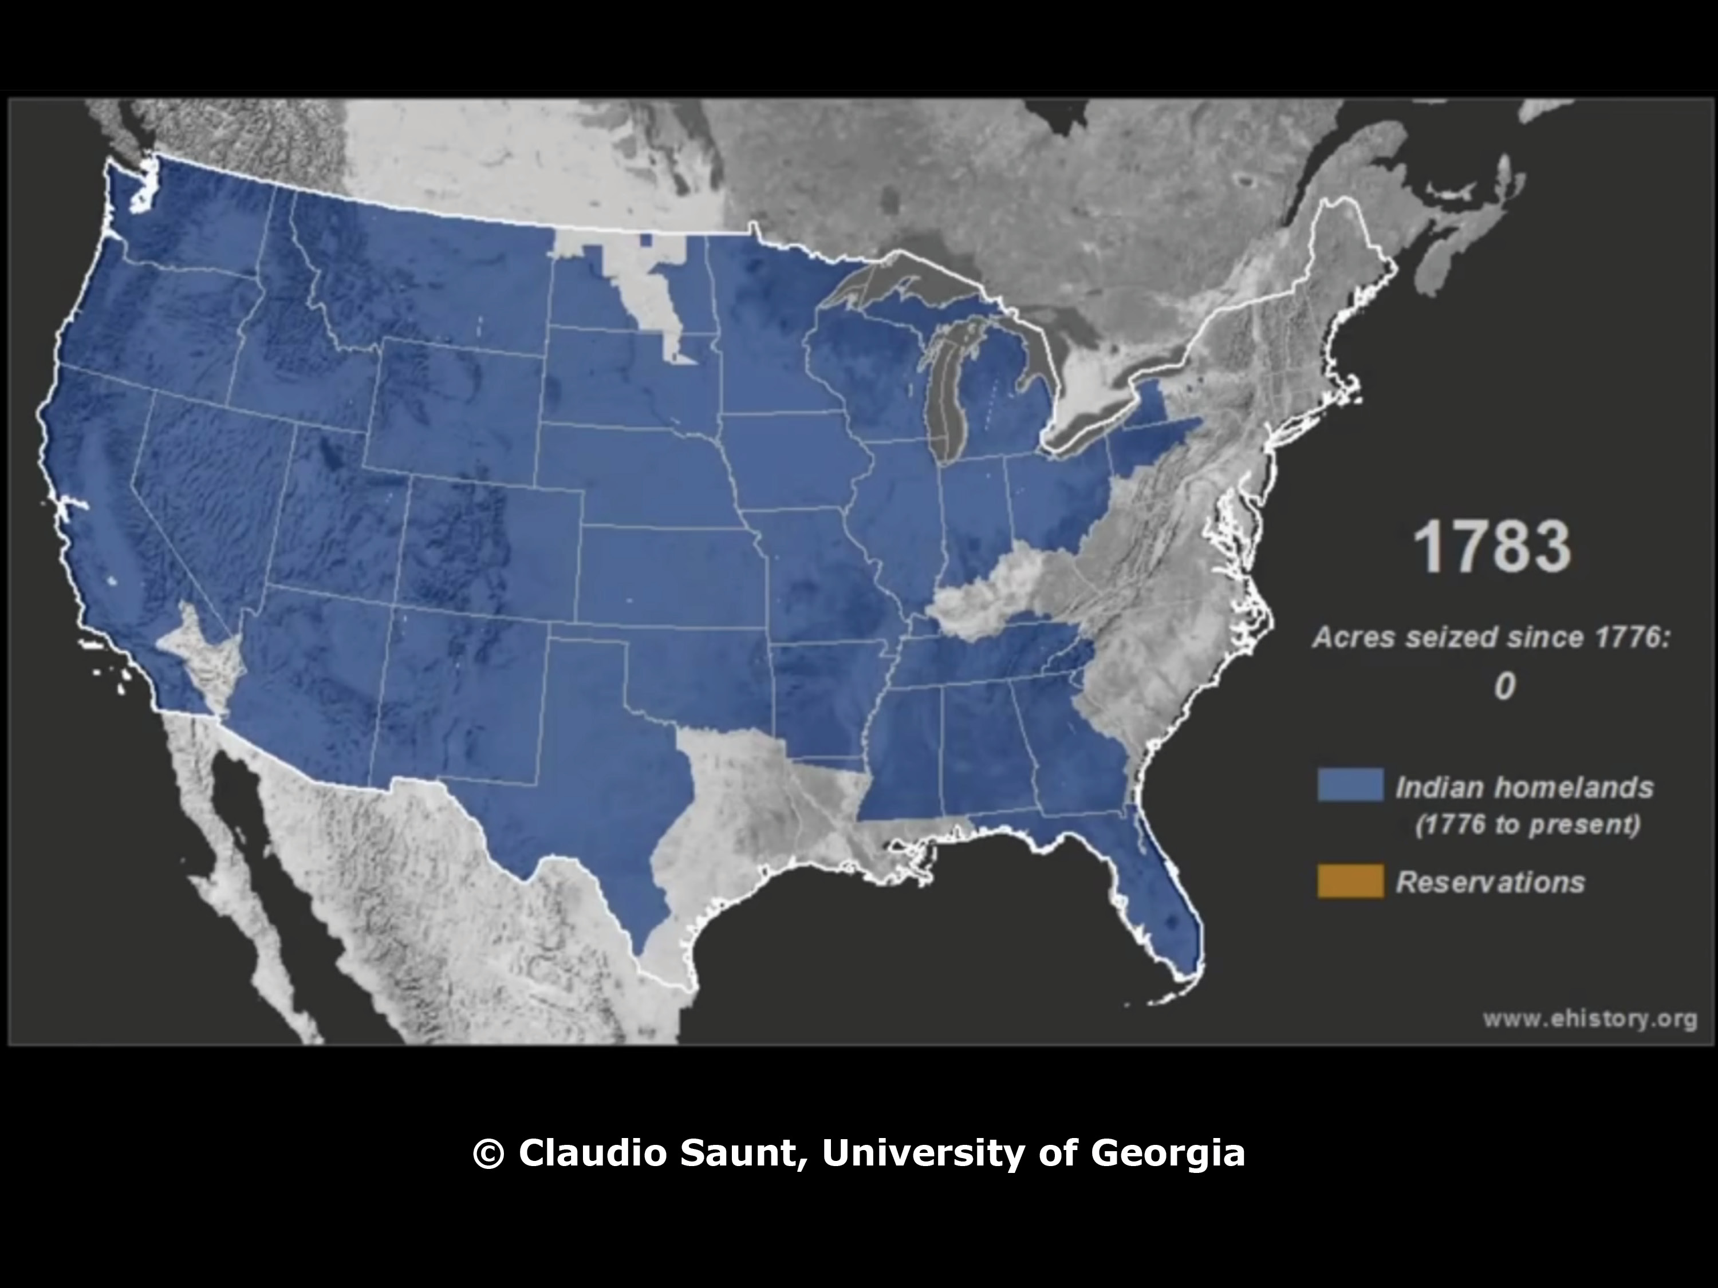

Slide 10
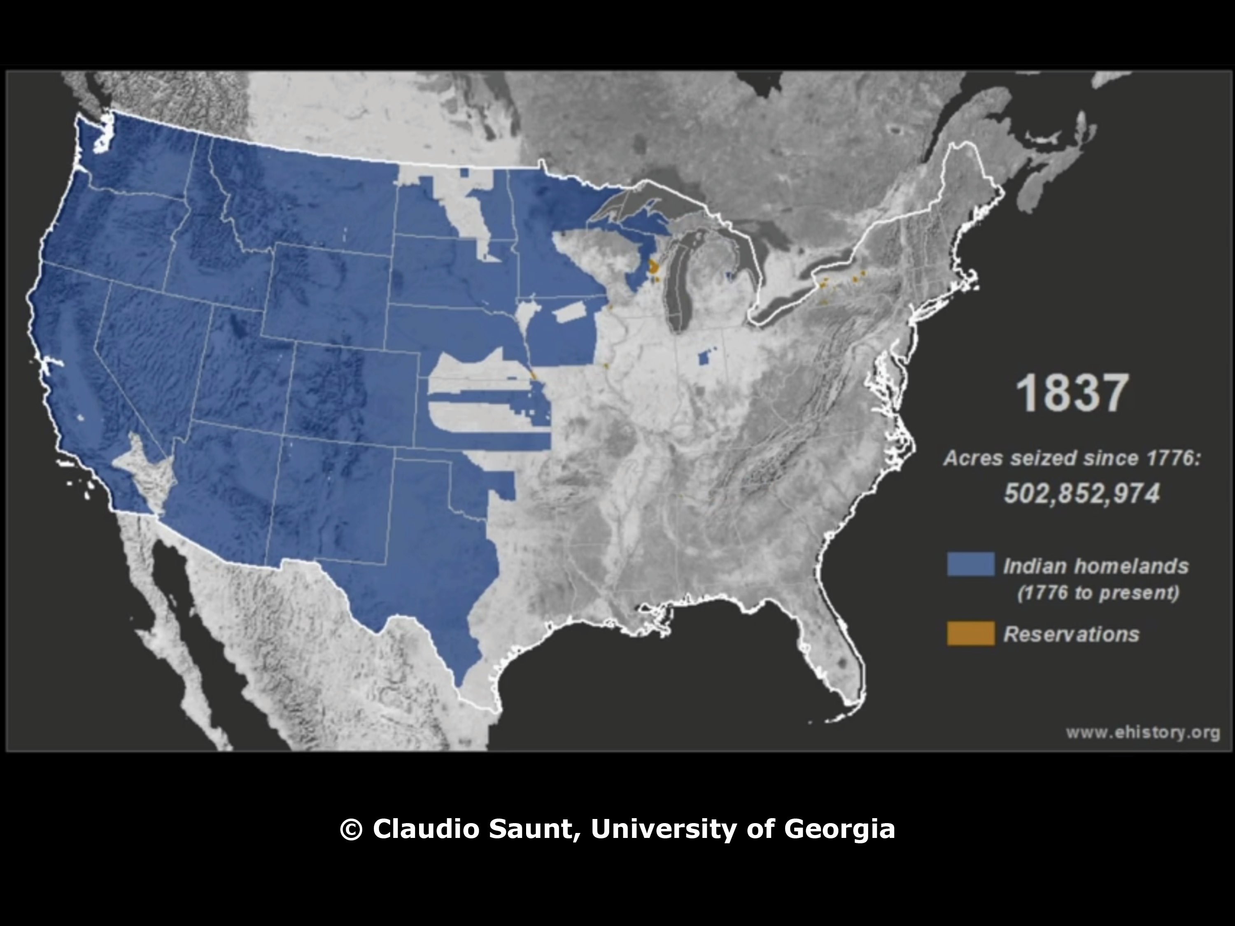

Slide 11
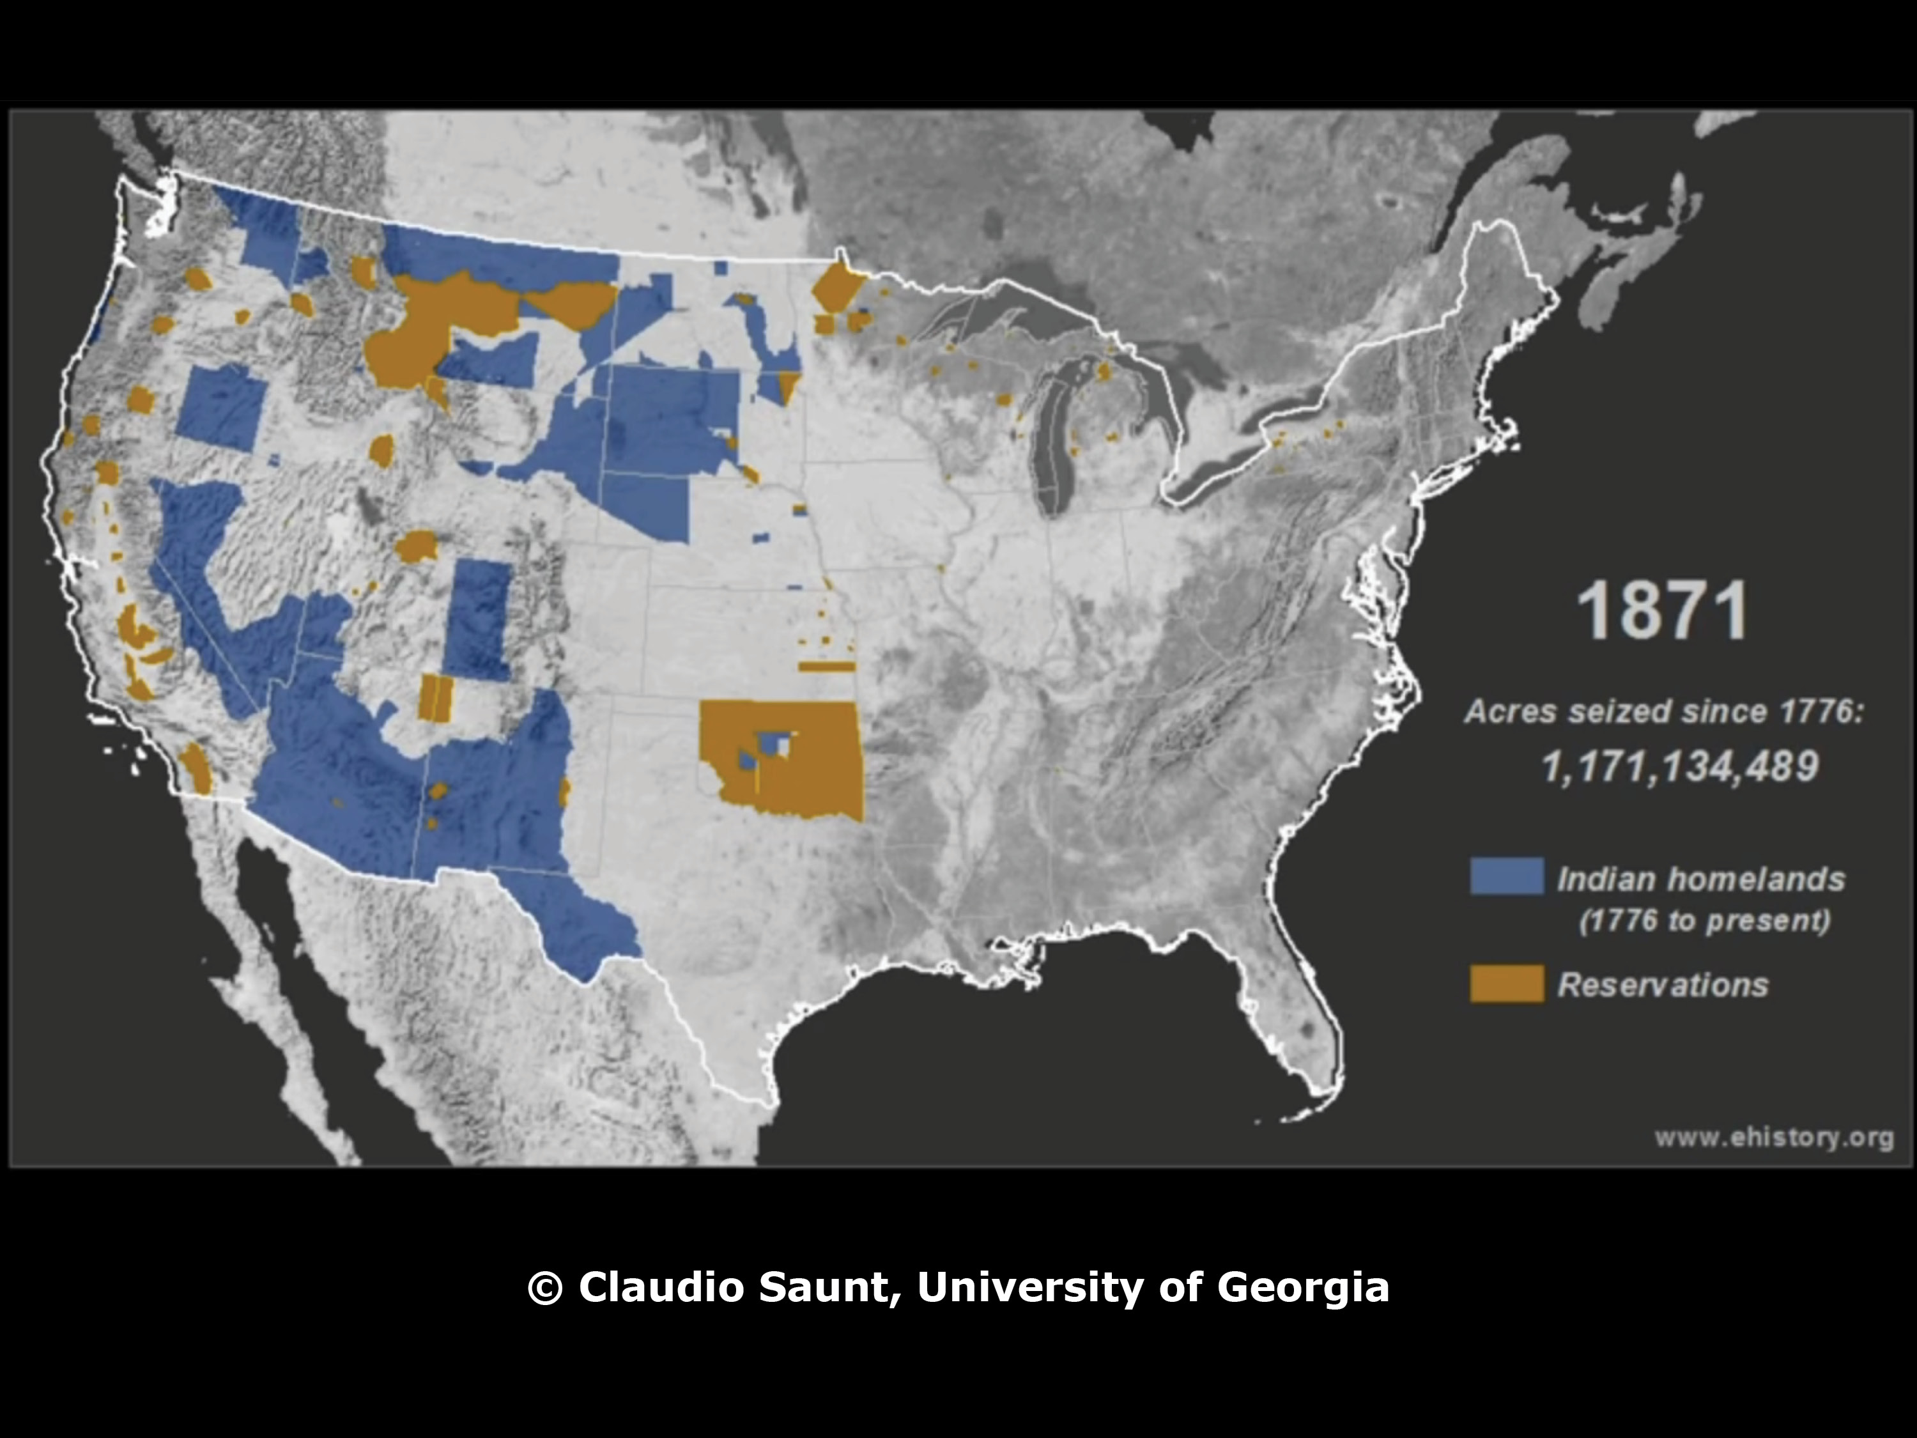

Slide 12
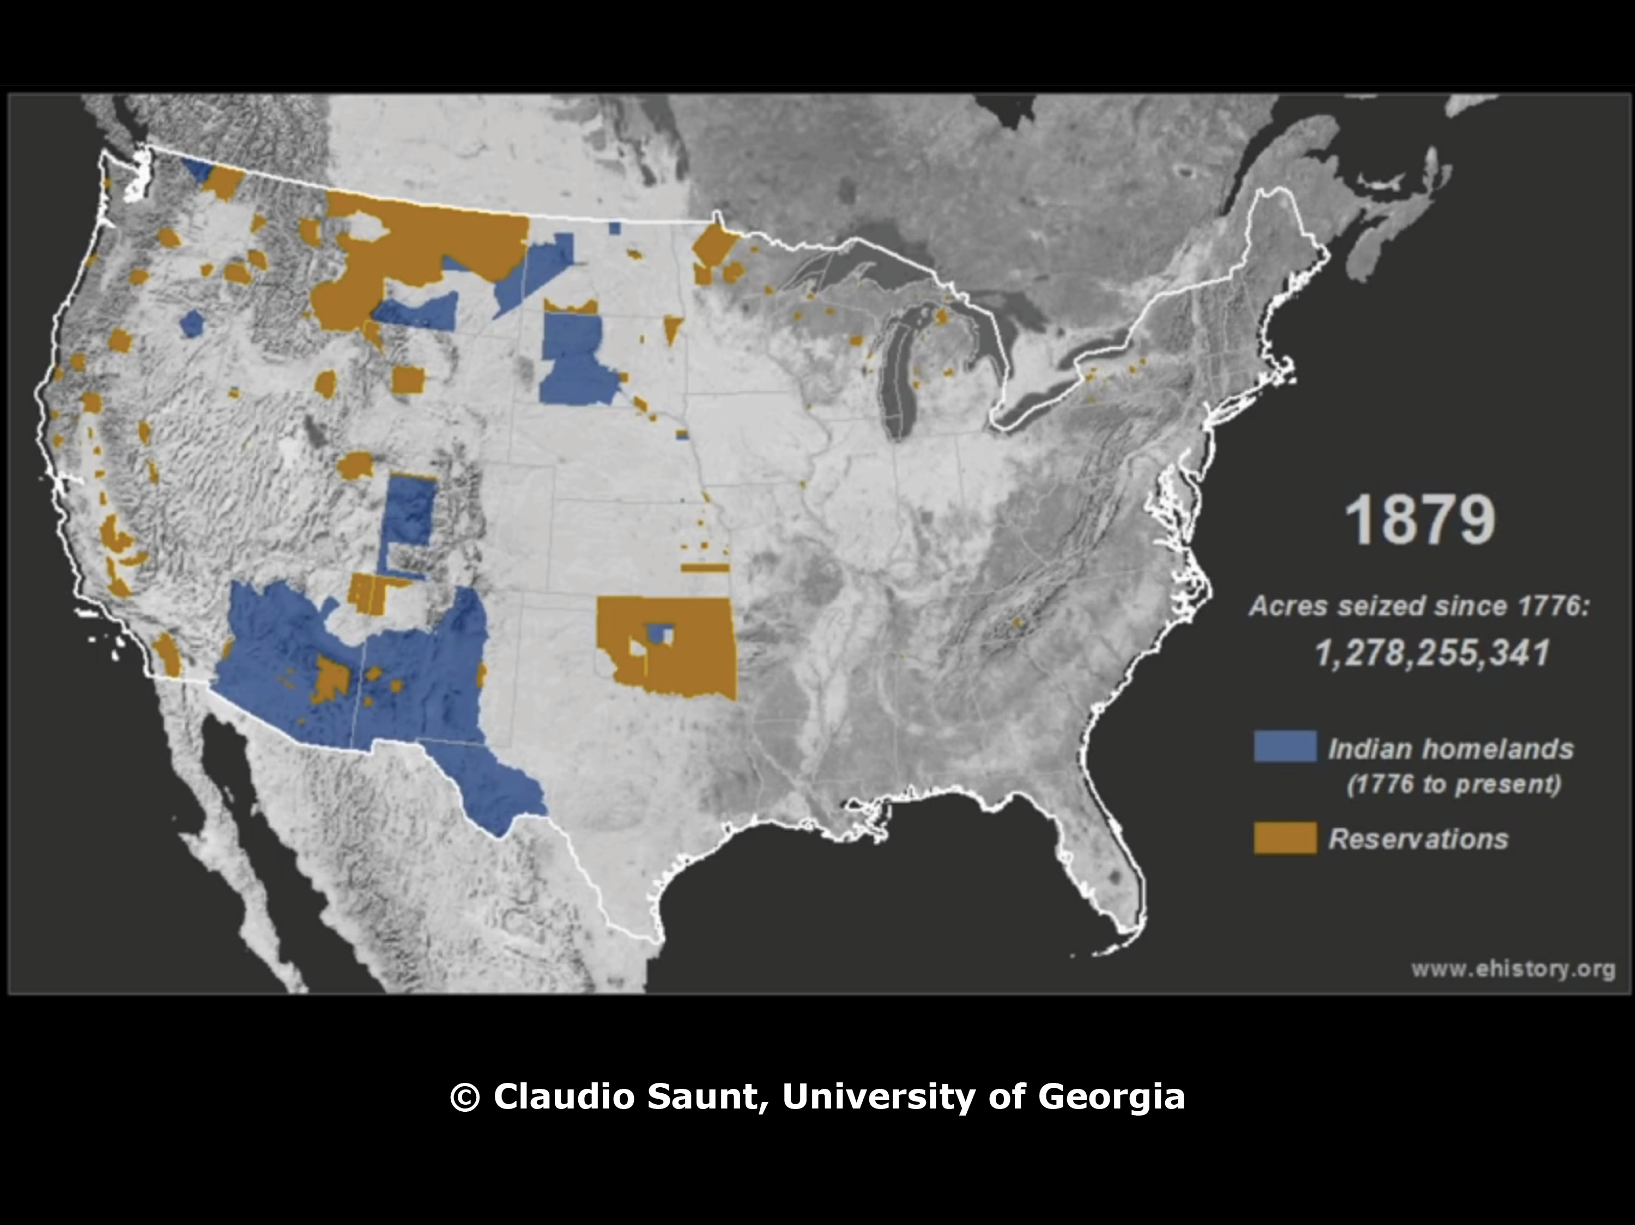

Slide 13
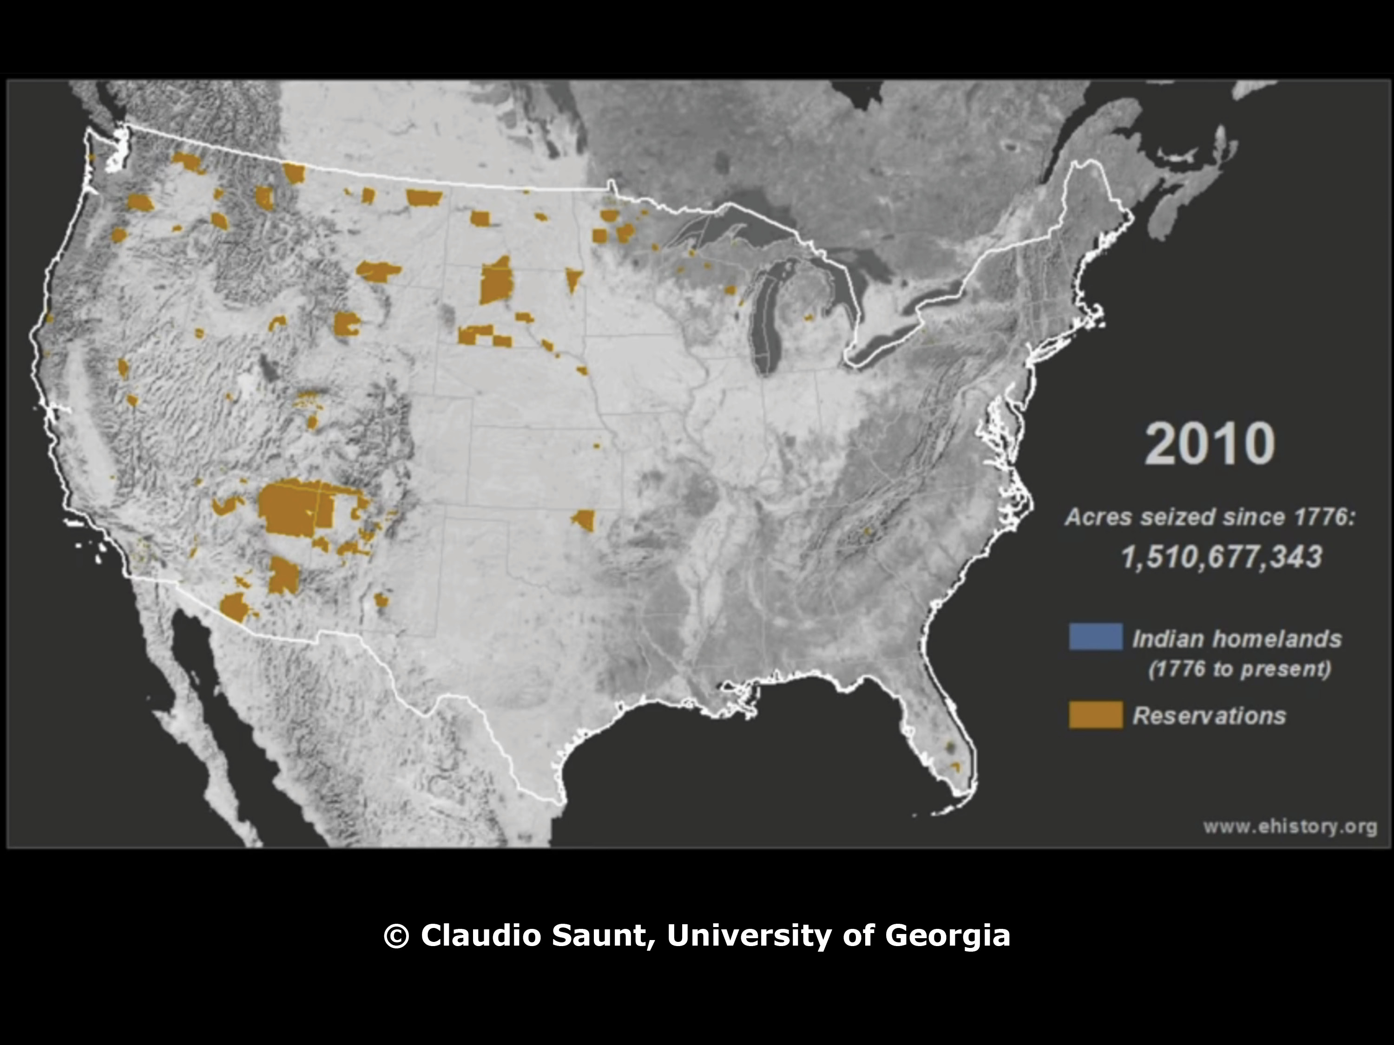

Slide 14
Eras of Federal Indian Policy
1800-1890s
War & Treaty Making
1887–1934
Assimilation & Land Allotment
1934–1945
Tribal Government Westernization
1945–1968
Tribal Termination
1968–present
Self-Determination

Slide 15
Impact of Federal Indian Policy
on
Tribal
Food & Agriculture
I. Destruction of Indigenous Foodways (War)
II. Forced Adoption of Western Farming (Assimilation)
III. Lack of Land and Resources to Implement (Allotment)
IV. Control & Punishment (Assimilation & Allotment)

Slide 16
Impact of Federal Indian Policy
on
Tribal
Food & Agriculture
I. Destruction of Indigenous Foodways (War)

Slide 17
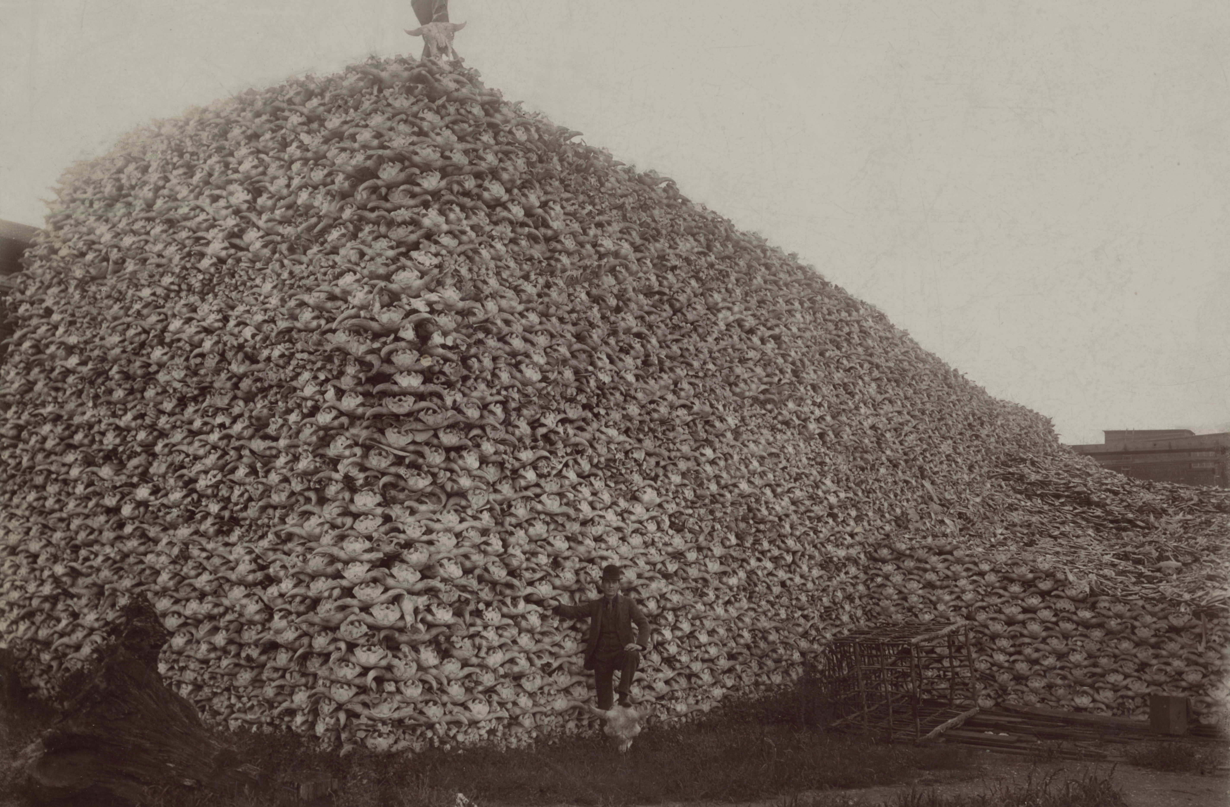

Slide 18
Impact of Federal Indian Policy
on
Tribal
Food & Agriculture
II. Forced Adoption of Western Farming/Food (Assimilation)

Slide 19
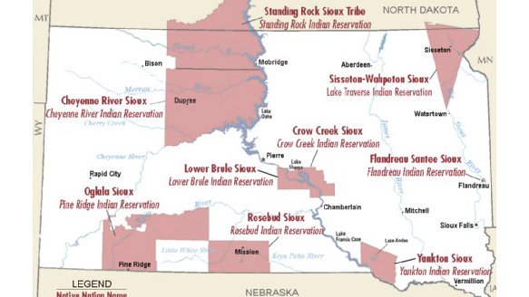

Slide 20
Black Hills Treaty
Act of February 28, 1877
(19 Stat. 254)
“In consideration of the foregoing cession of territory and rights, and upon full compliance with each and every obligation assumed by the said Indians, the United States does agree to provide all necessary aid to assist the said Indians in the work of civilization; to furnish to them schools and instruction in mechanical and agricultural arts, as provided for by the treaty of 1868.”

Slide 21
Article 5 - Agriculture
The Government will aid said Indians…in finding a market for their surplus productions, and in finding employment, and will purchase such surplus, as far as may be required, for supplying food to those Indians, parties to this agreement, who are unable to sustain themselves; and will also employ Indians…in the performance of Government work upon their reservation.

Slide 22
Impact of Federal Indian Policy
on
Tribal
Food & Agriculture
III. Lack of Land and Resources to Implement (Allotment)

Slide 23
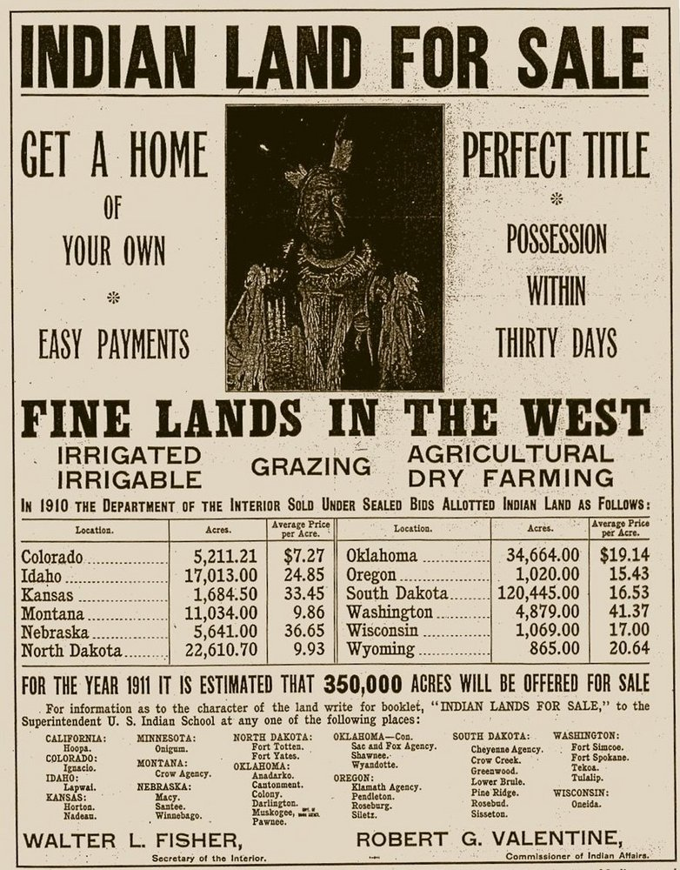

Slide 26
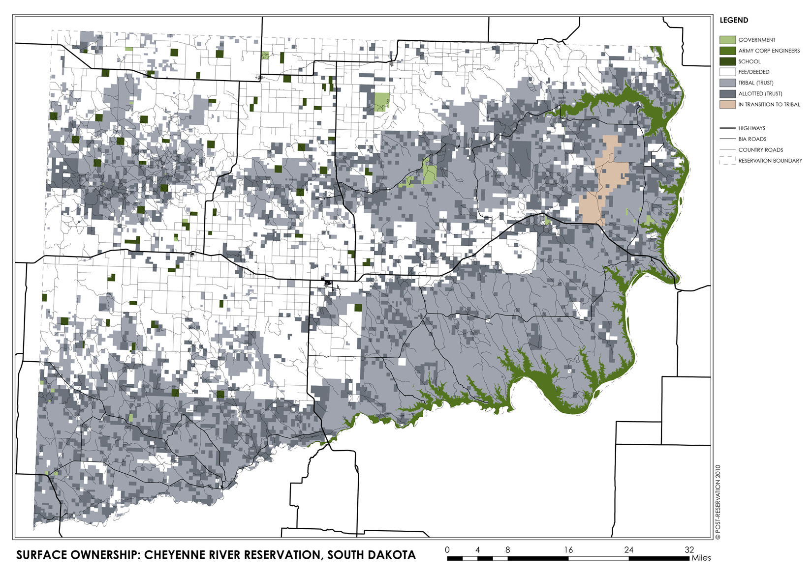

Slide 27
Impact of Federal Indian Policy
on
Tribal
Food & Agriculture
IV. Control & Punishment over Food/Ag (Assimilation & Allotment)

Slide 28
Article 5 - Agriculture
"In consideration of the foregoing cession of territory and rights … the United States does agree… to provide the said Indians with subsistence consisting of a rations for each individual of a pound and a half of beef, (or in lieu thereof, one half pound of bacon,) one-half pound of flour, and one-half pound of corn; and for every one hundred rations, four pounds of coffee, eight pounds of sugar, and three pounds of beans, or in lieu of said articles the equivalent thereof…. *
Rations shall, in all cases, be issued to the head of each separate family;… no rations shall be issued for children between the ages of six and fourteen years…unless such children shall regularly attend school. Whenever the said Indians shall be located upon lands which are suitable for cultivation, rations shall be issued only to the persons and families of those persons who labor….

Slide 29


Slide 30
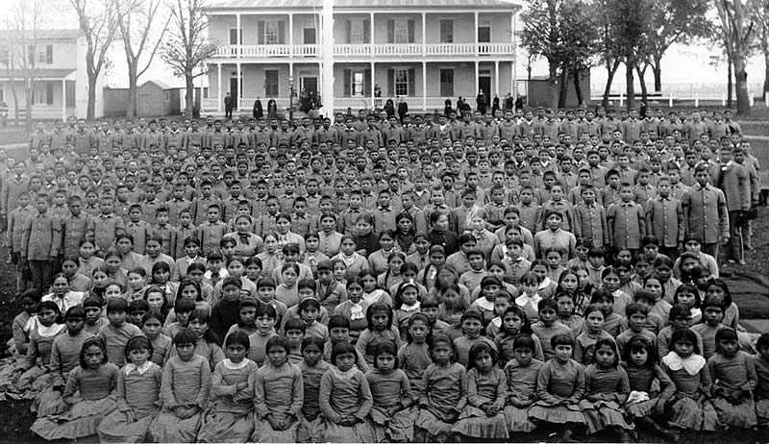
“Kill the Indian Save the Man”

Slide 31
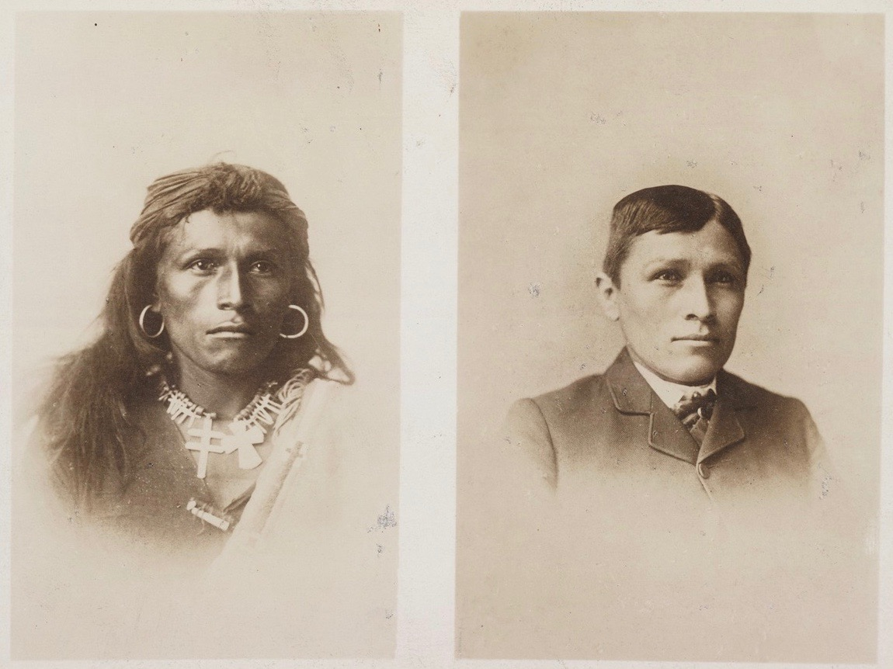

Slide 32
Where Does That Bring Us Today?

Slide 33
Indigenous Food Sovereignty

Slide 34
USDA
Programs
AMS: Mobile Meeting Processing/Field Harvest (Tribal Seafood; Future Meat Processing/Supply Chain Progams)
USFS: Providing Access to Indigenous Plants & Animals
(FS treaty rights, foraging policies)
FPAC: Funding Indigenous Plants & Animals
FDPIR: Incorporating Indigenous Foods
(salmon, bison, wild rice, Demonstration Project)

Slide 35
USDA
Indigenous Food Sovereignty Initiative
Indigenous Foods Foraging Videos: UTTC’s Linda Black Elk
Indigenous Foods Recipes & Cooking Videos: Sioux Chef’s Sean Sherman
Domestic Marketing for Native American Producers: Intertribal Agriculture Council
How To Manual: ITBC: Transitioning from Cattle to Bison Ranching
Indigenous Seed Processing Centers: Native American Food Sovereignty Alliance

Slide 36
Questions?
Heather Dawn Thompson
Director, Office of Tribal Relations
United States Department of Agriculture

