Slide 1

USDA TARGET CENTER
ERGONOMICS PROGRAM
United States Department of Agriculture
TARGET Center
Stephanie Bradley
Ergonomics Program Manager

Slide 2

Advancing Access & Equity

Slide 3

Today’s presenter
Stephanie Bradley, CAE, CEAS
Ergonomics Program Manager
Sl.Bradley@usda.gov
202-720-2600

Slide 4

Learning Objectives
Understand the science of workplace ergonomics and the USDA TARGET Center’s workplace improvement processes.
Identify the common risk factors associated with work-related musculoskeletal disorders, prevention principles and how to adopt proper mechanics.
Increase self-awareness of early discomfort and the signs of musculoskeletal disorders and understand the steps to establish an ergonomic evaluation for USDA employees nationwide at the USDA TARGET Center Ergonomic Program.
Identify the necessary resources available at the USDA TARGET Center and determine how the TARGET Center can provide support within education, identification of ergonomic equipment, and facilitation of product loans for USDA employees nationwide.

Slide 5
History of ergonomics at THE target center
The TARGET Center’s Ergonomic Program started in 1992 to support employees that needed support with obtaining an ergonomic chair.
A collaboration between a prominent chair vendor was established once it was identified the need for ergonomic chairs for many government employees that have Musculoskeletal Disorders.
This prominent chair vendor setup a weekly chair fittings which provides custom chairs to support government employees that have disabilities.
Thus, the Ergonomic Program at the TARGET Center has been successful in fitting thousands of employees with the appropriate ergonomic chair.

Slide 6
Ergonomics: What is it?
Definition:
  Ergonomics is the science of fitting the job to the worker. Designing workstations and tools to reduce work-related musculoskeletal disorders (MSDs) can help workers stay healthy and companies to reduce or eliminate the high costs associated with MSDs.
Strategy:
  Ergonomics considers the physical and mental capabilities and limits of the worker as he or she interacts with tools, equipment, work methods, tasks, and the working environment.
Goal:
    Reduce work-related musculoskeletal disorders (WMSD’s) by adapting the work to fit the person, instead of forcing the person to adapt to the work.

Slide 7
Ergonomics: why it matters?
Ergonomics prevents injury of workers!!!
Musculoskeletal disorders are preventable and unnecessary injuries:
  Cost the US economy billions of dollars annually
  Result in missed work, increased pain, and decreased morale among affected workers.
Integrating good ergonomics into job and workplace design costs no more than choosing a bad design.
Ergonomics programs focus on ways to reduce costs to companies by:
  - reducing injuries - reducing errors
  - reducing absenteeism - maximizing productivity

Slide 8
what are Musculoskeletal disorders (msds)?
Illnesses and Injuries of the musculoskeletal system that can have a work-related casual component include:
                - Sprains - Tears
                - Strains - Pinched nerves or blood vessels
                - Inflammation - Stress fractures
                - Degeneration
*29% of all workplace injuries in the U.S. requiring time away from work are caused by work-related MSDs

Slide 9
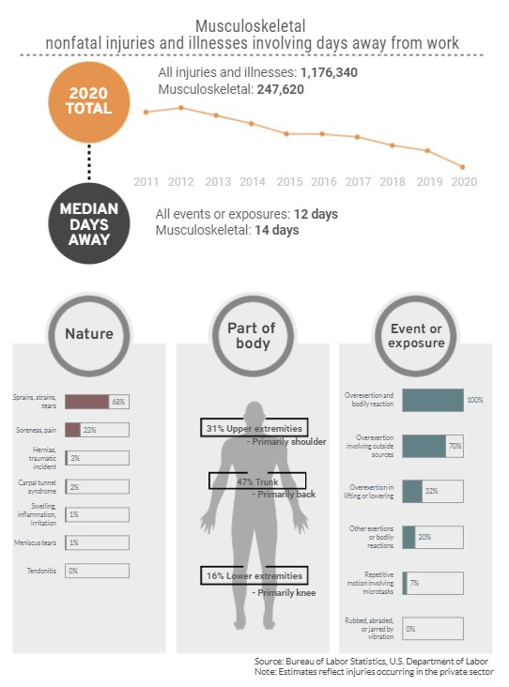
NO Slide title

Slide 10
Risk factors associated with musculoskeletal disorders
Work postures and movements
Repetitiveness and pace of work
Force of movements
Vibration
Temperature

Slide 11
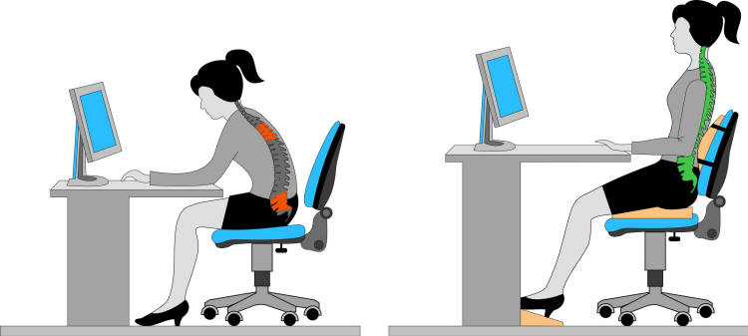
Work postures and movement
ERGONOMICS: AWKWARD POSTURE
  Awkward posture refers to positions of the body that deviate significantly from the neutral position while performing work activities.
  When you are in an awkward posture, muscles operate less efficiently, and you expend more force to complete the task. Examples of awkward postures are twisting, bending, reaching, pulling or lifting.

Slide 12
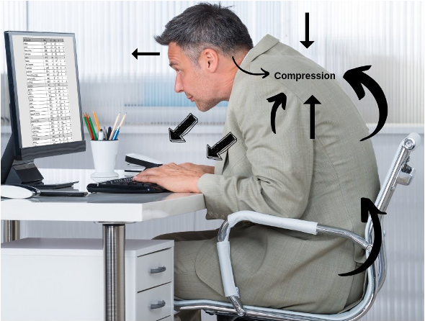
No slide title #2

Slide 13

Repetitive motions
Repetitive Motion Disorders (RMDs) are a family of muscular conditions that result from repeated motions performed during normal work or daily activities. The disorders are caused by too many uninterrupted repetitions of an activity or motion, unnatural or awkward motions such as twisting the arm or wrist, overexertion, incorrect posture, or muscle fatigue.
RMDs Include:
  Carpal tunnel syndrome
  Bursitis
  Tendonitis
  Epicondylitis
  Ganglion cyst
  Tenosynovitis
  Trigger finger
RMDs occur most commonly in the hands, wrists, elbows, and shoulders, but can also happen in the neck, back, hips, knees, feet, legs, and ankles.

Slide 14
Force of movements
Excessive force is one of the primary ergonomic risk factors. Many work tasks require high force loads on the human body. Muscle effort increases in response to high force requirements which increases fatigue and risk of an MSD.
There are numerous conditions that affect force, but the idea is to recognize when a job or task requires excessive force and then find ways to reduce that force.
Eliminating excessive force requirements will reduce worker fatigue and the risk of MSD formation in most workers. Using the following will help to reduce these risks:
        Mechanical assists
        Counterbalance systems
        Adjustable height lift tables and workstations
        Powered equipment
        Ergonomic tools

Slide 15
vibration
Occupational vibration exposure occurs when the body is exposed to pulsation, shaking or tremors usually produced by a vibrating object such as a power hand tool.
  Vibration is often called a vector quantity, which means that the vibratory motion has both a negative effect in of itself and a magnitude or intensity component.
  Vibration restricts the blood supply to the hands and fingers, which, depending on the vibration level and duration of exposure, can contribute to an ergonomic injury.
  Vibration exposure is separated into hand-arm vibration (HAV) and whole-body vibration (WBV). These two types of vibration have different sources, affect different areas of the body and produce different symptoms.

Slide 16


Vibration (Cont.)
    HAV (hand-arm vibration) is usually caused by a vibrating hand tool or work piece which transmits the movement.
    WBV (whole-body vibration) is usually felt when sitting or standing on a vehicle or machine, travelling over rough ground or along a track.

Slide 17


temperature
Extreme temperatures can cause various problems for workers. Problems may include trouble breathing, fatigue, reduced dexterity, sensory sensitivity and reduced grip strength.
    Hot temperatures can lead to dehydration and muscle fatigue, especially in conjunction with high humidity.
    Cold temperatures make the muscles less flexible, resulting in muscle strains and pulls.
Hot or cold work environments do not necessarily need to be outdoors. Any location that is outside of the typical comfort zone of 55 - 85 degree Fahrenheit is cause for concern.

Slide 18
what kind of injuries are musculoskeletal disorders
Acute Injuries
  Happen immediately due to overload
  Can become chronic
  Re-injury possible
  Strains, sprains, disc herniations
Chronic Injuries
  Pain or symptoms lasting more than a month
Cumulative Trauma
  Happen over time
  Difficult to cure
Musculoskeletal

Slide 19
Common WORKPLACE INJURIES
Hand & Wrist
Elbow
Shoulder
Neck
Back
Carpal Tunnel Syndrome
De Quervain’s Disease
Tendonitis
Epicondylitis
Rotator Cuff Tendonitis
Thoracic Outlet Syndrome
Disc Herniation
Back Pain/Sprain
Tension Neck Syndrome
Musculoskeletal

Slide 20
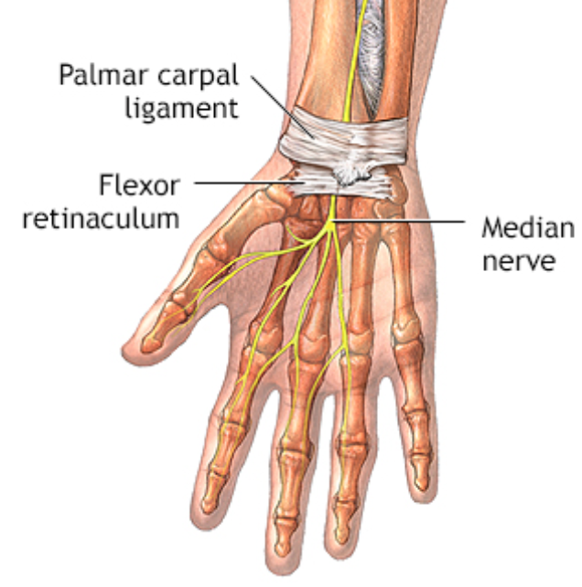
Carpal tunnel syndrome (CTS)
The carpal tunnel is composed of eight irregular shaped carpal bones covered by the tough fibrous flexor retinaculum which contains the finger flexor tendons and the median nerve.
  Median nerve innervates most of the palm, thumb, index finger, middle finger, and radial border of the ring finger.
Causes
  Flexor tendon sheaths that become swollen may impinge on the median nerve within the cramped carpal tunnel.
Symptoms
  Numbness
  Tingling
  pain in the distal distribution and may commonly wake patients during the night.
*In advanced cases, symptoms may persist during the day, person may drop objects frequently owing to decreased sensation, and linear muscle atrophy.

Slide 21
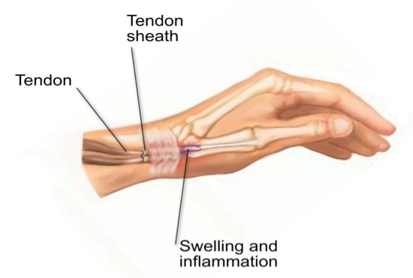
De Quervains disease
A form of tenosynovitis affecting the first dorsal (extensor) compartment of the hand.
The sheath of the tendons on the thumb side of the wrist become inflamed or swollen, making it difficult to move.
Symptoms:
    dull aching sensation over the tendon
    discomfort with specific movements, grasping or turning wrist
    tenderness to touch

Slide 22
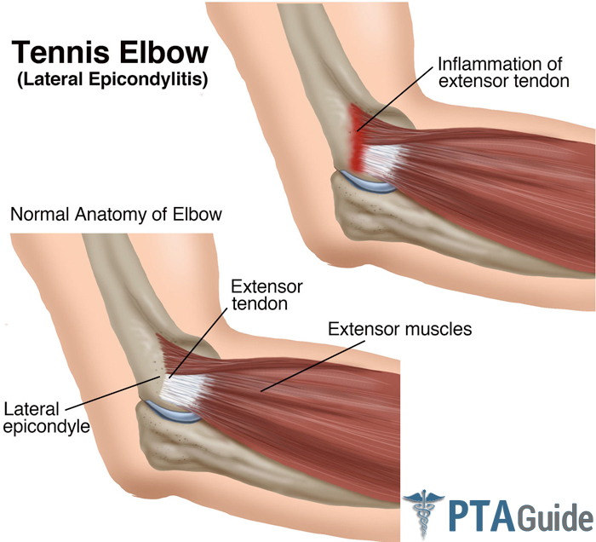
Elbow tendonitis
Also known as “tennis elbow”, affecting the outer part of the elbow.
Inflamed unsheathed tendon that may become frayed or torn apart when repeatedly exerted and tensed. Could become thickened, bumpy, and irregular.
Tendons without sufficient rest and recovery time may become permanently weakened.
Causes
  May be caused by repetitive motions which aggravate the tendons needed to perform the task.
Symptoms
  includes a dull aching sensation over the tendon
  discomfort with specific movements
  tenderness to touch

Slide 23
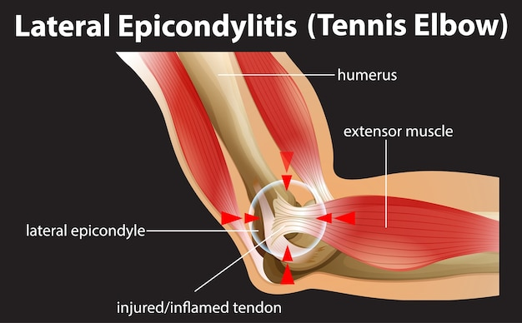
Epicondylitis
Also known “golfers' elbow,” affecting the inner part of the elbow.
This is another form of tendonitis affecting the wrist and digit flexors where they originate at the medial epicondyle of the elbow.
Causes
  May be caused by excess or repetitive motions in the wrist and fingers ( such as typing), or a sudden force to the elbow or wrist.
Symptoms
  includes a dull aching sensation over the tendon
  discomfort with specific movements
  tenderness to touch

Slide 24

Signs and symptoms of msds
Early Warning Signs:
  Numbness of burning sensation in hand
  Reduced grip strength in the hand
  Swelling or stiffness in the joints
  Pain in wrists, forearms, elbows, neck or back
  Reduced range of motion in the shoulder, neck, or back
  Dry, itchy, or sore eyes
  Blurred or double vision
  Aching or tingling
  Cramping
  Weakness
These signs and symptoms should be reported to the physician and ergonomic evaluation should be made.

Slide 25
Ergonomic adjustments to prevent musculoskeletal disorders
Fortunately, with early intervention and improved work & task design, MSDs can be prevented. Here are a few strategies you can use throughout your day to avoid discomfort and prevent injury:
  Take frequent breaks – get up and stretch, walk around or change your scenery.
  Vary the workday – if possible, try to space out different types of tasks.
  When using a computer, follow the 20-20-20 rule - every 20 minutes, look at something about 20 feet away for at least 20 seconds.
  Report pain or discomfort immediately – don’t wait until it becomes serious, always inform your supervisor.
If you are a supervisor, be sure to monitor your employees and make sure they are taking necessary breaks.

Slide 26

TARGET Center ERGONoMiC Services
Resources
Evaluations
Chair Fittings

Slide 27
ERGONOMIC Resources
1. The USDA TARGET Center Ergonomic loan program provides a variety of ergonomic equipment so that employees can test out equipment in preventing workplace injuries.
2. Demonstrations of ergonomic equipment can be provided in allowing employees information on ergonomic equipment and how to utilize the equipment.
3. Webinar training is provided for all USDA employees to receive education on ergonomics and identify the proper setup in positioning ergonomic tools and properly setting up your workstation.

Slide 28
Ergonomic Loan Program
Provide customers with Ergonomic loans to bridge a gap in time before customers have access to permanent solutions or for a temporary disability.
Loans are for 30 days. Items will be shipped to customers.
Not all Ergonomic equipment recommended is available for loan.

Slide 29



Ergonomic Evaluation Process
Pre-Evaluation Form
Evaluation Meeting
Report

Slide 30

USDA EMPLOYEES
Good News…All USDA employees can obtain an evaluation!!!
  Complete a pre-ergonomic evaluation form on the USDA TARGET Center website.
  Submit digital pictures of yourself at your workstation, so the Ergonomics Program Manager can see the workstation setup and how you are utilizing equipment.
  Evaluation can be done In-Person or Virtually
      If located within the NCR (National Capitol Region) then you can obtain an evaluation In-Person at the TARGET Center.

Slide 31
Ergonomic evaluation
Ergonomic Evaluations are the first step to a more comfortable working environment.
    An ergonomic evaluation is a comprehensive assessment of your workstation, tools, and equipment.
    It provides detailed information about how you use your workplace, which can help you adjust and improve comfort as well as reduce stress on the job.
    Ergonomic evaluations are especially important for people who spend long hours at their jobs or have repetitive tasks that strain their bodies.
    Any USDA employee can benefit from an ergonomic evaluation if they are experiencing pain or discomfort as part of their daily routine or even as prevention.

Slide 32
Vendor Connections
The TARGET Center Ergonomic Program partners with various vendors to help facilitate the acquisition process to obtain recommended ERGO products.
Vendors can provide quotes and work with agencies to ensure a smooth purchase process.

Slide 33
summary
Musculoskeletal Disorders (MSDs) are illnesses and injuries of the musculoskeletal system that can have a work-related casual component.
The goal of ergonomics is to minimize work-related MSD’s by adapting the work to fit the person, instead of forcing the person to adapt to the work.
Symptoms of MSD’s involve swelling, numbness, tingling, discomfort, burning sensation, irritation, stiffness, pain and weakness.
TARGET Center and the Ergonomic resources available to prevent Musculoskeletal Disorders at your workstation.

Slide 34
Upcoming Workshop
Ergonomics Program Demonstration Tuesday, 10/12/23

Slide 35
Thank you
Access Webinars
Collaborate with TARGET Center!
Share in Your Networks
Sign Up for Email List
Request Ergo Evaluation
Follow on Twitter
Request Training

Slide 36

Current and Upcoming Meetings
OCTOBER
MONDAY
TUESDAY
WEDNESDAY
THURSDAY
10/2/2023
10/3/223
11:00 AM – 12:00 PM
Rethinking Disability and What It Means to Be Disabled
Dr. Theresa Haskins Haskins Consulting
1:00 PM – 2:00 PM
(Neuro) Diversity Includes You
Dr. Theresa Haskins Haskins Consulting
10/3/2023
10/4/2023
10/5/2023
10:00 AM – 11:00 AM
USDA TARGET Center Assistive Technology Program
Rashida Owens
Assistive Technology Program Manager
12:00 PM – 1:00 PM
USDA TARGET Center
Ergonomics Program
Stephanie Bradley
CEAS, CAE
Ergonomics Program Manager
11:00 AM – 12:00 PM
Nurturing Workplace Well-Being and Supporting Mental Health (Part 1 of 2)
Dr. Theresa Haskins
Haskins Consulting
1:00 PM – 2:00 PM
PTSD Is More Common Than You Think
Alla Weinberg
Spoke & Wheel
10:00 AM – 11:00 AM
Empowering Lives Through Assistive Technology Solutions
Donny Osborn
Boundless AT
12:00 PM – 1:00 PM
Department of Defense Computer/Electronic Accommodations Program (CAP)
Erin Sanderson
CAP
HOLIDAY
10/10/2023
10/11/2023
10/12/2023
11:00 AM – 12:00 PM
Autism Inclusion and the Pathway to Neurodiversity
Dr. Theresa Haskins Haskins Consulting
1:00 PM – 2:00 PM
Lessons from Unpredictable Journeys: Insights from Temporary and Situational Disabilities (Part 1 of 2)
Dr. Theresa Haskins Haskins Consulting
11:00 AM – 12:00 PM
Creating a
Trauma-Informed Workplace
Alla Weinberg
Spoke & Wheel
1:00 PM – 2:00 PM
Nurturing Workplace Well-Being and Supporting Mental Health (Part 2 of 2)
Dr. Theresa Haskins Haskins Consulting
10:00 AM - 12:00 PM
USDA TARGET Center
Ergonomics Demonstrations
(Virtual/Onsite)
Stephanie Bradley
CEAS, CAE
Ergonomics Program Manager
Stephen DiCarlo
Humanscale
Howard Flowers
BodyBilt
1:00 PM - 3:00 PM
USDA TARGET Center Assistive Technology Demonstrations
(Virtual/Onsite)
Rashida Owens
Assistive Technology Program Manager

Slide 37

Target center Contact Information
TARGET Center Website
https://www.targetcenter.dm.usda.gov
TARGET Center Email
target-center@usda.gov
TARGET Center Phone Number
(202) 720-2600

