Slide 1

Using the Nutrition Facts Label in the Child and Adult Care Food Program
A Training Presentation for
Child and Adult Care Food Program
(CACFP) Operators
Guidance documents lack the force and effect of law, unless expressly authorized by statute or incorporated into a contract. USDA may not cite, use, or rely on any guidance that is not available through their guidance portal, except to establish historical facts.

Slide 2

USDA’s Team Nutrition
An initiative of the USDA’s Food and Nutrition Administration to support the USDA’s Child Nutrition Programs.
Aims to improve children’s lifelong eating and physical activity habits.
Provides nutrition education and training materials to State agencies, sponsoring organizations, and CACFP sites.
fna.usda.gov/tn/team-nutrition
Guidance documents lack the force and effect of law, unless expressly authorized by statute or incorporated into a contract. USDA may not cite, use, or rely on any guidance that is not available through their guidance portal, except to establish historical facts.
Notes:
Team Nutrition is an initiative of the USDA Food and Nutrition Administration that supports the Child Nutrition Programs, including the National School Lunch Program, the School Breakfast Program, and of course, the Child and Adult Care Food Program, or the CACFP.
It does so through training and technical assistance for those preparing and serving meals, providing nutrition education for children, and building support for healthier school and child care environments.

Slide 3
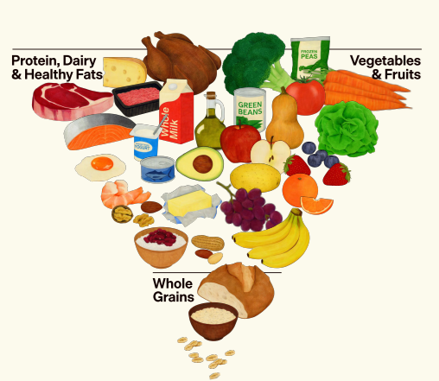

The Real Food Pyramid
realfood.gov
Guidance documents lack the force and effect of law, unless expressly authorized by statute or incorporated into a contract. USDA may not cite, use, or rely on any guidance that is not available through their guidance portal, except to establish historical facts.
Notes:
When planning your CACFP menus, use the Nutrition Facts label to help you follow the Dietary Guidelines for Americans and the Real Food Pyramid’s recommendations to eat high-quality, nutrient-dense foods as part of a healthy dietary pattern.
For more information about the Dietary Guidelines and the Real Food Pyramid go to the web address, realfood.gov or see the policy memo titled “Dietary Guidelines for Americans, 2025-2030 – Eat Real Food” by accessing the QR code on the screen.

Slide 4
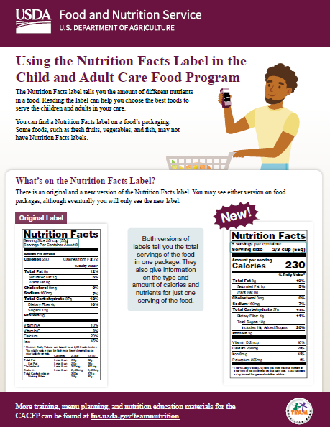
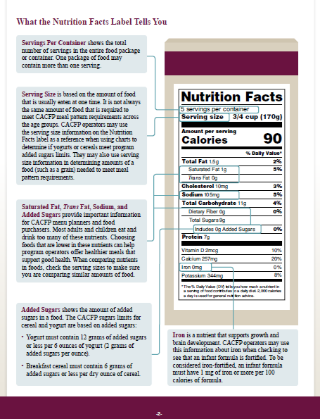

Using the Nutrition Facts Label in the CACFP
fna.usda.gov/tn/using-nutrition-facts-label-cacfp
Guidance documents lack the force and effect of law, unless expressly authorized by statute or incorporated into a contract. USDA may not cite, use, or rely on any guidance that is not available through their guidance portal, except to establish historical facts.
Notes:
Today’s training focuses on how to use the Nutrition Facts label in the CACFP.
This slide shows the first two (2) pages of the worksheet.
You can download the worksheet using the web address or the QR code shown on the screen if you have not already done so. You can also just follow along with the images on the slides.
Page 1 of the worksheet, which is on the left side of the screen, tells you why you should use the Nutrition Facts Label. It also shows you a comparison of the original version and the current version of the Nutrition Facts Label.
Page 2, shown on the right side, of this slide, explains different parts of the Nutrition Facts label, including servings per container, serving size, total sugars, added sugars, and more.
We will talk about that more in the next few slides.

Slide 5
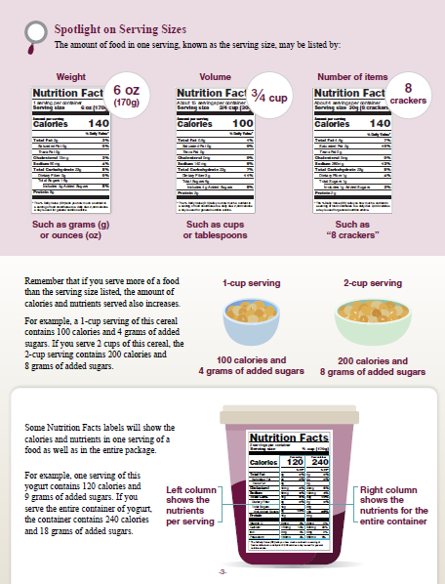
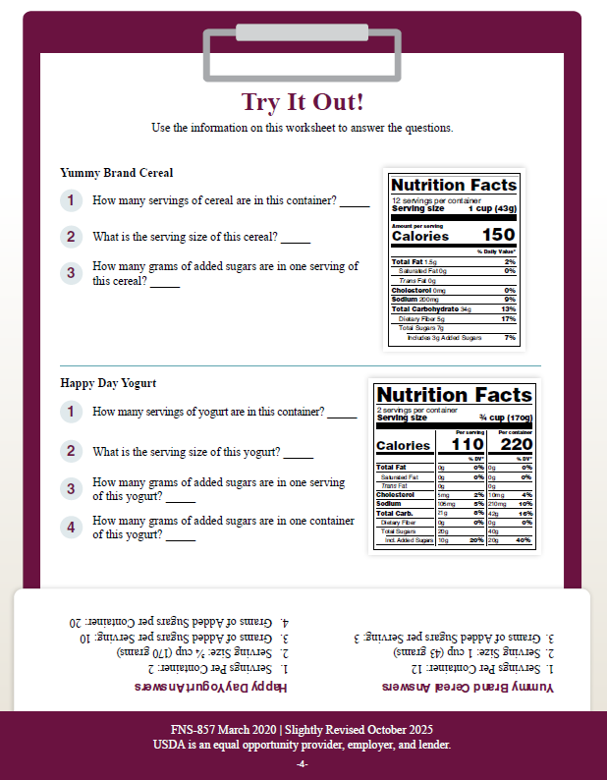
Using the Nutrition Facts Label in the CACFP, cont.
fna.usda.gov/tn/using-nutrition-facts-label-cacfp
Guidance documents lack the force and effect of law, unless expressly authorized by statute or incorporated into a contract. USDA may not cite, use, or rely on any guidance that is not available through their guidance portal, except to establish historical facts.
Notes:
The 3rd page, shown on the left, gives a great overview of the different serving sizes you may find on the nutrition facts label.
and lastly, the 4th page of the worksheet, shown on the right, is dedicated to an activity where you can apply the knowledge you’ve learned from the worksheet.
Now let’s get started.

Slide 6
When Do We Use the Nutrition Facts Label?
The Nutrition Facts label can help you:
Determine the amount of different nutrients in a food.
Choose the best foods to offer children and adults in your care.
Some foods may not have a Nutrition Facts label, including fresh:
Vegetables
Fruits
Fish
Guidance documents lack the force and effect of law, unless expressly authorized by statute or incorporated into a contract. USDA may not cite, use, or rely on any guidance that is not available through their guidance portal, except to establish historical facts.
Notes:
So, when do we use the Nutrition Facts label?
You may want to use the Nutrition Facts label when determining the amount of different nutrients in a food and to help you choose the best foods to offer children and adults in your care.
For example, you may use the Nutrition Facts label to see if a certain cereal or yogurt meets the CACFP added sugar limit, determine how much of a grain item or meat/meat alternate to serve to meet ounce equivalent requirements, or to see if a fortified infant formula contains enough iron.
Some foods may not have a Nutrition Facts label, including fresh vegetables, fruits, and fish.

Slide 7

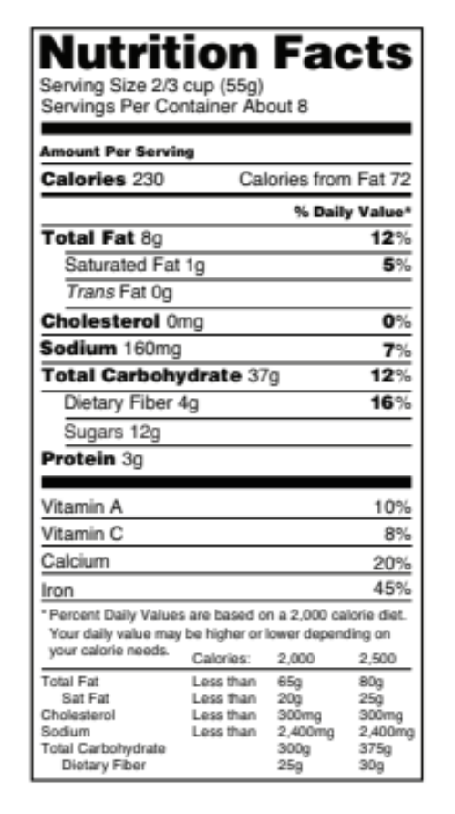
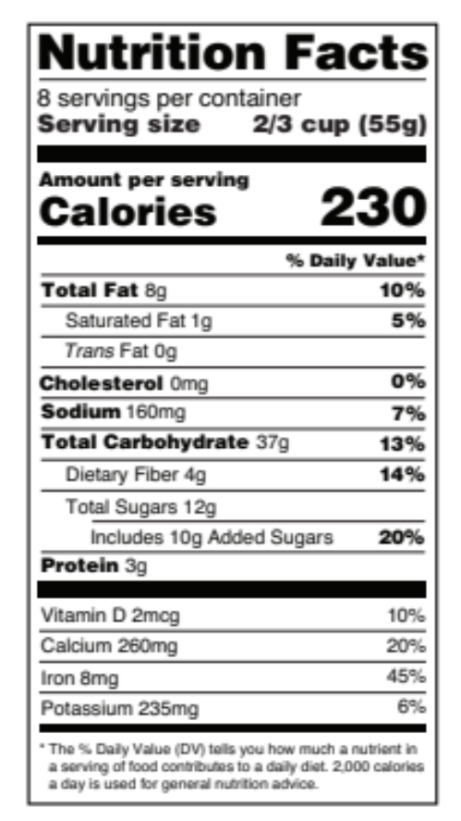
Comparison
Current Label
1
Both versions of
labels tell you the total servings of the food in one package. They also give information on the type and amount of calories and nutrients for just one serving of the food.
1
2
2
3
3
4
4
Guidance documents lack the force and effect of law, unless expressly authorized by statute or incorporated into a contract. USDA may not cite, use, or rely on any guidance that is not available through their guidance portal, except to establish historical facts.
Notes:
As I just stated, the first page of the worksheet shows two different versions of the Nutrition Facts label. The one on the left is the original version and the label on the right is the updated version released in 2016 which we will call the current label. As of January 1, 2021, all product manufacturers are required to use the format shown on the current label.
Let’s review some of the key changes to Nutrition Facts label.
At the top of the label, highlighted in light orange with the number 1 is the serving size. You will notice that the serving size is now printed in a larger, bolder font.
The calories line, shown in blue with the number 2, is also displayed in a larger, bolder font to make it easier to see.
On the current label, under the Total Carbohydrate section, highlighted in purple with the number 3, you’ll see a new line for Added Sugars listed directly under Total Sugars. This helps consumers understand how many grans of sugars are naturally occurring versus how many have been added to the product.
Finally, the Daily Value information, shown in green with the number 4, has been updated. Instead of vitamins A and C, manufacturers are now required to include values for vitamin D and potassium, to show nutrients of public health concern.

Slide 8
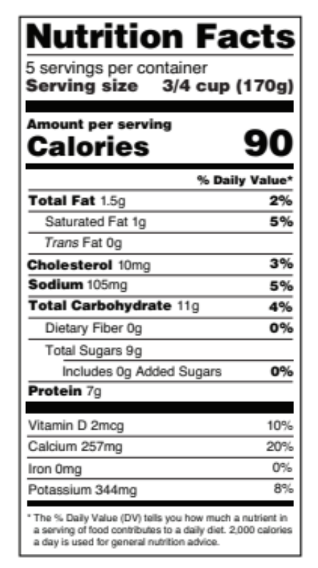
Servings Per Container
Shows the total number of servings in the entire food package or container.
One package of food may contain more than one serving.
Guidance documents lack the force and effect of law, unless expressly authorized by statute or incorporated into a contract. USDA may not cite, use, or rely on any guidance that is not available through their guidance portal, except to establish historical facts.
Notes:
Now, let’s take a closer look at page 2 of the worksheet to see what is on the current Nutrition Facts label and what it means for choosing foods. The label we will be looking at is from a large container of low-fat yogurt.
The first line of the Nutrition Facts label that is mentioned on the worksheet and on the slide here is “servings per container.” This shows the total number of servings in the entire food package or container. Be aware that one package of food may contain more than one serving.
For example, when you look at the “servings per container” line highlighted on the slide it shows that there are 5 servings of yogurt in this container.

Slide 9
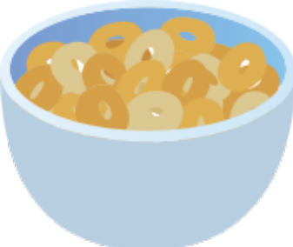
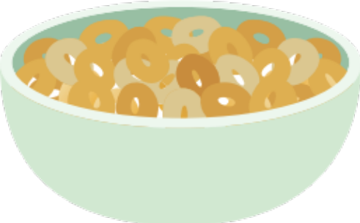
Serving Sizes Explained
1-cup serving
2-cup serving
100 calories and
4 grams of added sugars
200 calories and
8 grams of added sugars
Guidance documents lack the force and effect of law, unless expressly authorized by statute or incorporated into a contract. USDA may not cite, use, or rely on any guidance that is not available through their guidance portal, except to establish historical facts.
Notes:
Remember, that the Nutrition Facts label lists the amount of calories and nutrients in one serving of the food. So, if you provide more than one serving, you are also supplying more calories, sugars, and other nutrients.
For example, a 1-cup serving of the cereal shown on the left of the slide contains 100 calories and 4 grams of added sugars.
However, if you serve 2 cups of that same cereal shown on the right of the slide, then the 2-cup serving contains 200 calories and 8 grams of added sugars.

Slide 10

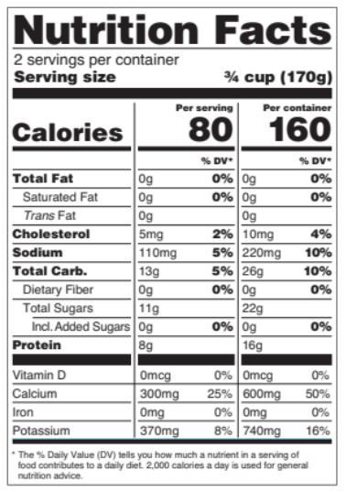
One Serving and Entire Container
Left column shows the nutrients
per serving
Right column shows the
nutrients for the
entire container
Guidance documents lack the force and effect of law, unless expressly authorized by statute or incorporated into a contract. USDA may not cite, use, or rely on any guidance that is not available through their guidance portal, except to establish historical facts.
Notes:
One last note about the serving size of a container.
Most times, the Nutrition Facts label shows the calories and nutrients in one serving of the food. However, you may find some products that show the calories and nutrients in one serving of the food and the calories and nutrients in the entire container.
For these types of Nutrition Facts labels you can look at the heading on the top of the column to see the serving amount. In the example on the screen (which is also on page 3 of the worksheet), you can see that there is a heading that says “one serving” above where it says “80 calories.” This means the middle column shows the calories and nutrients for one serving of the food.
The heading on the right column, above 160 calories, says “per container.” This means the right column shows the calories and nutrients for the entire container.

Slide 11
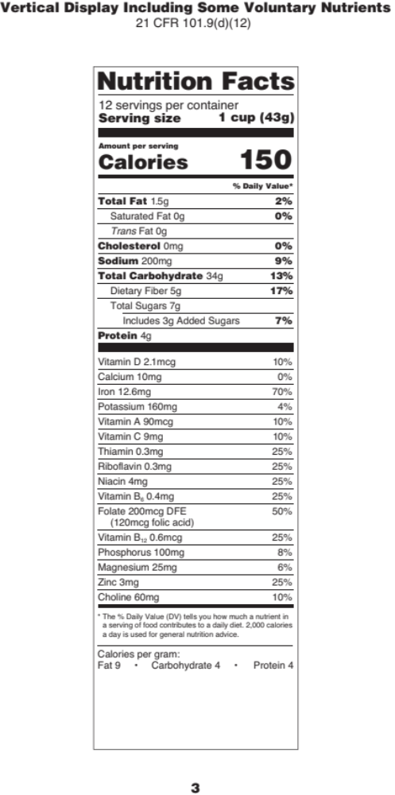
Try It Out #1!
How many servings of cereal are in this box?
?
1 serving
12 servings
43 servings
150 servings
Guidance documents lack the force and effect of law, unless expressly authorized by statute or incorporated into a contract. USDA may not cite, use, or rely on any guidance that is not available through their guidance portal, except to establish historical facts.
Notes:
Ok, let’s pause and do our first practice question. This is the Nutrition Facts label for a box of cereal.
The question says, “How many servings of cereal are in this box?”
Raise your hand if you think there are:
1 serving of cereal in this box [pause and wait for a show of hands],
12 servings [pause and wait for a show of hands],
43 servings [pause and wait for a show of hands], or
150 servings [pause and wait for a show of hands].

Slide 12
Answer #1
How many servings of cereal are in this box?
?
1 serving
12 servings
43 servings
150 servings
✓
Guidance documents lack the force and effect of law, unless expressly authorized by statute or incorporated into a contract. USDA may not cite, use, or rely on any guidance that is not available through their guidance portal, except to establish historical facts.
Notes:
Great job, everyone! The answer is “12 servings.” If you look at the top of the Nutrition Facts label shown on the right of this slide, you can see that it says “12 servings per container.”

Slide 13
Serving Size
Based on the amount of food that is
typically eaten at one time.
Not always the same amount of food that is required to meet CACFP meal pattern requirements at each age group.
Use this to determine if:
  Yogurts or cereals meet CACFP sugar limits.
  The amount of a grain meets meal
  pattern requirements.
Guidance documents lack the force and effect of law, unless expressly authorized by statute or incorporated into a contract. USDA may not cite, use, or rely on any guidance that is not available through their guidance portal, except to establish historical facts.
Notes:
Next, let’s talk about the “Serving size” line on the Nutrition Facts label.
The serving size is based on the amount of food that is typically eaten at one time. The serving size is not always the same amount of food that is required to meet CACFP meal pattern requirements for each age group. For example, the Nutrition Facts label on the slide is for a large container of yogurt. You’ll notice that the serving size highlighted on the slide is ¾ cup. However, if you’re serving yogurt to 1-2 year olds, the CACFP meal pattern requirement is only ½ cup at lunch or supper. Always follow the CACFP meal pattern requirements to determine how much to serve the children and adults in your care.
Always follow the CACFP meal pattern requirements to determine how much to serve the children and adults in your care.
You can also use the serving size information on the Nutrition Facts label to help you decide if a yogurt or cereal meets CACFP added sugars limits.
Serving size information is also useful when offering grains. It helps you determine the appropriate amount of foods, such as crackers, to give each participant so CACFP meal pattern requirements are met. For additional guidance on serving grains in the CACFP, refer to the training worksheets on this topic.

Slide 14
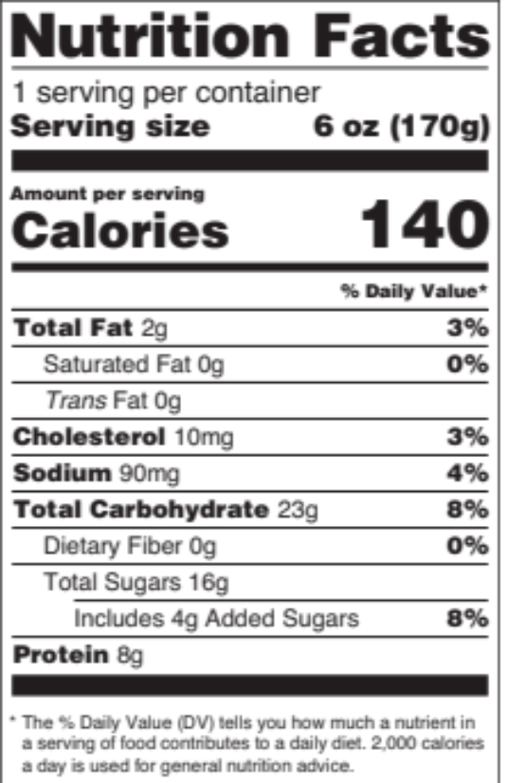
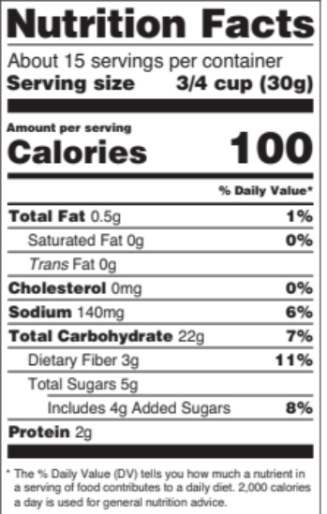
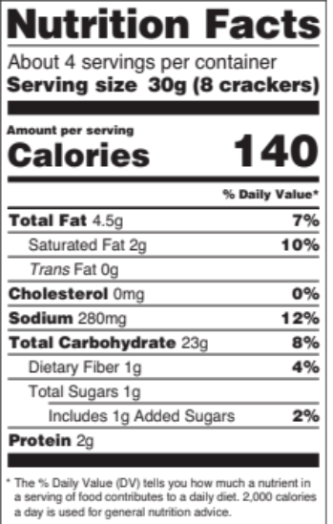
Spotlight on Serving Sizes
Weight
Volume
Number of
items
6 oz
(170g)
8
crackers
3/4 cup
Such as grams (g)
or ounces (oz)
Such as cups
or tablespoons
Such as
8 crackers
Guidance documents lack the force and effect of law, unless expressly authorized by statute or incorporated into a contract. USDA may not cite, use, or rely on any guidance that is not available through their guidance portal, except to establish historical facts.
Notes:
On Nutrition Facts labels, you may see serving sizes listed as a weight, such as in ounces or grams. For example, one serving of yogurt might weigh 6 ounces or 170 grams.
You may also see serving sizes listed by volume, such as cups, tablespoons, or fluid ounces. For example, the serving size for one serving of cereal might be ¾ cup.
Finally, you may see serving sizes listed as number of items. For example, one serving of saltines might be shown as 8 crackers.
Please note that ounces are not the same as ounce equivalents. Ounces tell us how much one serving of that food weighs. Ounce equivalents tell you the amount of grains or meats/meat alternates in a product. Ounce equivalents are not shown on the Nutrition Facts label, but you can use information on the Nutrition Facts label to determine the ounce equivalents of grains in a product.
Again, the serving size listed on the Nutrition Facts label may be different than the amount of food required at a CACFP meal or snack. But, the serving size on the Nutrition Facts label can help you make sure you are choosing foods that are creditable, and to determine how much of a food to serve to meet meal pattern requirements.

Slide 15
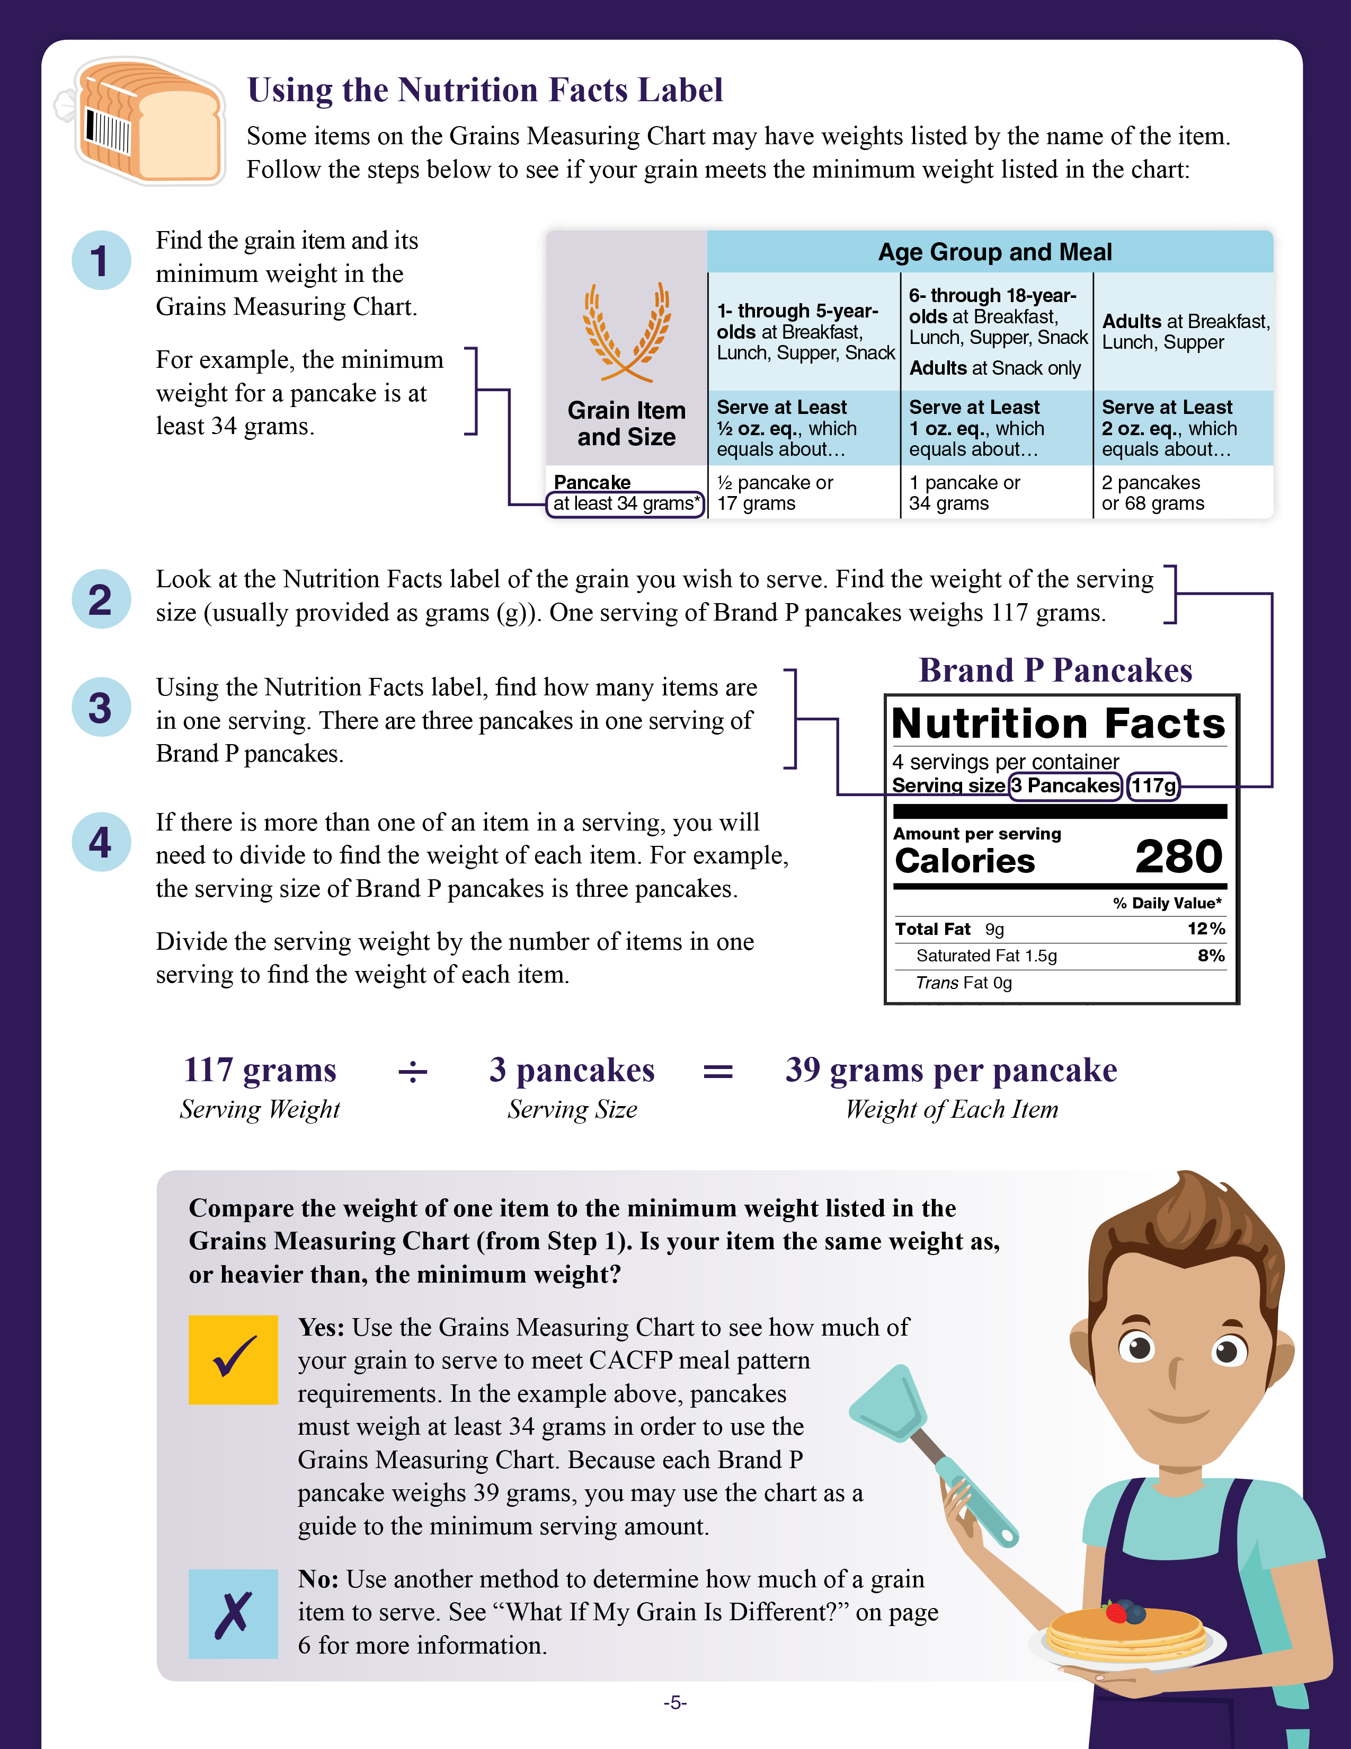
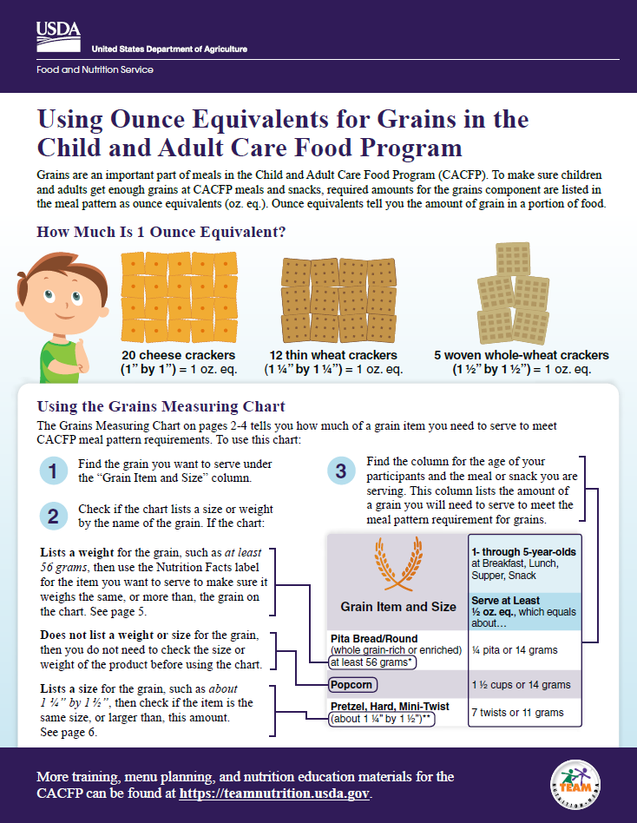
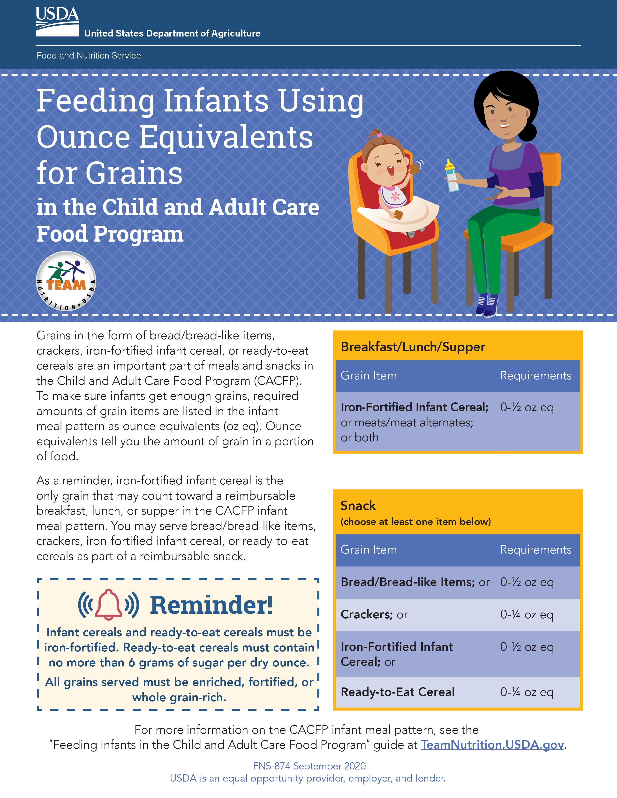

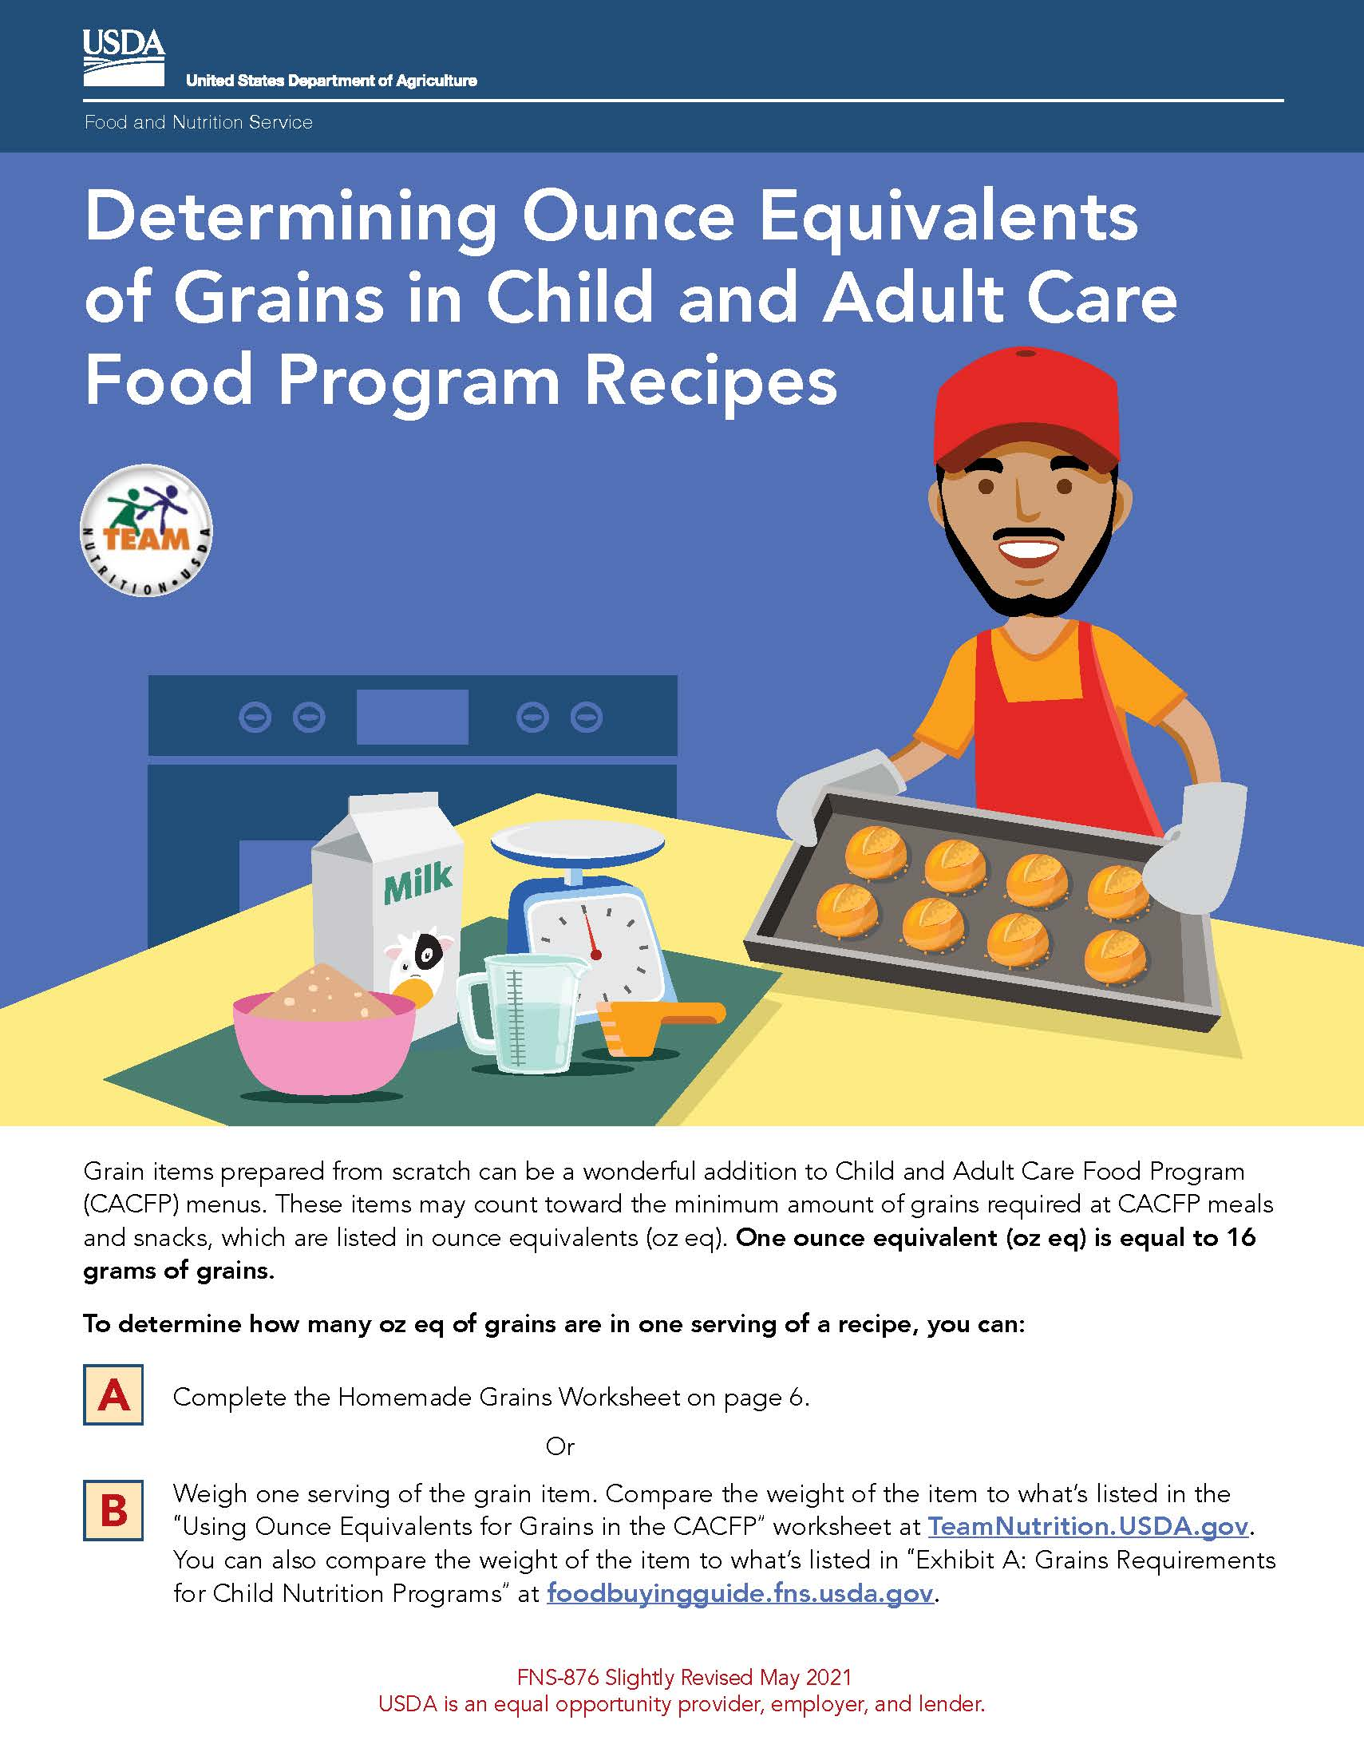
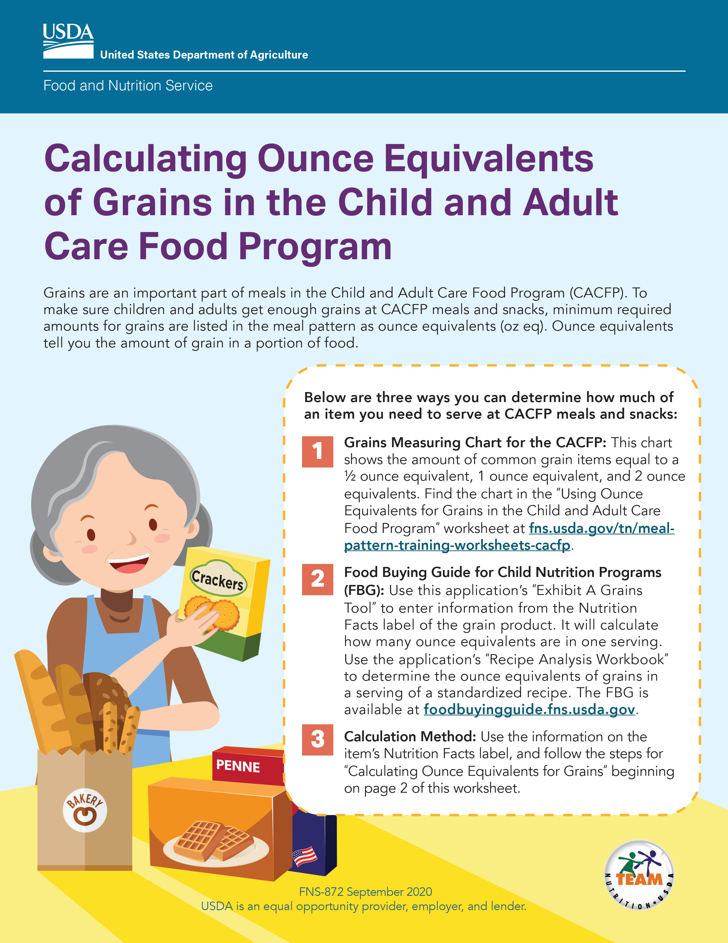
Team Nutrition Resources on Oz Eq for Grains
fna.usda.gov/tn/cacfp/grains-ounce-equivalents-resources
Guidance documents lack the force and effect of law, unless expressly authorized by statute or incorporated into a contract. USDA may not cite, use, or rely on any guidance that is not available through their guidance portal, except to establish historical facts.
Notes:
For more information on ounce equivalents for grains, please visit Team Nutrition's “CACFP Grains Ounce Equivalents Resources” webpage at the web address on the slide.

Slide 16
Try It Out #2!
According to this Nutrition Facts label, what is the serving size of 1 serving of cereal?
?
12 cups
150 grams
43 ounces
1 cup
Guidance documents lack the force and effect of law, unless expressly authorized by statute or incorporated into a contract. USDA may not cite, use, or rely on any guidance that is not available through their guidance portal, except to establish historical facts.
Notes:
Let’s do another practice question. This is the same Nutrition Facts label for a box of cereal we saw in the last polling question. We know from the first polling question that this box of cereal has 12 servings.
This time, our question looks at the size of the serving. The question is, “According to this Nutrition Facts label, what is the serving size of 1 serving of cereal?”
Raise your hand if you think the serving size of 1 serving of cereal is:
12 cups [pause and wait for a show of hands],
150 grams [pause and wait for a show of hands],
43 ounces [pause and wait for a show of hands], or
1 cup [pause and wait for a show of hands].

Slide 17
Answer #2
According to this Nutrition Facts label, what is the serving size of 1 serving of cereal?
?
12 cups
150 grams
43 ounces
1 cup
✓
Guidance documents lack the force and effect of law, unless expressly authorized by statute or incorporated into a contract. USDA may not cite, use, or rely on any guidance that is not available through their guidance portal, except to establish historical facts.
Notes:
Great job, everyone! The answer is 1 cup. If you look at the top of the Nutrition Facts label shown on the right of this slide, you can see next to “Serving size” it says “1 cup.”
So, one serving of this cereal is 1 cup.

Slide 18
Total Sugars and Added Sugars
Shows the amount of sugars in a food.
Includes both naturally occurring sugars and added sugars.
The CACFP sugar limits are based on added sugars.
  Yogurt must contain no more than 12 grams of added sugars per 6 ounces of yogurt.
  Breakfast cereal must contain no more than 6 grams or added sugars per dry ounce of cereal.
Guidance documents lack the force and effect of law, unless expressly authorized by statute or incorporated into a contract. USDA may not cite, use, or rely on any guidance that is not available through their guidance portal, except to establish historical facts.
Notes:
Next, let’s talk about “Total Sugars and “Added sugars.” The “Total Sugars” line shows the amount of sugars in one serving of the food. It includes both naturally occurring sugars in foods, like in fruit, as well as added sugars.
The CACFP sugar limits for cereal and yogurt are based on the amount of added sugars in the product.
Remember, yogurt must contain no more than 12 grams of added sugars per 6 ounces, if served as part of a reimbursable meal or snack in the CACFP.
Breakfast cereal must contain no more than 6 grams of added sugars per dry ounce if served as part of a reimbursable meal or snack in the CACFP.

Slide 19
A Note About Sugars
Guidance documents lack the force and effect of law, unless expressly authorized by statute or incorporated into a contract. USDA may not cite, use, or rely on any guidance that is not available through their guidance portal, except to establish historical facts.
Notes:
As mentioned earlier, the current Nutrition Facts label, provides information for “Total Sugars” and “Added Sugars”. Use the amount of “Added Sugars” to determine if the item meets the CACFP added sugars limit.
Now, let’s do a few more practice questions.

Slide 20
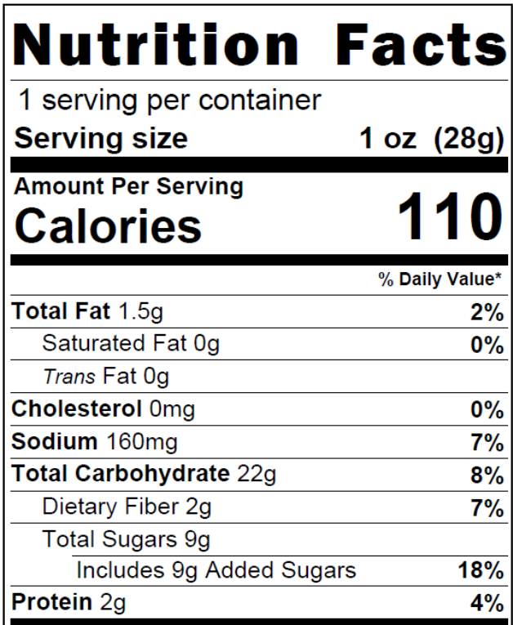
Try It Out #3!
How many grams of total sugars are in 1 serving of this cereal?
?
28 grams
1.5 grams
22 grams
9 grams
Guidance documents lack the force and effect of law, unless expressly authorized by statute or incorporated into a contract. USDA may not cite, use, or rely on any guidance that is not available through their guidance portal, except to establish historical facts.
Notes:
Let’s do this try it out question, “How many grams of total sugars are in 1 serving of this cereal?
Raise your hand if you think there are:
28 grams of total sugars in 1 serving of this cereal [pause and wait for a show of hands],
1.5 grams [pause and wait for a show of hands],
22 grams [pause and wait for a show of hands], or
9 grams [pause and wait for a show of hands].

Slide 21
Answer #3
How many grams of total sugars are in 1 serving of this cereal?
?
28 grams
1.5 grams
22 grams
9 grams
✓
Guidance documents lack the force and effect of law, unless expressly authorized by statute or incorporated into a contract. USDA may not cite, use, or rely on any guidance that is not available through their guidance portal, except to establish historical facts.
Notes:
Great work, everyone! The answer is 9 grams.
To get this answer, we find “Total Sugars” on the Nutrition Facts label and next to that we find “9 g” or “9 grams.” You’ll see that outlined in yellow on the slide.
However, CACFP meal pattern requirements are based on added sugars, not total sugars. This means the total sugars amount alone does not determine whether the cereal is creditable in the CACFP. To make that decision, we need to check the added sugars amount — and we’ll practice that next.

Slide 22
Try It Out #4!
Does this cereal meet the CACFP added sugars limit*?
?
Yes
No
*Breakfast cereals must contain no more than 6 grams of added sugars or less per dry ounce of cereal.
Guidance documents lack the force and effect of law, unless expressly authorized by statute or incorporated into a contract. USDA may not cite, use, or rely on any guidance that is not available through their guidance portal, except to establish historical facts.
Notes:
Let’s do another practice question. Using the same Nutrition Facts label for a container of cereal, let’s answer this question.
The question says, “Does this cereal meet the CACFP sugar limit?” Remember, cereal must contain no more than 6 grams of added sugars per dry ounce of cereal to serve as part of a reimbursable meal or snack in the CACFP.
Raise your hand if you think the answer is:
Yes, this cereal meets the CACFP added sugars limit and it can be served as part of a reimbursable meal or snack. [pause and wait for a show of hands], or
No, this cereal does not meet the added sugar limit and it cannot be served as part of a reimbursable meal or snack in the CACFP [pause and wait for a show of hands].

Slide 23
Answer #4
Does this cereal meet the CACFP added sugars limit*?
?
Yes
No
✓
*Breakfast cereals must contain no more than 6 grams of added sugars or less per dry ounce of cereal.
Guidance documents lack the force and effect of law, unless expressly authorized by statute or incorporated into a contract. USDA may not cite, use, or rely on any guidance that is not available through their guidance portal, except to establish historical facts.
Notes:
Nice work, everyone! The answer is “No, the cereal does not meet the sugar limit.” This means it cannot be served as part of a reimbursable meal or snack.
This was a tricky one, so let’s walk through how to get the answer together. First, we go up to the “Serving Size” line and see that it’s “1 ounce.” Next, we go down to the “Added Sugars” line to see that a 1-ounce serving of cereal contains 9 grams of added sugars. Nine grams is more than 6 grams of added sugar, so this cereal cannot be served as part of a reimbursable meal or snack.

Slide 24
Try It Out #5!
How many grams of added sugars are in 1 serving of this yogurt?
?
2 grams
16 grams
4 grams
8 grams
Guidance documents lack the force and effect of law, unless expressly authorized by statute or incorporated into a contract. USDA may not cite, use, or rely on any guidance that is not available through their guidance portal, except to establish historical facts.
Notes:
Let’s do another practice question. This one is about yogurt.
The question says, “How many grams of added sugars are in 1 serving of this yogurt?
Raise your hand if you think there are:
2 grams of added sugars in 1 serving of this yogurt [pause and wait for a show of hands],
16 grams [pause and wait for a show of hands],
4 grams [pause and wait for a show of hands], or
8 grams [pause and wait for a show of hands].

Slide 25
Answer #5
How many grams of added sugars are in 1 serving of this yogurt?
?
2 grams
16 grams
4 grams
8 grams
✓
Guidance documents lack the force and effect of law, unless expressly authorized by statute or incorporated into a contract. USDA may not cite, use, or rely on any guidance that is not available through their guidance portal, except to establish historical facts.
Notes:
Nice work, everyone! The answer is 4 grams of added sugars.
To get this answer, we start by checking how many servings are in the container. The Nutrition Facts label shows that this product is a single‑serving container. Next, we look under the Total Sugars line and find “Includes 4 g Added Sugars.” That amount is highlighted in the label on the slide.

Slide 26
Try It Out #6!
Does this yogurt meet the CACFP added sugars limit*?
?
Yes
No
*Yogurt must contain no more than 12 grams of added sugars per 6 ounces (2 grams of added sugars per ounce).
Guidance documents lack the force and effect of law, unless expressly authorized by statute or incorporated into a contract. USDA may not cite, use, or rely on any guidance that is not available through their guidance portal, except to establish historical facts.
Notes:
Let’s do one more practice question on added sugars. Using the same Nutrition Facts label for a container of yogurt, let’s answer this question.
The question says, “Does this yogurt meet the CACFP added sugars limit?” Remember, yogurt must contain no more than 12 grams of added sugars per 6 ounces of yogurt to be served as part of a reimbursable meal or snack in the CACFP.
Raise your hand if you think the answer is:
Yes, the yogurt does meet the added sugars limit and can be served as part of a reimbursable meal or snack [pause and wait for a show of hands]; or
No, it does not meet the added sugars limit [pause and wait for a show of hands].

Slide 27
Answer #6
Does this yogurt meet the CACFP added sugars limit*?
?
✓
Yes
No
*Yogurt must contain no more than 12 grams of added sugars per 6 ounces (2 grams of added sugars per ounce).
Guidance documents lack the force and effect of law, unless expressly authorized by statute or incorporated into a contract. USDA may not cite, use, or rely on any guidance that is not available through their guidance portal, except to establish historical facts.
Notes:
Nice work, everyone! The answer is “Yes, the yogurt meets the added sugars limit and can be served as part of a reimbursable meal or snack.”
Let’s talk through how we got the answer. First, we go up to the “Serving size” line and see that it’s “6 ounces.” Next, we go down to the “Added Sugars” line to see that a 6-ounce serving of yogurt contains 4 grams of added sugars. 4 grams is less than 12 grams of added sugars, so this yogurt can be served as part of a reimbursable meal or snack.

Slide 28
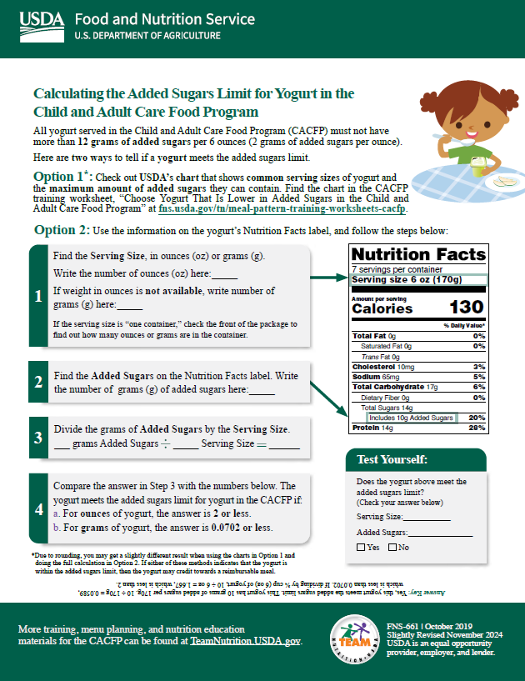
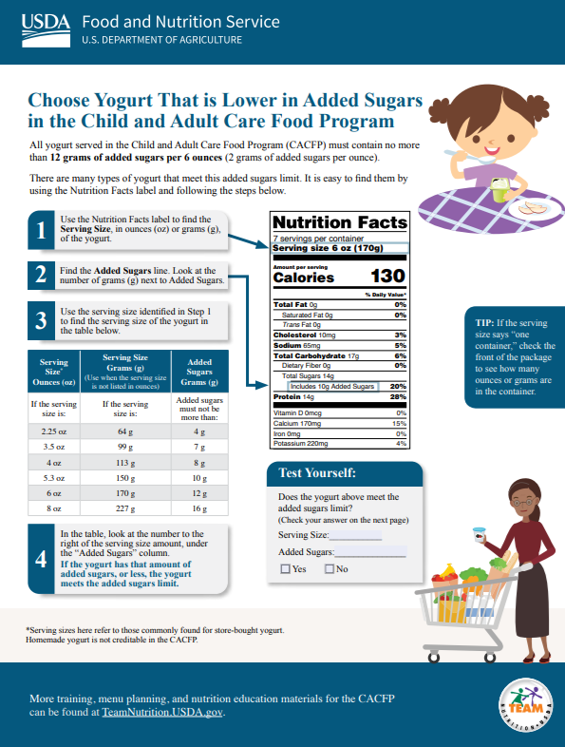
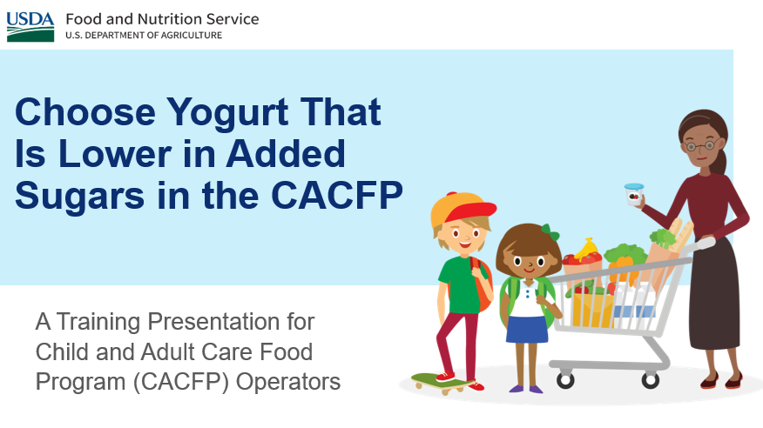

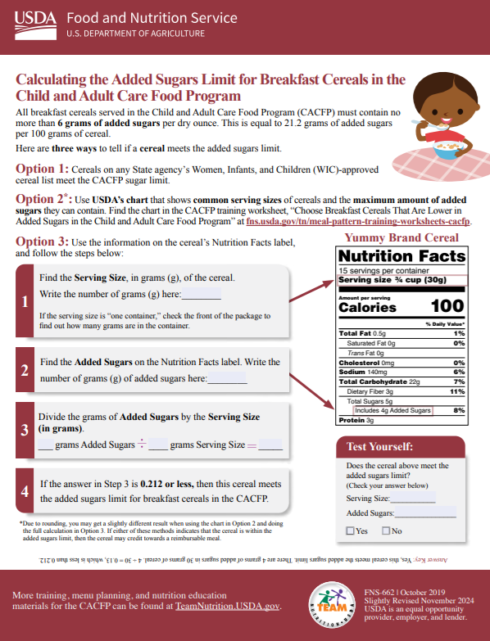
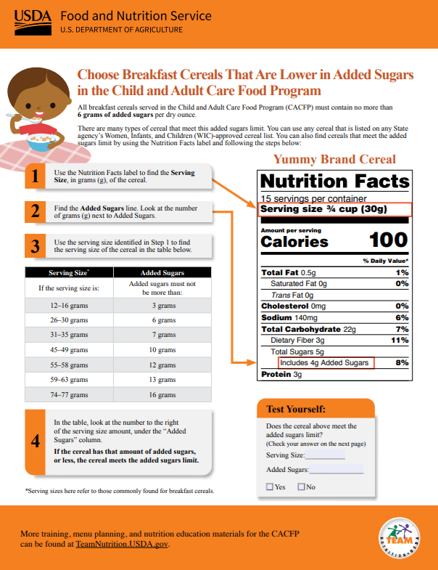
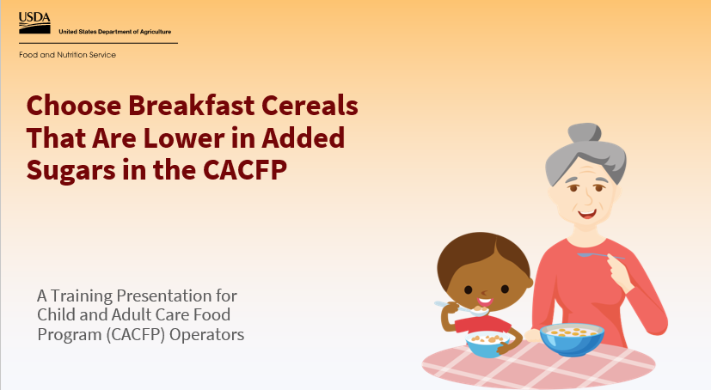
Team Nutrition Resources Added Sugars
fna.usda.gov/tn/cacfp/trainers-tools
Guidance documents lack the force and effect of law, unless expressly authorized by statute or incorporated into a contract. USDA may not cite, use, or rely on any guidance that is not available through their guidance portal, except to establish historical facts.
Notes:
For more information on added sugars in the CACFP, please visit Team Nutrition’s Training Tools webpage at the web address on the slide.

Slide 29
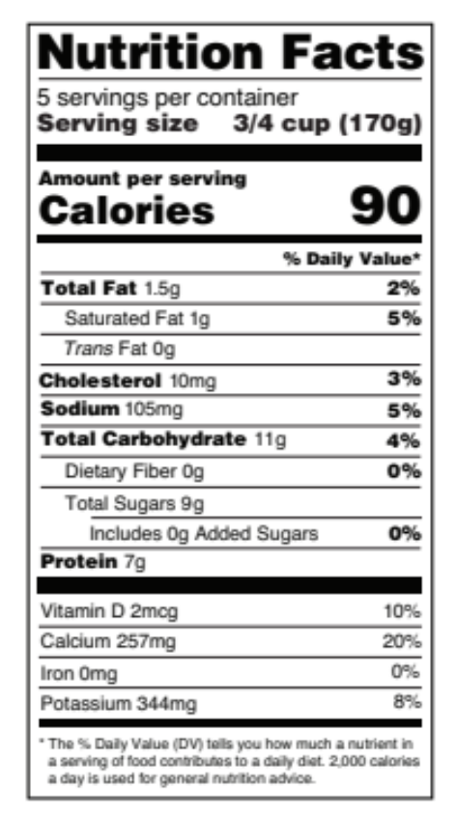
Iron
A nutrient that supports growth and brain development.
Use this to see that an infant formula is iron-fortified.
Guidance documents lack the force and effect of law, unless expressly authorized by statute or incorporated into a contract. USDA may not cite, use, or rely on any guidance that is not available through their guidance portal, except to establish historical facts.
Notes:
Now, let’s look at some of the other nutrient information you may find on the Nutrition Facts label.
The first one is Iron. Iron is a nutrient that supports growth and brain development. You may use the Nutrition Facts label when checking to see that an infant formula is fortified with iron.

Slide 30
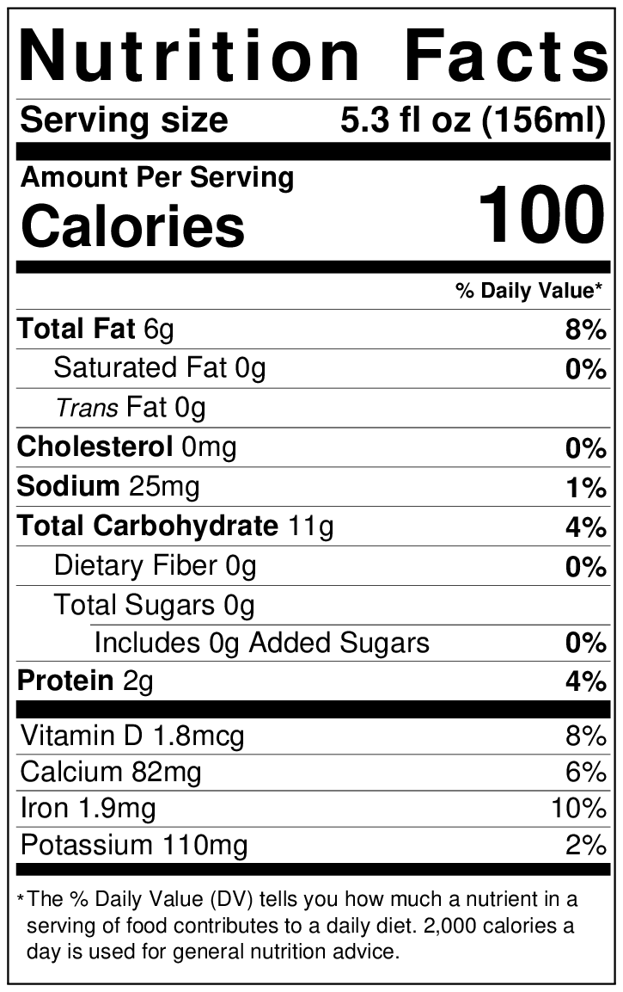
Iron-Fortified Infant Formula
Choose a creditable iron-fortified infant formula by:
Looking for “infant formula with iron” or a similar statement on the package, and
Making sure it contains 1 milligram of iron or more per 100 calories.
  Look at “Calories” to make sure it says “100” or more, then
  Look at “Iron” to make sure it says
  “1 mg” or more.
Guidance documents lack the force and effect of law, unless expressly authorized by statute or incorporated into a contract. USDA may not cite, use, or rely on any guidance that is not available through their guidance portal, except to establish historical facts.
Notes:
As a reminder, iron-fortified infant formula is required in the CACFP for babies who are not breastfed or are partially breastfed.
To make sure the iron-fortified infant formula you offer is creditable in the CACFP, you should:
Look for “infant formula with iron” or a similar statement on the front of the formula package and make sure it contains 1 milligram of iron or more per 100 calories of formula when prepared using the label instructions.
You can use the Nutrition Facts label as a guide to make sure the formula has enough iron. First look at the line that says “Calories” and make sure it says “100” or more. Then, look at the line that says “iron.” This should have “1 milligram” or more listed.
If you have an infant formula that contains less than 100 calories, you'd have to take additional steps to determine if it is creditable in the CACFP.

Slide 31
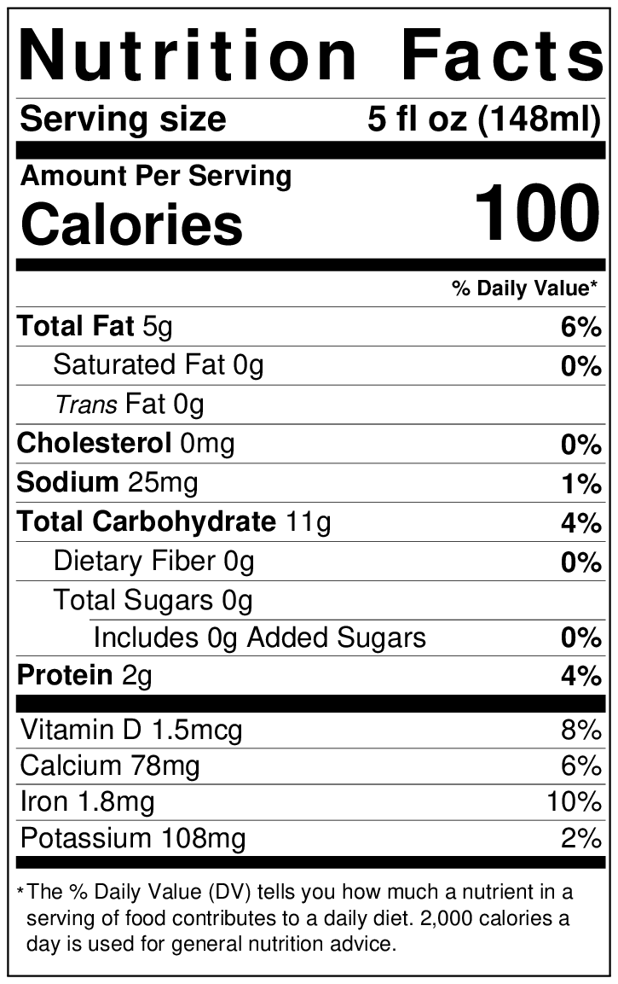
Try It Out #7!
Is this infant formula creditable in the CACFP?
?
Yes
No
Iron-fortified infant formula must contain 1 milligram of iron or more per 100 calories.
Guidance documents lack the force and effect of law, unless expressly authorized by statute or incorporated into a contract. USDA may not cite, use, or rely on any guidance that is not available through their guidance portal, except to establish historical facts.
Notes:
Ok, let’s do one last practice question.
Using the Nutrition Facts label of an iron-fortified infant formula on the slide here, let’s answer this question:
The question says, “Is this infant formula creditable in the CACFP?” Remember from the previous slide, we need to make sure it contains
1 milligram of iron or more per 100 calories of formula to be creditable in the CACFP.
Raise your hand if you think the answer is:
Yes, it is creditable in the CACFP [pause and wait for a show of hands], or
No, it is not creditable in the CACFP [pause and wait for a show of hands].

Slide 32
Answer #7
Is this infant formula creditable in the CACFP?
?
Yes
No
✓
Iron-fortified infant formula must contain 1 milligram of iron or more per 100 calories.
Guidance documents lack the force and effect of law, unless expressly authorized by statute or incorporated into a contract. USDA may not cite, use, or rely on any guidance that is not available through their guidance portal, except to establish historical facts.
Notes:
Great job, everyone! The answer is “Yes,” this infant formula is creditable in the CACFP.
We know this, because we find “Calories” on the Nutrition Facts label and it says 100 calories. Then, we look at the line for “Iron” and see that it contains 1.8 milligrams of iron. 1.8 milligrams of iron is more than the 1 milligram of iron required, so this iron-fortified infant formula can be served as part of a reimbursable meal.

Slide 33
Saturated Fat, Trans Fat, Sodium, and Added Sugars
Most adults and children eat and drink too many of these nutrients.
Choose foods that are lower in these nutrients.
Avoid highly processed packaged, prepared, ready-to-eat, or other foods that are salty or sweet.
Guidance documents lack the force and effect of law, unless expressly authorized by statute or incorporated into a contract. USDA may not cite, use, or rely on any guidance that is not available through their guidance portal, except to establish historical facts.
Notes:
Finally, let's talk briefly about some of the other nutrients on the Nutrition Facts label: saturated fat; trans fat; sodium; and added sugars. The Nutrition Facts label lists the amount of each of these nutrients for one serving of this food.
Most adults and children eat and drink too many of these nutrients. Choosing foods that are lower in these nutrients can help you offer healthier meals that support good health. When comparing nutrients in foods, check the serving sizes to make sure you are comparing similar amounts of food.
Remember that the Dietary Guidelines for Americans recommend avoiding highly processed packaged, prepared, ready-to-eat, or other foods that are salty or sweet such as chips, cookies, and candy that have added sugars and sodium (salt). This recommendation helps to lower consumption of these nutrients.

Slide 34
Frequently Asked Question #1
The Nutrition Facts label contains a lot of information, what are some key pieces of information I can look for to help me plan meals for CACFP participants?
Guidance documents lack the force and effect of law, unless expressly authorized by statute or incorporated into a contract. USDA may not cite, use, or rely on any guidance that is not available through their guidance portal, except to establish historical facts.
Notes:
The Nutrition Facts label contains a lot of information, what are some key pieces of information I can look for to help me plan meals for CACFP participants?

Slide 35
Question #1: The Nutrition Facts Label contains a lot of information, what are some key pieces of information I can look for to help me plan meals for CACFP participants?
Answer #1: When planning CACFP meals, focus on the serving size, servings per container, added sugars, protein, sodium, and the ingredient list (especially for whole grain‑rich items and allergens).
These facts help you confirm portion sizes, choose foods that meet CACFP meal pattern requirements and build balanced menus that align with the 2025-2030 Dietary Guidelines for Americans and the Real Food Pyramid.
Guidance documents lack the force and effect of law, unless expressly authorized by statute or incorporated into a contract. USDA may not cite, use, or rely on any guidance that is not available through their guidance portal, except to establish historical facts.
Notes:
When planning CACFP meals, focus on the serving size, servings per container, added sugars, protein, sodium, and the ingredient list (especially for whole grain‑rich items and allergens). These parts of the Nutrition Facts label help you confirm portion sizes, choose foods that meet CACFP meal pattern requirements and build balanced menus that align with the 2025-2030 Dietary Guidelines for Americans and the Real Food Pyramid.

Slide 36
Frequently Asked Question #2
With the old Nutrition Facts label, we used the “Sugars” line to check if cereals and yogurts met CACFP sugar limit. The new label shows “Total Sugars” and “Added Sugars.” Which one should we use now?
Guidance documents lack the force and effect of law, unless expressly authorized by statute or incorporated into a contract. USDA may not cite, use, or rely on any guidance that is not available through their guidance portal, except to establish historical facts.
Notes:
Another question we have received is “With the old Nutrition Facts label, we used the “Sugars” line to check if cereals and yogurts met CACFP sugar limit. The new label shows “Total Sugars” and “Added Sugars.” Which one should we use now?”

Slide 37
Question #2: With the old Nutrition Facts label, we used the “Sugars” line to check if cereals and yogurts met CACFP sugar limit. The new label shows “Total Sugars” and “Added Sugars.” Which one should we use now?
Answer #2: To help you determine if a cereal or yogurt meets the CACFP added sugars limit, you should now always look at the “Includes g Added Sugars” line on the new Nutrition Facts label.
Our Team Nutrition worksheets and slide presentations on choosing yogurt and cereal that are lower in added sugars include that information.
Check them out at this webpage: fna.usda.gov/tn/cacfp/trainers -tools.
Guidance documents lack the force and effect of law, unless expressly authorized by statute or incorporated into a contract. USDA may not cite, use, or rely on any guidance that is not available through their guidance portal, except to establish historical facts.
Notes:
To help you determine if a cereal or yogurt meets the CACFP added sugars limit, you should now always look at the “Total Sugars” line on the new Nutrition Facts label. Our Team Nutrition worksheets and slide presentations on choosing yogurt and cereal that are lower in added sugars include this information. Check them out by using the web address of the QR code on the screen.

Slide 38
Frequently Asked Question #3
Are there limits on sodium and saturated fat, or should we just try to keep them low?
Guidance documents lack the force and effect of law, unless expressly authorized by statute or incorporated into a contract. USDA may not cite, use, or rely on any guidance that is not available through their guidance portal, except to establish historical facts.
Notes:
The next question is, “are there limits on sodium and saturated fat, or should we just try to keep them low?”

Slide 39
Question #3: Are there limits on sodium and saturated fat, or should we just try to keep them low?
Answer #3: The CACFP does not set specific limits for sodium or saturated fat. Program operators are encouraged to choose whole, nutritious foods and avoid highly processed packaged, prepared, ready-to-eat, or other foods that are salty or sweet such as chips, cookies, and candy that have added sugars and sodium (salt).
More information about the 2025-2030 Dietary Guidelines for Americans is available at RealFood.gov.
Guidance documents lack the force and effect of law, unless expressly authorized by statute or incorporated into a contract. USDA may not cite, use, or rely on any guidance that is not available through their guidance portal, except to establish historical facts.
Notes:
The CACFP does not set specific limits for sodium or saturated fat. Program operators are encouraged to choose whole, nutritious foods and avoid highly processed packaged, prepared, ready-to-eat, or other foods that are salty or sweet, as recommended by the 2025-2030 Dietary Guidelines for Americans. More information about the Dietary Guidelines is available at RealFood.gov.

Slide 40
Frequently Asked Question #4
How do I know if a grain item meets the CACFP “whole grain‑rich” requirement by using the Nutrition Facts label?
Guidance documents lack the force and effect of law, unless expressly authorized by statute or incorporated into a contract. USDA may not cite, use, or rely on any guidance that is not available through their guidance portal, except to establish historical facts.
Notes:
The final question we have is “How do I know if a grain item meets the CACFP “whole grain‑rich” requirement by using the Nutrition Facts label?

Slide 41
Question #4: How do I know if a grain item meets the CACFP “whole grain‑rich” requirement by using the Nutrition Facts label?
Answer #4: The Nutrition Facts label can help, but it’s not the only thing you need to check. CACFP requires that at least one grain serving per day be whole grain‑rich. To confirm this, you must look at the ingredient list for the food item.
For more information on this topic see the CACFP Training Tools on Grains Ounce Equivalents at the web address:
fna.usda.gov/tn/cacfp/grains-
ounce-equivalents-resources.
Guidance documents lack the force and effect of law, unless expressly authorized by statute or incorporated into a contract. USDA may not cite, use, or rely on any guidance that is not available through their guidance portal, except to establish historical facts.
Notes:
The Nutrition Facts label can help, but it’s not the only thing you need to check. CACFP requires that at least one grain serving per day be whole grain‑rich. To confirm this, you must look at the ingredient for the food item. For more information on this topic see the CACFP Training Tools on Grains Ounce Equivalents at the web address on the slide or scan the QR code.
That concludes this webinar.

Slide 42

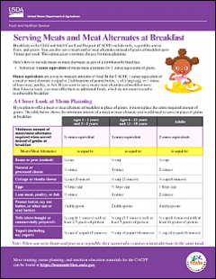
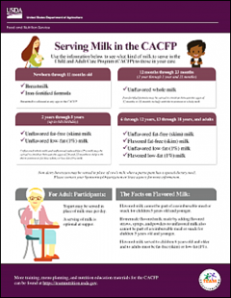
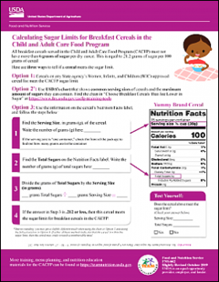
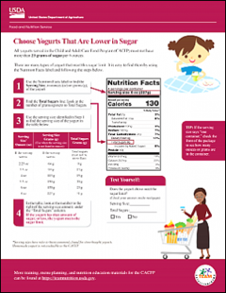
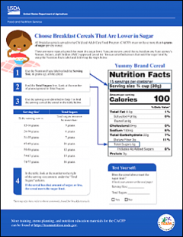
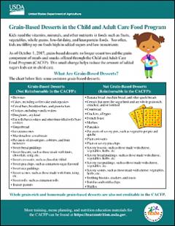
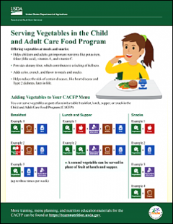
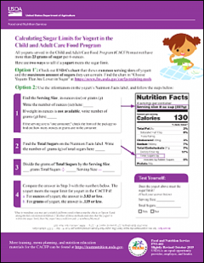
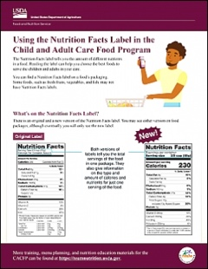
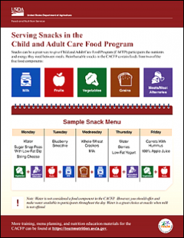
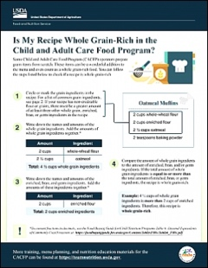
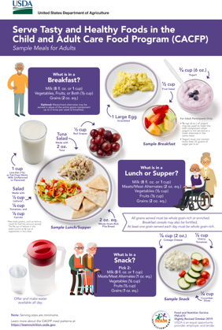
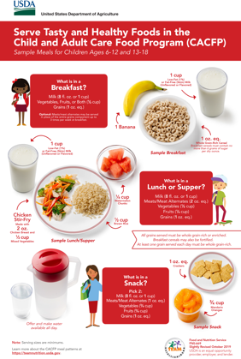
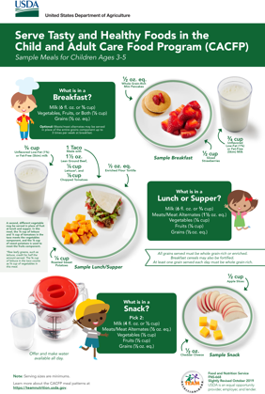
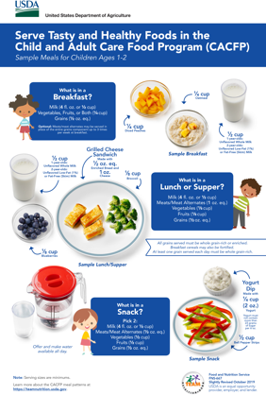
More Team Nutrition Resources
fna.usda.gov/teamnutrition
Guidance documents lack the force and effect of law, unless expressly authorized by statute or incorporated into a contract. USDA may not cite, use, or rely on any guidance that is not available through their guidance portal, except to establish historical facts.
Notes:
All Team Nutrition materials are available online from Team Nutrition’s website and are available for free download to anybody who is interested.

Slide 43



Thank You!
fna.usda.gov/teamnutrition
TeamNutrition@usda.gov
USDA is an equal opportunity provider, employer, and lender.
Guidance documents lack the force and effect of law, unless expressly authorized by statute or incorporated into a contract. USDA may not cite, use, or rely on any guidance that is not available through their guidance portal, except to establish historical facts.
Notes:
These training slides were provided by U.S. Department of Agriculture's Team Nutrition. If you would like to learn more about Team Nutrition and additional resources available, please visit the website, subscribe to the e-newsletter, or connect with us via email at TeamNutrition@USDA.gov.

